Slide 1



Aerial Location of Hazardous Atmosphere in Industries
PROBLEM STATEMENT
Detect
Sensors read flammable and toxic gases from above.
Predict
An ML model flags conditions that lead to fire.
Use drones or aircraft fitted with gas sensors to find, predict and map hazardous atmospheres inside industrial sites, so fires can be prevented and emergency teams get a clear, data-backed Fire Pre-Plan.
Respond
Maps, alerts and a pre-plan guide the response.
Aerial survey
Gas sensors
ML prediction
GIS mapping
Alerts

Slide 2




Why this problem matters
~62
deaths a day
Lives are at risk
Industrial fires threaten workers, responders and nearby communities.
Average from fire accidents in India, 2010 to 2014 (NCRB data)
Losses are heavy
Fires cause large economic losses, so action must come before an incident.
~16
deaths a day
A Fire Pre-Plan is critical
Industries need a clear, data-backed plan that is ready before anything ignites.
Fire-accident deaths in 2024: far lower, yet still avoidable (NCRB ADSI data)
Real incidents show the urgency
The 2009 IOCL Jaipur terminal fire is one example of what can go wrong.
Figures cover all fire accidents in India, not only industrial ones.

Slide 3




Our solution: from sky to response
1
2
3
4
5
6
Aerial survey
Sense gases
Store data
Predict risk
Map hazards
Alert and act
Drones or aircraft fly over the site carrying gas sensors and cameras.
MQ-series sensors measure flammable and toxic gas levels in the air.
Every reading goes into a database, building a history of the site.
An SVM model checks readings and flags likely fire conditions.
GIS maps colour zones by flammability, toxicity and threat.
Alert messages and a red light trigger the emergency plan.
Result: live hazard-zone maps and a Fire Pre-Plan, before a spark becomes a fire.

Slide 4
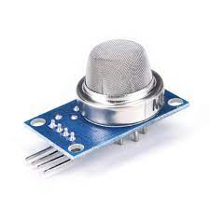
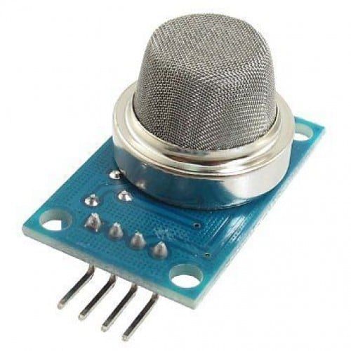
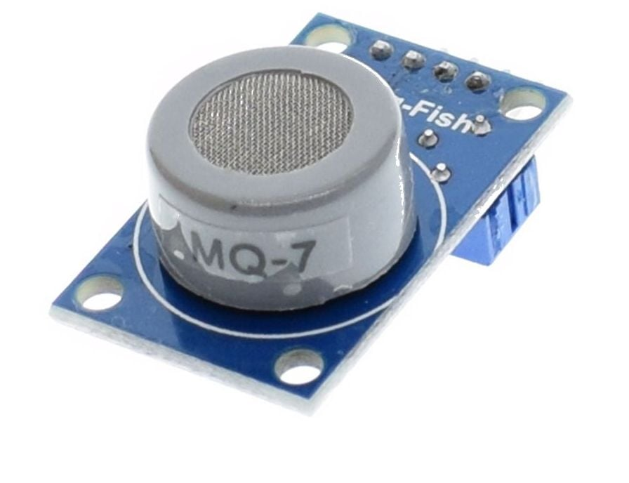
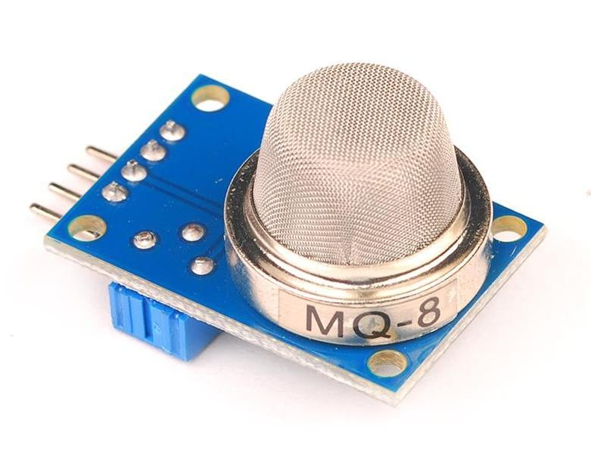
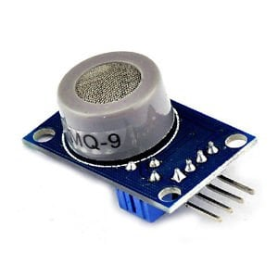
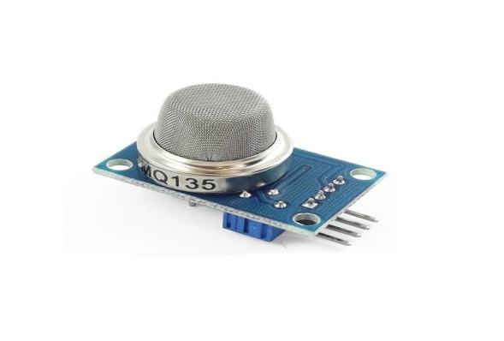


Gas sensors and the gases they watch
MQ-3
MQ-4
MQ-7
MQ-8
MQ-9
MQ-135
Alcohol vapour (mg/L)
Methane (ppm)
Carbon monoxide (ppm)
Hydrogen (ppm)
Carbon monoxide (ppm)
Air quality (ppm)
Flammable gases
Toxic gases
Hydrogen H₂
Methane CH₄
Ethane C₂H₆
Carbon monoxide CO
Ammonia NH₃
Chlorine Cl₂
Propane C₃H₈
Butane C₄H₁₀
Acetylene C₂H₂
Hydrogen sulfide H₂S
Sulfur dioxide SO₂
Propylene C₃H₆
Butadiene C₄H₆
Ethylene C₂H₄
Nitrogen dioxide NO₂
Phosgene COCl₂
Natural gas (CH₄)
Hydrogen cyanide HCN
Ozone O₃
Formaldehyde CH₂O

Slide 5
Fire prediction model
No: keep monitoring
Sample reading
SVM model
Fire risk?
MQ-3 Alcohol
25.18 mg/L
Sensor readings
MQ-3, 4, 7, 8, 9, 135
Database
Stores every reading
MQ-4 Methane
300.01 ppm
MQ-7 CO
25.10 ppm
Yes
MQ-8 Hydrogen
210.00 ppm
Fire alert message
Red light on
MQ-9 CO
205.67 ppm
MQ-135 Air quality
300.80 ppm
Readings keep flowing in; the model decides whether to raise the alarm.

Slide 6
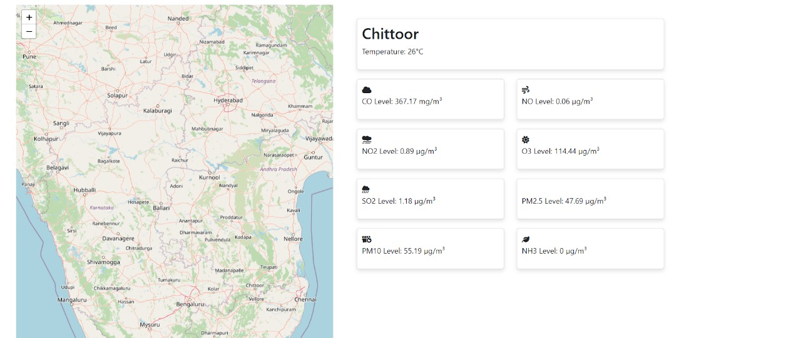
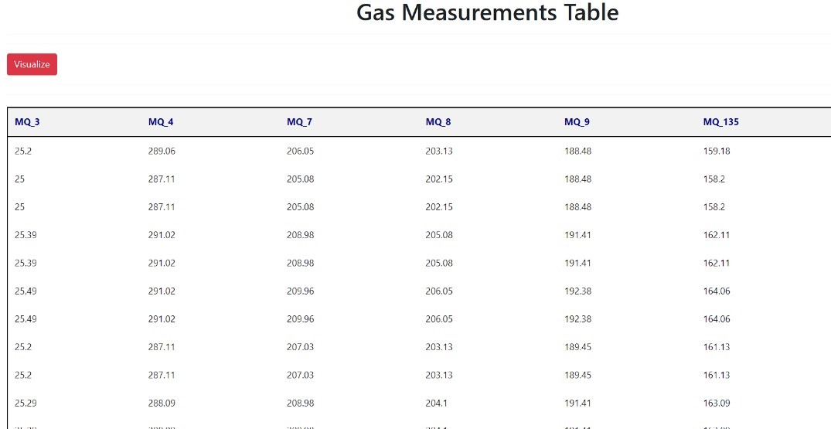
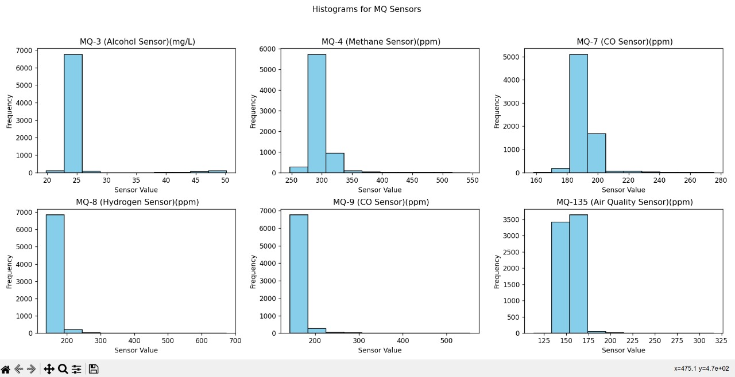
Hazard mapping and historical data
Stored readings every value saved
Live hazard map
Shows place, temperature and a card for every gas level, so teams see where to look first.
Leaflet map API
+ Weather API
= Hazardous mapping
Histograms normal range, rare spikes

Slide 7
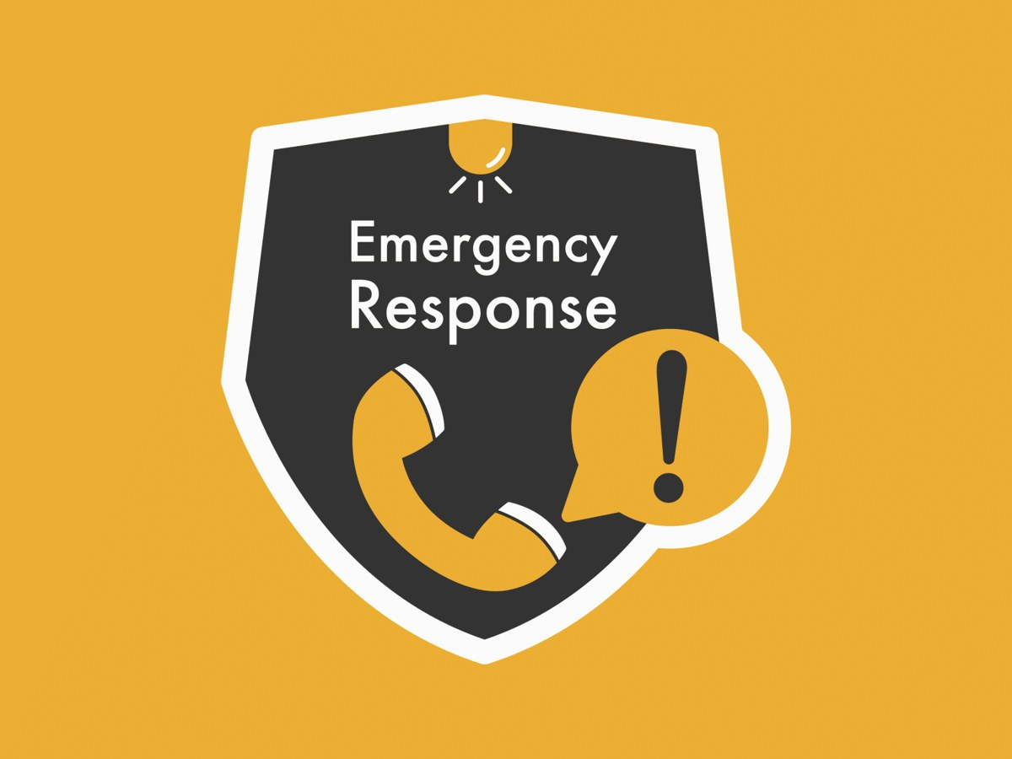

People, planning and alerts
Training and awareness
Emergency plan
Smart notifications
Online risk training
Learn to spot and prevent fire hazards
Know where to go
Learn the nearest exits and safe spots
Quick info, quick action
Readable at a glance, easy to act on
Watch the equipment
Check status often to catch faults early
Stay connected
Share contacts, pick a meeting place
Sounds and signs
Meaningful and noticed right away
No careless smoking
Remove a simple ignition source
Pack the basics
Small kit with water, snacks, supplies
You are in control
Choose which alerts you receive
Know the extinguisher
Everyone knows where it is and how to use it

Slide 8






Feature scope
Automated machinery shutdown
Smart sprinkler system
Visual indicators
Equipment in a danger zone can be switched off automatically when gas levels turn unsafe.
Sprinklers are driven by the fire prediction, so water starts before flames spread.
Clear lights and on-screen signs show the hazard level at a glance.
Real-time communication
Mobile alert integration
Continuous alerts
Control room, field staff and responders share the same live picture.
Alerts reach phones, so people are warned wherever they are on site.
Alerts repeat until someone acknowledges them, so none are missed.

Slide 9




Technology stack
Sensing
Machine learning
Back end
MQ-3
MQ-4
MQ-7
MQ-8
SVM
NumPy
TensorFlow
Python
Node.js
Flask
MQ-9
MQ-135
OpenCV
MathWorks
Django
PHP
Front end
Data
Maps and weather
HTML
CSS
JavaScript
PostgreSQL
Leaflet API
Weather API
Bootstrap
D3.js
GIS mapping

Slide 10




Where it helps, and what to manage
CHALLENGES TO MANAGE
USE CASES
Data accuracy
Precise readings are needed for a trustworthy risk assessment.
Industrial safety
Emergency response
Equipment reliability
Aerial equipment must work without interruption.
Environmental protection
Regulatory compliance
Privacy
Surveys must respect regulations and people’s privacy.
Preventive maintenance
Urban planning
Insurance assessment
Environmental studies
Data security
Collected data must be protected from unauthorised access.

