Slide 1
Evaluating Data Concerning Airline Passenger Satisfaction
Parv Bhargava, Jehan Bugli, Venkata Madisetty, and Namratha Prakash

Slide 2





Introduction
Dataset: a survey of passengers on commercial airlines
Goal: predict satisfaction for passengers based on certain characteristics and aspects of the flight experience
Strategy: conduct exploratory data analysis (EDA) to evaluate potential model inputs and identify a suitable model structure

Slide 3



Variables in the dataset
Ordinal Variables: Individual Ratings
Inflight Service
Departure/Arrival Time Convenience
On-board Service
Inflight Entertainment
Inflight Wi-fi Service
Check-in Service
Cleanliness
Leg Room Service
Baggage Handling
Gate Location
Seat Comfort
Online Boarding
Ease of Online Booking
Food and Drink
Continuous Variables
Categorical Variables
Age
Customer Type
Gender
Flight Distance
Departure/Arrival Delays
Type of Travel
Class

Slide 4
Our Data
X | id | Gender | Customer.Type | Age | Type.of.Travel | Class | Flight.Distance | Inflight.wifi.service | …
0 | 70172 | Male | Loyal Customer | 13 | Personal Travel | Eco Plus | 460 | 3 | …
1 | 5047 | Male | disloyal Customer | 25 | Business travel | Business | 235 | 3 | …
2 | 110028 | Female | Loyal Customer | 26 | Business travel | Business | 1142 | 2 | …
3 | 24026 | Female | Loyal Customer | 25 | Business travel | Business | 562 | 2 | …
4 | 119299 | Male | Loyal Customer | 61 | Business travel | Business | 214 | 3 | …

Slide 5



Data Pre-Processing
The field for arrival delay in minutes had 310 NA values, which were replaced with the median delay.
The “X” and “id” fields for index number and survey ID are also removed from the data frame due to their limited relevance for modeling.
Responses for the ratings variables are coded as values from 0-5. where 0 indicates that the question was not applicable. Respondents that select this option for any of the ratings variables are filtered out.

Slide 6




Data Summary
Median
Mean
Summary statistics for continuous variables:
Min
Q1
Q3
Max
Summary statistics for nominal/ordinal variables:
Total number
Distinct number
Most frequent

Slide 7
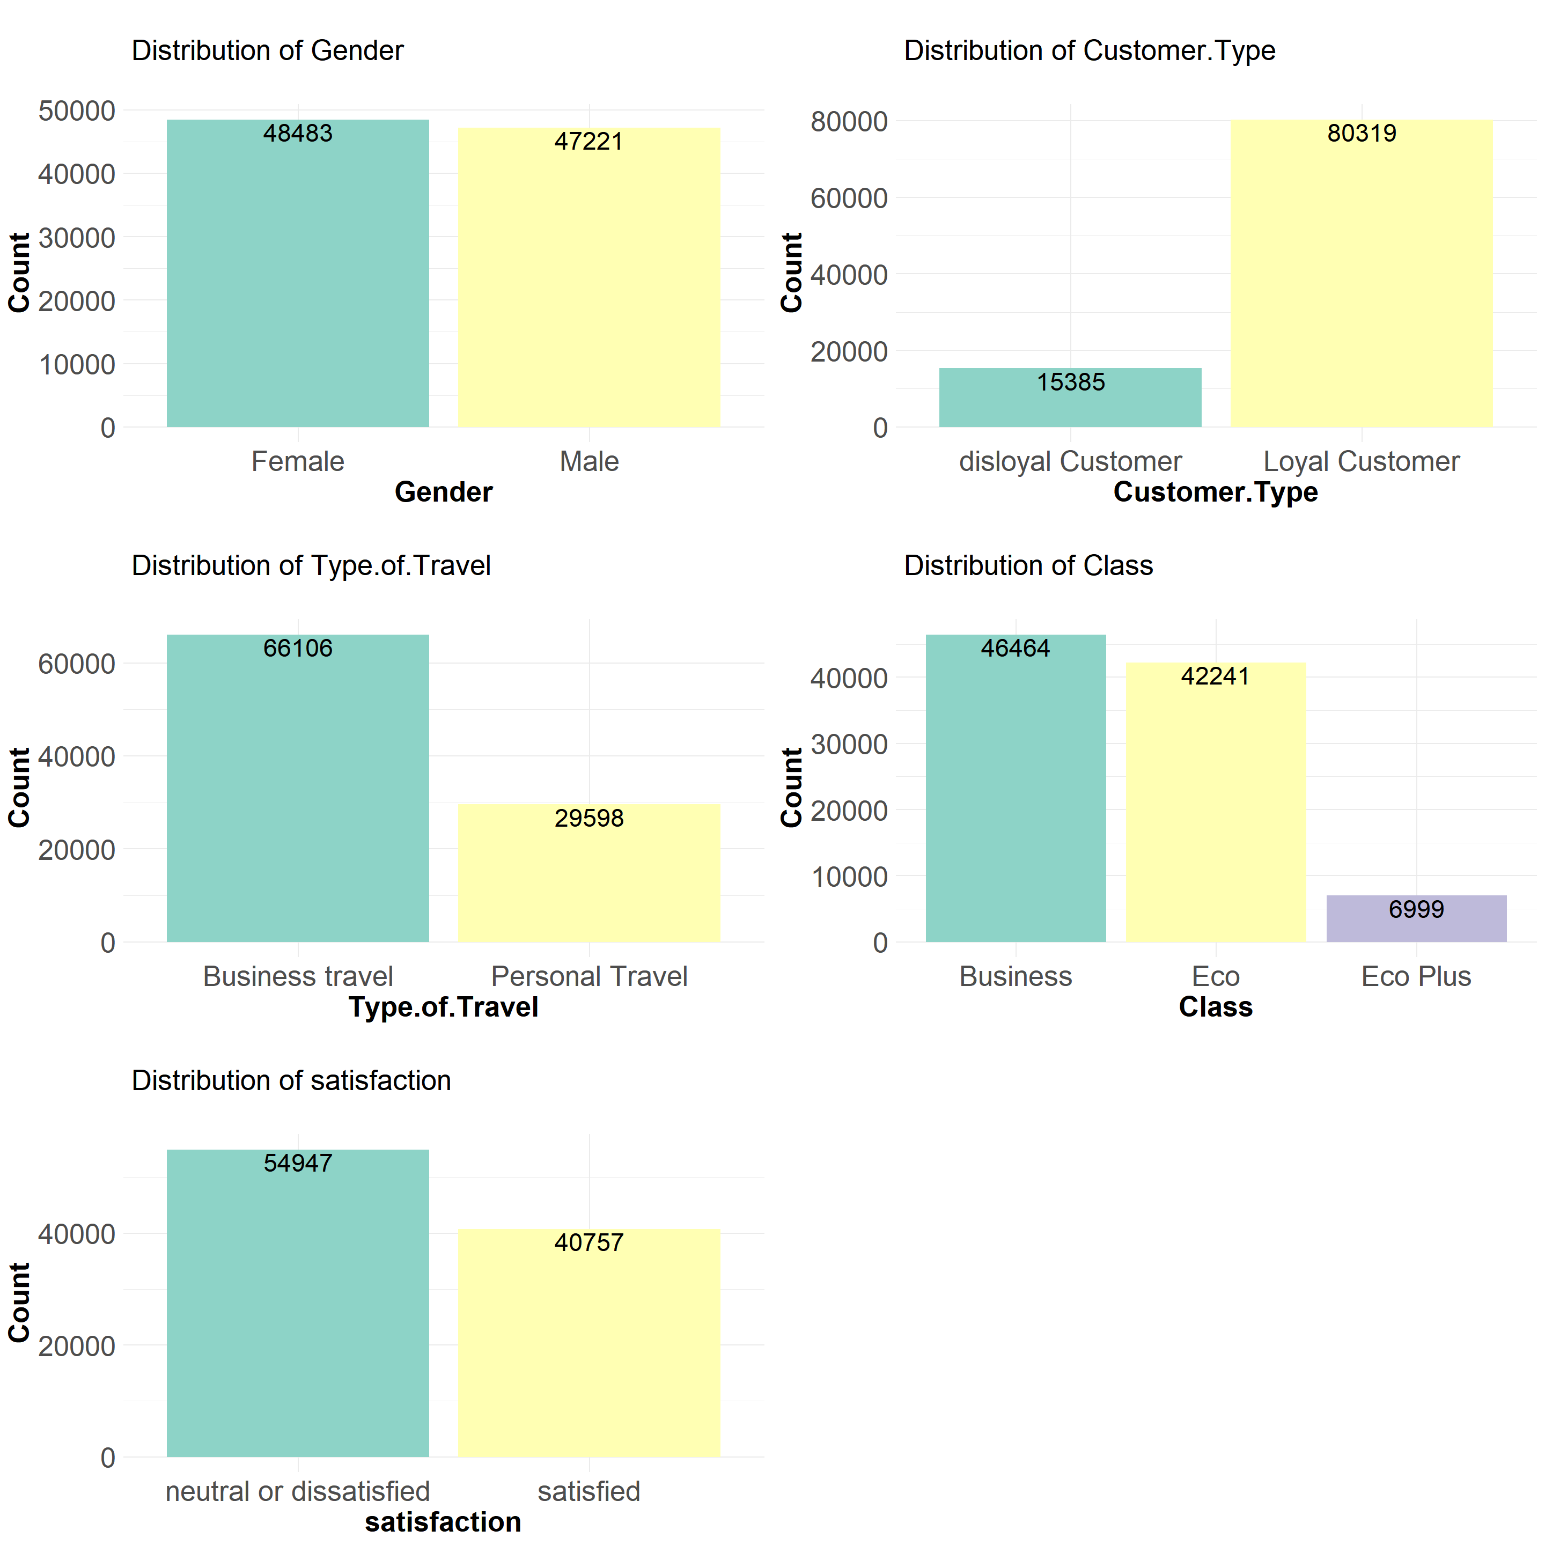
Variable Distributions
Part 1: Categorical Variables
These variables can be included in our regression model with limited assumptions.
Most can be encoded as binary variables (0/1) for use in a model.
Class may require some transformation (to be discussed later).

Slide 8
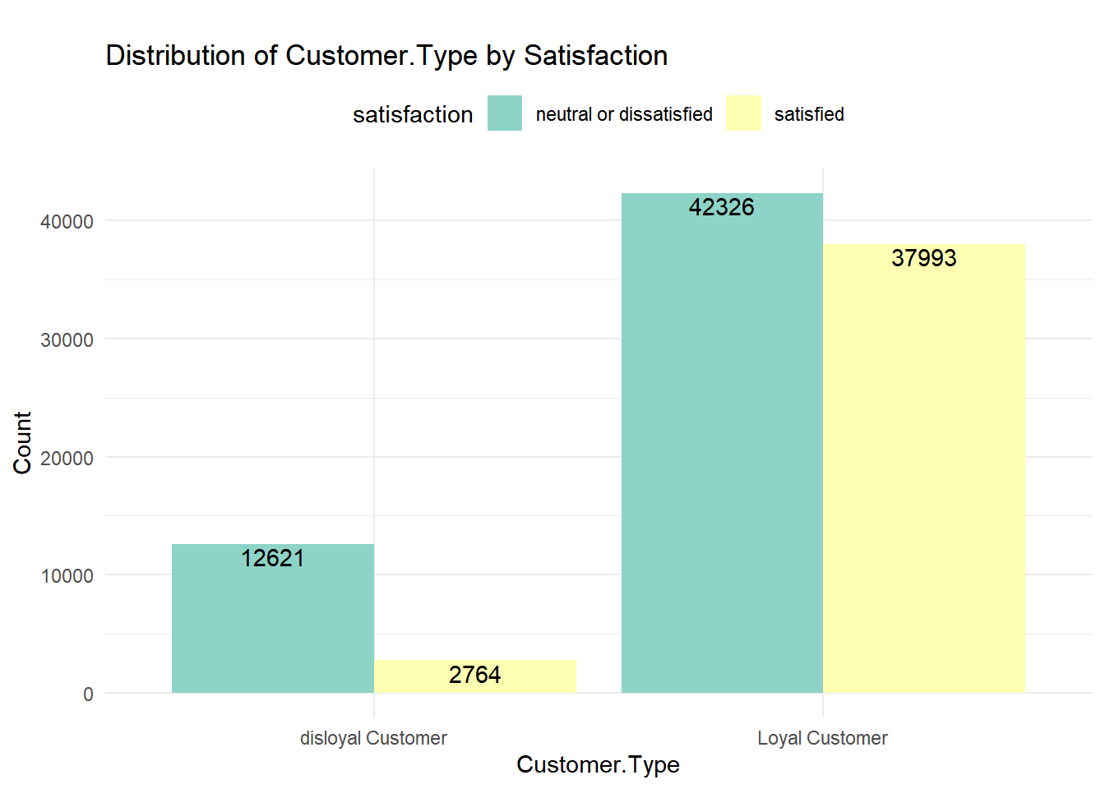
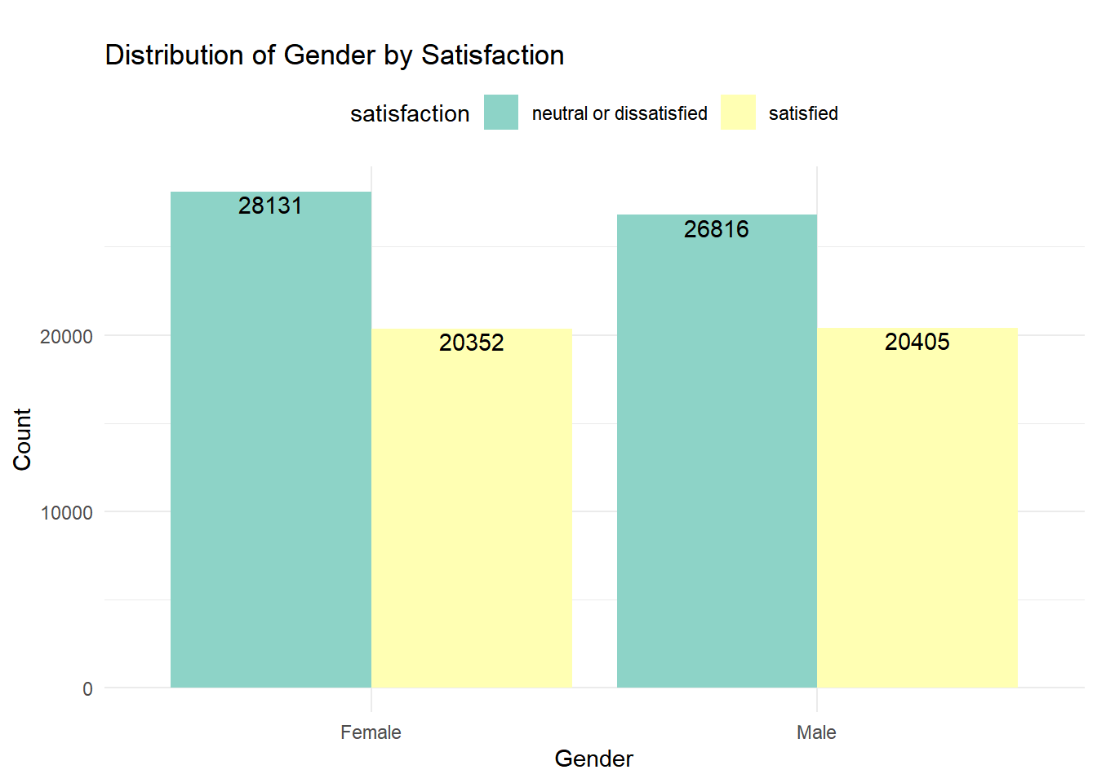
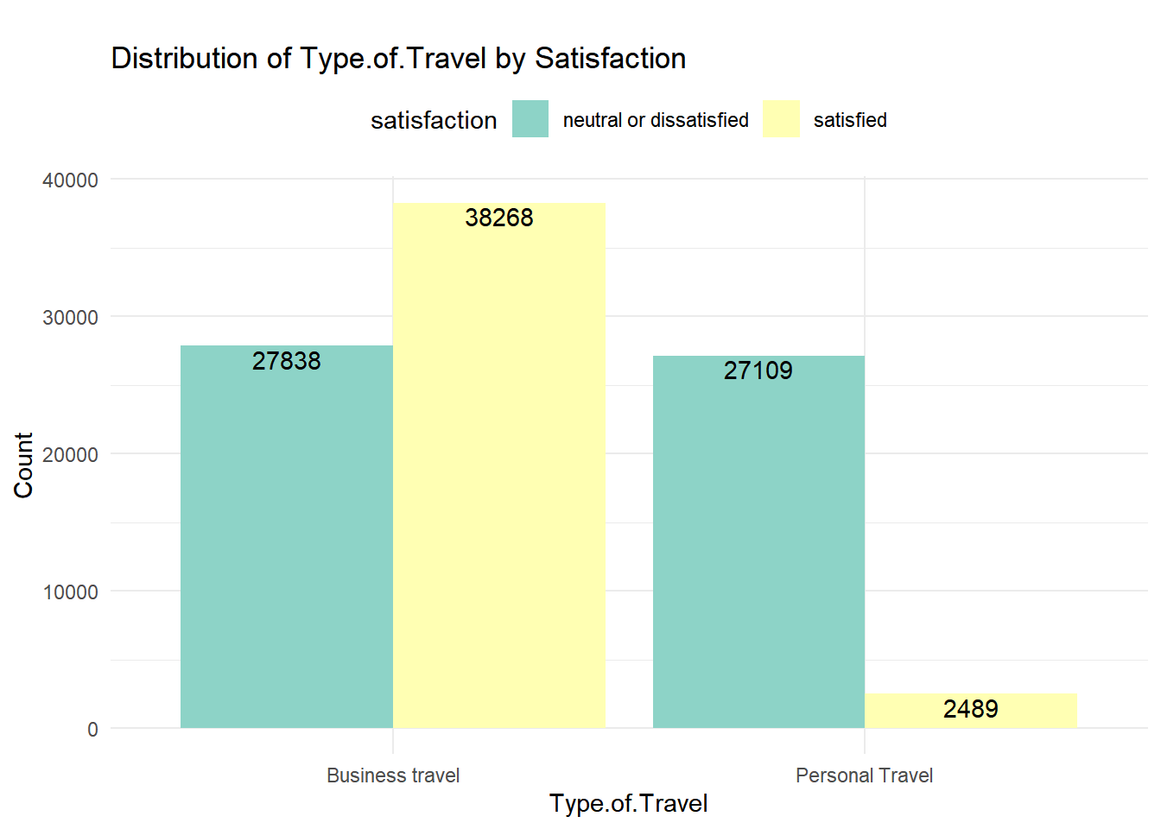
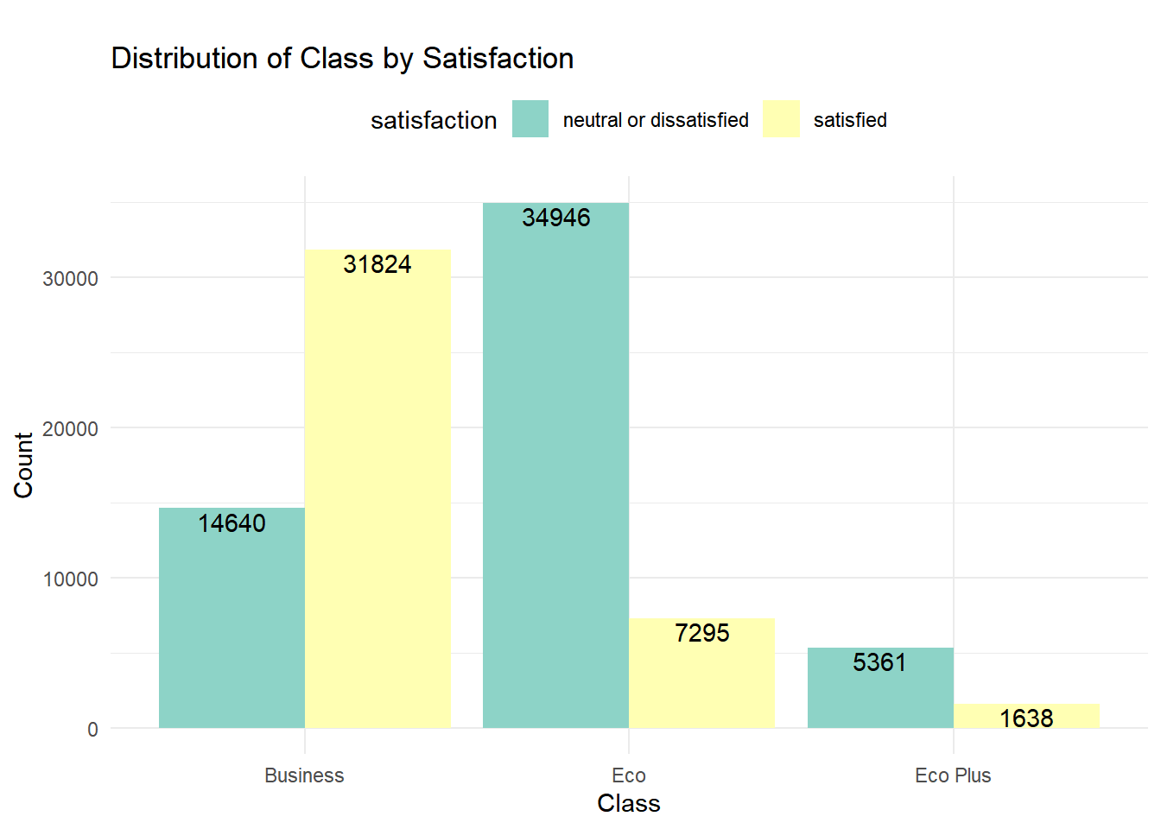
Variable Distributions
Part 1: Categorical Variables
Gender: Both genders have a similar distribution of satisfaction levels.
Customer Type: Loyal customers tend to be more satisfied than disloyal ones.
Type of Travel: Passengers traveling for business purposes are generally more satisfied than those traveling for personal reasons.
Class: Business class passengers are noticeably more satisfied than those in Eco or Eco Plus.

Slide 9
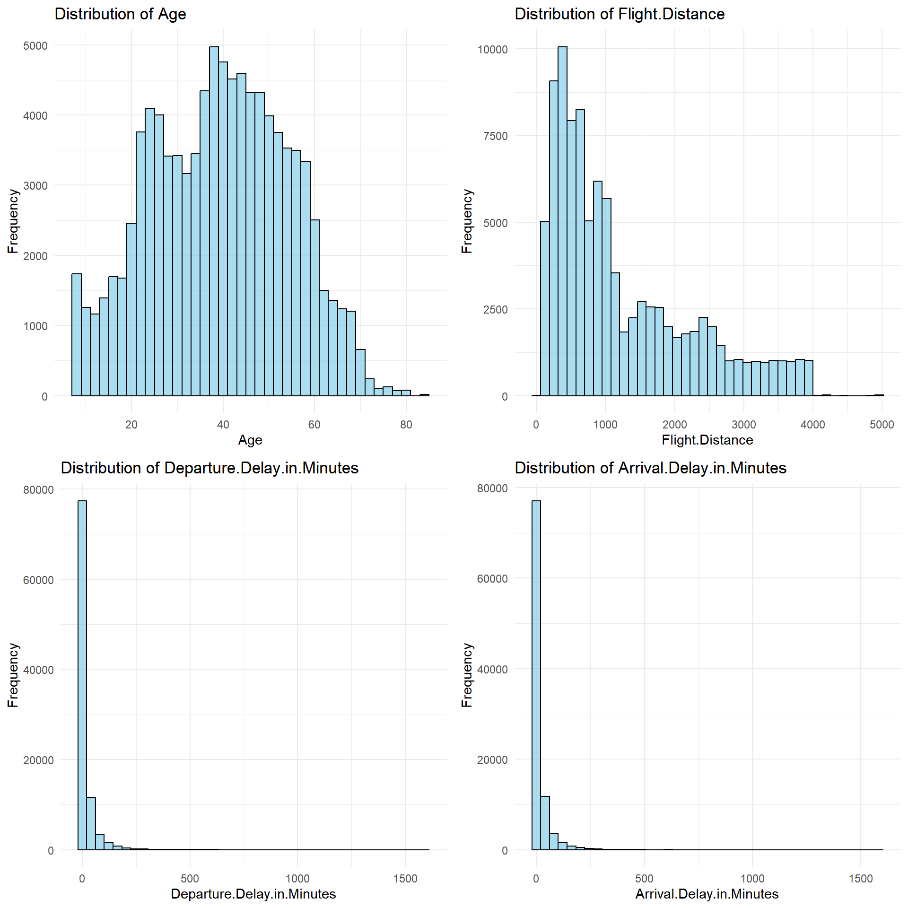
Variable Distributions
Part 2: Continuous Variables
Flight distance and both delay variables share strongly right-skewed distributions.
Respondent age, as we would expect, more closely approximates a normal distribution.
Depending on their relationship with the dependent variable, these variables may need to be transformed.

Slide 10
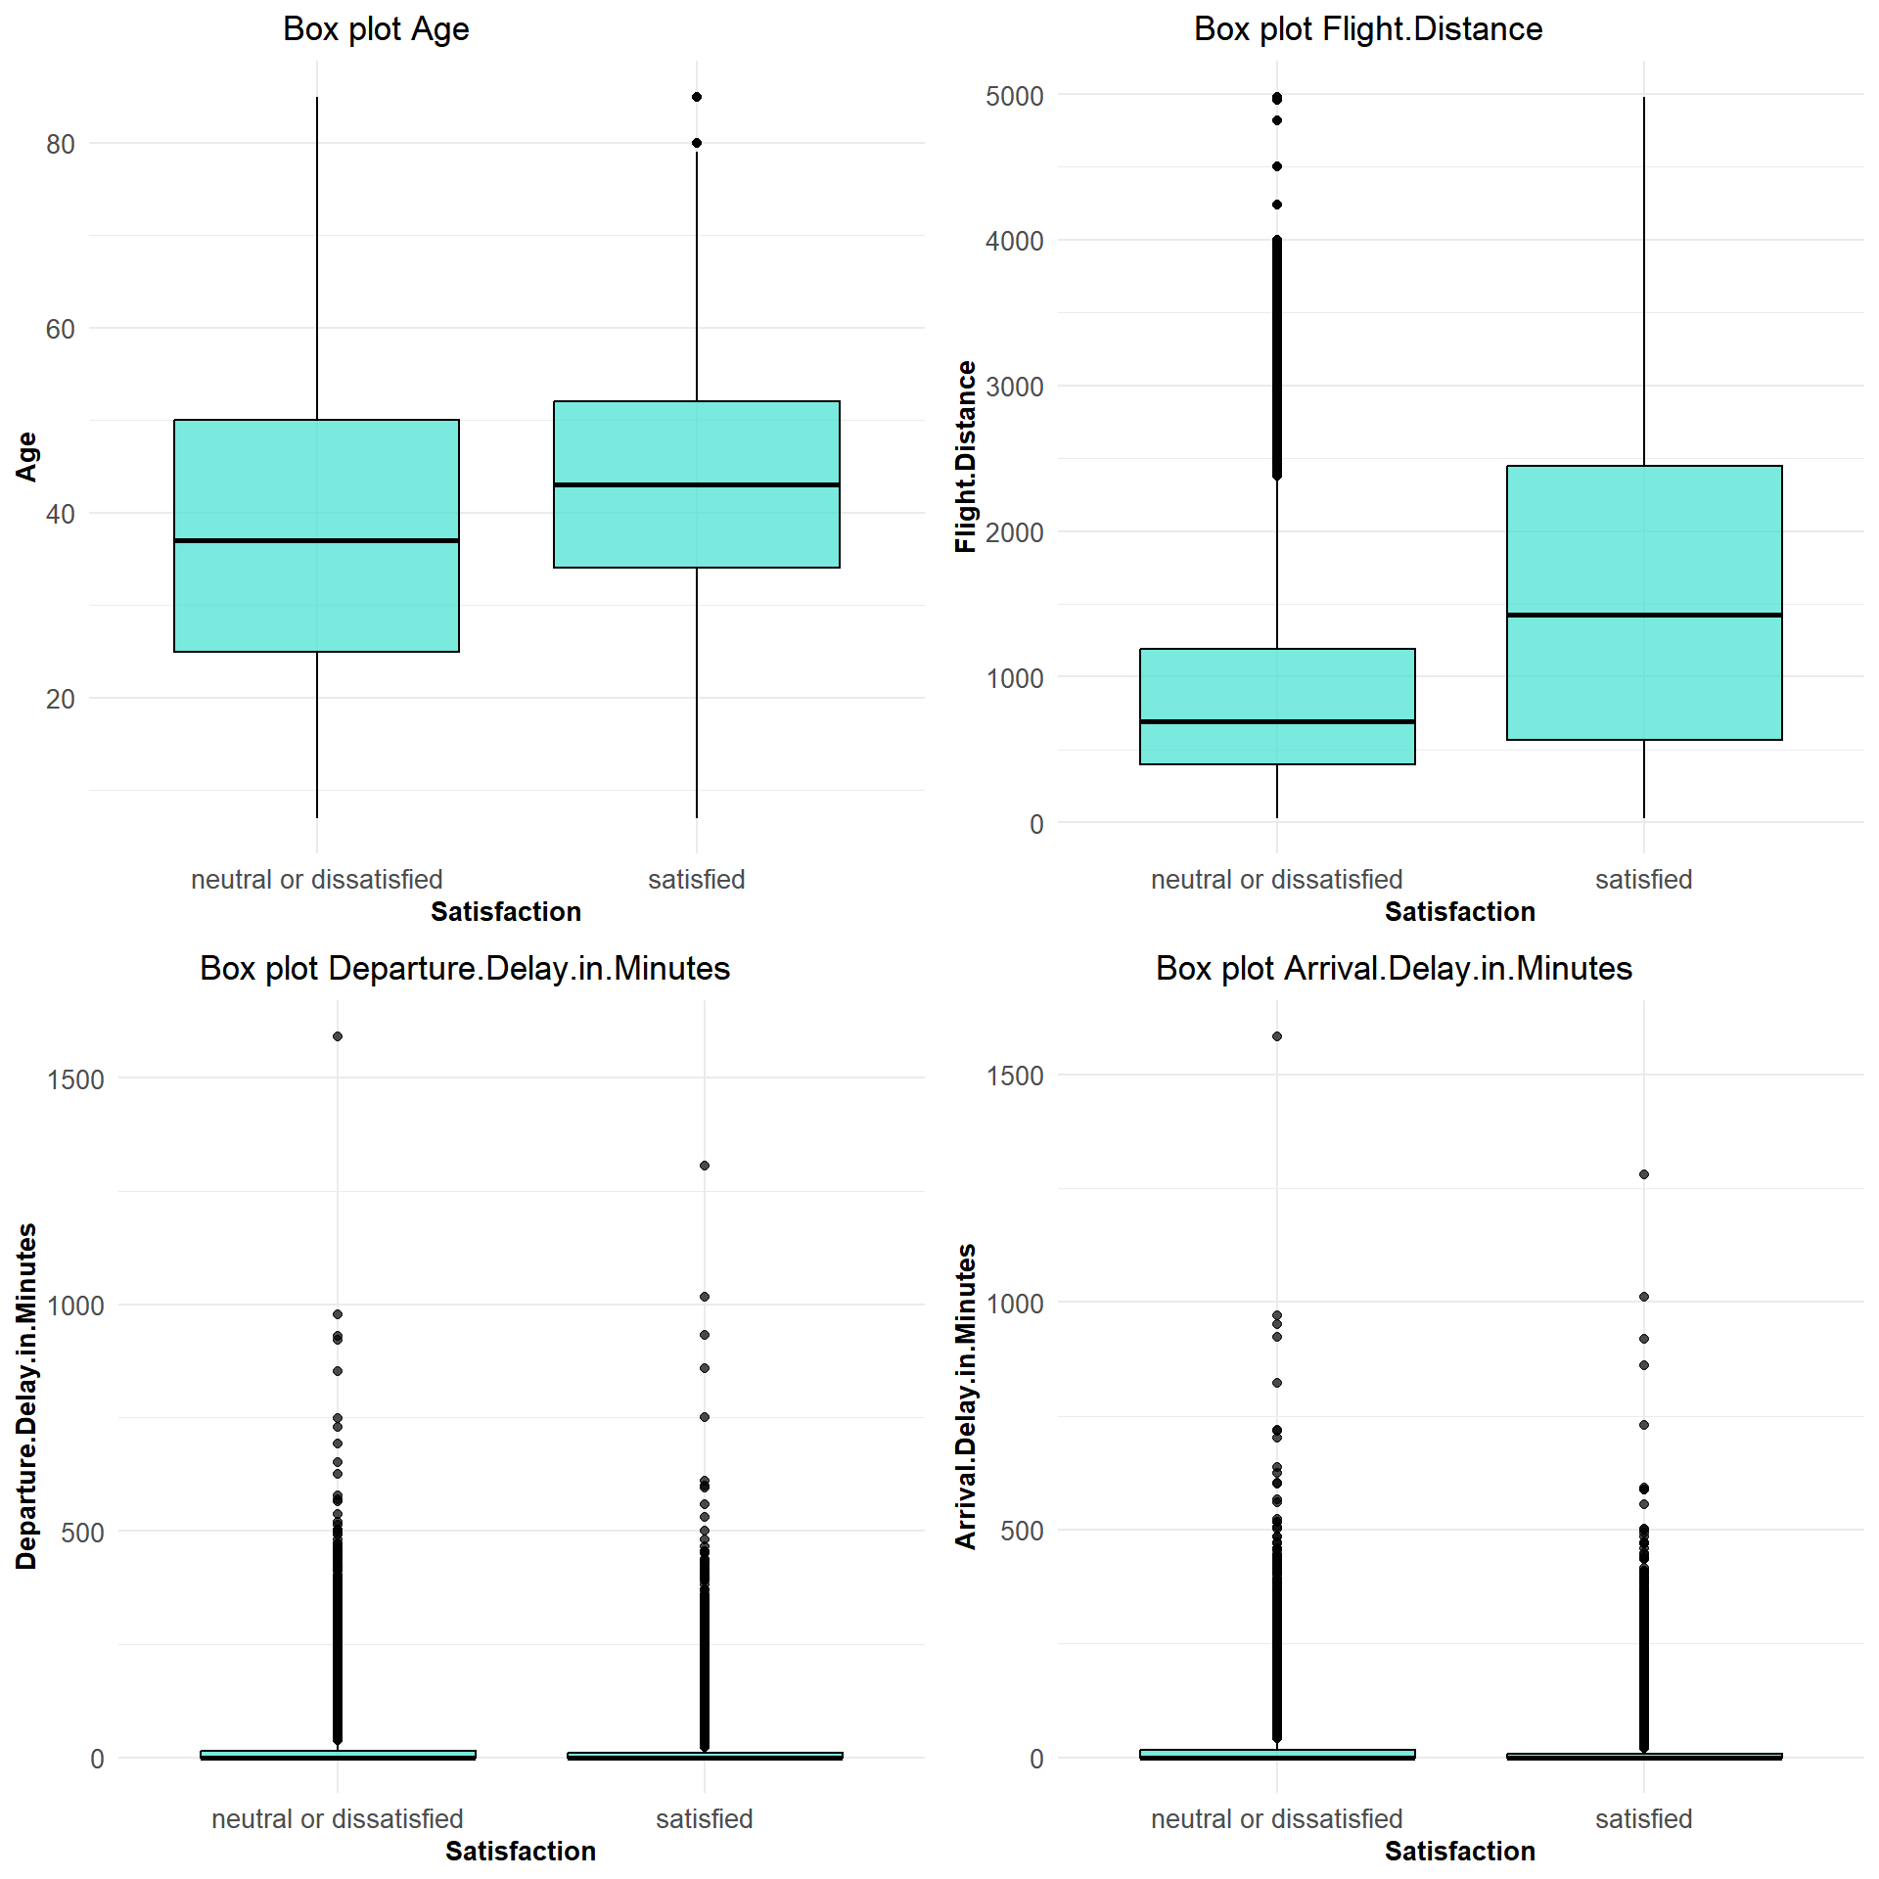
Variable Distributions
Part 2: Continuous Variables
Age: Satisfied customers tend to be older than neutral or dissatisfied customers.
Flight Distance: Satisfied customers, on average, seem to travel longer distances.
Departure Delay in Minutes: Flights with higher departure delays tend to have slightly more neutral or dissatisfied customers.
Arrival Delay in Minutes: Similarly, flights with higher arrival delays tend to have slightly more neutral or dissatisfied customers.

Slide 11
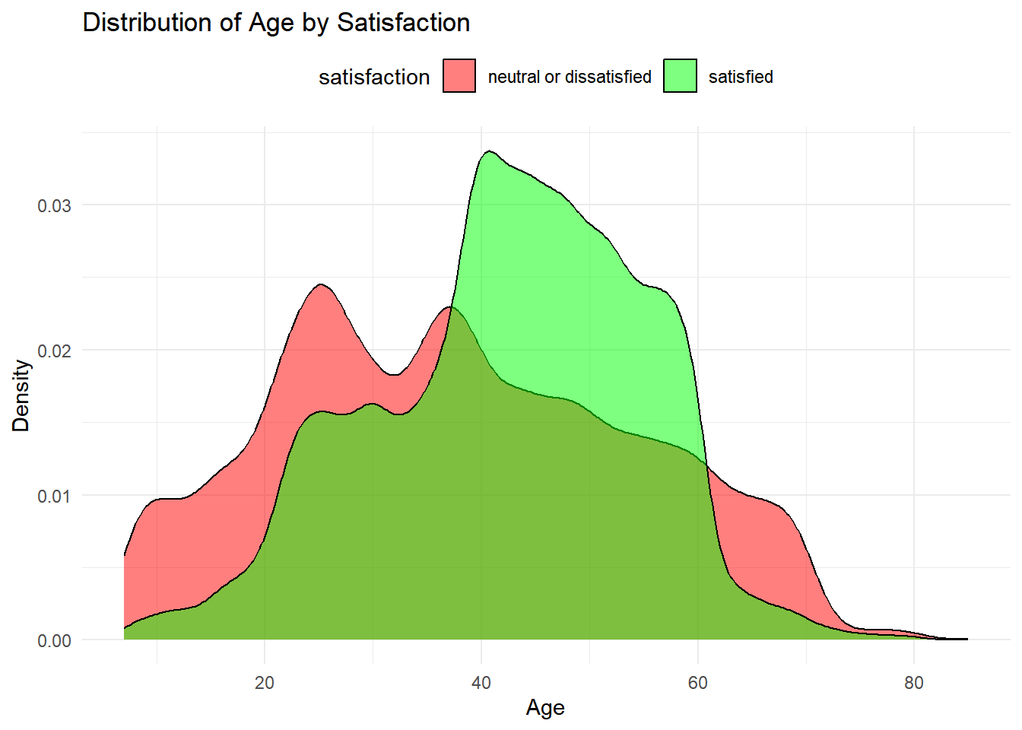
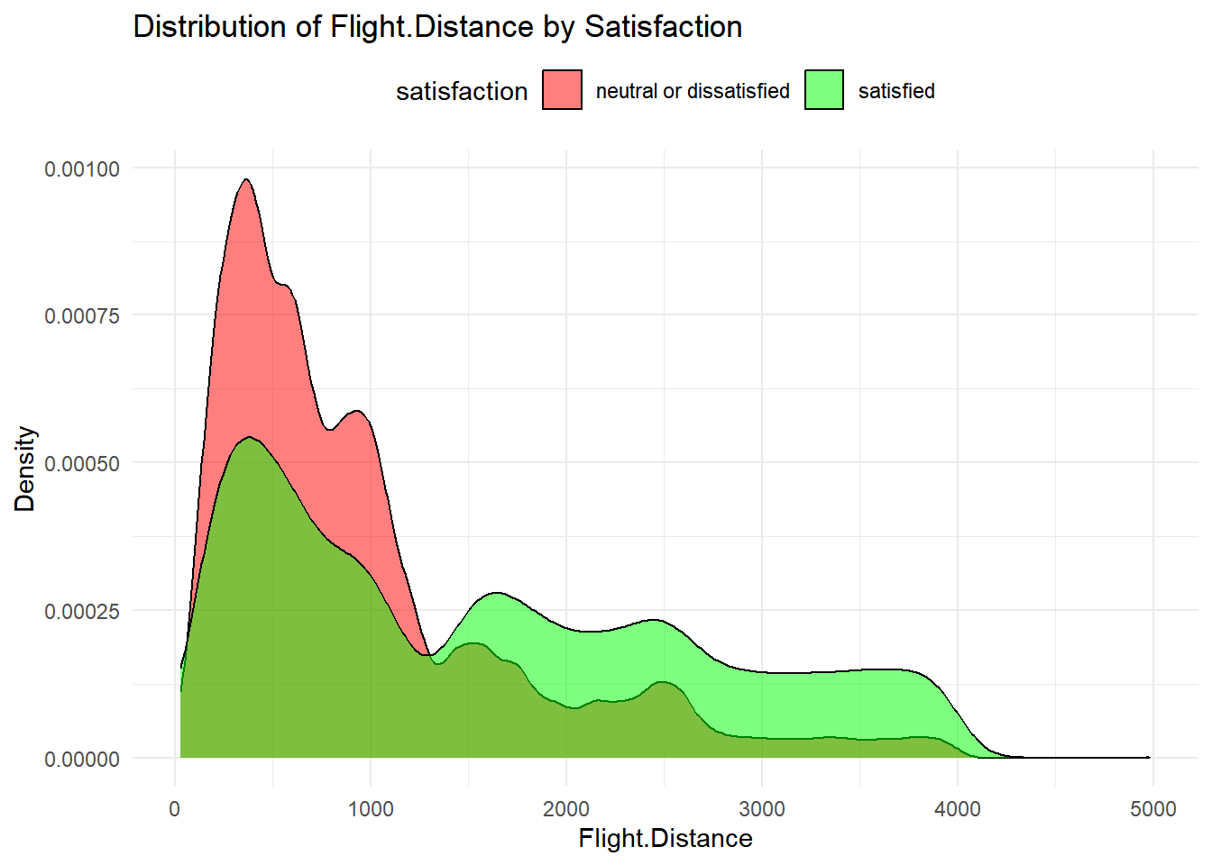
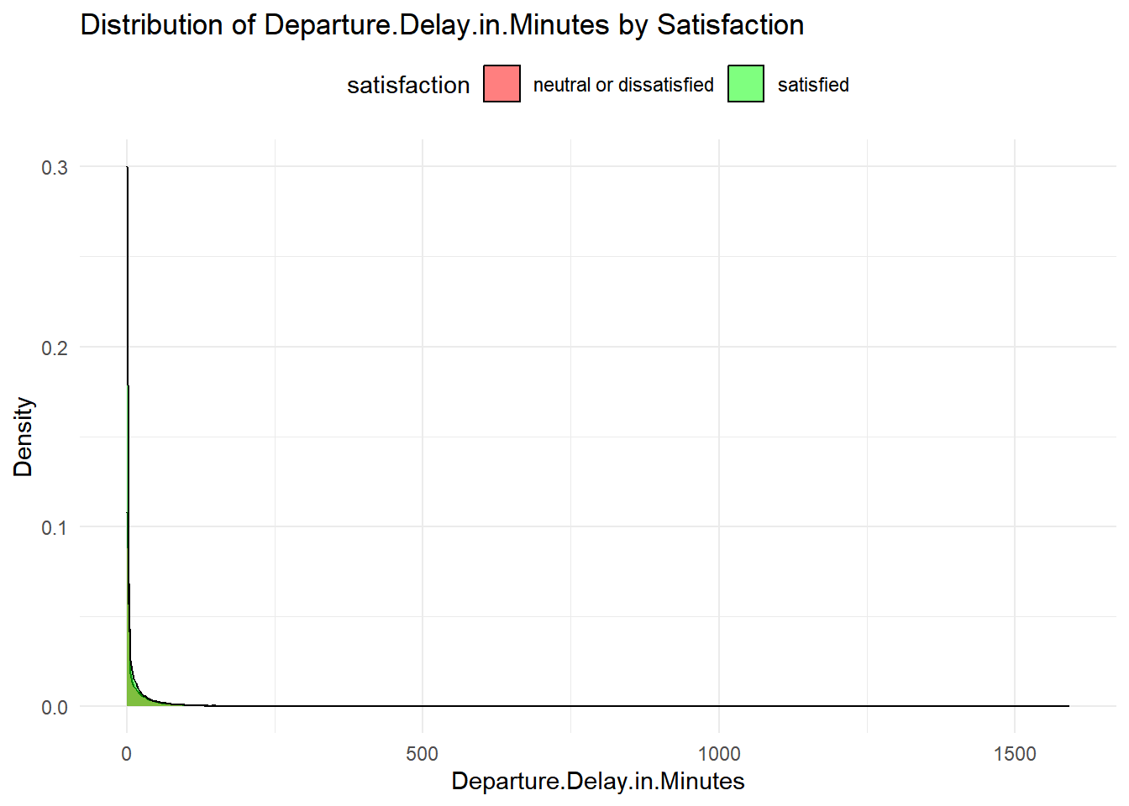
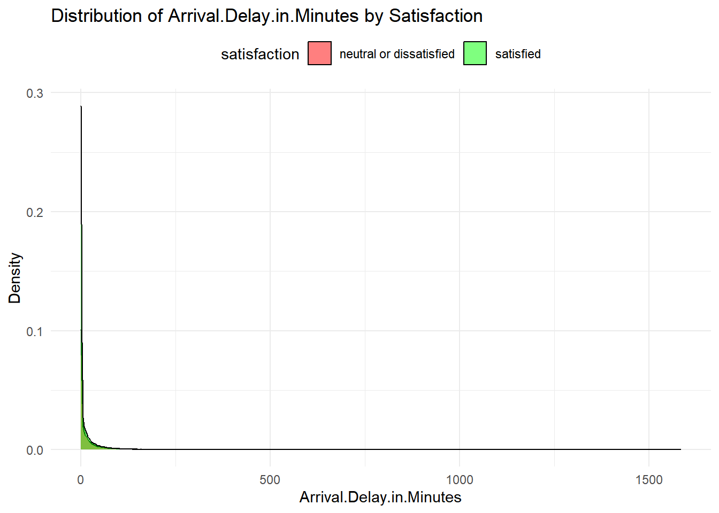
Variable Distributions
Part 2: Continuous Variables
Age: Middle-aged passengers tend to be more satisfied than younger and older age groups.
Flight Distance: Passengers traveling shorter distances seem to be more neutral or dissatisfied compared to those traveling longer distances.
Arrival/Departure Delays: It is difficult to discern any meaningful differences between passengers that were satisfied or neutral/dissatisfied based on arrival or departure delay durations using this method.

Slide 12
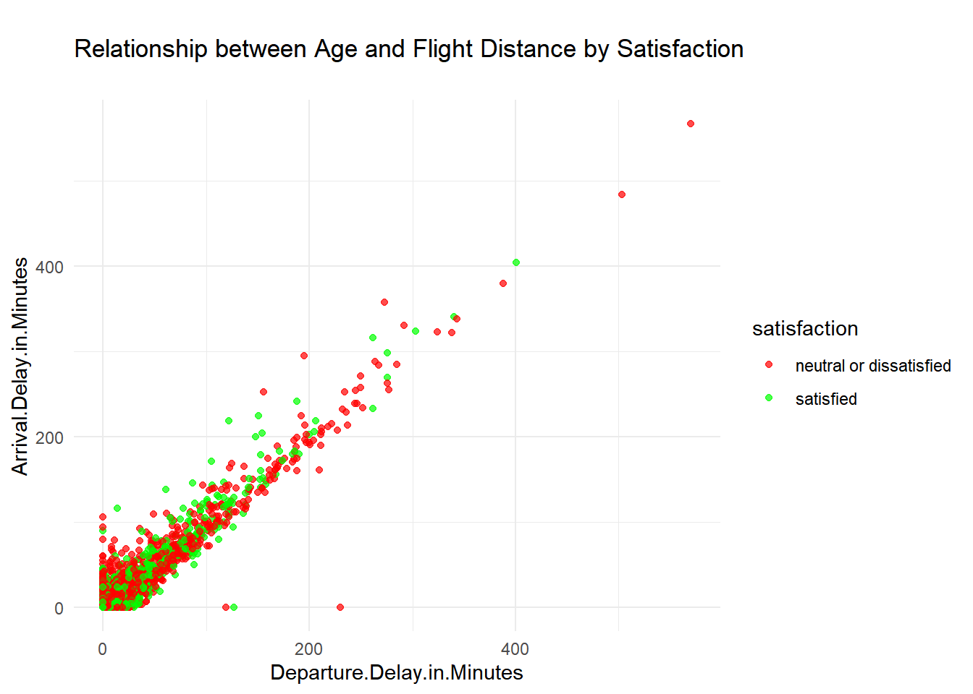
Variable Distributions
Part 2: Continuous Variables
This scatter plot clearly indicates that arrival and departure delays follow a roughly similar linear trajectory, potentially indicating high correlation between these fields; differences between satisfied and neutral/dissatisfied groups are still not visually distinct.

Slide 13
Variable Distributions
Part 3: Ordinal Variables (1/2)
Many of the individual ratings variables display similar distributions; we noted at this stage that transformations may be required to avoid multicollinearity concerns.

Slide 14
Variable Distributions
Part 3: Ordinal Variables (2/2)
Many of the individual ratings variables display similar distributions; we noted at this stage that transformations may be required to avoid multicollinearity concerns.

Slide 15



Multicollinearity testing
One of the essential steps in data analysis is assessing multicollinearity among independent variables.
Multicollinearity occurs when predictor variables are highly correlated with each other, which can impact the reliability of regression models.
To begin examining fields with respect to multicollinearity, we used two correlation matrices:
Continuous variables
Ratings variables

Slide 16
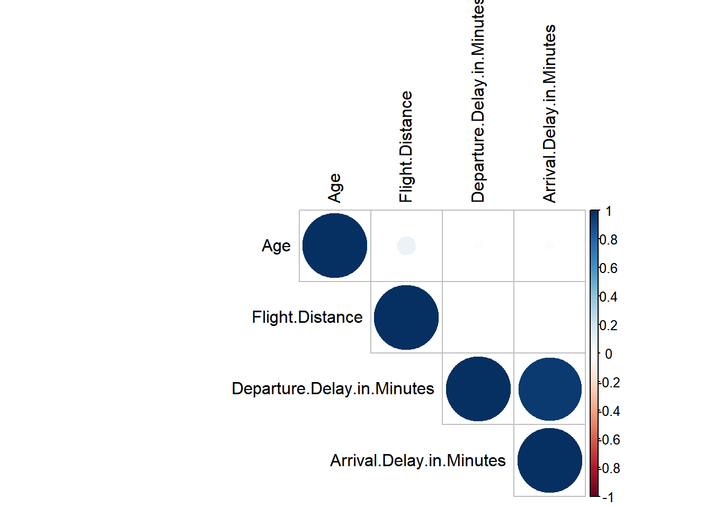

Correlation Matrix 1
Continuous Variables
Departure delays appear to be highly correlated with arrival delays; certain steps, such as removing one of the two or calculating an average delay variable, would likely be necessary for use in a predictive model.
Outside of continuous variables, many of the ratings appear to share similar frequency distributions based on the graphs displayed earlier, sparking significant multicollinearity concerns. Our next step to evaluate these potential relationships was to create another correlation matrix.

Slide 17
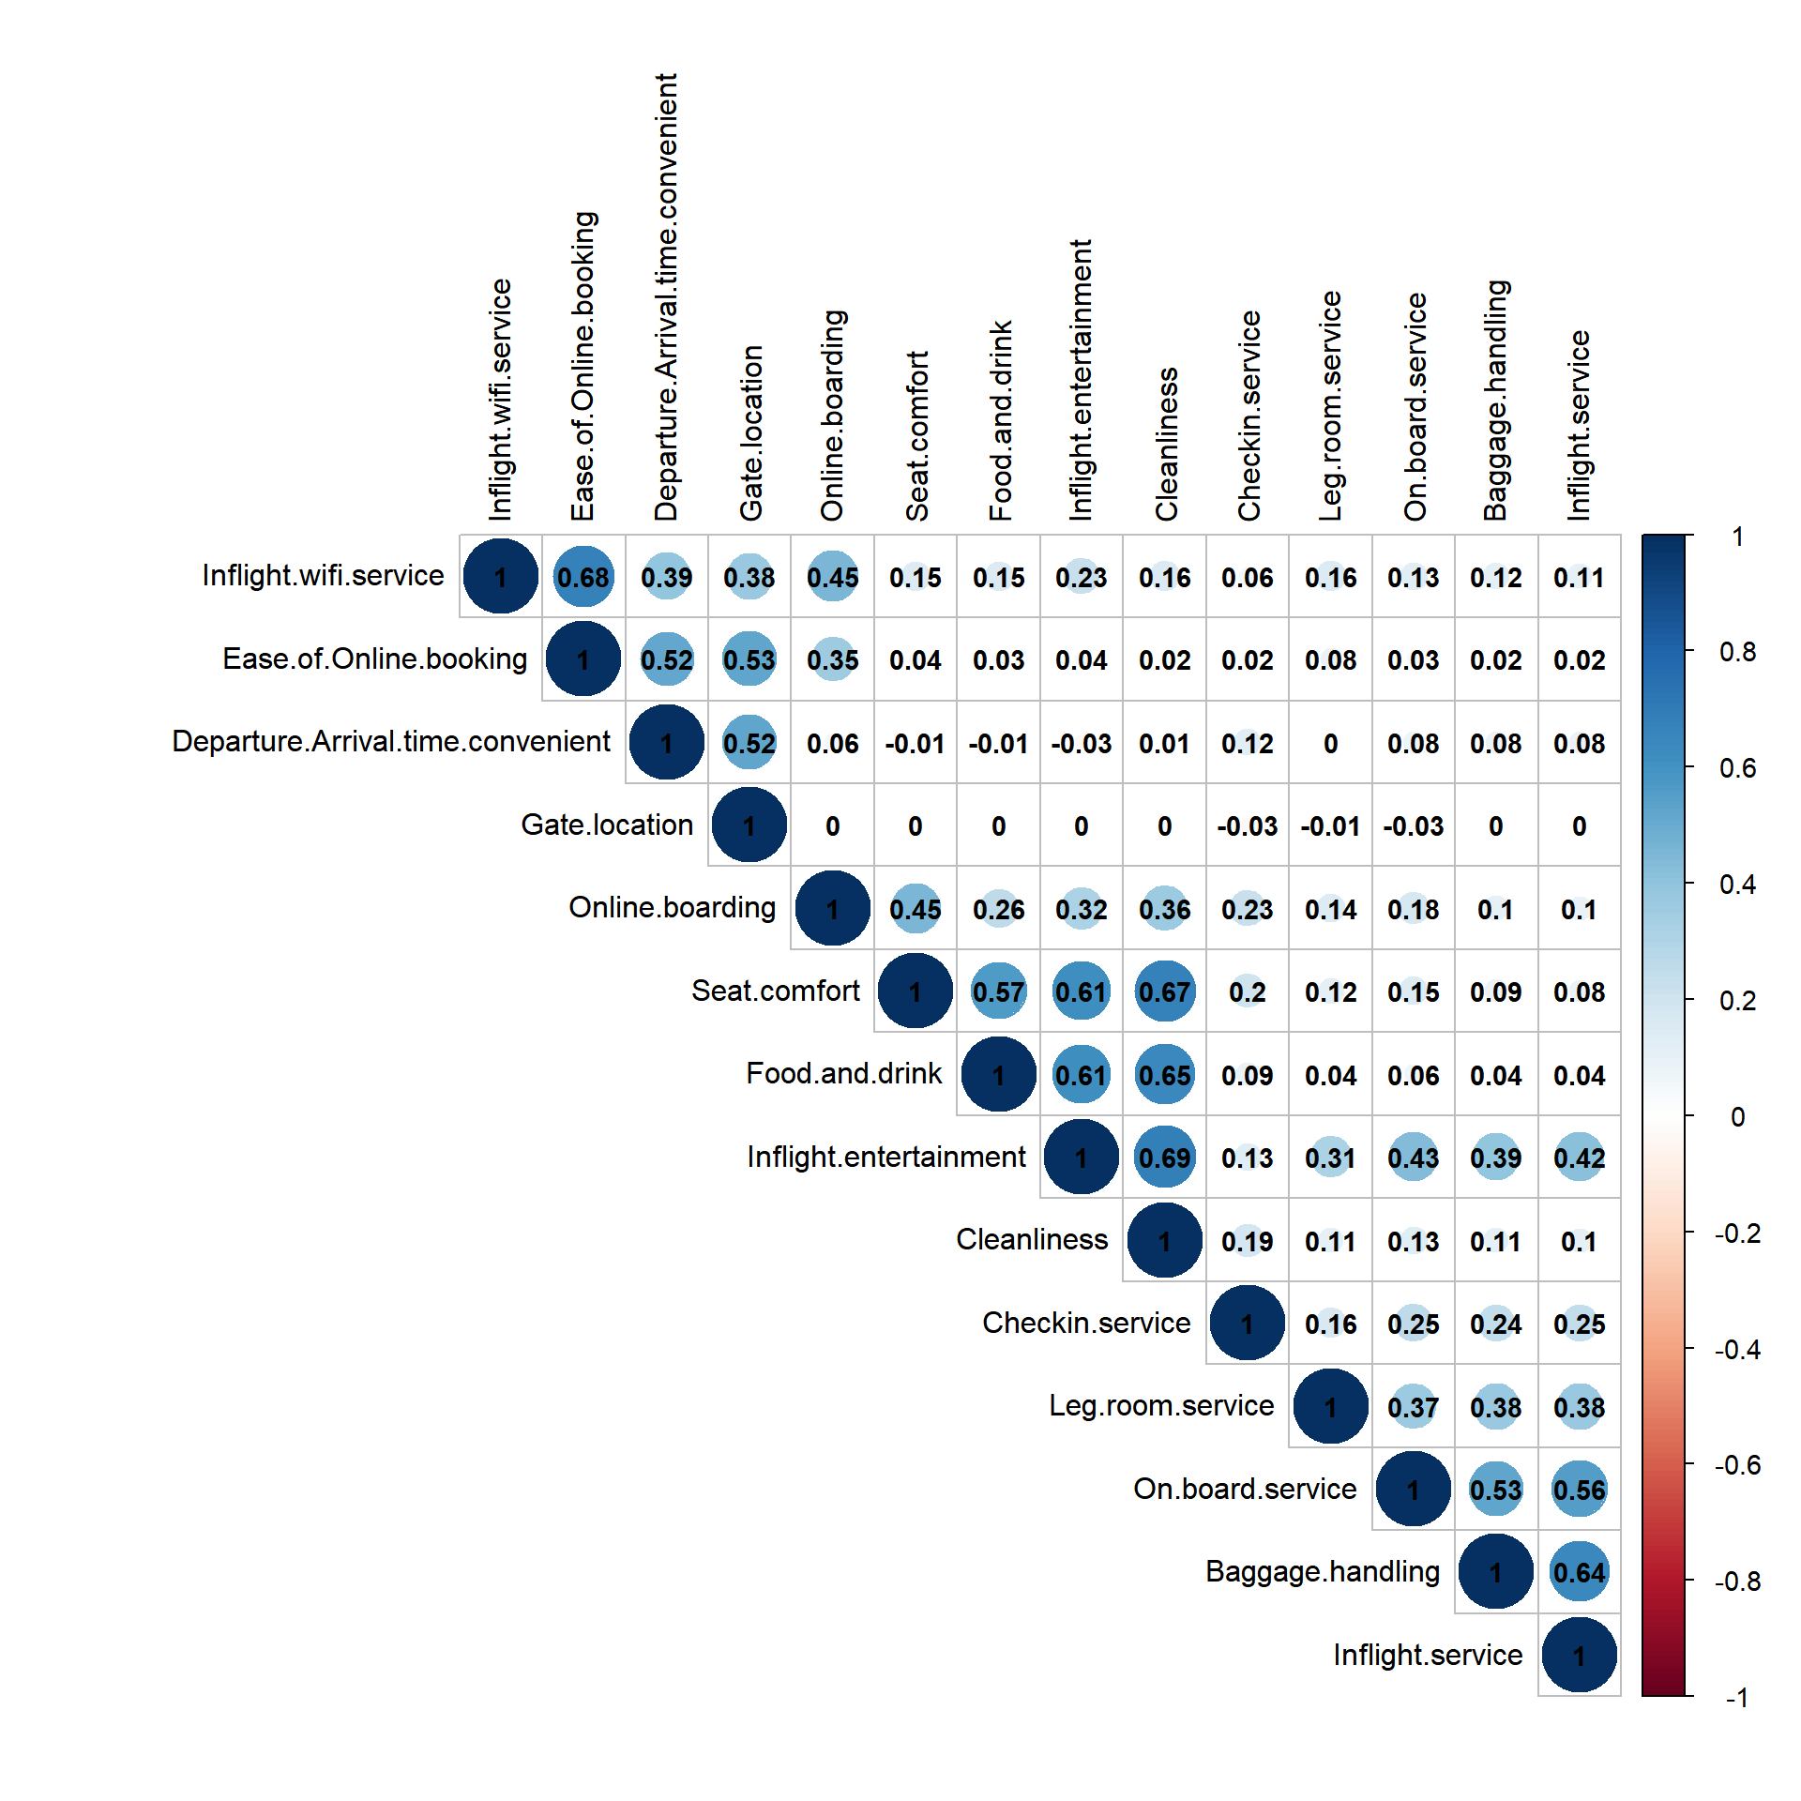
Correlation Matrix 2
Ratings Variables
We can see from the matrix that certain ratings variables have strong positive correlations with each other. If these are included in the model without adjustments, our model may suffer a loss in reliability.
In order to avoid this issue, we elected to combine ratings variables into two groups—based on the degree of correlation—and utilize average ratings from these two groups as model inputs.

Slide 18



Aggregated ratings variables
Ratings Group 2: In-Flight & Baggage
Food and Drink
Seat Comfort
In-Flight Entertainment
Onboard Service
Leg Room Service
Baggage Handling
Check-In Service
In-Flight Service
Cleanliness
Ratings Group 1: Pre-Flight & Wi-Fi
In-Flight Wifi Service
Departure / Arrival Time
Ease of Online Booking
Gate Location
Online Boarding

Slide 19
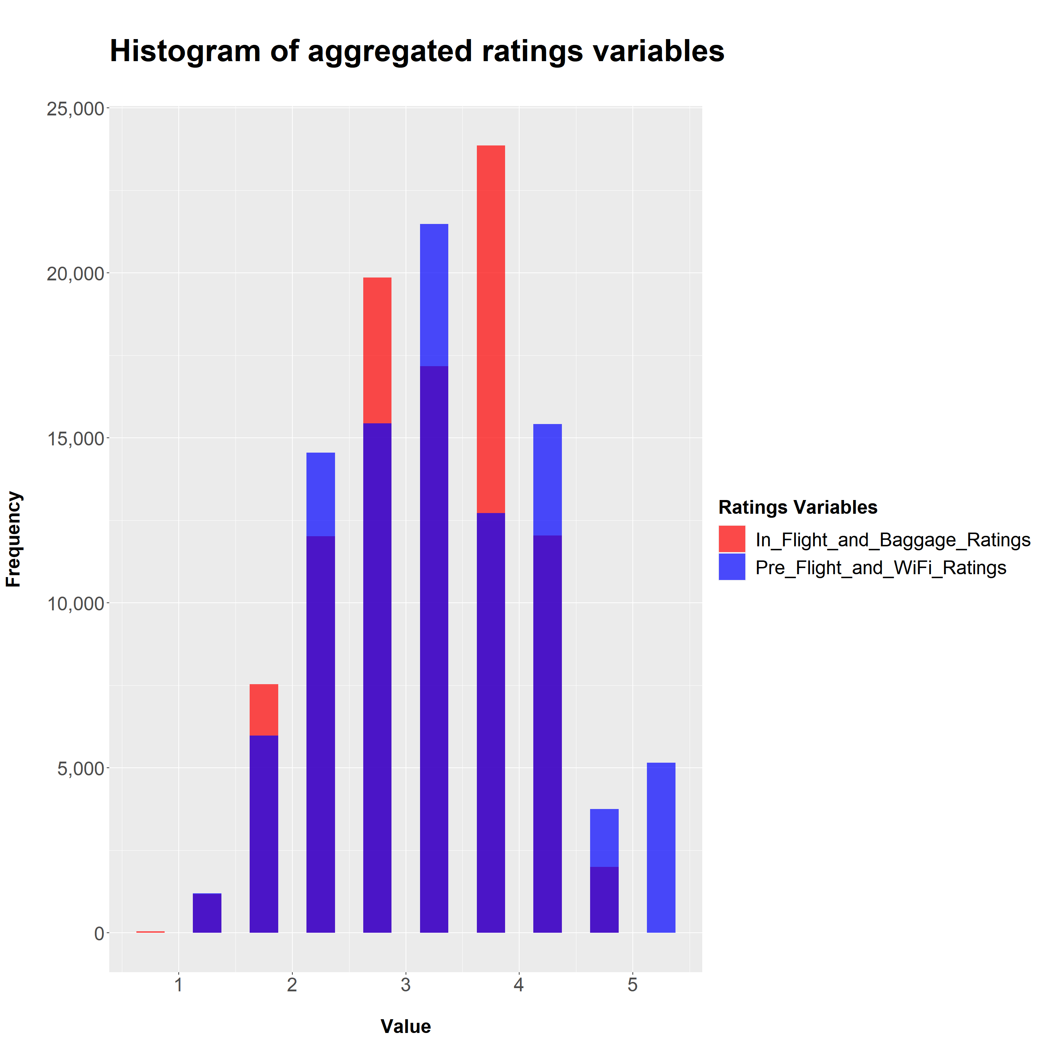
Aggregated Ratings Variables
Combined Histogram
When viewing these aggregated ratings, we can see a clear separation in values
The two consolidated ratings variables share a weak positive correlation (correlation coefficient = 0.181), indicating that they can be jointly included in our model without violating the collinearity assumption to a significant degree.

Slide 20
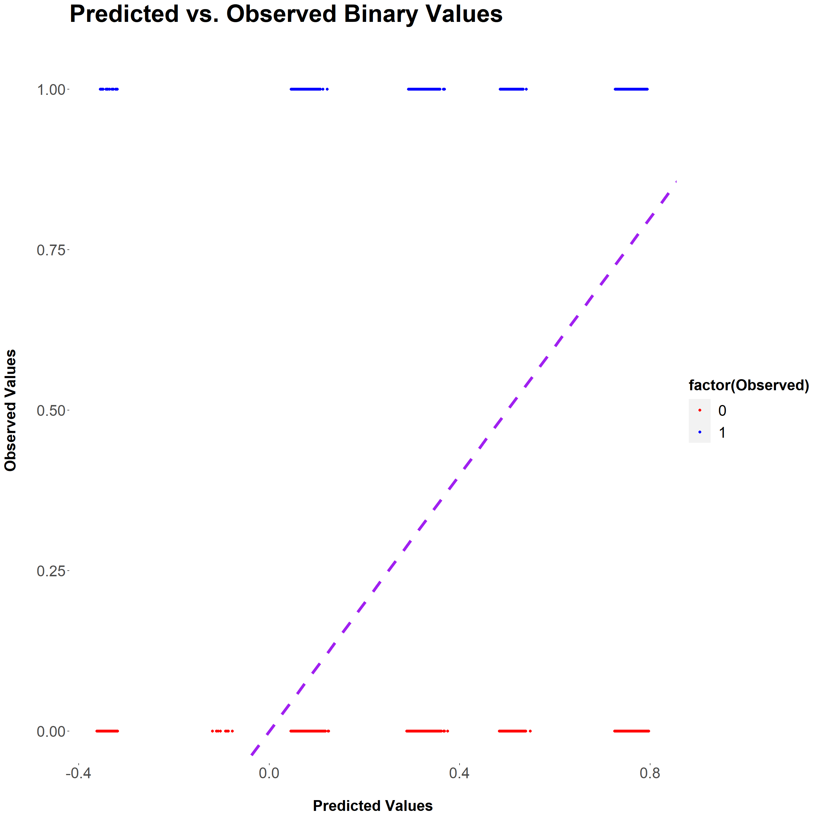
Ruling Out the Linear Model
Coefficients:
## Estimate Std. Error t value Pr(>|t|)
## (Intercept) -3.69e-01 5.04e-03 -73.15 < 2e-16 ***
## Gender 2.92e-03 2.51e-03 1.17 0.24
## Customer.Type 4.10e-01 3.96e-03 103.42 < 2e-16 ***
## Age 5.34e-04 8.72e-05 6.12 9.4e-10 ***
## Type.of.Travel 4.34e-01 3.61e-03 120.27 < 2e-16 ***
## Class 2.42e-01 3.38e-03 71.81 < 2e-16 ***
## Flight.Distance 8.38e-06 1.45e-06 5.77 8.1e-09 ***
Before engaging in further analysis, we first identified that satisfaction—as a categorical/binary variable—cannot be reliably predicted through a linear model. We created a rough initial model to demonstrate this roadblock.
Notes:
We can see that, despite purportedly containing various coefficients of high statistical significance, the linear model is fundamentally incapable of modeling binary output. For various x-values, the linear model predicts unattainable values between satisfied or neutral/dissatisfied (encoded as 1 and 0 respectively).

Slide 21


Logistic Regression
Rather than a linear model, we will evaluate and prepare the data for use in a logistic regression, which predicts the log odds of satisfaction. Such models utilize different assumptions relative to linear models, significantly altering the necessary EDA steps.
Assumptions are altered as follows:
Linearity: Rather than a linear relationship between parameters and the dependent variable, logistic regression assumes a linear relationship between parameters and the log odds
Independence of Errors: Remains as an assumption for both linear and logistic models
Homoscedasticity: Not required under logistic regression
Normally distributed residuals: Not required under logistic regression
Multicollinearity: Remains as an assumption for both linear and logistic models

Slide 22



Testing Linearity with Log Odds (1/3)
Unlike a standard linear regression, which assumes that independent parameters have a linear relationship with the dependent variable, logistic regression assumes that parameters have a linear relationship with the log odds.
Odds represent the number of favorable outcomes divided by the number of unfavorable outcomes. Put differently, if “p” represents the probability of favorable outcomes, Odds = p/(1-p). Log odds take the natural log of the odds, which can be expressed as ln(p/1-p)).
We can use a visual test to examine whether or not this assumption holds true for continuous variables. While it is not sensible to compute log odds for individual data points, we can group continuous variables into discrete buckets—calculating the average log odds for each—to examine whether or not they might satisfy this assumption.

Slide 23
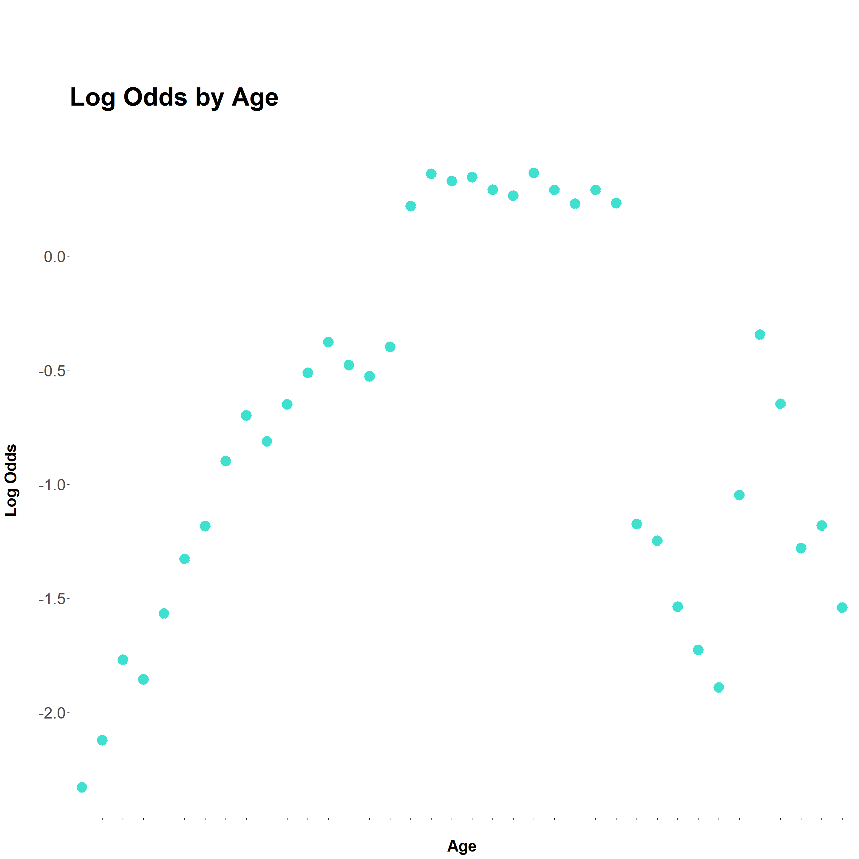
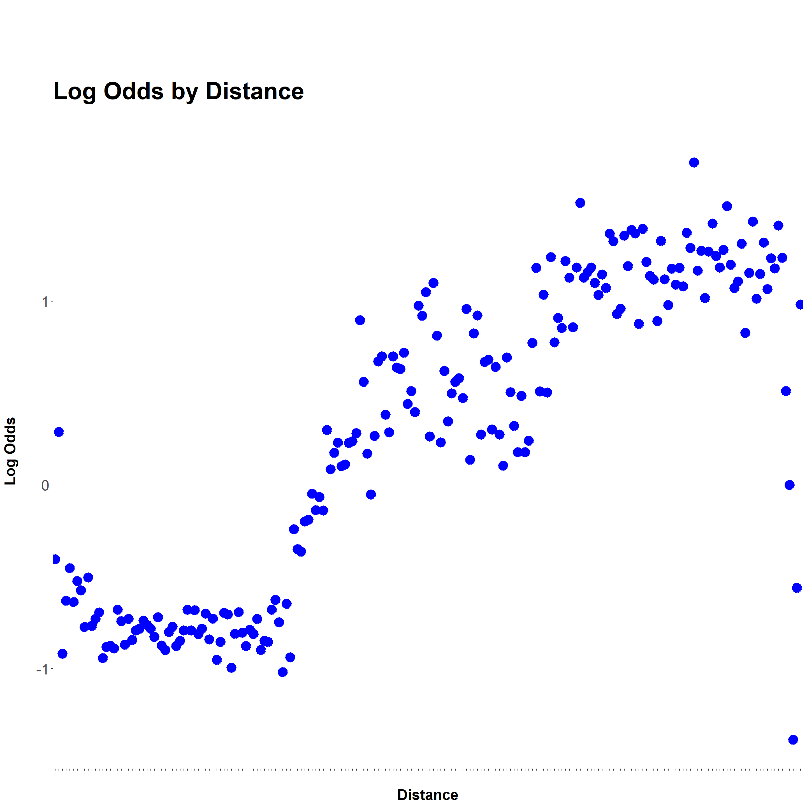
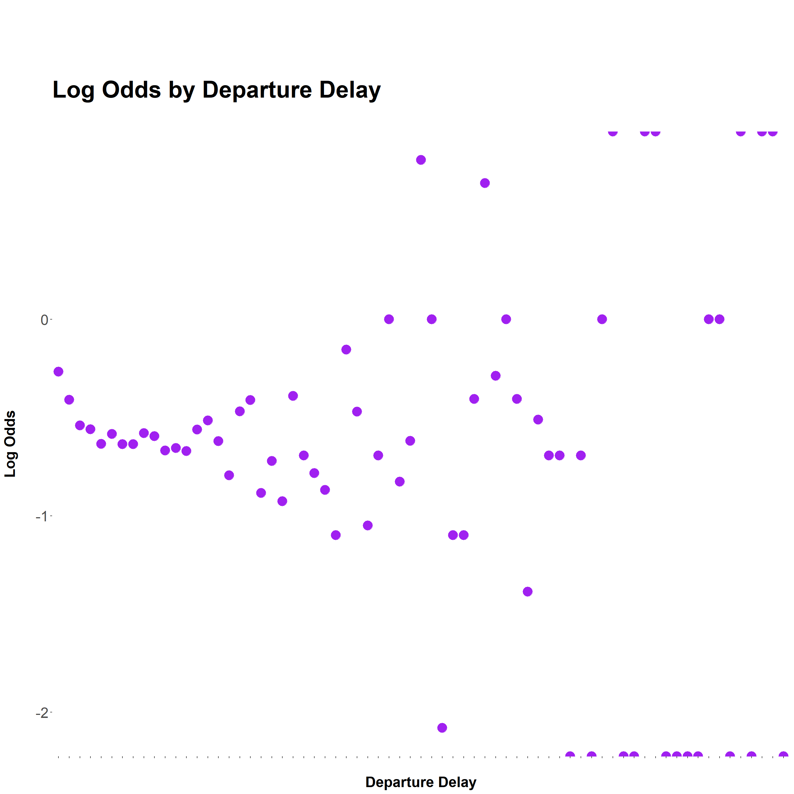
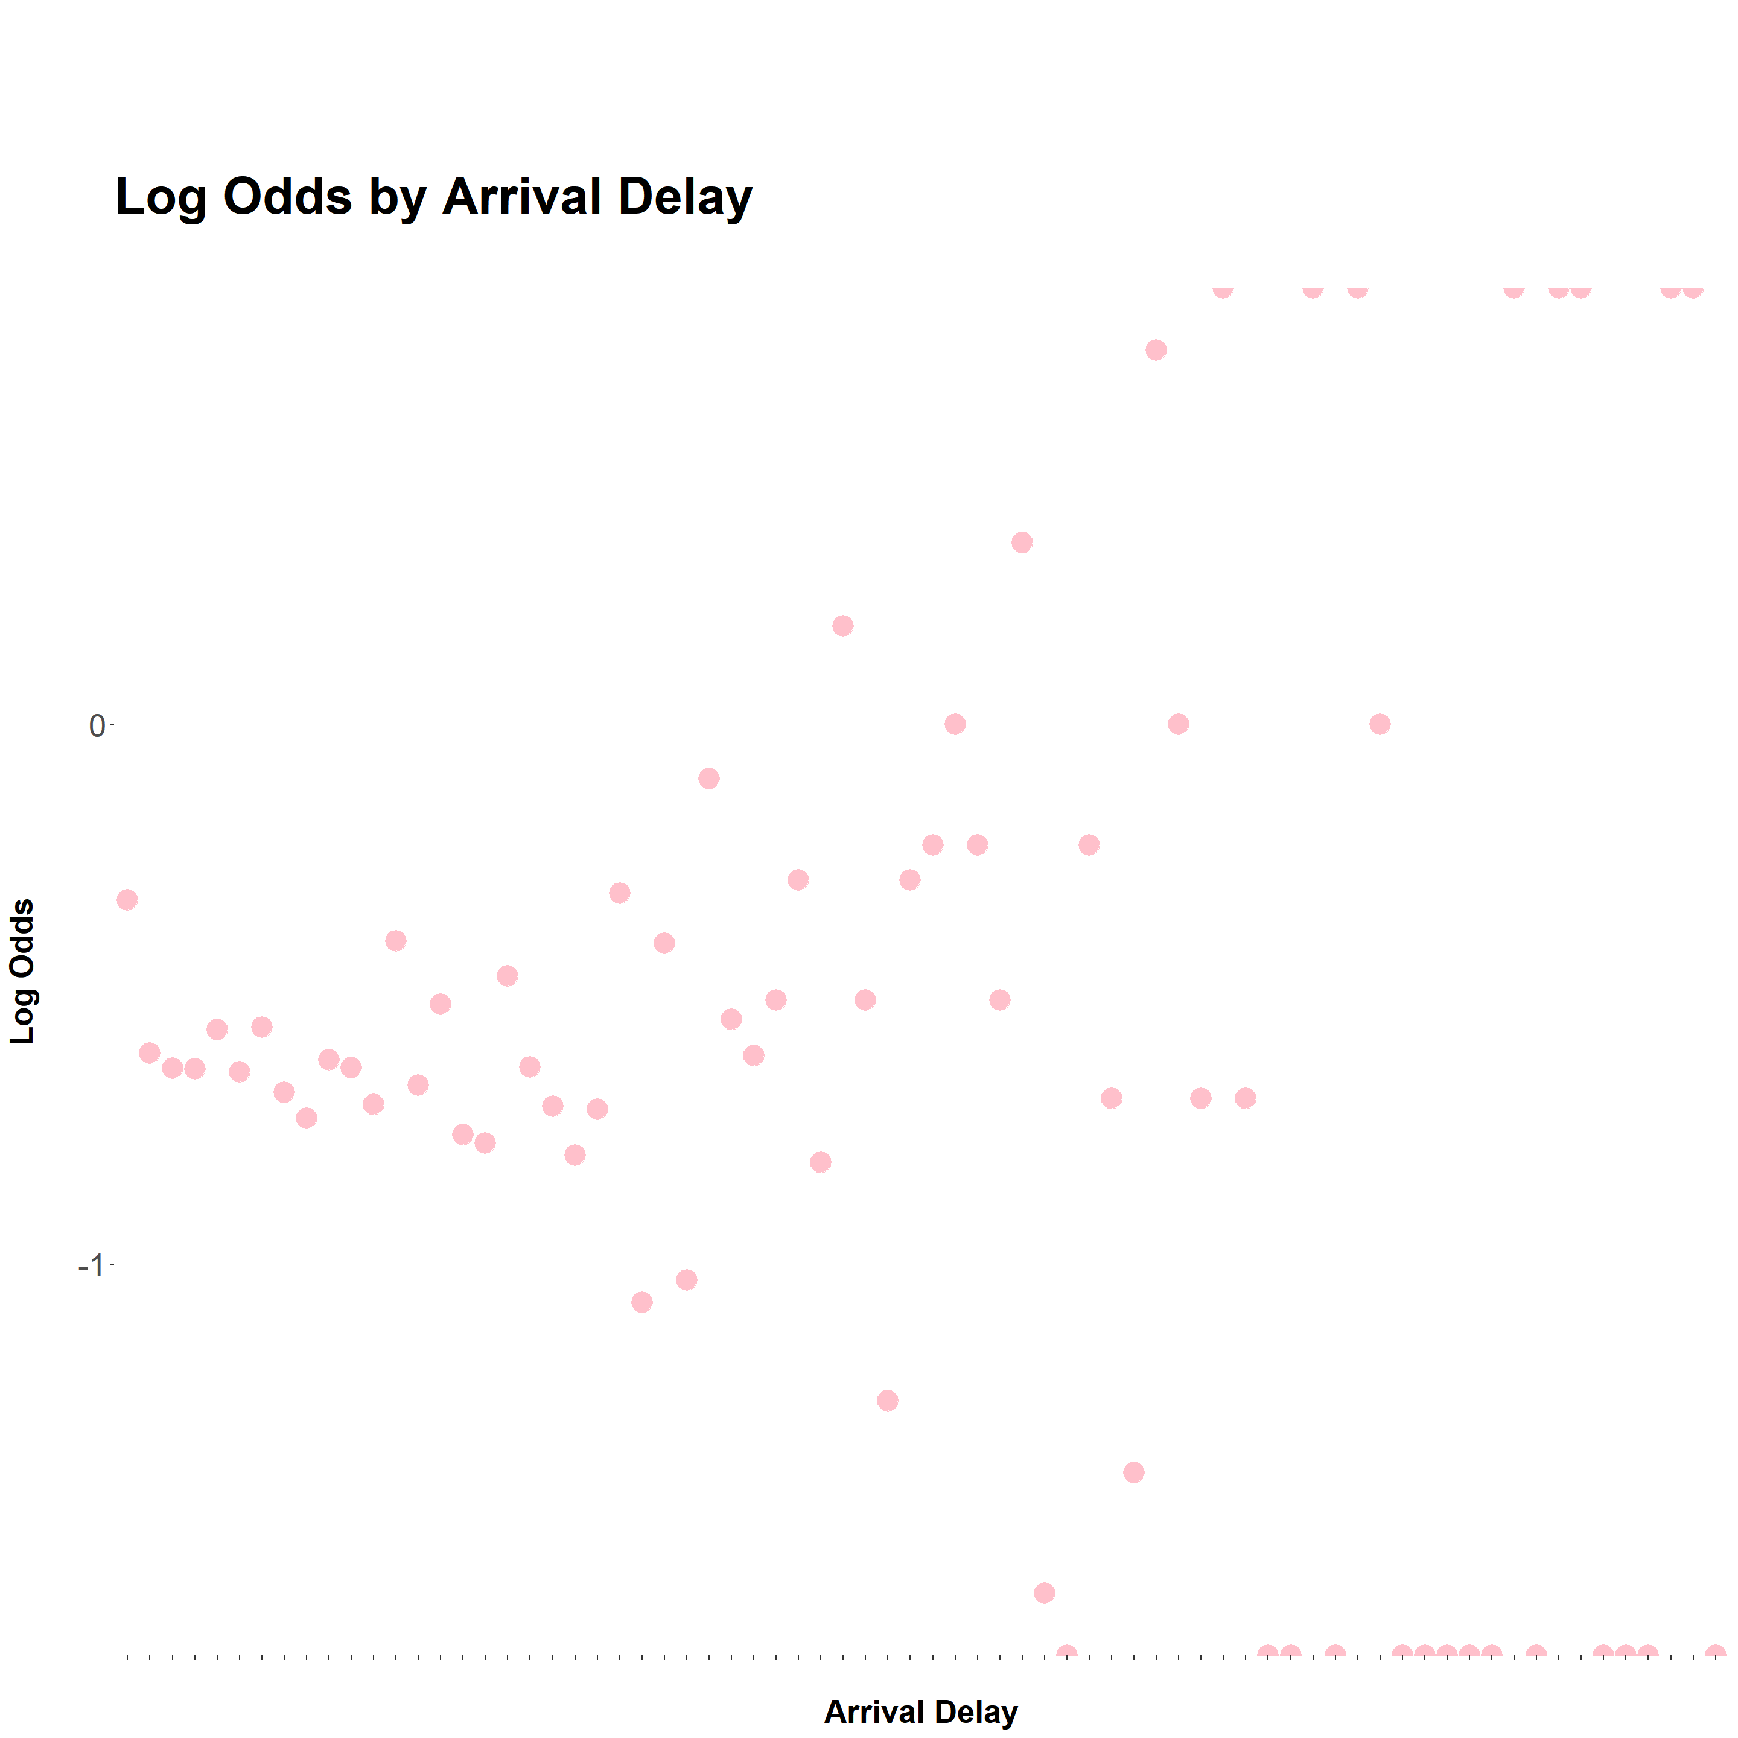
Testing Linearity with Log Odds (2/3)
Notes:
Only flight distance has a roughly linear relationship with log odds of satisfaction.
Age appears to have a parabolic relationship, peaking in the middle; aggressive transformations may be required to reach a linear relationship.
Log odds for both delay statistics quickly disperse in both directions as they increase, making it difficult to conclude with certainty that a linear relationship exists.

Slide 24
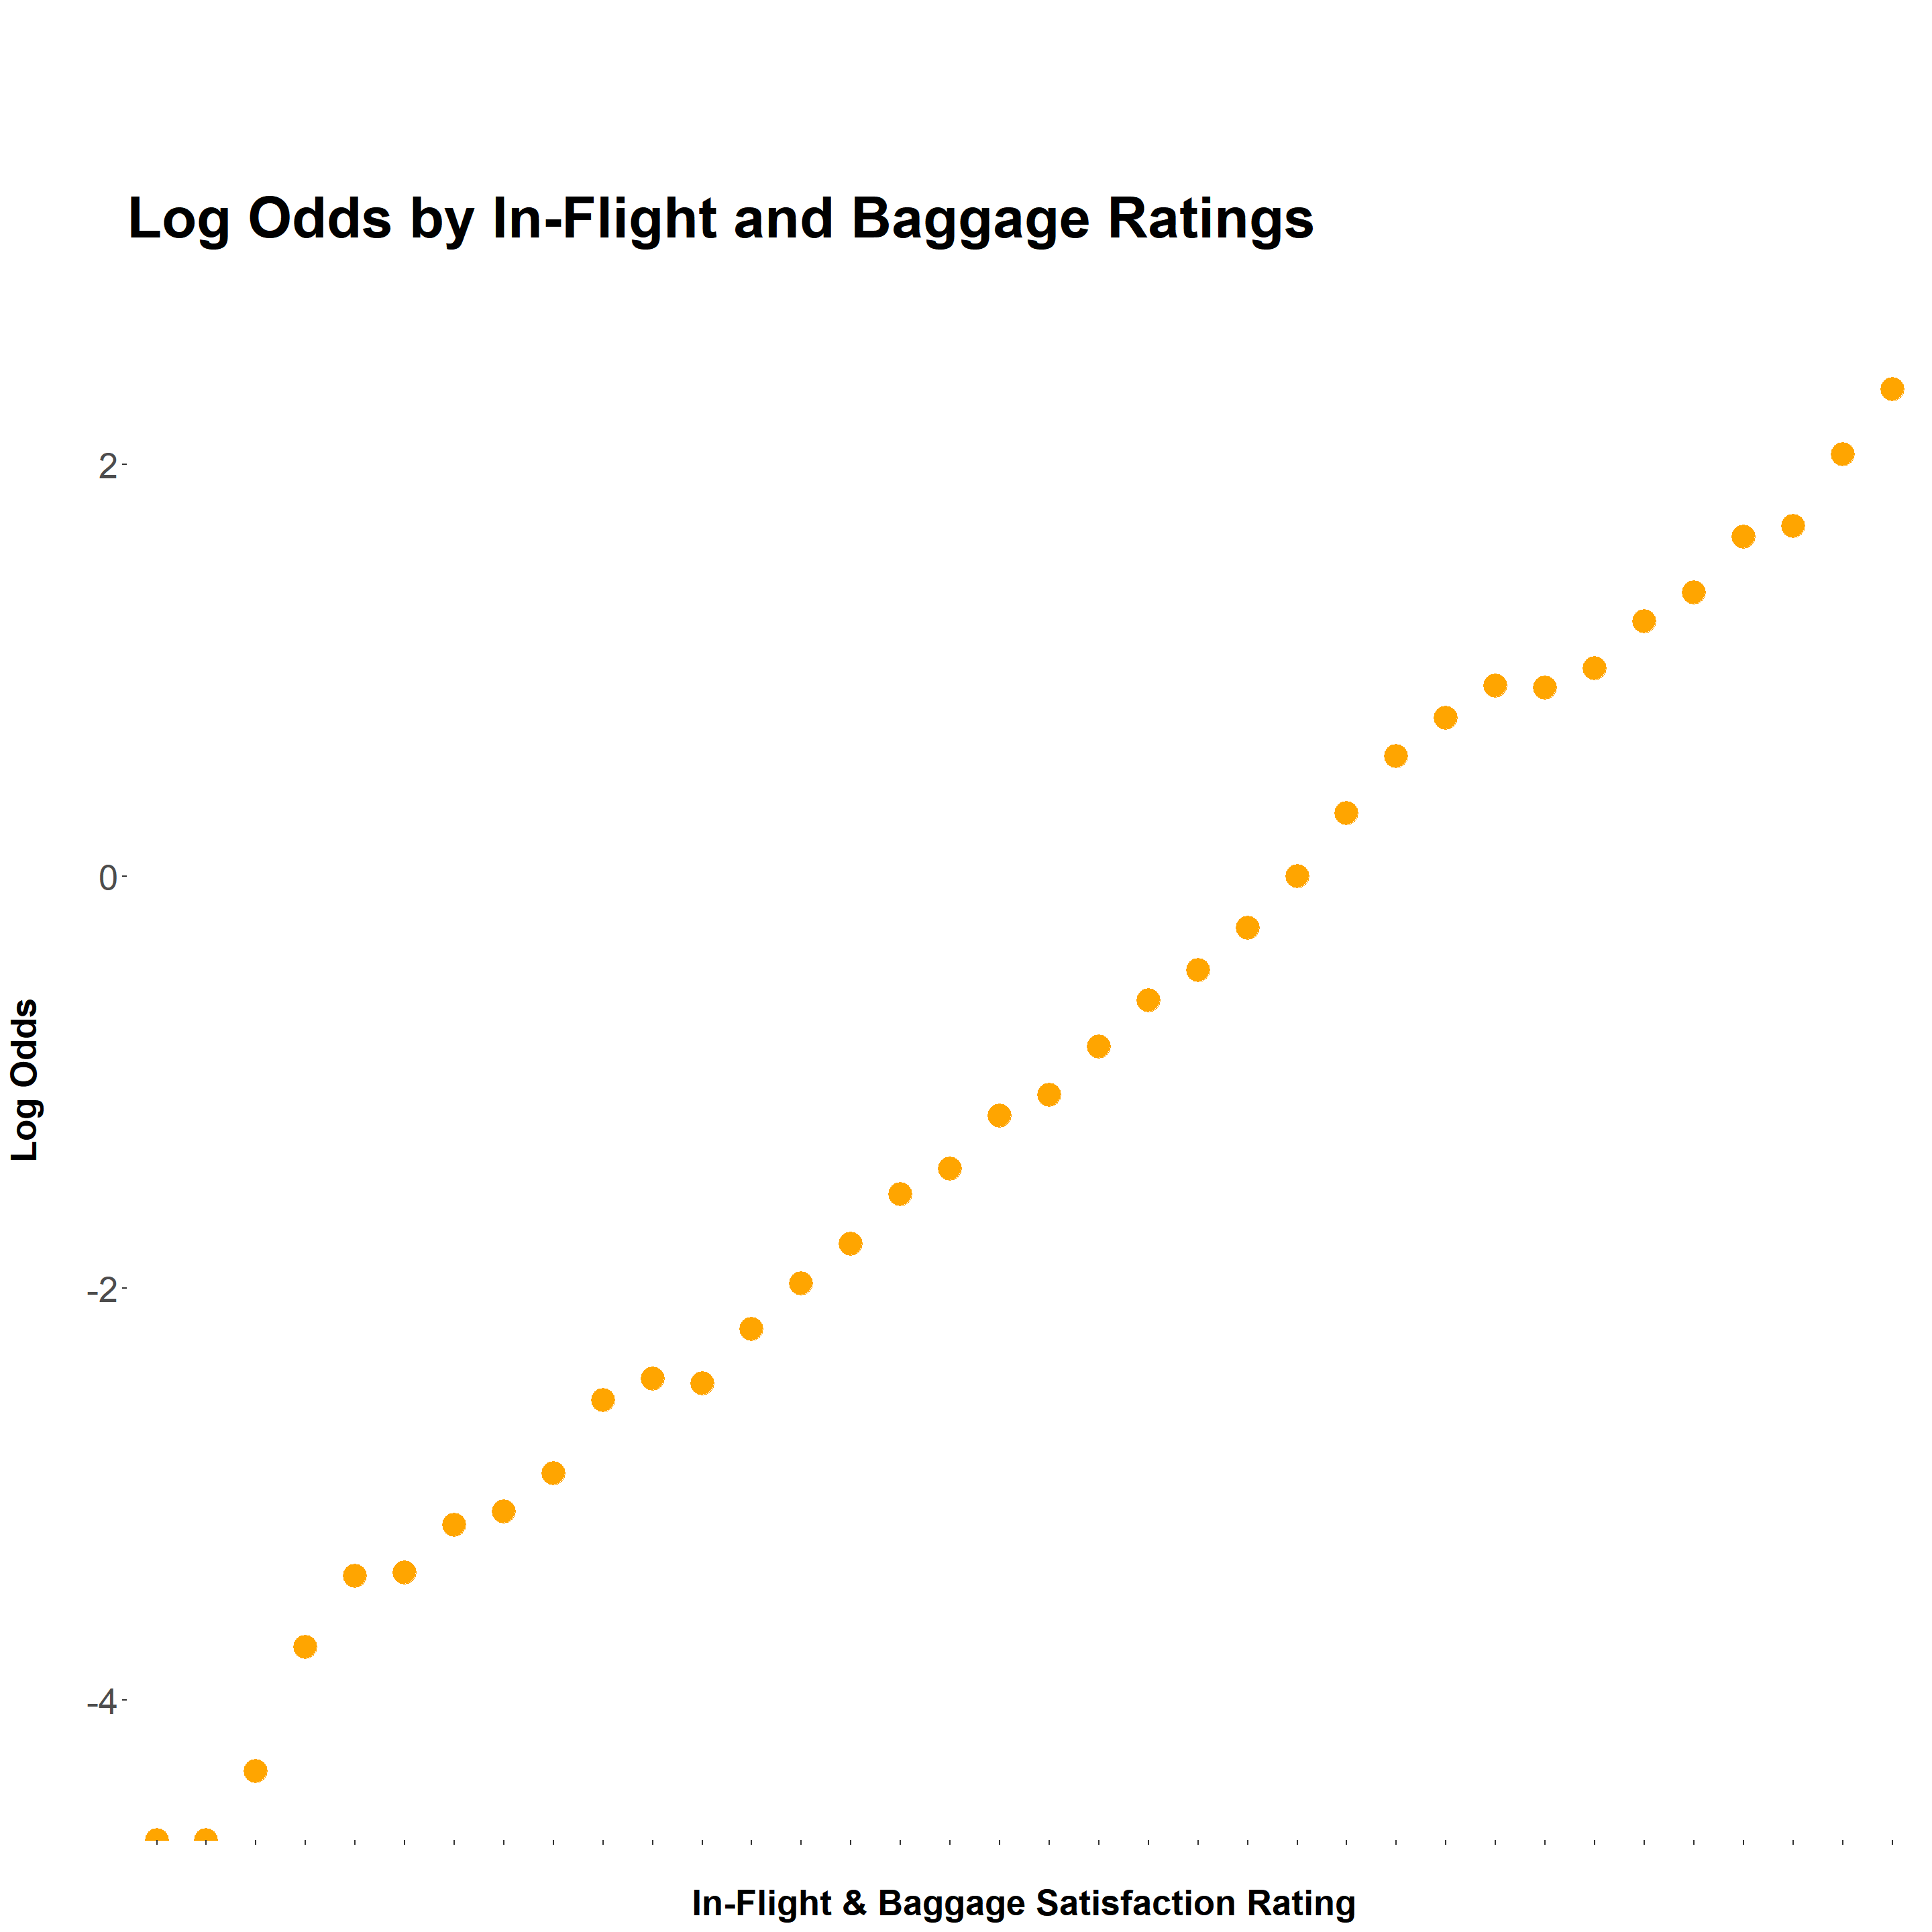
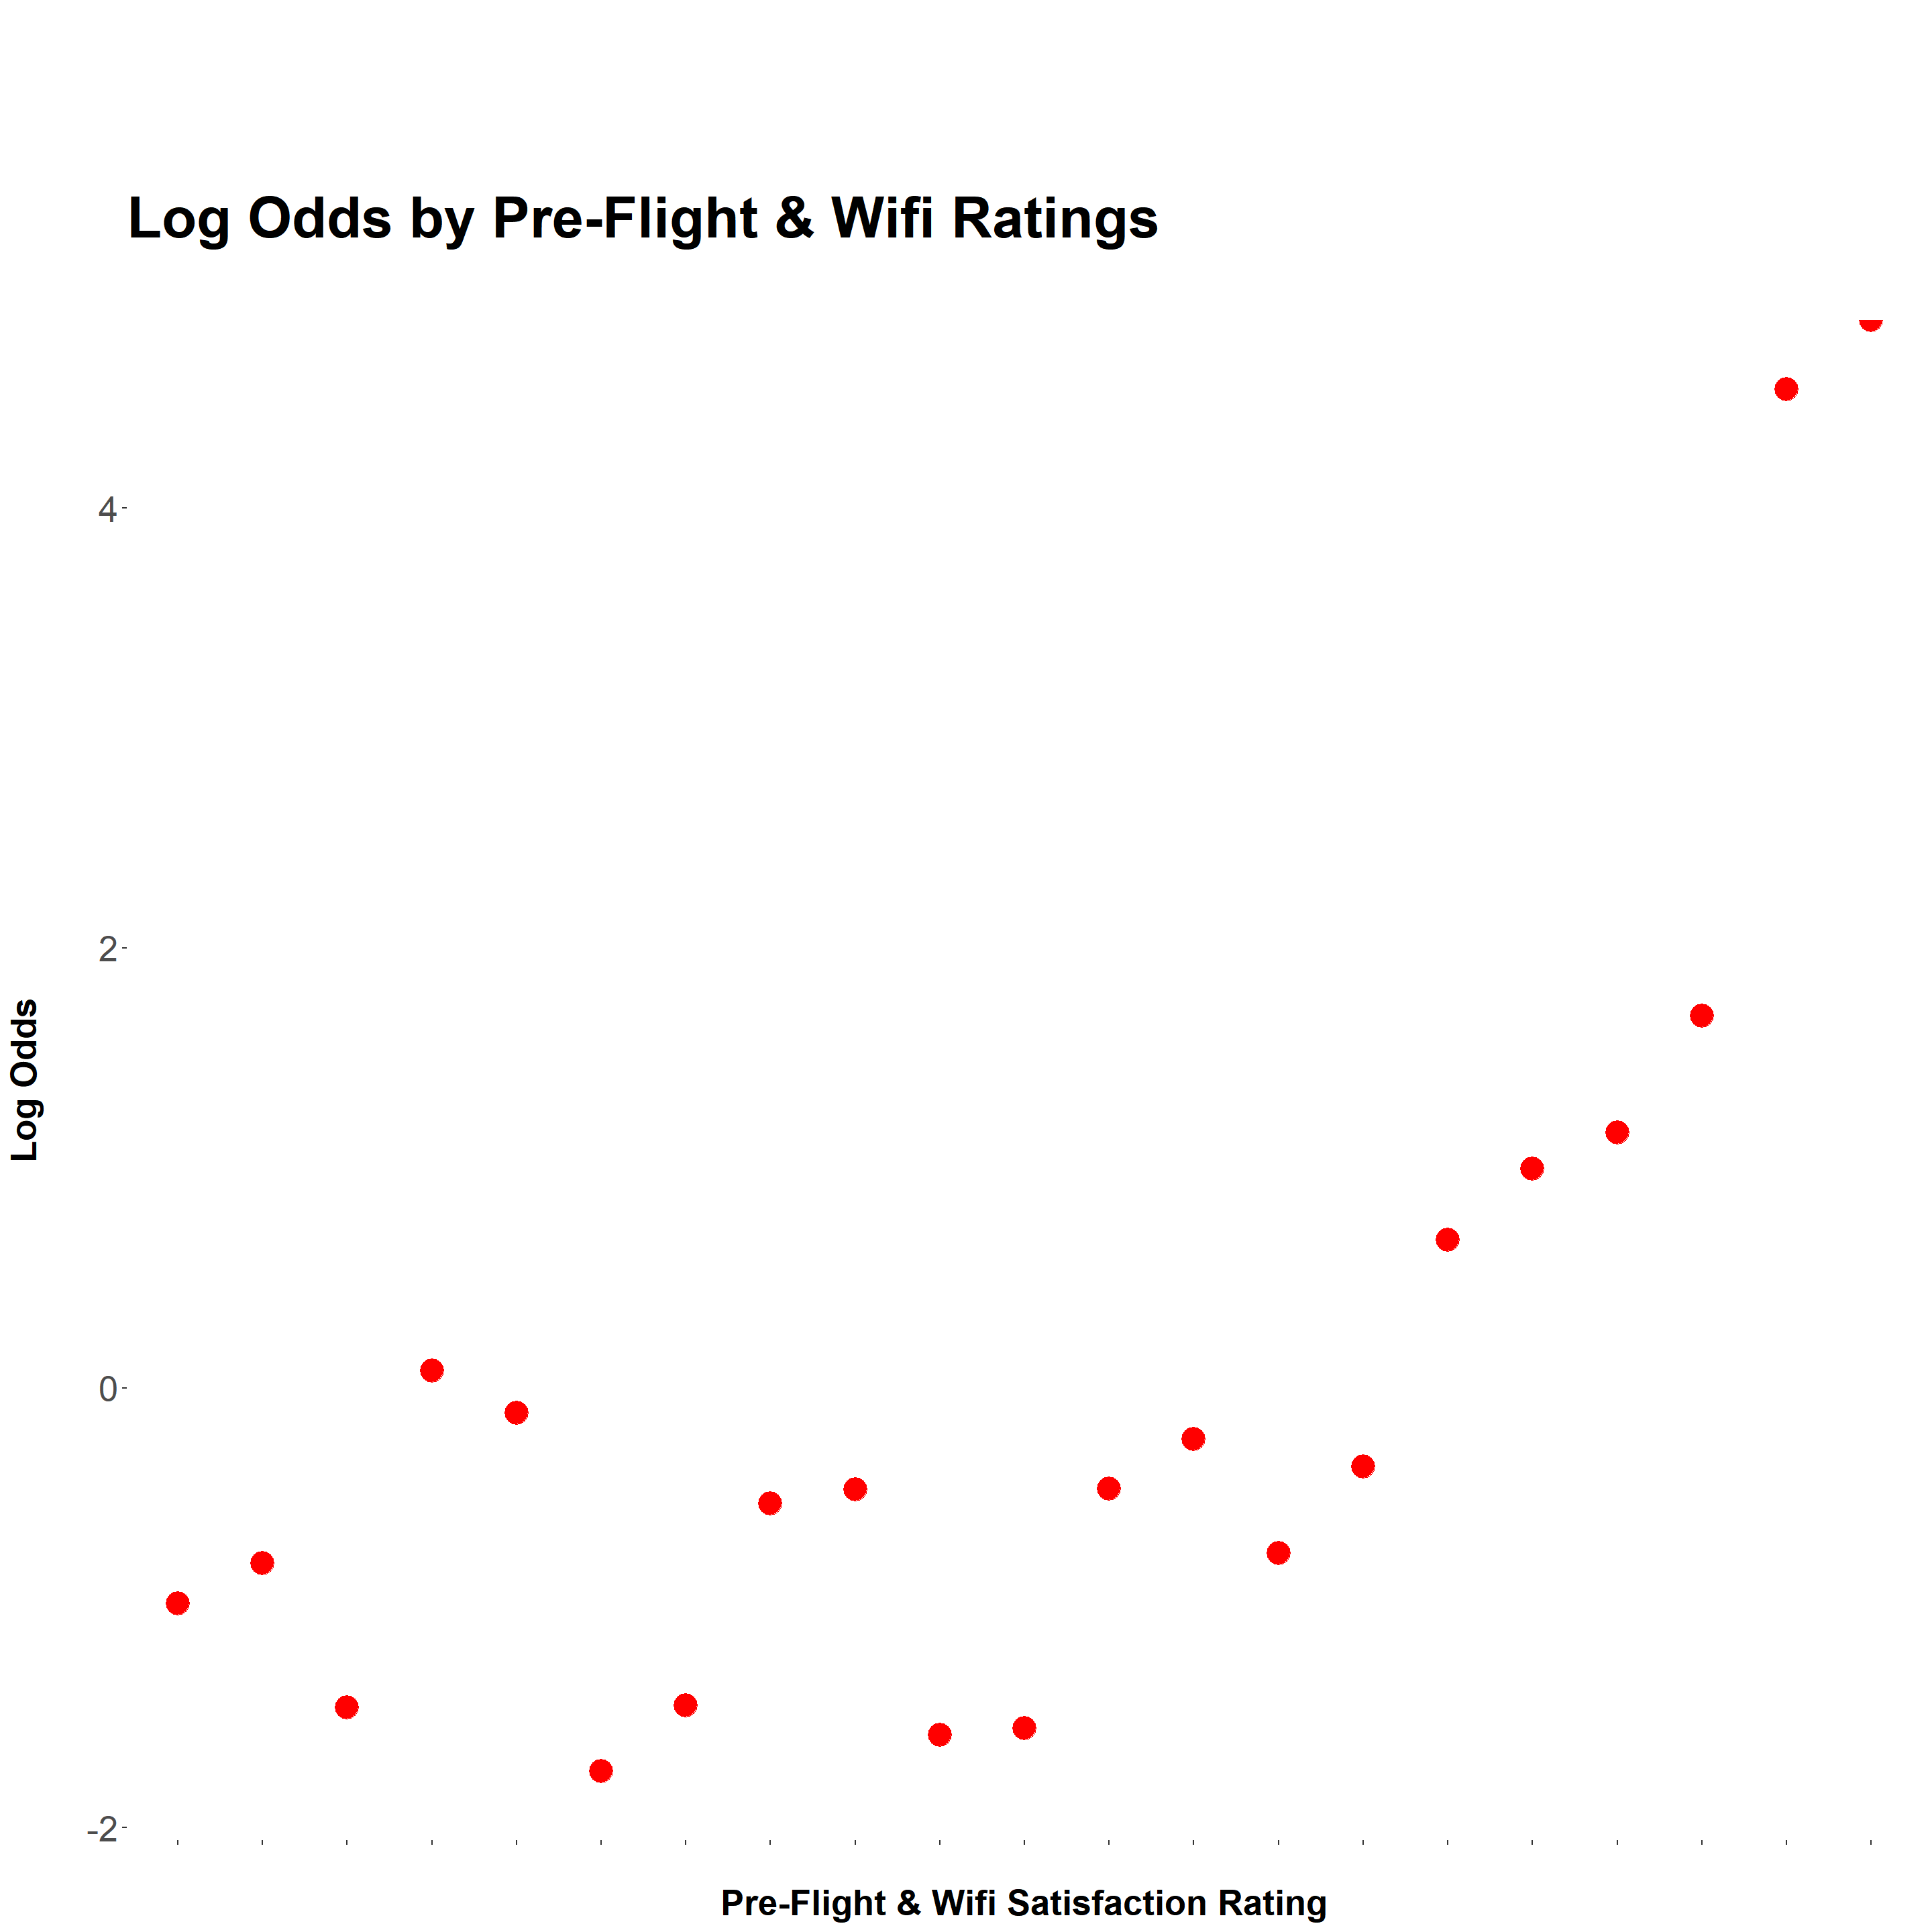
Testing Linearity with Log Odds (3/3)
Notes:
In-flight and baggage ratings have a strikingly linear relationship with log odds; meanwhile, pre-flight and wi-fi ratings appear to have a significantly looser connection.
We can conclude with confidence that the in-flight aggregate fulfills the linearity assumption, while the pre-flight ratings are far more obscure in that regard.

