Slide 1

Predicting Avocado Prices: Machine Learning with SVR, Linear Regression & Decision Trees
Unlocking market insights through predictive analytics.
Aradhya Mishra 23BIT0261
Parva Kothari 23BIT0053
Ansari Mohd. Umair 23BIT0292
Thiran Devesh 23BIT0340
Harsh Singh 23BIT0242

Slide 2




Why Predict Avocado Prices?
Market Volatility
Smarter Decisions
Rich Dataset
Avocado market volatility significantly impacts growers, retailers, and consumers. Prices can fluctuate wildly based on supply, demand, and external factors.
Accurate price forecasts enable smarter supply chain management, optimized pricing strategies, and better inventory planning.
A comprehensive Kaggle dataset offers rich historical sales, volume, and regional data, perfect for developing robust predictive models.

Slide 3

Understanding the Dataset
Key Data Points
- Source: Avocado Prices Dataset on Kaggle
- Features: Date, AveragePrice, Type (Conventional/Organic), Region, Volumes, Bags, PLU codes
- Target Variable: AveragePrice
- Records: ~18,000 (2015–2018)
Challenges Ahead
Missing values need imputation.
Categorical variables require encoding.
Time series nature demands specific modeling approaches.

Slide 4


Preprocess and clean the avocado dataset
Column Management
Time-Based Features
Convert categorical features (type, region) into numeric form.
month, seasonal sine/cosine encoding
Categorical Encoding
Normalization & Outliers
Ratios, PLU volumes, price momentum
Handled outliers and normalized volume features to ensure model stability and improve performance.

Slide 5
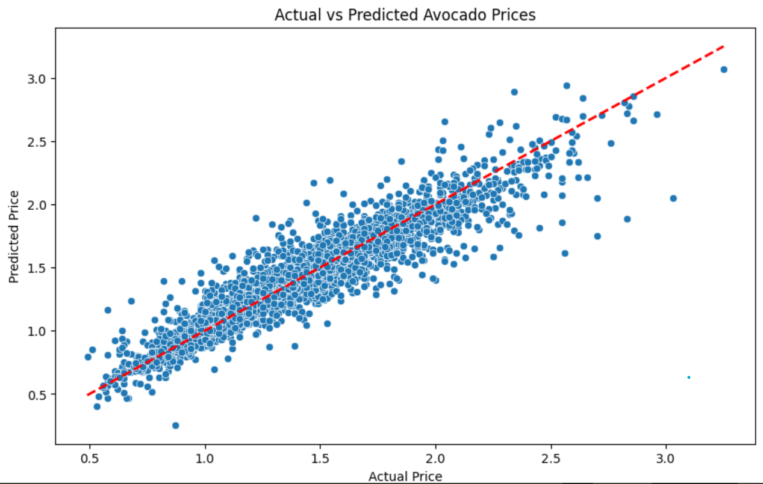
Model 1: Linear Regression (LR)
The Foundation
Our baseline model, Linear Regression, helps us understand the fundamental linear relationships within the data.
Strength: Simplicity and high interpretability, making it easy to understand initial trends.
Limitation: Struggles to capture complex non-linear price fluctuations and the inherent seasonality of avocado prices.

Slide 6
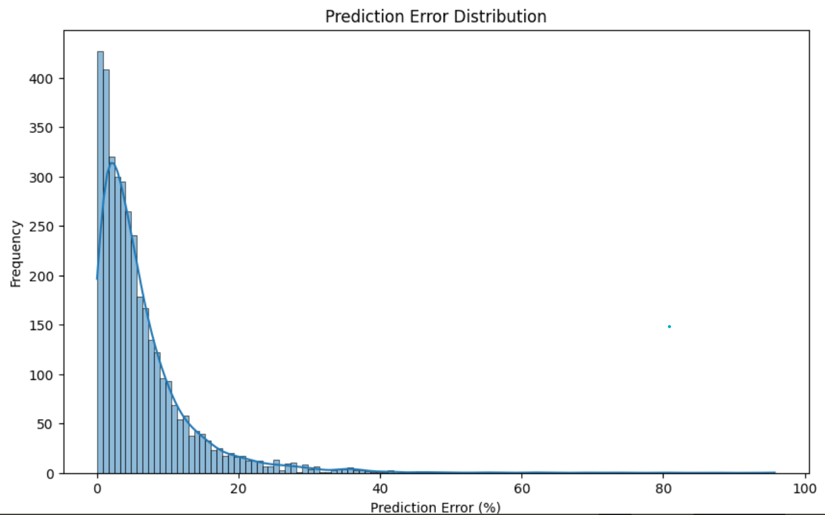
Model 2: Support Vector Regression (SVR)
Advanced Predictive Power
SVR leverages kernel functions to effectively capture intricate, non-linear patterns in the avocado price data.
Refined Tuning: Hyperparameters (C, epsilon, kernel) were optimized using grid search CV for superior accuracy.
Robustness: Offers better handling of outliers compared to Linear Regression, though it is more computationally intensive.
Captures non linear relationships.

Slide 7
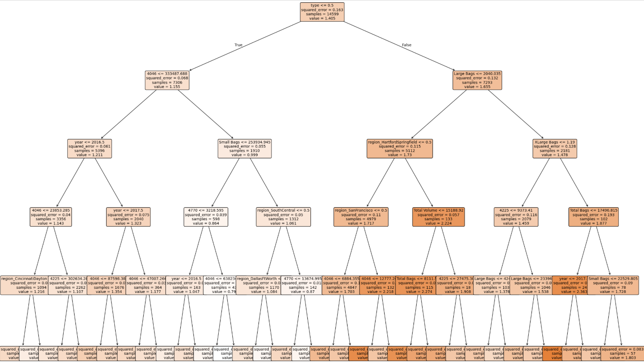
Model 3: Decision Tree Regressor
Insightful Segmentation
This tree-based model excels at capturing non-linearities and identifying important feature interactions within the dataset.
Interpretability: Easy to understand with visualizable decision paths, offering clear insights into price drivers.
Consideration: Carries a risk of overfitting if not properly pruned or if its maximum depth is not carefully controlled.

Slide 8
Model Performance Comparison
Model
RMSE
MAE
Adjusted R² Score (Real)
Linear Regression
0.138
0.0954
0.8786 (0.8807)
Support Vector Regression 0.1336
0.0874
0.8870 (0.8889)
Decision Tree
0.2035
0.1375
0.7375 (0.7421)
The Support Vector Regressor (SVR) delivered the best accuracy, successfully balancing bias and variance in its predictions. The Decision Tree followed closely, offering excellent interpretability alongside strong performance. Linear Regression provided a valuable and understandable baseline.

Slide 9

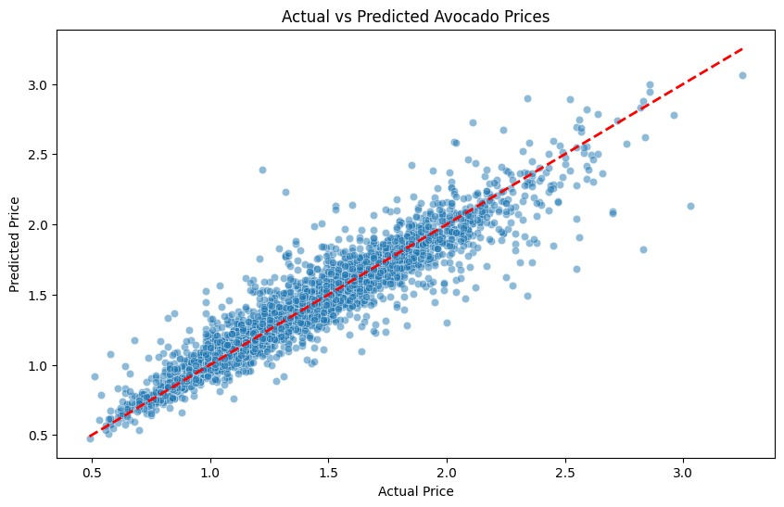
Visualizing Predictions vs Actual Prices
Our visualizations confirm that SVR is particularly effective at capturing seasonal price spikes. The Decision Tree, meanwhile, provides clear insights into how specific volume and regional factors influence avocado prices, showcasing its interpretability.

Slide 10
Conclusion & Next Steps
SVR: Our Top Performer
Actionable Insights
Future Enhancements
The Support Vector Regressor (SVR) emerged as the most effective model for avocado price prediction on this dataset.
These predictive insights empower growers and retailers to proactively anticipate price trends, optimizing their strategies.
Preprocessing & feature engineering significantly improved predictions

