Slide 1
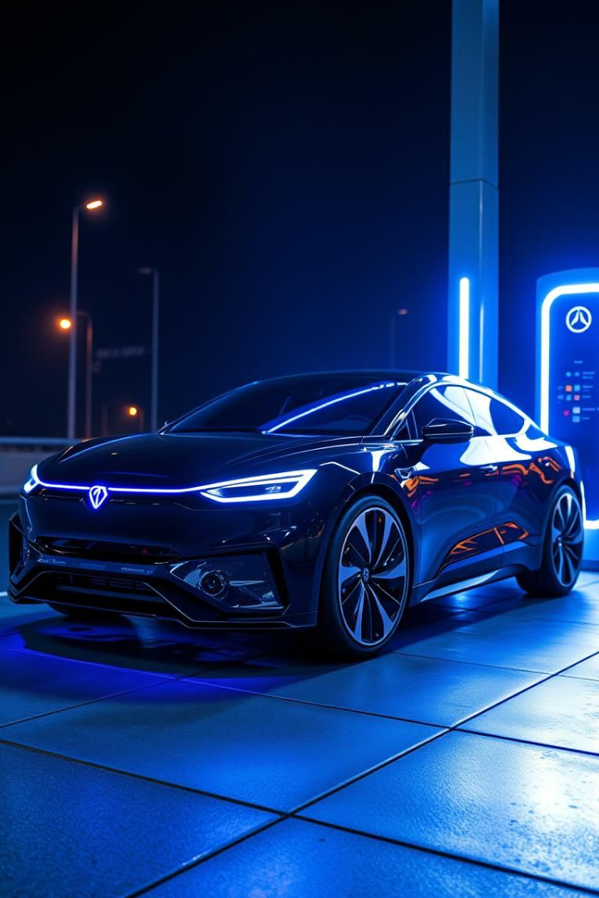
Powering the Future: Batteries for Electric Vehicles
Electric vehicles are rapidly transforming the automotive landscape. Batteries play a crucial role in this transition. The global EV market is expected to grow at a rate of 40% annually through 2030. Meeting this demand will require massive investments in battery production.

Slide 2




Factors Affecting Battery Life and Range
Temperature
Driving Habits
Extreme temps reduce performance. Optimal: 15-35°C (59-95°F).
Aggressive driving reduces range. Smooth driving improves efficiency.
1
2
Battery Management System (BMS)
4
3
State of Charge (SoC)
Optimal SoC extends life. Avoid 100% or 0% regularly.
Monitors and optimizes battery performance to prevent issues.

Slide 3




Technologies Behind This Model
Python
EV Dataset
Primary programming language for bot development.
Real Time EV dataset including various factors .
Prediction model
A prediction model that intake various factors and predict the range.

Slide 4
Problem statement
Data Inputs
Takes input from the user about their specifications of Ev cars.
Federated Learning
Transfer Learning
Collaborative model training without data sharing.
Adapting pre-trained models to new EMS applications.
Collect and calculates the data
Collect .
Robust and Secure ML
Reliable EMS operation in the presence of attacks.

Slide 5





System Architecture
Data Acquisition
Fetch real-time data from the dataset and take the input of the variables.
Data Pre-processing Layer
Analyze the variables and processing it for further prediction.
Prediction layer
Prediction layer predict the range accurately.
Decision layer
After predicting the model reaches a fix decision.
Output
Output the decision and prediction with all the variables.

Slide 6
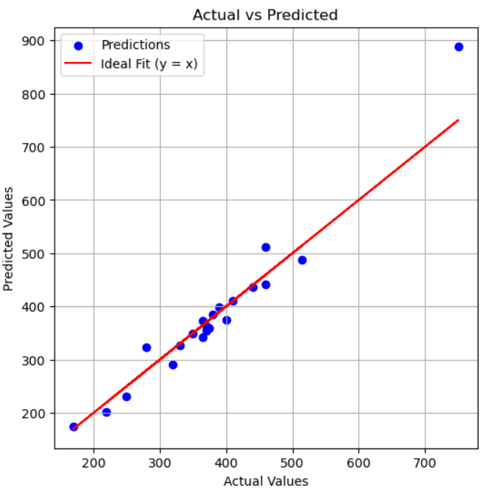
Methodology for range prediction
Model selection
Explore regression models and made a comparison with every aspect of the BMS
Predictive Modeling
Simple INT based prediction model.

Slide 7




Execution Strategy
Data Acquisition
1
Dataset includes vehicle related information
Comparison and predication
2
The data is than being compared and with a regression model predict the range
Accuracy
3
Range prediction is reliable and accurate
Notes:
6

Slide 8


Performance Metrics
89%
2s
Low
Accuracy
Order Execution Speed
Risk
Based on testing
Via compiling
Accurately predict with low risk
Notes:
9

Slide 9
Results & Implications
Improved Prediction Accuracy
Improved Energy Efficiency
Benefits for customers
Regression models show accuracy compared to other traditional methods.
Regression models improves EMS performance. Major gaps exist in data, interpretability, scalability, and security.
Prediction model improves the customer Information on range and helps to avoid range related problems.

Slide 10






Research Gaps
Data Availability & Quality
Dynamic Environmental Factors
Driver Behavior
Analysis
Integration with Grid Management
Scalability and
Adaptability
Limited high-resolution EV charging data is a key gap. Also, complex models lack interpretability. Integration with grid systems is also limited.

Slide 11


Conclusion & Future Enhancements
Enhanced Fault Detection
Sensor redundancy and anomaly detection.
External factors processing
Many dynamic factors like environmental and driving patterns to predict range will be added
Smart grid integration using ML
Using ML-based model to integrate smart grid with improved accuracy.
This project creates an prediction model predicting the range for EV vehicles with high Accuracy. Future enhancements include integration with ML-based models and enhance grid system which will even predict the fastest and convenient route with improved scalability and accuracy.
Notes:
10

