Slide 1

Divide and Conquer Algorithm Comparison with Different Branching Factors
Technical Presentation
Presented by:
Parvatha Reddy Greeshma
Register No: 192424418
CSA0620: Design and Analysis of Algorithms

Slide 2


INTRODUCTION
DIVIDE AND CONQUER
Divide and Conquer is an algorithm design technique where a problem is solved by dividing it into smaller subproblems, solving them recursively, and combining the results.
STEPS
Divide the problem into smaller subproblems.
Solve each subproblem recursively.
Combine the solutions to obtain the final answer.
Examples
Merge Sort
Quick Sort
Binary Search
Strassen Matrix Multiplication.

Slide 3
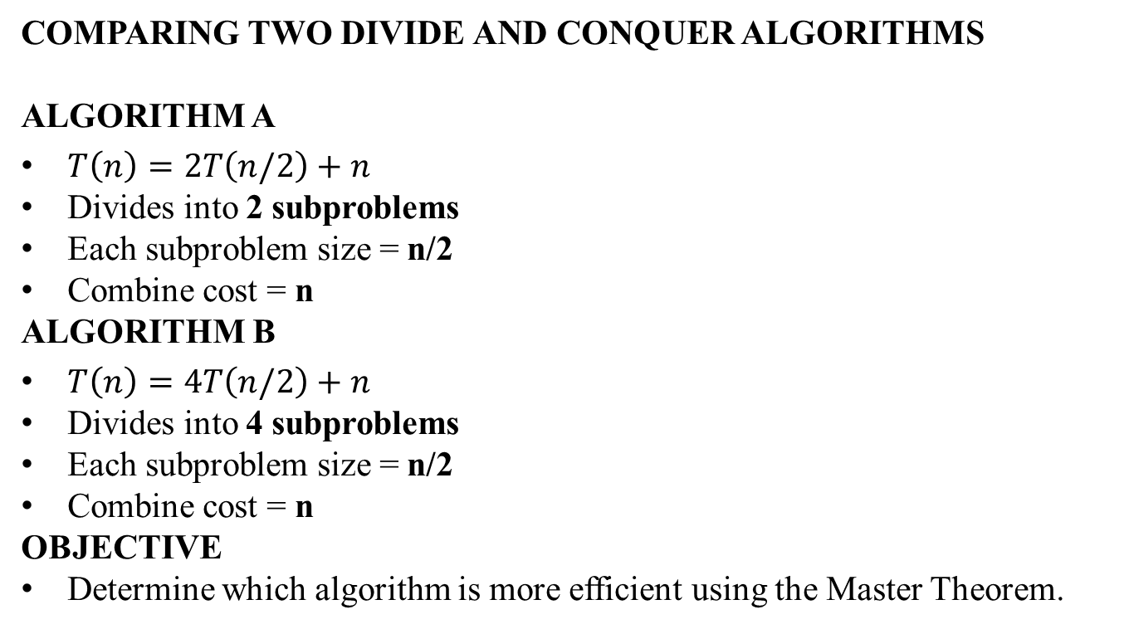
PROBLEM STATEMENT
COMPARING TWO DIVIDE AND CONQUER ALGORITHMS
ALGORITHM A
$T\left(n\right)=2T\left(n/2\right)+n$
Divides into 2 subproblems
Each subproblem size = n/2
Combine cost = n
ALGORITHM B
$T\left(n\right)=4T\left(n/2\right)+n$
Divides into 4 subproblems
Each subproblem size = n/2
Combine cost = n
OBJECTIVE
Determine which algorithm is more efficient using the Master Theorem.

Slide 4
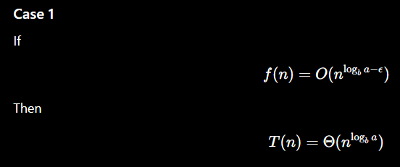
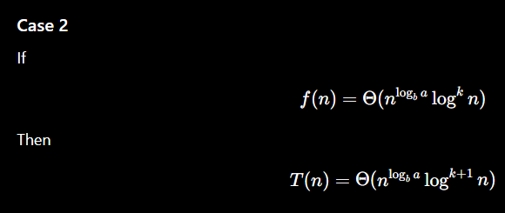
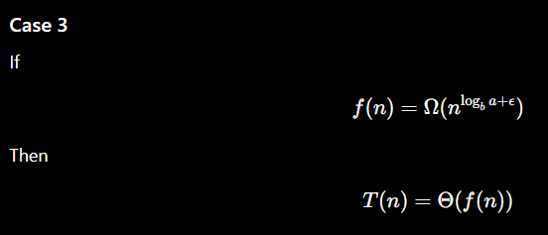

MASTER THEOREM
General Form
$$T\left(n\right)=aT\left(n/b\right)+f\left(n\right)$$
Where
a = number of recursive calls
b = division factor
f(n) = work done outside recursion

Slide 5
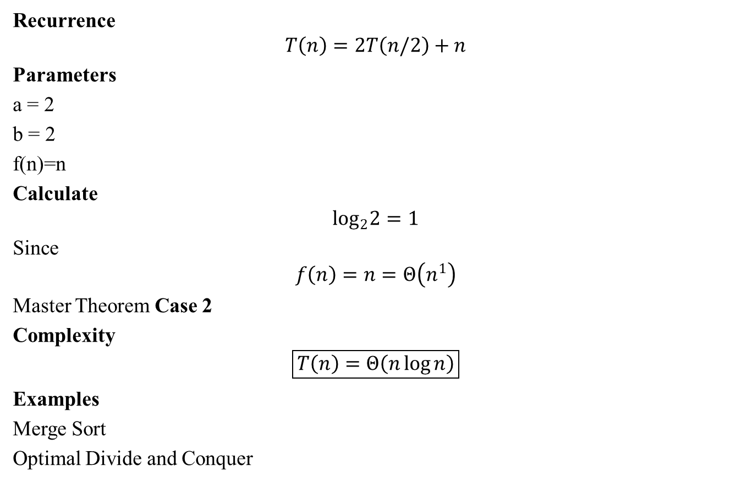
ANALYSIS OF ALGORITHM A
Recurrence
$$T\left(n\right)=2T\left(n/2\right)+n$$
Parameters
a = 2
b = 2
f(n)=n
Calculate
$$\log_{2}2=1$$
Since
$$f\left(n\right)=n=Θ\left(n^{1}\right)$$
Master Theorem Case 2
Complexity
$$\boxed{T\left(n\right)=Θ\left(n\log{n}\right)}$$
Examples
Merge Sort
Optimal Divide and Conquer

Slide 6

ANALYSIS OF ALGORITHM B
Recurrence
$$T\left(n\right)=4T\left(n/2\right)+n$$
Parameters
a = 4
b = 2
f(n)=n
Calculate
$$\log_{2}4=2$$
Since
$$n=O\left(n^{2−ε}\right)$$
Master Theorem Case 1
Complexity
$$\boxed{T\left(n\right)=Θ\left(n^{2}\right)}$$

Slide 7
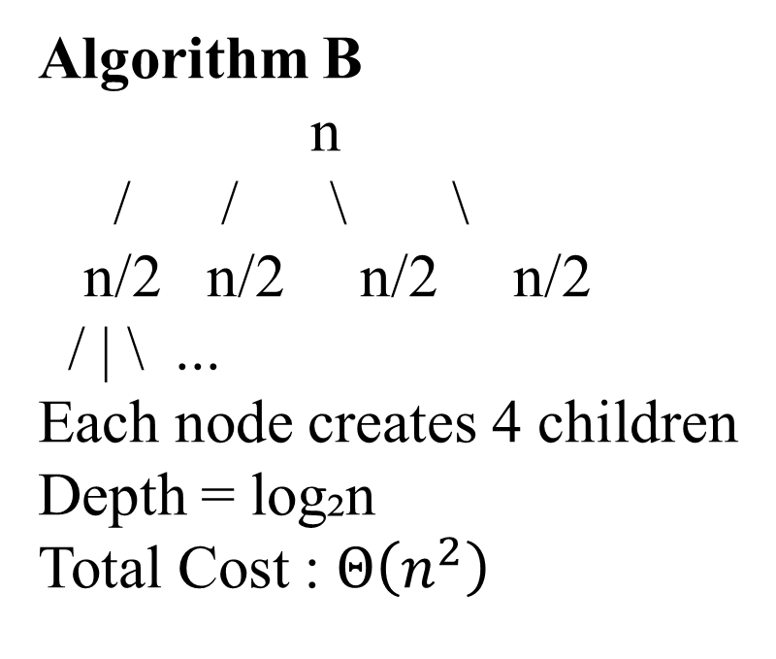
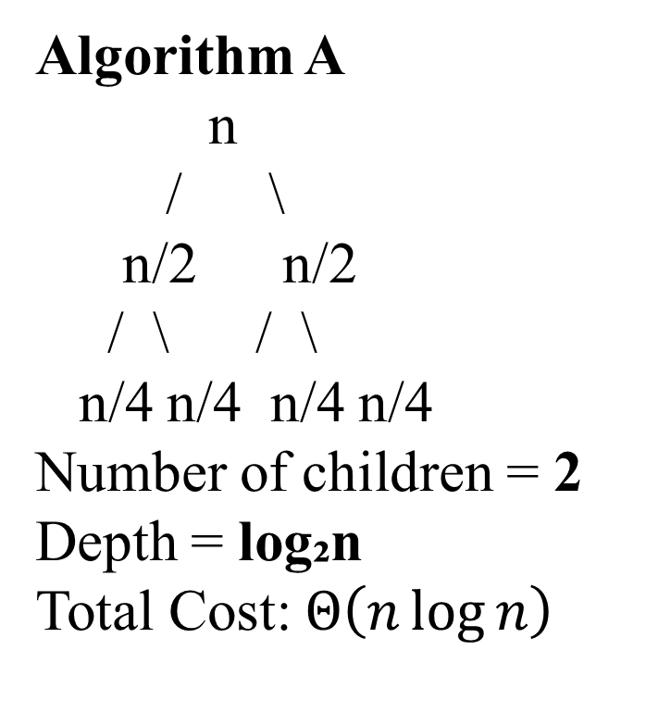
RECURSIVE STRUCTURES
Algorithm A
n
/ \
n/2 n/2
/ \ / \
n/4 n/4 n/4 n/4
Number of children = 2
Depth = log₂n
Total Cost: $Θ\left(n\log{n}\right)$
Algorithm B
n
/ / \ \
n/2 n/2 n/2 n/2
/ | \ ...
Each node creates 4 children
Depth = log₂n
Total Cost : $Θ\left(n^{2}\right)$

Slide 8
COMPARISON
Feature | Algorithm A | Algorithm B
Recurrence | T(n)=2T(n/2)+n | T(n)=4T(n/2)+n
Recursive Calls | 2 | 4
Divide Size | n/2 | n/2
Combine Cost | n | n
logb(a) | 1 | 2
Master Theorem | Case 2 | Case 1
Time Complexity | Θ(n log n) | Θ(n²)
Efficiency | Better | Less Efficient

Slide 9
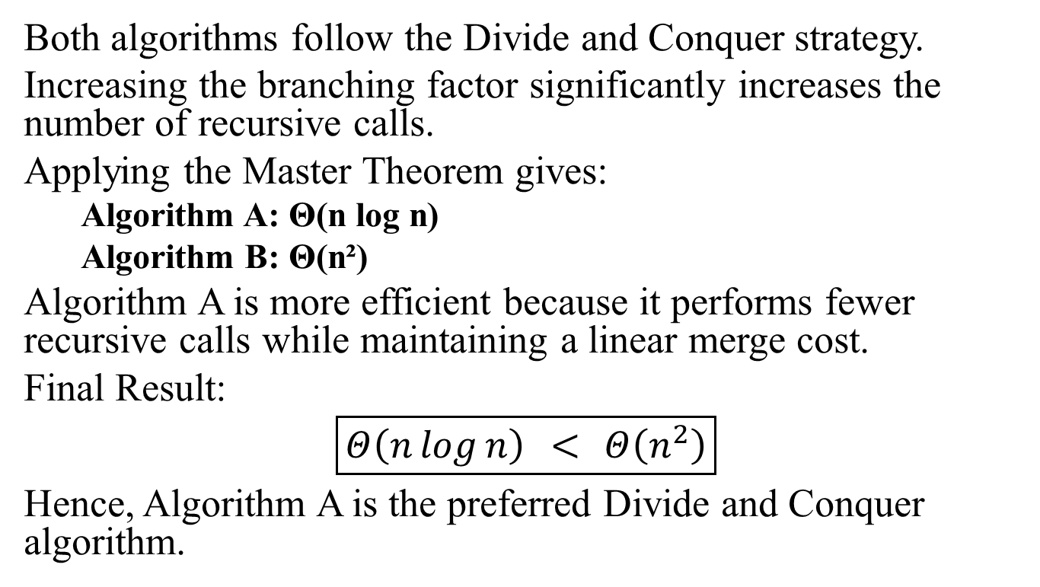
CONCLUSION
Both algorithms follow the Divide and Conquer strategy.
Increasing the branching factor significantly increases the number of recursive calls.
Applying the Master Theorem gives:
Algorithm A: Θ(n log n)
Algorithm B: Θ(n²)
Algorithm A is more efficient because it performs fewer recursive calls while maintaining a linear merge cost.
Final Result:
$$\boxed{Θ\left(n\log{n}\right) < Θ\left(n^{2}\right)}$$
Hence, Algorithm A is the preferred Divide and Conquer algorithm.

Slide 10
THANK YOU!

