Slide 1
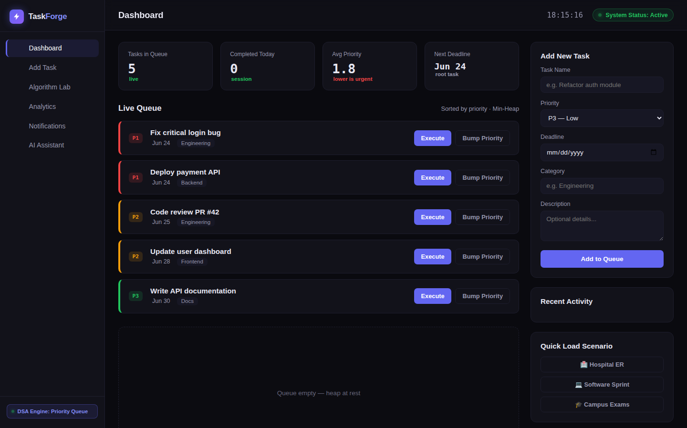
⚡
TaskForge
Intelligent
Task Scheduling
Engine
A real Min-Heap Priority Queue — made visual, interactive, and AI-powered.
Min-Heap DSA
AI Assistant
Live Visualizer
Algorithm Lab
DSA Mini-Project · Java · Web Prototype
Live prototype
Notes:
TaskForge is a single-file web app demonstrating Min-Heap Priority Queue DSA visually. Right side shows the actual running prototype.

Slide 2
Problem Statement
02
❌
No Visual DSA Schedulers are black-box. Students can't see the heap restructure in real-time.
O(n)
FIFO worst-case
for critical task
❌
FIFO Bottleneck A P1 critical bug waits behind 10 P3 low-priority tasks added earlier.
O(log n)
❌
Starvation Risk Low-priority tasks ignored forever with no automatic promotion.
Priority Queue
extract time
∞
❌
No Algorithm Comparison No easy way to see why Priority Queue beats FIFO or Round-Robin.
Starvation without
auto-aging
Notes:
Four core problems that motivated TaskForge. Right side shows the algorithmic complexity contrast.

Slide 3
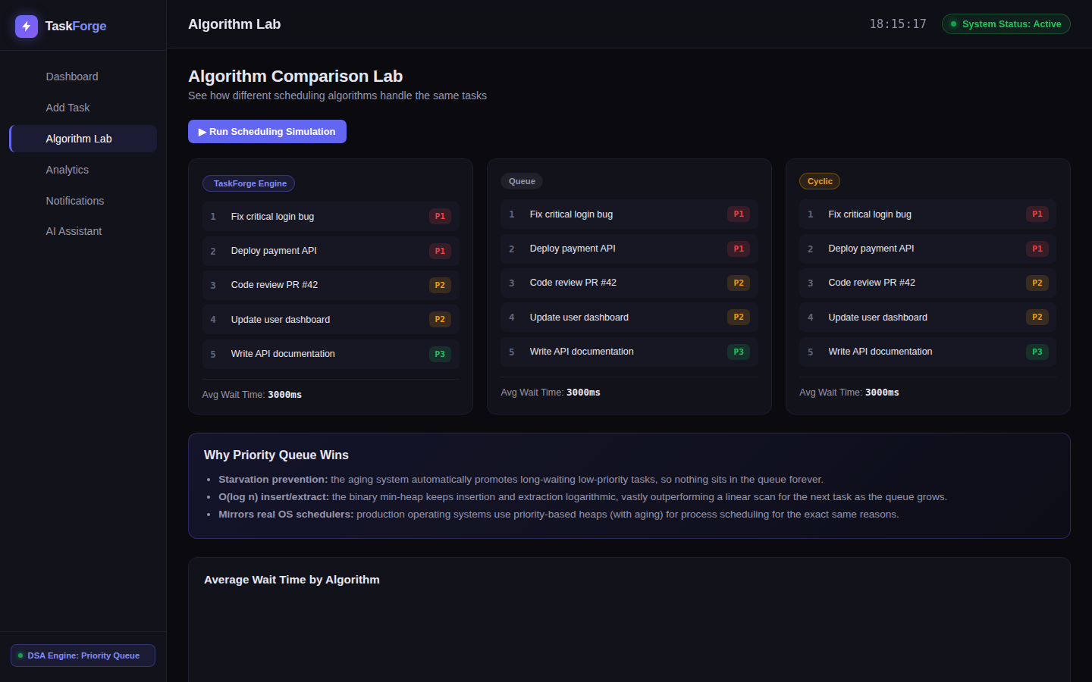
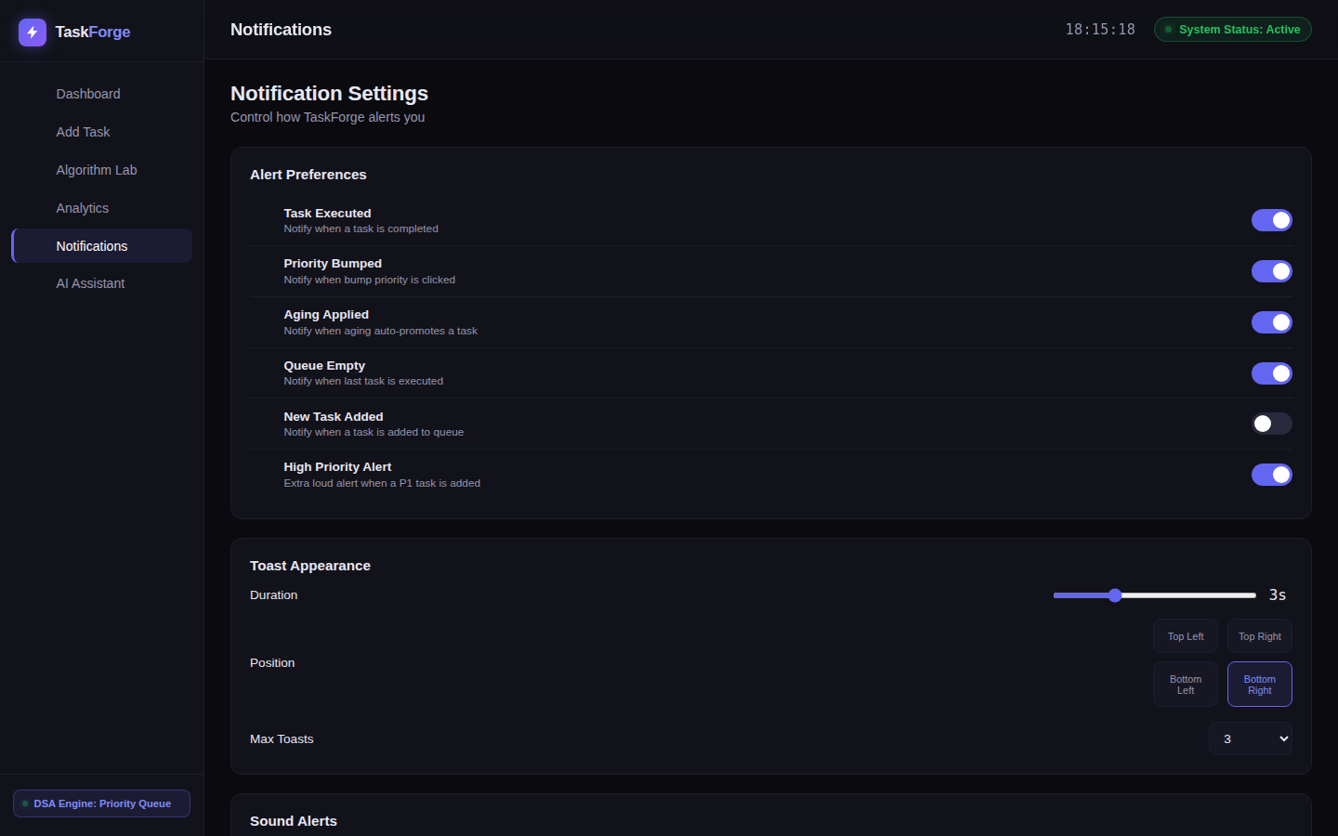
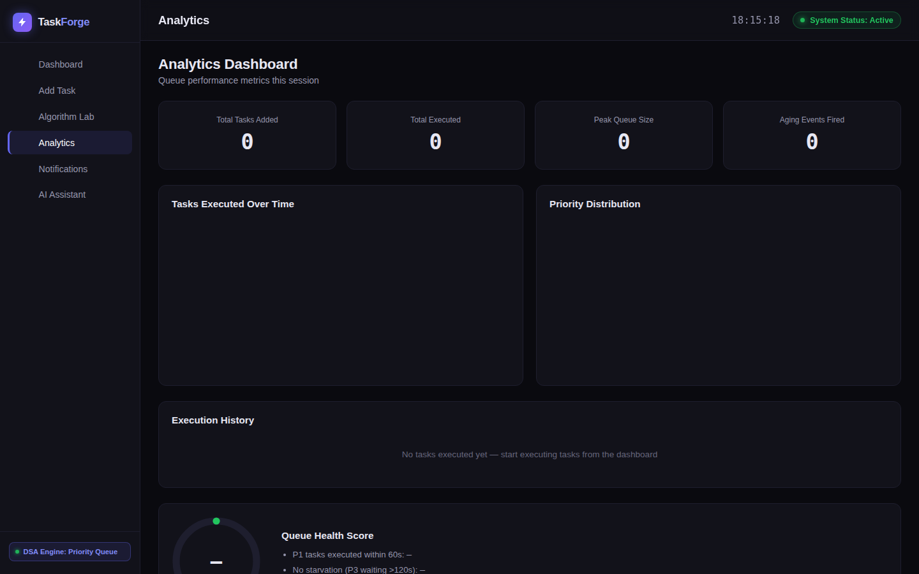
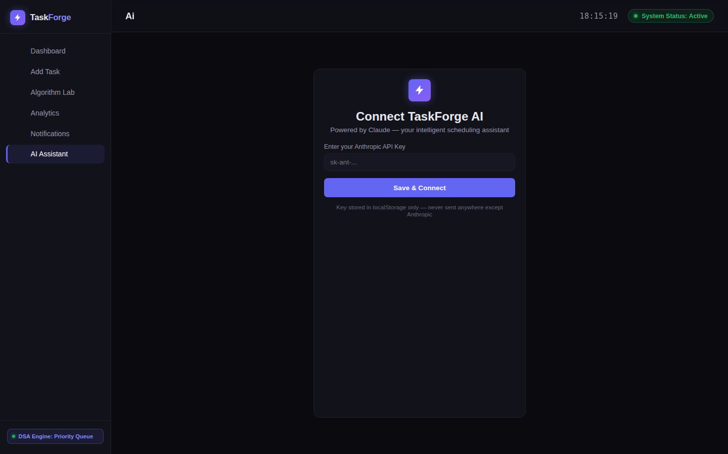
Methodology & Approach
03
🧱
Min-Heap Engine
🌳
D3 Tree Visualizer
Built from scratch. O(log n) insert & extract. No array.sort().
Live animated binary tree on every heap operation.
⏰
Task Aging System
⚗️
Algorithm Lab
P3→P2 after 60s, P2→P1 after 90s. Prevents starvation.
Priority Queue vs FIFO vs Round-Robin side-by-side.
Algorithm Lab
Notifications
🤖
AI Assistant
Stack
Vanilla JS · D3.js
Chart.js · Claude API
Single HTML file
Claude API with live queue context for DSA explanations.
Analytics
AI Assistant
Notes:
Five key components: heap engine, live visualizer, aging system, algorithm lab, and AI assistant. Right shows four prototype sections.

Slide 4
Results & Outcome
04
5
O(log n)
3
1 file
Sections
delivered
Heap
complexity
Algorithms
compared
Zero build
step
✅
Live Heap Visualizer
✅
Algorithm Lab
D3 tree animates every insert & extract. Evaluator watches the heap restructure live.
Same tasks through 3 algorithms side-by-side with wait-time bar chart.
✅
Analytics Dashboard
✅
Notification Settings
Session metrics, distribution chart, execution history, Queue Health Score 0–100.
6 toggles, toast position/duration, Web Audio sound previews, localStorage persist.
✅
AI Assistant
✅
Task Aging System
Claude API chat with live queue context — explains DSA, detects starvation.
OS-scheduler starvation prevention: P3→P2 after 60s, P2→P1 after 90s.
TaskForge — running prototype
Notes:
All 6 planned features delivered. Dashboard screenshot shows the live prototype.

Slide 5
Conclusion
05
TaskForge transforms abstract DSA into a live, visual, AI-powered experience — making the Min-Heap Priority Queue understandable at a glance.
Dashboard
01
DSA Made Visual
Algorithm Lab
The live D3 heap tree turns O(log n) theory into something you can watch in real-time — a genuine teaching tool, not just a console printout.
02
Real-World Concepts
Task aging mirrors OS process schedulers. Algorithm Lab mirrors production trade-off analysis. This is a working model, not a toy.
Analytics
03
Unique Differentiator
The Claude AI Assistant with live queue context sets this apart from every other student project — conversational DSA explanation is unprecedented.
Notifications
AI Assistant
TaskForge · DSA Mini-Project · Vanilla JS · D3.js · Chart.js · Claude API
Notes:
Summary: TaskForge delivers real DSA implementation, visual interactivity, algorithm comparison, and an AI assistant — all in one single HTML file.

