Slide 1


ANNADATHA
Smart Food Wastage to Reusable Utilisation System
REDUCE WASTE
FEED THE NEEDY
BUILD SUSTAINABILITY
Presented by: M. Geetha, G. Parvathi, Sk. Sadiya, K. Keerthi, Ch. Prasanna

Slide 2
THE CHALLENGE
Food Surplus Meets Hunger Crisis
The Stark Reality
Massive daily wastage
Every day, tonnes of perfectly edible food is discarded while millions remain hungry
Homes, restaurants, hostels, and events generate surplus food with no clear destination
Hidden hunger persists
Despite food abundance, vulnerable communities struggle to access nutritious meals
Organic waste mismanaged
Valuable resources dumped in landfills instead of being transformed into compost or energy
No unified platform
Lack of centralised, transparent systems for donation tracking and accountability

Slide 3


CURRENT SCENARIO
Existing Systems Fall Short
Manual coordination
No real-time updates
Food spoilage
Food donation relies on phone calls and volunteer availability
Donors and recipients operate without visibility or tracking
Delays and poor coordination lead to waste before distribution
Trust deficit
Lack of transparency prevents accountability and impact measurement
Critical Gap: Without structured systems, even well-intentioned efforts fail to maximise social impact

Slide 4
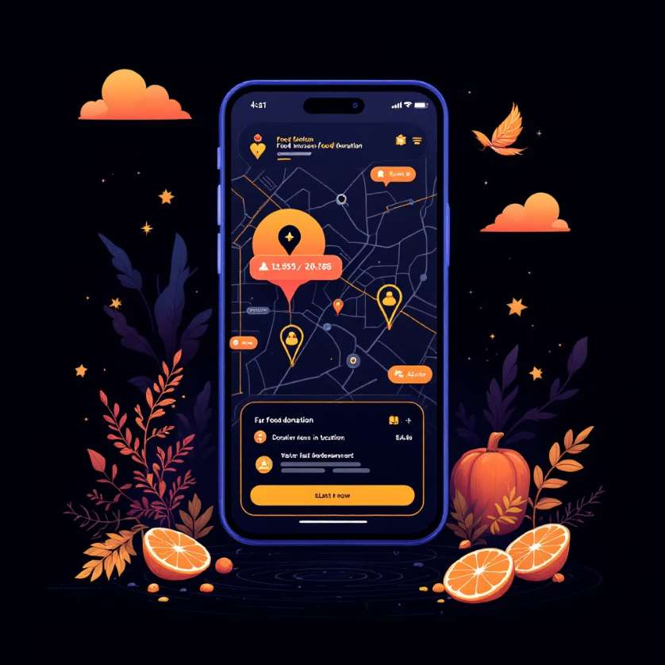
OUR SOLUTION
Introducing Annadatha
A smart mobile-based platform bridging surplus and need
Connects stakeholders
Links food providers directly with NGOs, shelters, and waste processors
Smart classification
Automatically categorises food and waste based on condition and type
Timely coordination
Ensures rapid pickup and distribution before food quality deteriorates
Real-time impact tracking
Monitors every donation from post to delivery, measuring social outcomes
Our Mission: Transform surplus food and organic waste into valuable resources that nourish communities and protect the environment

Slide 5
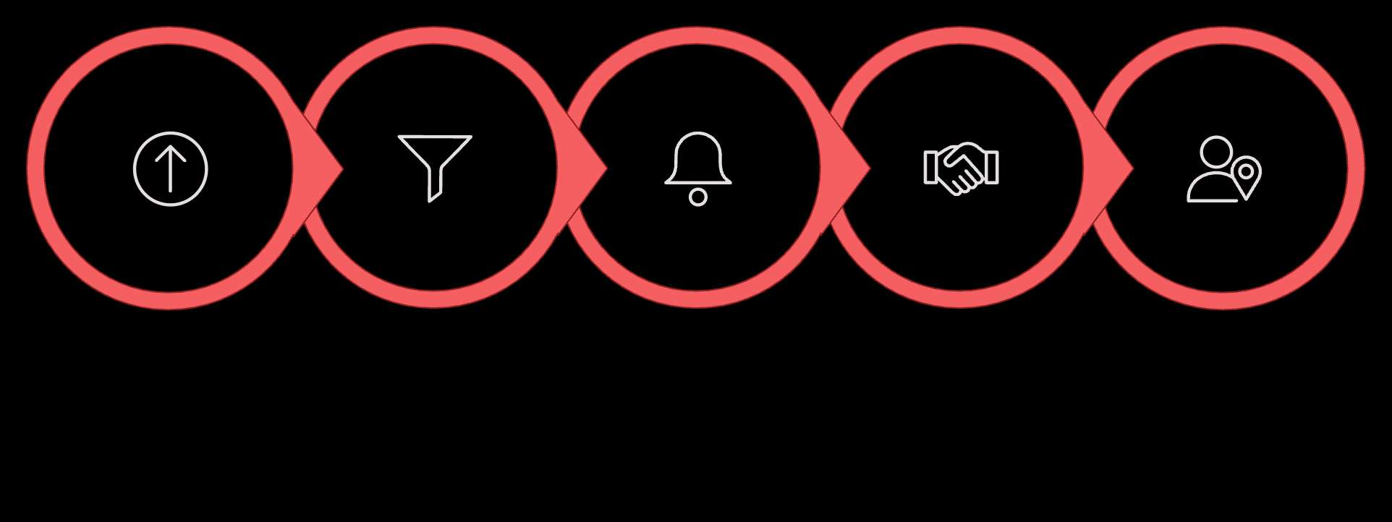
HOW IT WORKS
Simple, Transparent Workflow
Post Food
System Classifies
Notify NGO
Volunteer Collects
Food Delivered
Annadatha creates a seamless journey from surplus to service, ensuring nothing is wasted and everyone is informed
1
Post donation
User logs in and shares food or waste details with photos and quantity
2
Intelligent matching
System analyses condition, type, and location to find the best recipient
3
Instant notification
Nearby NGO or waste partner receives alert with pickup details
4
Coordinated collection
Verified volunteer arrives at scheduled time to collect donation
5
Impact confirmation
Completion updates sent to donor with beneficiary count and environmental metrics

Slide 6

Transforming Waste Into Worth
Key Uses
Benefits Delivered
Surplus food donation
Channel excess meals from homes, restaurants, and events directly to those in need
Organic waste conversion
Transform food scraps into nutrient-rich compost and renewable biogas energy
NGO empowerment
Provide shelters and community kitchens with reliable food sources and resources
Landfill reduction
Divert thousands of tonnes of organic waste from polluting dumpsites
Zero hunger action
Environmental care
Ensure nutritious food reaches vulnerable populations daily
Reduce methane emissions and create circular economy solutions
Trust through transparency
Efficient coordination
Eliminate delays and maximise food utilisation before spoilage
Track every donation with verified delivery and impact data

Slide 7
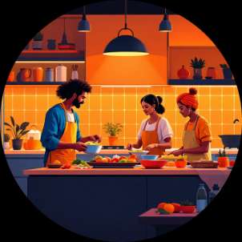
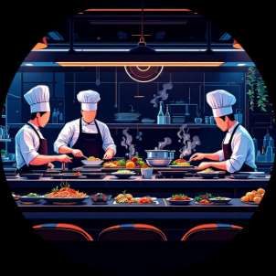
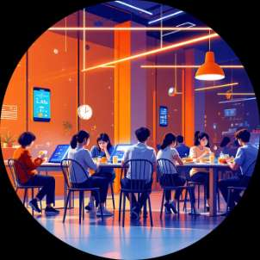
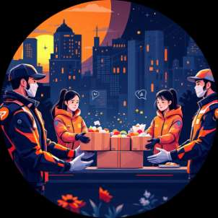
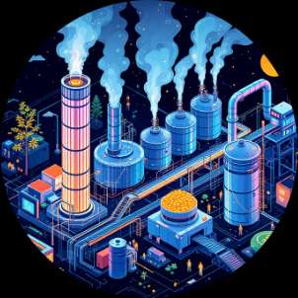
MARKET POTENTIAL
Reaching Communities That Matter
Homes & Individuals
Restaurants & Hotels
Hostels & Event Organisers
NGOs & Community Kitchens
Empower households to donate surplus from daily cooking and celebrations
Help hospitality sector redirect excess inventory and buffet leftovers
Manage large-scale food surplus from institutional dining and functions
Streamline food collection for shelters and feeding programmes
Waste Management Units
Enable efficient organic waste processing and resource recovery
Expansion Opportunities
Market Scale
Smart city sustainability initiatives
Corporate CSR partnerships
Government waste management programmes
NGO and social enterprise ecosystems
India generates 68 million tonnes of food waste annually, while 190 million people remain food insecure—Annadatha bridges this gap

Slide 8

TECHNOLOGY STACK
Built With Modern Tools
Development Platform
Lovable / Base44
Replit
Rapid app generation, workflow automation, and user experience design
Backend logic development, API integration, and cloud hosting
Firebase / Supabase
Secure authentication, real-time database, and data synchronisation
Core Technologies
Mobile-first web application for universal access
Cloud backend infrastructure ensuring scalability
Maps & geolocation services for proximity matching
Push notification system for real-time updates
Image recognition for food quality assessment

Slide 9
COMING SOON
Future Enhancements
AI-powered quality detection
Computer vision to automatically assess food freshness and safety before distribution
Smart IoT bins
Connected waste containers with sensors monitoring fill levels and organic composition
Multilingual support
Interface in regional Indian languages to expand accessibility across diverse communities
Analytics dashboard
Comprehensive impact metrics, trend analysis, and reporting for stakeholders
Government integration
Seamless connection with public distribution systems and municipal waste programmes

Slide 10

From Waste to Worth
Real-world impact
Technology meets compassion
Addressing hunger and waste simultaneously with measurable social outcomes
Digital innovation serving humanity's most fundamental needs
Scalable solution
UN SDG alignment
Designed to expand across cities, states, and eventually the nation
Contributing directly to Zero Hunger and Sustainable Cities goals
"Annadatha Makes a Difference"
Join us in building a future where no food is wasted and no one goes hungry
Together, we transform surplus into sustenance, waste into worth, and compassion into action

