Slide 1
Web Scraping With Ruby

Slide 2
Problem Statement
Why?
Data analysis helps to make informed decisions and not just through guessing or predictions.we need to get the unstructured data from the website and make it as structured data for analysis.we can achieve this by web scraping
Applications
online price change monitoring, price comparison, product review scraping ,more and more

Slide 3
Web scraping is an automatic method to obtain large amounts of data from websites.
Web Scraping

Slide 4
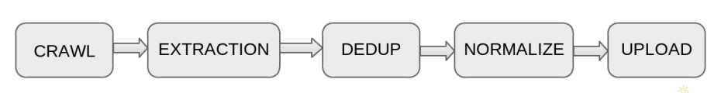
Pipeline Overview

Slide 5
Crawl
● Crawl is the process of fetching a webpage in html format.
● There are two stages in pipeline recrawl and feedcrawl.
● Recrawl is discovering product URLs from the webpage
● Feedcrawl is fetching that product page from the internet in html format.

Slide 6
Recrawl
● Its purpose is to get almost all urls to be crawled
● we will start with seedurl (i.e., https://bmstores.co.uk/ )
● for getting all the category urls from the seedurl we need to write xpath, proxy source and request type.
● we will define a method called get_category_urls for fetching the corresponding urls.
● Then returned category urls will get into the next depth.

Slide 7
List of category_urls
● https://www.bmstores.co.uk/products/home-and-furniture/furniture/storage-and-shelving
● https://www.bmstores.co.uk/products/toys-and-games/browse-by-age/toys-for-3-4-years
● https://www.bmstores.co.uk/products/food-and-drink/food/breakfast

Slide 8
Fetching Pagination urls
● It will take category urls as an input url.
● For getting all the pagination urls from the category url, we define function get_pagination_urls.
List of pagination_urls :
https://www.bmstores.co.uk/products/home-and-furniture/furniture/storage-and-shelving?page=1
https://www.bmstores.co.uk/products/home-and-furniture/furniture/storage-and-shelving?page=2
https://www.bmstores.co.uk/products/home-and-furniture/furniture/storage-and-shelving?page=3

Slide 9
Fetching Product urls
● It will take pagination urls as an input url.
● For getting all the product urls from the pagination url, we define function get_product_urls.
List of pagination_urls :
https://www.bmstores.co.uk/products/skinny-crunch-cereal-choco-hoops-and-marshmallows-375g-388554
https://www.bmstores.co.uk/products/back-to-the-future-multigrain-chocolate-balls-cereal-375g-382740
https://www.bmstores.co.uk/products/skinny-crunch-cereal-375g-388555

Slide 10
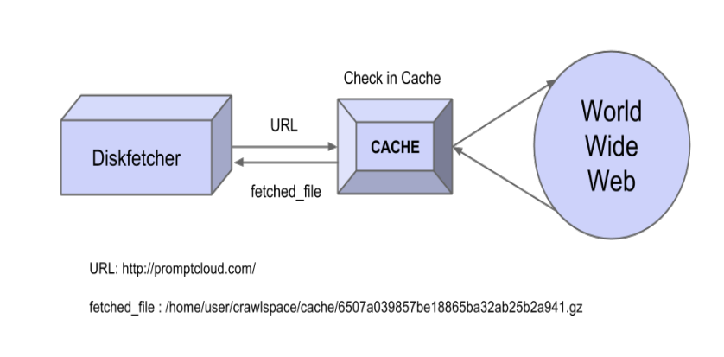

Slide 11
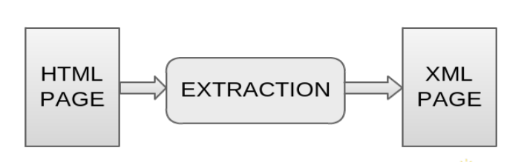
Extraction
● Extraction is the process of extracting essential information from the crawled HTML page, and form a XML structure of this information.

Slide 12
Fetching Product urls
● The final product page that we had fetched through feedcrawl will send it to extraction for extracting the essential information like product_name,product_price,product_description,product_page_url,product_rating and product_brand etc.
● For every product , we will generate a uniq_id and crawl_time_stamp for it.these are the require fields for every product.
● For getting each details of the page, we will take the help of xpath.

Slide 13
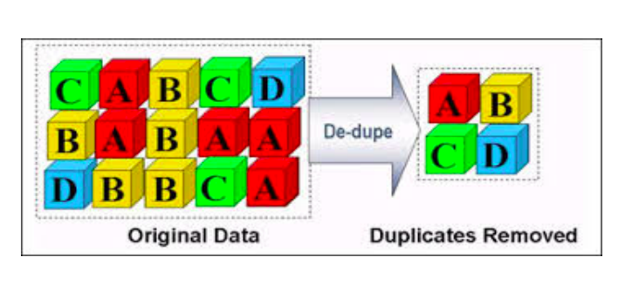
Dedup
● Dedup Alias De-duplication is the process of removing duplicate entries(data) from the extracted XML page.

Slide 14
Normalization
Normalization is the process of transforming the deduped XML according the client requirements, this may include transformation of XML into CSV, etc.

Slide 15
Upload
Upload is the process of uploading the normalized XML, CSV, etc data fle to the API,so that client can access the data.

Slide 16
Thank You

