Slide 1

21DS602-ML TERM PROJECT
PERFORMANCE OF MACHINE LEARNING ALGORITHMS FOR MALARIA DETECTION
Submitted by
Parvathi Pradeep
[CB.EN.P2DSC21019]
Date:February 1,2022

Slide 2

Problem Statement
From the given malaria dataset,classify the cell images as parasitic or uninfected cells with the help of feature extraction techniques and classification algorithms and evaluate each of the algorithms performance based on the metrics used.

Slide 3
Literature Review
In paper [1], the author discusses the approaches of defining texture on an image through statistical methods i.e.,a measure of the intensities in the image that can be used as a feature vector to represent the image.
In [2], the feature used are derived from the connected components and the moments at multiple thresholds. Thereafter the classical machine learning algorithms are used and it performance is analyzed
In [3] the authors have used Convoluted Neural Networks to classify the images
[1]R. Haralick, K. Shanmugam and I. Dinstein, "Textural Features for Image Classification", IEEE Transactions on Systems, Man, and Cybernetics, vol. -3, no. 6, pp. 610-621, 1973. Available: 10.1109/tsmc.1973.4309314.
[2] G Saiprasath, Naren Babu, J ArunPriyan, R Vinayakumar, V Sowmya, and K Soman. Performance comparison of machine learning algorithms for malaria detection using microscopic images. IJRAR19RP014 Int. J. Res. Anal. Rev.(IJRAR), 6(1), 2019
[3]S. Rajaraman et al., "Pre-trained convolutional neural networks as feature extractors toward improved malaria parasite detection in thin blood smear images", PeerJ, vol. 6, p. e4568, 2018. Available: 10.7717/peerj.4568.

Slide 4
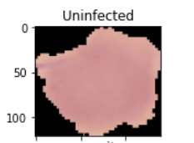
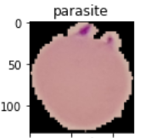
Dataset
Obtained from Lister Hill National Center for Biomedical Communications, for a malaria screener research
Contains low resolution images of cells collected from the blood swatches from 50 patients
Consists of 27558 instances with equal number of parasitic and uninfected cell images

Slide 5
Flow chart
Parasitic cell
Dataset
Preprocessing
Feature Extraction
Classification model
Uninfected cell
Label and split the instances as train and test
Remove redundant images, split to train and test
Extract most important features using Haralick’s features method and moments at different thresholds
Train the data with the machine learning algorithms and and predict the labels with test instances

Slide 6
Feature Extraction
Haralick features and Hu moments are taken with the help of opencv and mahotas packages.
Extracted each images moments and Haralick features .
The Haralick features are based on the statistical measures eg.variance,contrast,,correlation etc, of the gray scale image
Hu moments are the central moments that are invariant to translation, scaling or rotation of the image.
7 moments are returned based on the central moments calculated for the gray image
Concatenated the features and the label to form the modified dataset.

Slide 7
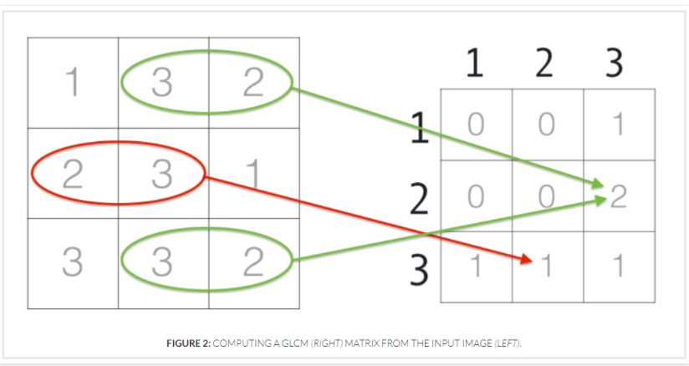
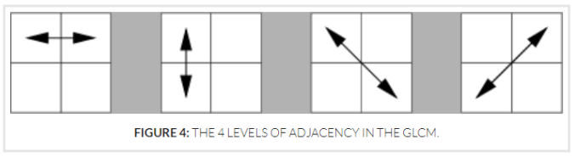
Haralick feature extraction from GLCM
GLCM matrix formation from gray scale image
The four levels of adjacency considered
Figure source: https://cvexplained.wordpress.com/2020/07/22/10-6-haralick-texture/

Slide 8
Applying algorithms and Checking performance
The dataset is split in 75:25 ratio,scaled and then given as input to the algorithms
The accuracy,precision,recall and f1 score are checked for each and compared
The ROC and Precision vs Recall graphs are plotted.
Algorithms considered for analysis include:
Support Vector Classifier | Adaboost Classifier
Random Forest | Extra Trees Classifier
Naive Bayes | Logistic Regression
KNN | Decision Trees

Slide 9
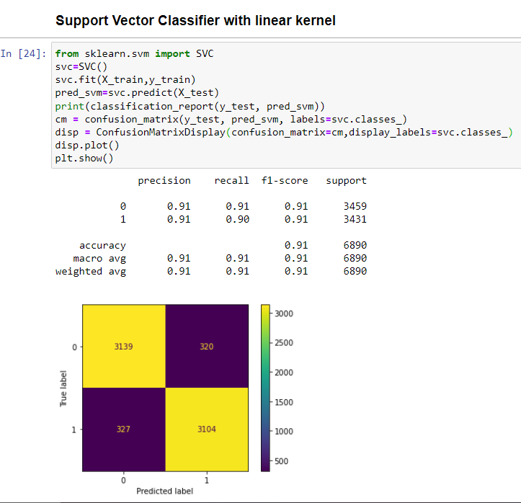
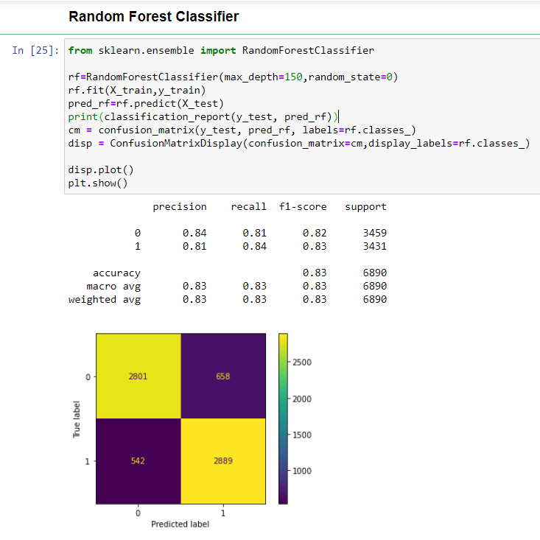
Algorithms-Snapshot

Slide 10
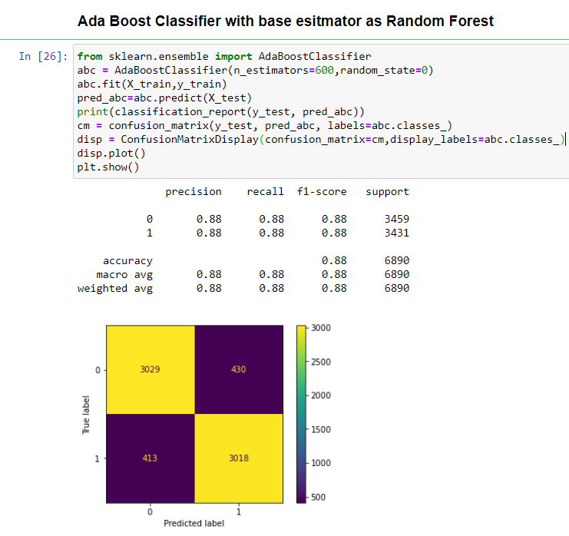
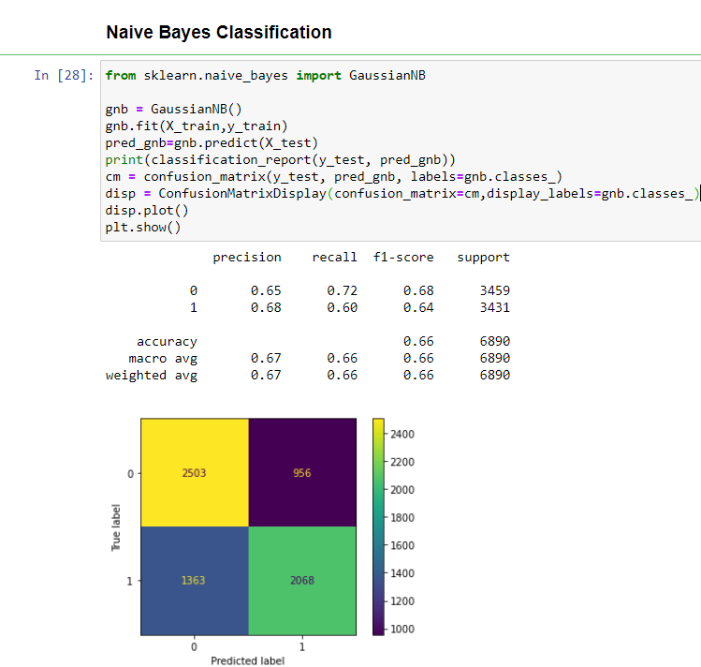
Algorithms-Snapshot

Slide 11
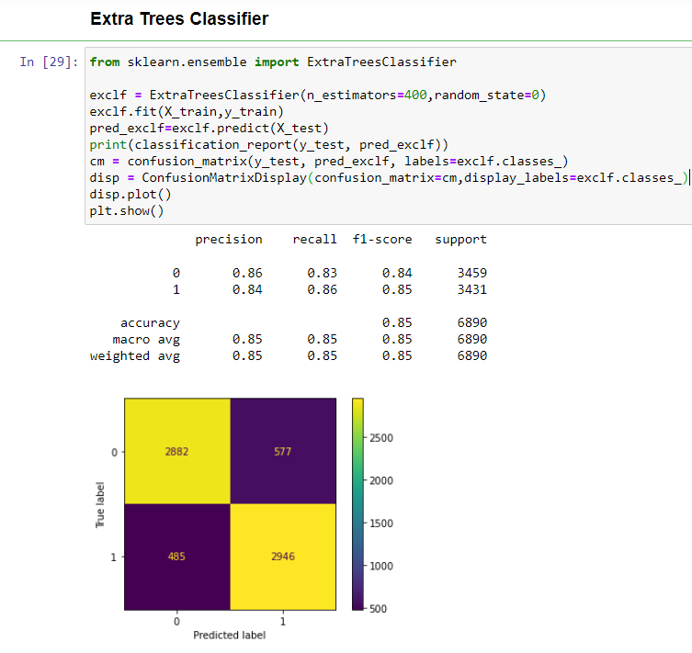
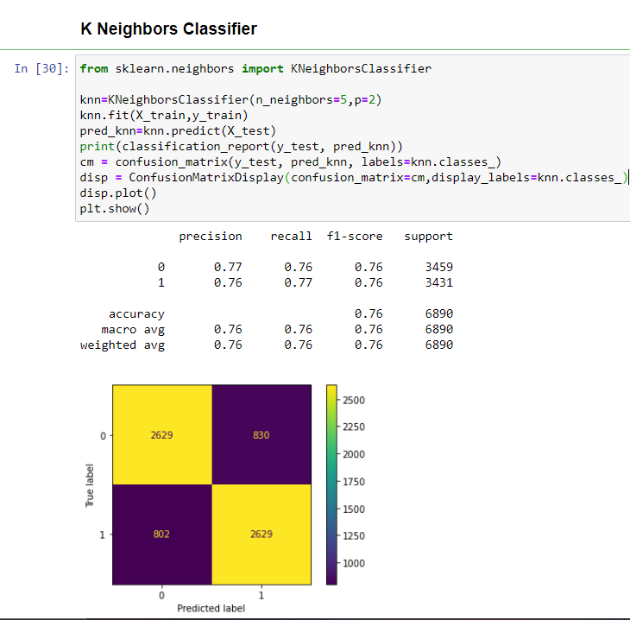
Algorithms-Snapshot

Slide 12
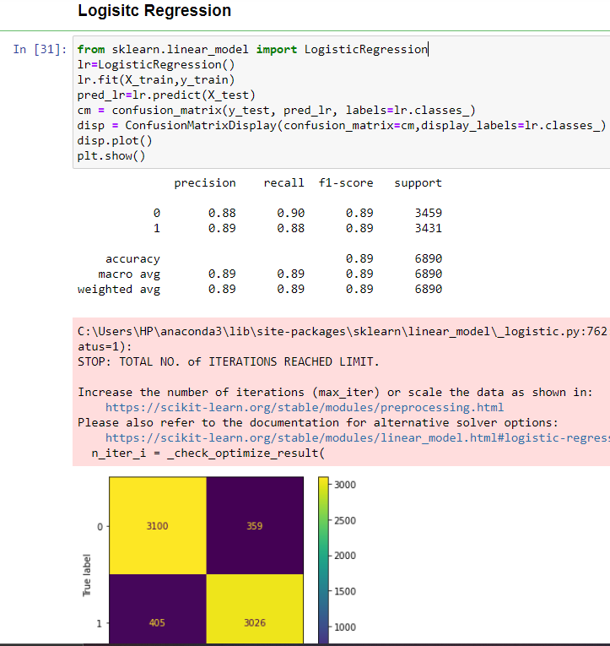
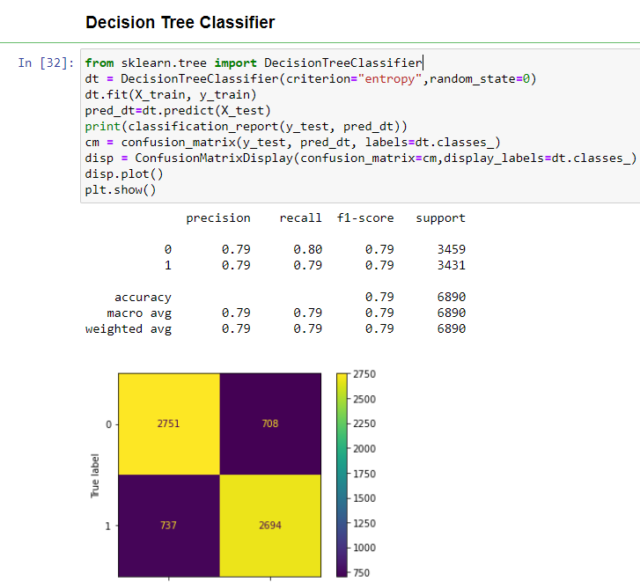
Algorithms-Snapshot

Slide 13
The priority should be given to reduce false negatives among all misclassifications that occur

Slide 14
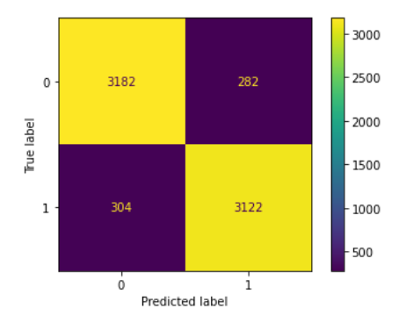
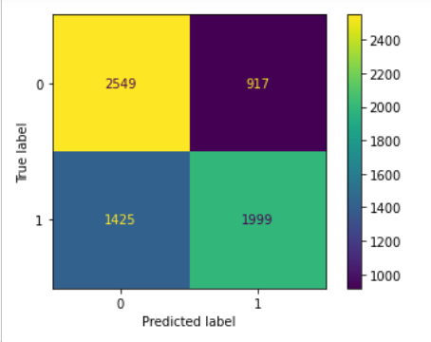
False Negatives Comparison
Confusion Matrix for SVC
Confusion Matrix for Naive Bayes

Slide 15
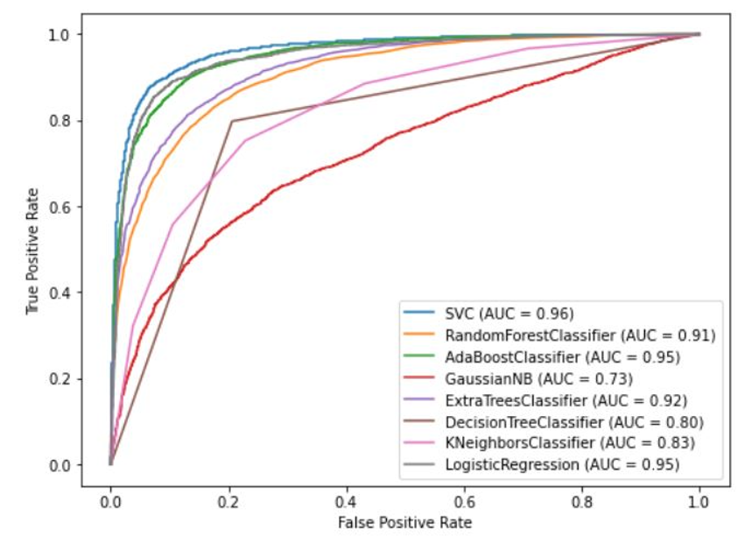
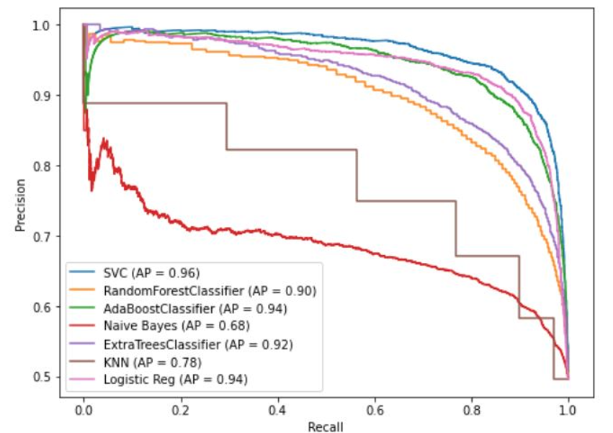
Results and Discussions
ROC Curve
Support Vector Classifiers performed the best in terms of accuracy with a value of 0.91, followed by Logistic Regression (0.89) and Adaboost (0.88)
In terms of Precision vs Recall, SVM gave the accuracy-precision score of 0.96
Precision Recall Curve

Slide 16
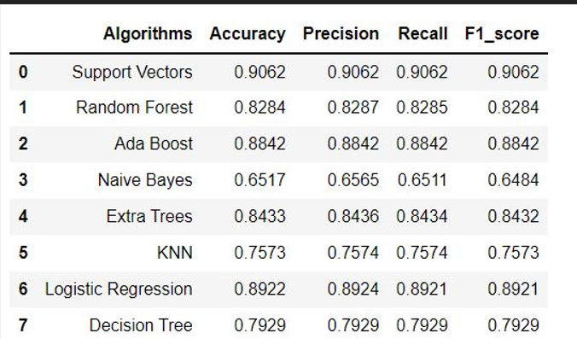
Results and Discussions (contd)

Slide 17
Conclusions
The cell images in the malaria dataset have been classified with the help of various machine learning algorithms and their performances are compared.
Haralick features and Hu moments use basic statistics, which may or may not discriminate enough to distinguish different textures.
Better classification metrics can be obtained with the help of neural networks (CNN, etc) and deep learning algorithms.

Slide 18
References
https://www.kaggle.com/debasish05/image-classification-using-svm
https://learnopencv.com/shape-matching-using-hu-moments-c-python/
https://gogul.dev/software/texture-recognition
https://towardsdatascience.com/precision-vs-recall-evaluating-model-performance-in-credit-card-fraud-detection-bb24958b2723
https://scikit-learn.org/stable/auto_examples/model_selection/plot_precision_recall.html#sphx-glr-auto-examples-model-selection-plot-precision-recall-py
https://cvexplained.wordpress.com/2020/07/21/10-4-hu-moments/

Slide 19
THANK YOU

