Slide 1
AI Assisted Trust Evaluation In blockchain based digital twin system
Dayananda sagar college of engineering
Department of computer science & engineering (cyber security)
Technical Seminar –I
2025-2026
Group Number: G-17
Presented By: Guided By:
Parvati Waladunki Dr. Deepthi V S
1DS22CY032 Assistant Professor
CSCY, DSCE
Date: 25-04-2026

Slide 2
AGENDA
Abstract
Introduction
Literature Survey
Design and Working
Advantages and Disadvantages
Applications
Conclusion
Future Work
References

Slide 3
Abstract
.
Digital Twin systems rely on real-time data for simulation and decision-making, ensuring data trust and security is a major challenge
AI is used for anomaly detection and trust evaluation
Blockchain provides secure and tamper-proof data storage
Integration improves data reliability and system accuracy
Applications include smart cities, healthcare, and industrial IoT

Slide 4
INTRODUCTION
Digital Twin creates a virtual model of physical systems, it depends on continuous real-time data from IoT devices
Untrusted or manipulated data leads to incorrect decisions
Traditional systems lack security, transparency, and trust evaluation
Need for integration of AI for trust evaluation and Blockchain for secure data storage
Physical Systems
AI
Blockchain
Digital Twin

Slide 5
Literature Survey
Title | Author | Problem Statement | Methodology | Key Findings | Limitation
Blockchain-Based Trust Mechanism for DT | Zhang et al. | Lack of trust in IIoT data | PoA-based blockchain + trust model | Improved data integrity | Limited scalability
TFL-DT Trust Evaluation Model | Chen et al. | Malicious participants in FL | AI-based trust scoring | Better accuracy, secure learning | High computation cost
Blockchain-enabled DT for Smart Cities | Kumar et al. | Data inconsistency & attacks | LSTM + blockchain | Improved prediction & trust | Complex implementation
AI-based Trust Models | Kumar et al. | Static trust models ineffective | ML anomaly detection | Dynamic trust evaluation | Needs training data
Secure DT using AI & Blockchain | Patel et al. | No unified secure framework | AI + blockchain + smart contracts | Real-time trust evaluation | Latency issues

Slide 6
DESIGN AND WORKING
Physical Twin Layer:
- Real-world devices (sensors, actuators)
- Performs data sensing and control
Data Layer:
- Handles data storage and processing
- Includes: Presentation, Elaboration, Persistence
Digital Twin Layer:
- Creates virtual model of physical system
- Performs: Modeling, Reasoning, Feedback
Service Layer:
- Provides system functionalities: Simulation, monitoring, prediction, optimization

Slide 7
Security Layer:
- Ensures identity & access control, encryption, privacy protection, intrusion detection
Connectivity Layer
- Enables communication: Inter-twin connectivity and intra-twin connectivity

Slide 8
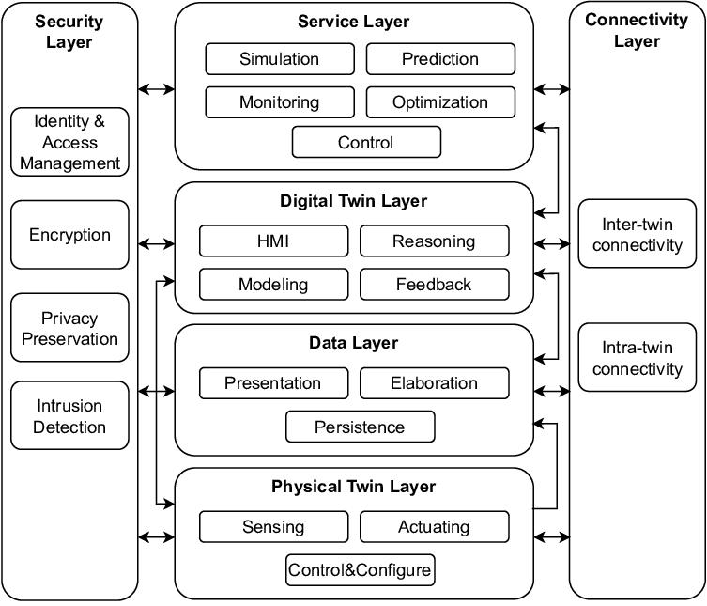

Slide 9
Step 1: Data Generation - Sensors collect real-time data
Step 2: Data Processing - Data layer stores and processes information
Step 3: Digital Twin Creation - Virtual model replicates physical system
Step 4: Analysis & Services - Simulation, prediction, monitoring performed
Step 5: Secure Communication - Security layer ensures safe data handling, connectivity layer enables system interaction
Step 6: Feedback & Control - Insights sent back to physical system

Slide 10
Advantages and disadvantages
Advantages | Disadvantages
Ensures data trust and reliability using AI | High computational complexity
Provides secure and tamper-proof storage with blockchain | Latency issues in real-time applications
Enables real-time monitoring and decision-making | Requires high infrastructure and cost
Improves system accuracy and efficiency | Integration of multiple technologies is complex
Reduces risk of malicious or false data | Privacy concerns due to data transparency

Slide 11
APPLICATIONS
Smart Cities: Traffic management, infrastructure monitoring
Healthcare: Patient monitoring, predictive diagnosis
Industrial IoT: Predictive maintenance, fault detection
Supply Chain Management: Transparency, tracking, fraud prevention
Energy Systems: Smart grids, energy optimization
Transportation: Autonomous vehicles, fleet monitoring

Slide 12
CONCLUSION
Digital Twin systems depend on accurate and trustworthy data
AI enables intelligent trust evaluation and anomaly detection
Blockchain ensures secure, transparent, and tamper-proof data storage
Integration improves system reliability, security, and decision-making
Provides a robust solution for modern smart systems

Slide 13
FUTURE WORK
Scalable Blockchain Solutions: Improve blockchain performance to handle large-scale data with reduced latency and higher throughput.
Advanced AI Models: Use deep learning and federated learning to enhance accuracy in trust evaluation and anomaly detection.
Integration Edge Computing: Process data closer to devices to reduce delay and improve real-time system performance.

Slide 14
References
[1] Y. Zhang, X. Liu, and H. Wang, “Blockchain-Based Trust Mechanism for Digital Twin in Industrial IoT,” Future Generation Computer Systems, vol. 130, pp. 1–12, 2022.
[2] J. Chen, Q. Li, and K. Zhao, “TFL-DT: A Trust Evaluation Scheme for Federated Learning in Digital Twin,” IEEE Access, vol. 11, pp. 112345–112356, 2023.
[3] A. Kumar, R. Singh, and S. Patel, “Blockchain-Enabled Digital Twin Framework for Smart Cities,” IEEE Internet of Things Journal, vol. 10, no. 5, pp. 4567–4578, 2023.
[4] M. Rahman, S. Islam, and T. Ahmed, “Blockchain-Based Collaborative Digital Twin Framework for Healthcare Systems,” IEEE Access, vol. 9, pp. 145678–145689, 2021.
[5] L. Wang, Y. Zhou, and H. Chen, “Causio-TwinChain: AI-Driven Trust and Security Model for Digital Twins,” Scientific Reports, vol. 14, pp. 1–12, 2024.

Slide 15
[6] T. Nguyen, D. Kim, and J. Park, “Blockchain in Digital Twin: A Comprehensive Survey,” ACM Computing Surveys, vol. 56, no. 3, pp. 1–34, 2023.
[7] P. Sharma, R. Gupta, and S. Verma, “Blockchain-Based Digital Twin for Industrial IoT Security,” IEEE Transactions on Industrial Informatics, vol. 19, no. 2, pp. 1234–1243, 2023.
[8] X. Li, Y. Zhang, and Z. Chen, “Trust Management in Blockchain-Based IoT Systems,” IEEE Internet of Things Journal, vol. 8, no. 6, pp. 4560–4570, 2021.
[9] V. Kumar, P. Reddy, and M. Singh, “AI-Based Trust Evaluation Models in Distributed Systems,” IEEE Access, vol. 10, pp. 98765–98776, 2022.
[10] N. Patel, K. Shah, and R. Mehta, “Secure Digital Twin Framework Using AI and Blockchain,” IEEE Access, vol. 11, pp. 76543–76555, 2023.

Slide 16
[11] S. Wan, J. Lu, P. Fan, and K. B. Letaief, “Toward Smart Cities: Digital Twin-Enabled Internet of Things With Blockchain and Artificial Intelligence,” IEEE Internet of Things Journal, vol. 9, no. 14, pp. 12345–12356, 2022.
[12] M. Grieves and J. Vickers, “Digital Twin: Mitigating Unpredictable, Undesirable Emergent Behavior in Complex Systems,” IEEE Systems Journal, vol. 10, no. 3, pp. 1–8, 2017.
[13] H. Ning, H. Liu, and J. Ma, “Cyber-Physical-Social Based Security Architecture for Future Internet of Things,” IEEE Internet of Things Journal, vol. 6, no. 2, pp. 1–12, 2019.
[14] K. Zhang, Y. Mao, S. Leng, Y. He, and Y. Zhang, “Mobile Edge Computing for Intelligent IoT Systems: Trust and Security Perspective,” IEEE Communications Magazine, vol. 56, no. 10, pp. 1–7, 2018.

Slide 17
[15] Q. Xu, Z. Su, and Y. Wang, “Blockchain-Based Trust Management in Distributed Systems: A Survey,” IEEE Access, vol. 9, pp. 112345–112360, 2021.
[16] Y. Lu, “Digital Twin-Driven Smart Manufacturing: Connotation, Reference Model, Applications and Research Issues,” IEEE Access, vol. 8, pp. 187125–187140, 2020.

Slide 18
THANK YOU

