Slide 1


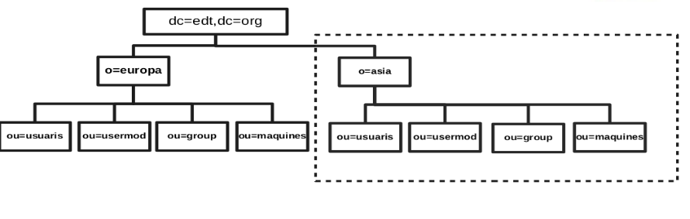

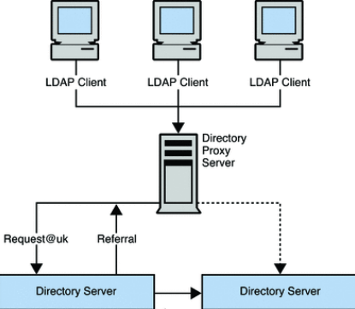
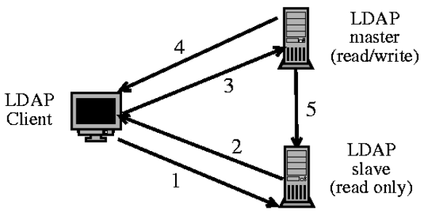

Administración de sistemas informáticos en red
LDAP SERVICE
My project is about to explain some basic and advance functions of openldap.
LDIF structure like this one
Process of project
In this project I use different docker make different type of ldap server to make easy to understand configure and concept.
* Basic ldap server and explain about schema.
* Consumer and provider server function (Replication).
* ldab_master and ldap_sub server information(Subordinate).
* Connection of tls use openssl.
* Configure of clients to connect by using pam and httpd server.
.
europa
asia
AUTHOR – PARVEEN
Course - Hisx2 Year – 2019/18
Github codi
URI - https://github.com/parveen1/project-parveen
Project in detail and process step by step all in my github repo.
Institut Escola del Treball – Carrer Comte d’Urgell, 187, edifici 11 – 08036 Barcelona

