Slide 1
LDAP SERVICE PROJECT
PARVEEN

Slide 2
LDAP SERVICE PROJECT
  What is ldap ?
  LDAP stands for Lightweight Directory Access Protocol.
  LDAP is a "lightweight" (smaller amount of code) version of Directory Access Protocol (DAP), which is part of X.500, a standard for directory services in a network

Slide 3
LDAP SERVICE PROJECT
Where do we use LDAP?
LDAP is predominantly used application protocol for authentication purposes.
If frequent updates and inserts are essential, then choose database over LDAP as it's the ideal way.

Slide 4
LDAP SERVICE PROJECT
How does LDAP work ?
LDAP directory service is based on a client-server model.
One or more LDAP servers contain the data making up the LDAP directory tree or LDAP backend database.

Slide 5
LDAP SERVICE PROJECT
What is ldif ?
The LDAP Data Interchange Format (LDIF) is a standard plain text data interchange format for representing LDAP (Lightweight Directory Access Protocol) directory content and update requests.
LDIF conveys directory content as a set of records, one record for each object (or entry).

Slide 6
LDAP SERVICE PROJECT
About slapd ?
system contains a complete configuration file for your LDAP server at /etc/openldap/slapd.conf.

Slide 7
LDAP SERVICE PROJECT
Now I am going start explaine about my project.
Let's begin…………………

Slide 8
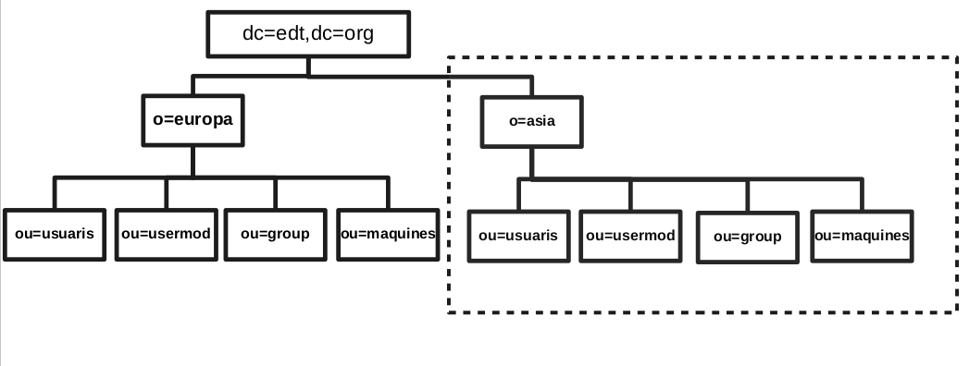
LDAP SERVICE PROJECT
Here i show how is structure of directory information tree (DIT) all data in backend( hbd)

Slide 9
LDAP SERVICE PROJECT
Schema Specification
An LDAP schema is a set of rules that define what can be stored as entries in an LDAP directory. Each LDAP directory has a default schema, which organizations can customize, or "extend," by adding elements to it. The elements of a schema are attributes, syntaxes, and object classes.

Slide 10
LDAP SERVICE PROJECT
Replication
OpenLDAP now supports a wide variety of replication topologies, these terms have been deprecated in favor of provider and consumer: A provider replicates directory updates to consumers; consumers receive replication updates from providers

Slide 11
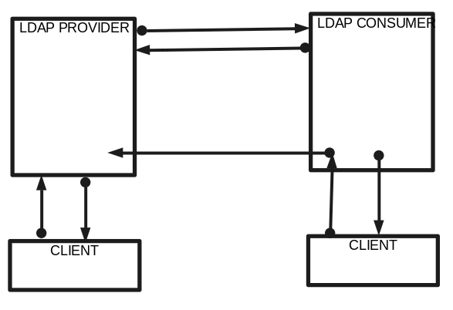
LDAP SERVICE PROJECT
Provider and consumer understand by fig.

Slide 12
LDAP SERVICE PROJECT
Provider conf.
overlay syncprov
Add in plugin for save all entres later update for consumer
syncprov-checkpoint 50 10
this means update ever 50 operction or 10 mintus
syncprov-sessionlog 100
user log in after 100

Slide 13
LDAP SERVICE PROJECT
Consumer conf.
syncrepl rid=001
provider=ldap://ldap_p
type=refreshOnly
interval=00:00:00:10
searchbase="dc=edt,dc=org"
binddn="cn=Manager,dc=edt,dc=org"
credentials=jupiter
updateref ldap://ldap_p

Slide 14
LDAP SERVICE PROJECT
Overlay chain conf.
overlay chain
chain-uri "ldap://ldap_p"
chain-idassert-bind bindmethod="simple" binddn="cn=user01,ou=usermod,o=europa,dc=edt,dc=org"
credentials="user01"
mode="self"
flags=non-prescriptive

Slide 15
LDAP SERVICE PROJECT
Subordinate and TLS
Subordinate knowledge information may be provided to delegate a subtree.
Subordinate knowledge information is maintained in the directory as a special referral object at the delegate point.

Slide 16
LDAP SERVICE PROJECT
TLS
Here both ldap master and sub_ldap both use tls cert. With client to make secure connection.
Also if these server connect each other use tls connection.

Slide 17
LDAP SERVICE PROJECT
Here we can conf. Server in two different ways
1) Only get referral
2) get all data form sub.

Slide 18
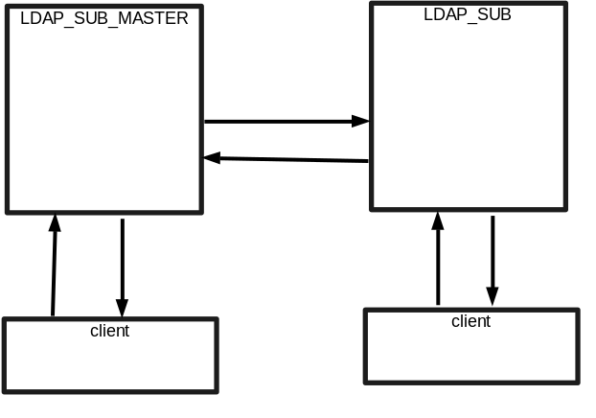
LDAP SERVICE PROJECT
Understand by figure(1):-

Slide 19
LDAP SERVICE PROJECT
Figure(2):-

Slide 20
LDAP SERVICE PROJECT
OK HERE FINISH PART 1
NOW START PRACTICA PART 2

Slide 21
LDAP SERVICE PROJECT
Make new network in docker (project)
Start docker ldap_schema
Show schema futbol.schema
Show edt.ldif file and data de edt.ldif
Show photo and pdf in edt.ldif

Slide 22
LDAP SERVICE PROJECT
Check point
now check all work correctly
Also we find adv. search

Slide 23
LDAP SERVICE PROJECT
Scripts
Explaine scripts and how is works one by one
Frist show user and group explaine we need
to both file
Also after scripts execute check again data

Slide 24
LDAP SERVICE PROJECT
Start docker provider and consumer
Now open provider and consumber
do search in each to check all work fine
Now edit some thing in provider
Check again in both server data is up to date
Now edit consumer some things
check in both server if data is update

Slide 25
LDAP SERVICE PROJECT
Show slapd in both provider and consumer
Explaine litte bit again

Slide 26
LDAP SERVICE PROJECT
Subordinate and TLS
Start docker ldap_sub_master and ldap_sub
Show slapd conf. In ldap_sub_master
Both usind tls so need to explaine
And refferal in edt.ldif
In sub_ldap edt.ldif and refferal in slapd
Now search in both server data

Slide 27
LDAP SERVICE PROJECT
LDAP PAM
Open docker ldap_pam
Check login by pere etc..
Show mount directory
And home directory
Show which server we need
And there conf.

Slide 28
LDAP SERVICE PROJECT
GRAHICAL VIEW PHP AND HTTPS
Simple page explaine why
Show home page conf
Start docker php and httpd
Show conf. File
At last show how works

Slide 29
LDAP SERVICE PROJECT
Explaine about two year of study
Works of computer before start this curs
beatiful grapica,fast and security
After two year
connect, coding and concept
no limits

Slide 30
LDAP SERVICE PROJECT
          Thankyou
            to join
            project

Slide 31
LDAP SERVICE PROJECT
      FINISH

Slide 32
LDAP SERVICE PROJECT
THIS PROJECT 4 PART
INTRODUCTION
BASIC INFO LDAP AND WORKS
PACTICAL WORK
Final words

