Slide 1


KINETIC
The one stop fitness app

Slide 2

Problem statement As Head of Product for Amazon, have decided to propose a new app, where-in users can be fitter and healthier without going to a gym from the comforts of their home.
Competitor

Slide 3



Why existing solutions are not enough
No Personalized Training Schedule and Diet Plans:- Existing fitness apps are not personalized and give a common exercise and diet schedule to everyone.
Simply Gamification Techniques doesn’t Motivate Anymore:- Giving points/ in-game currency/ levels for workout has become a traditional way of retention which is not engaging anymore.
No customized playlist according to the mood while working out:- User listens to music as a source of entertainment which is not personalized to their dynamic mindset.

Slide 4
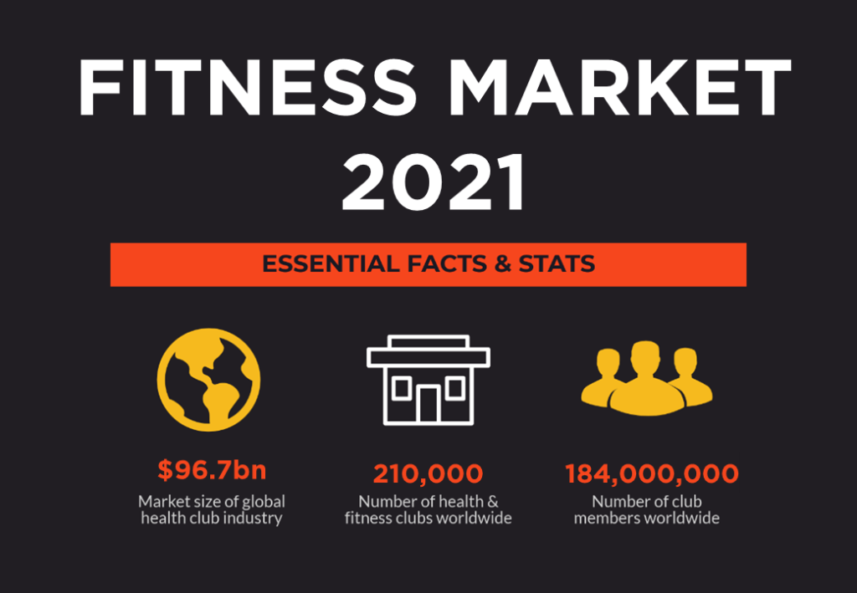
Market sizing
Statistics indicate the number of people using fitness and nutrition apps is set to rise to 825.7 million in 2020, a 26percent increase in a year. The number of users in the wearables segment is forecast to grow 24 percent year-on-year to 441.5 million. The global gym industry is worth $96.7 billion in 2020, with more than 184 million gym members in total. 2020 is a true testament to the growing gym industry trends where the global gym industry is worth $96.7 billion.

Slide 5
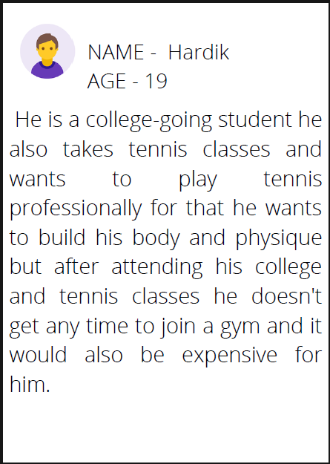
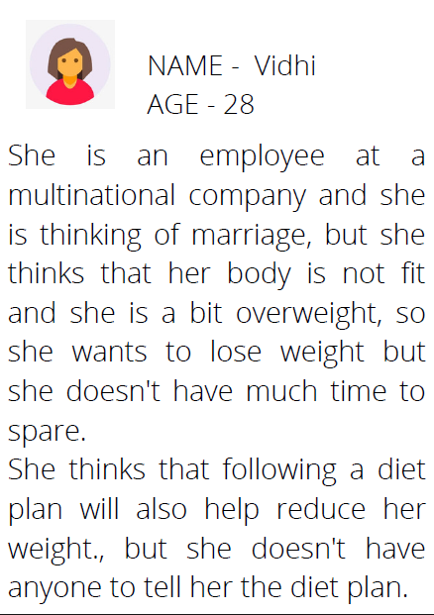
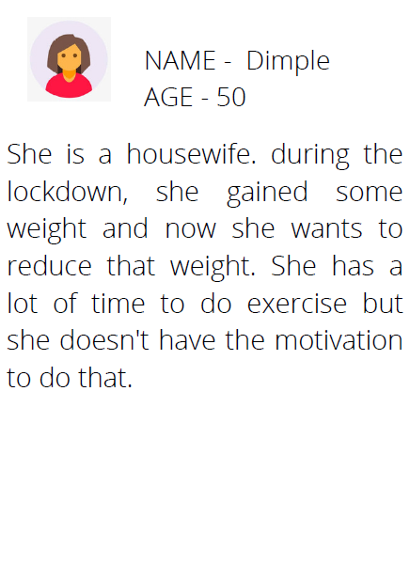
User persona

Slide 6
Pain points
Fixed schedules
Join the Gym is the little things that you do each day that add up to being healthy and fit. But with a tight schedule balancing work and personal life, it becomes very difficult for most people to go to a gym.
Insufficiency of professional training
Every person cannot access the information about how athletes and sports personalities train for their fitness. A fitness workout app like this can be like a boon for them at that time.
Inaccurate Information
There are a lot of blogs and articles available on the internet about health and fitness tips. Sadly, as the internet is available everywhere and to everyone, it is exposed to have incorrect information as well.
High Gym Rates
Nowadays, gym rates are very high and many people cannot afford that. They also have to pay extra if they want a private trainer.

Slide 7
Solution 1
COMMMUNITY HUB
With this solution user will be able talk to other people and know about their journey how they achieved their goal. User will get health update through this hub. There will also be many post about health food recipes and much more.
This feature will help user to connect with different people. With this feature people will be able to tell their story which will help people to motivate other people.

Slide 8
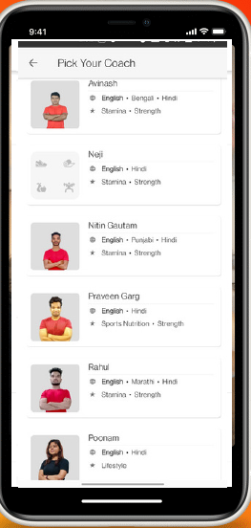
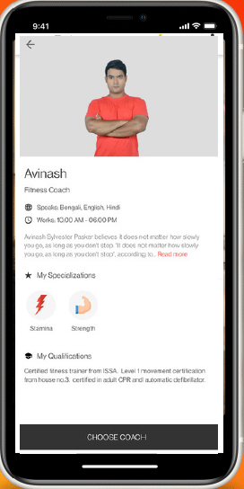
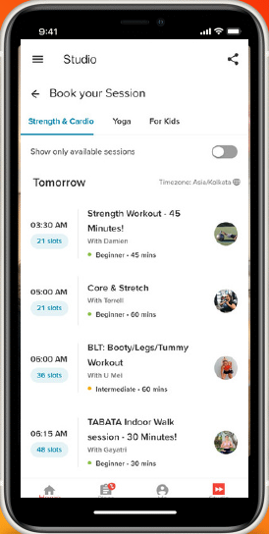
SOLUTION 2
Personalized Trainer
There are people who can only work when someone guides them. Our app will hire different types of trainer for every type of people. User can select from which trainer he/she wants to get guided and they would have to pay the trainers fee.
Here the user can choose from which trainer he/she wants to be trained. There
will be all kinds of trainer.
After selecting a trainer the user can see his/her profile.
User will also be able to attend live sessions on
interesting topics from their favourite trainer.

Slide 9
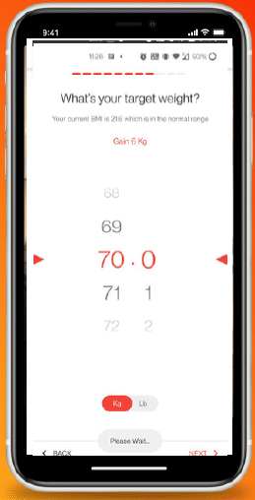
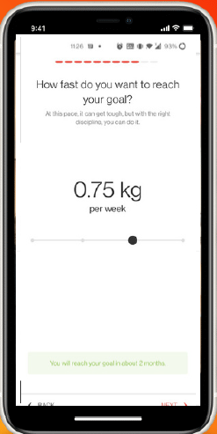
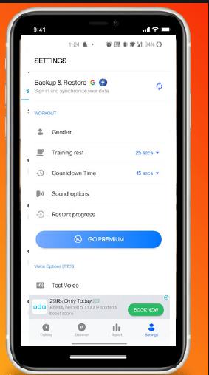
Solution 3
Personalized goal and app
By collecting user data it would help us to personalize the app according to the user, and it will also help us to determine the goal and the time it will take to achieve.
Here the user can choose their target weight.
After selecting their target weight, users can select how fast they want to reach the goal.
Here the users can see their daily progress.

Slide 10
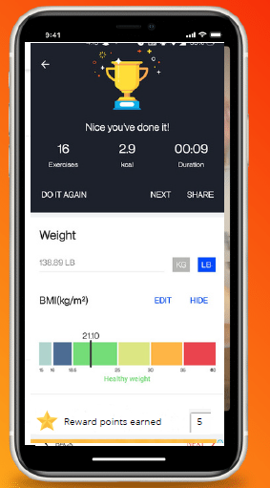
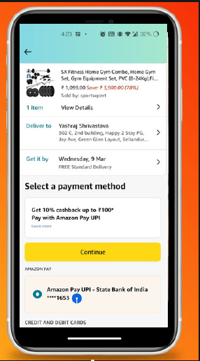
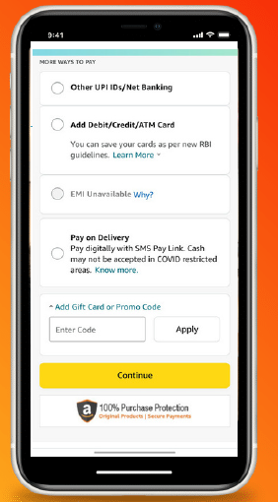
Solution 4
Gamification of the App
When ever a user complete a goal he/she will be rewarded with gift points. After collecting some gift points user can use this points in purchasing any fitness equipment.
After a user completes a the activity he or she will get some reward points which will allow them to purchase gym equipment on discount.
After the user have valuable amount of reward points he will be suggested with gym equipment which are relevant for the user.
After the user selects the equipment he/she wants to buy, they will be provided with a unique number which the user will use to get discount.

Slide 11
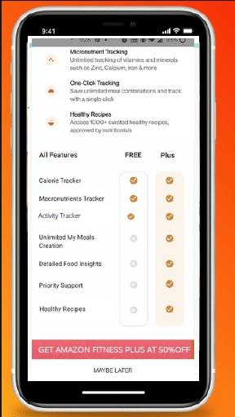
Monetization strategy
User will get either take a free plan or a plus plan . For the plus plan the user will have to pay 200 Rs.
In the case of the Fitness app, we can set up agreements with companies selling health and fitness equipment, products and services.
Monetizing our fitness and workout application by allowing third-party vendors to sell their products through your app via advertisements is one way to generate money.

Slide 12
Success metrics
No. of people registered in a month.
Conversion rate - No. of people converting from free to a plus member
Membership usage – To check infrequent users
Net promoter score

Slide 13
Future expansion
The app may be linked to Google fit so if any user wants to track his/her activity he can link the amazon fitness account to google fit.
Building in-app communities for GYM trainers/ nutritionist/ doctors.
The app will be linked to smart watch that will be easy for users to track their fitness progress.

Slide 14
Thank you
Submitted by- Parveen

