Slide 1

Global Fashion Retail Analytics Capstone Project
zzzz
Insights from SQL, Power BI, and Machine Learning
Mentorship Program: WsCube Tech – Data Analytics
By- Parvej Alam

Slide 2
PROBLEM STATEMENT
As a Data Analyst at Global Fashion Retail, a multinational apparel brand with stores across multiple countries, your mission is to transform raw transactional and customer data into strategic insights. Your analysis will help the company:
Goal:
    Optimize product assortment and pricing strategies
    Identify high-value customers and improve retention
    Measure promotion effectiveness
    Reduce returns and operational inefficiencies
This capstone simulates a real-world, end-to-end analytics project, combining advanced SQL querying, interactive dashboards, and machine learning for predictive modeling.

Slide 3
TABLE OF CONTENTS
PROJECT OVERVIEW
PROJECT OBJECTIVES
ALL 10 BUSINESS QUESTIONS (Query → Output → Key Insights → Recommendations)
Multi-page Power BI Dashboard Screenshots (Key Insights → Recommendations)
Machine Learning Overview
Return Prediction Model – Evaluation & Summary
Monthly Demand Forecasting – Evaluation & Summary
Final Strategic Recommendations (Overall)

Slide 4


PROJECT OVERVIEW
This project focuses on analyzing Global Fashion Retail’s operations to uncover insights that support strategic decisions.
SCOPE
DATASET
TOOLS USED
Perform data-driven analysis using SQL to answer 10 business questions
Develop an interactive Power BI dashboard for executive insights
Build ML models to predict returns and forecast sales
SQL – Data extraction & business query analysis
Power BI – Dashboard visualization
Python (ML) – Predictive analytics & forecasting
DATASET SOURCE | TIME PERIOD COVERD
https://drive.google.com/file/d/1evgN42dtPleHtd545rJsRWj6_1nQNsXH/view | JAN 2023 TO MAR 2025

Slide 5
PROJECT OBJECTIVES
SQL Insights Extraction
Use advanced SQL to extract business-critical insights from Global Fashion Retail’s operations, enabling leadership to make informed strategic decisions.
Interactive Dashboard
Build a multi-page Power BI dashboard to visualize sales trends, product performance, promotions, and customer behavior for executive-level analytics.
Machine Learning Applications
Develop ML models to predict returns and forecast demand, optimizing operations and inventory management.

Slide 6
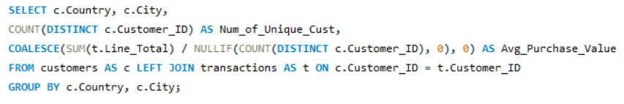
1. Customer Demographics Analysis
Retrieve the number of unique customers by country and city along with their average purchase value.
Country | City | Num_of_Unique_Cust | Avg_Purchase_Value
Deutschland | Ahrensburg | 1423 | 101.96
Deutschland | Altona | 1550 | 101.75
Deutschland | Bad Homburg | 964 | 86.05
Deutschland | Barsinghausen | 94 | 22.97
Deutschland | Bergedorf | 1502 | 101.86

Slide 7
Key Insights
Recommendations
Customer Concentration :
Cities like Altona, Bergedorf, and Ahrensburg have the highest number of unique customers (≈1500+ each), indicating they are major customer hubs.
Average Purchase Value Variance:
There’s a wide range in average purchase value — for instance, Bad Homburg has a lower average (≈86), while Barsinghausen is significantly lower (≈23), showing different spending behaviors.
High-Value Cities:
Cities with both high customer counts and high average purchase values (like Altona & Bergedorf) represent core revenue centers.
Low Engagement Areas:
Cities with low purchase values and fewer customers (like Barsinghausen) may indicate emerging or underperforming markets
Focus on High-Value Cities:
Strengthen marketing and retention in top-performing cities (Altona, Ahrensburg, Bergedorf) to boost ROI.
Improve Low-Value Regions:
Analyze and address factors behind low purchase values (e.g., pricing or awareness) in cities like Barsinghausen.
Targeted Customer Segmentation:
Use demographic and geographic insights to deliver region-specific offers.
Boost Mid-Tier Markets:
Apply loyalty programs or promotions in moderate-performing cities to increase customer spend.

Slide 8
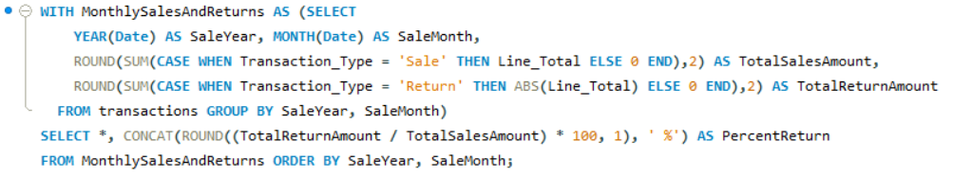
2. Sales vs Returns Trends
Calculate the percentage of returns compared to total transactions and track how it changes monthly.
SaleYear | SaleMonth | TotalSalesAmount | TotalReturnAmount | PercentReturn
2023 | 1 | 14793539.65 | 891617.87 | 6.00%
2023 | 2 | 12044607 | 700397.21 | 5.80%
2023 | 3 | 32054421.6 | 1808846.41 | 5.60%
2023 | 4 | 24753445.5 | 1344153.53 | 5.40%
2023 | 5 | 25428006.75 | 1348670.74 | 5.30%
2023 | 6 | 19564096 | 1096634.34 | 5.60%

Slide 9
Key Insights
Recommendations
Declining Return Rate:
Return percentage dropped from 6.0% (Jan) to 5.3% (May 2023), reflecting better quality or satisfaction.
Sales Peak:
March 2023 saw the highest sales (₹32.05M), likely due to promotions or seasonal demand.
High Absolute Returns:
Even with lower return %, total return value stayed high because of large sales volumes.
Inverse Relationship:
Higher sales months showed slightly lower return percentages.
Maintain Quality:
Focus on product improvements and customer support to keep returns under 5%.
Leverage Sales Drivers:
Analyze and replicate factors behind March’s success in upcoming periods.
Reduce High Returns:
Identify top-return products or vendors and take corrective actions.
Plan Strategically:
Use sales–return trends for accurate forecasting and campaign planning.

Slide 10
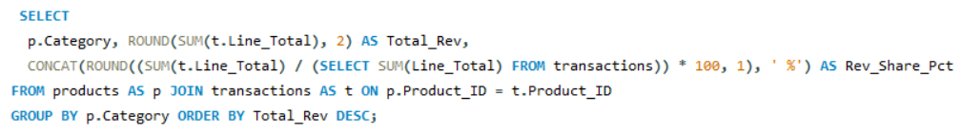
3. Top Performing Categories
Identify the top categories by total revenue and their share in overall sales.
Category | Total_Rev | Rev_Share_Pct
Feminine | 340685345.8 | 46.49%
Masculine | 326979394.6 | 44.62%
Children | 65080134.57 | 8.88%

Slide 11
Key Insights
Recommendations
Feminine category contributes the highest revenue (₹340.7M), accounting for 46.49% of total sales.
Masculine category follows closely with ₹326.9M (44.62%), showing strong demand.
Children category generates only 8.88% of sales, indicating a smaller market presence.
Together, Feminine and Masculine segments dominate with over 91% of total revenue.
Prioritize Feminine & Masculine lines — focus marketing, inventory, and new launches here to maximize ROI.
Expand Children category through targeted campaigns, bundling, or new product introductions.
Diversify offerings to reduce over-reliance on top two segments.
Analyze subcategory trends within Feminine and Masculine to identify high-growth niches.

Slide 12
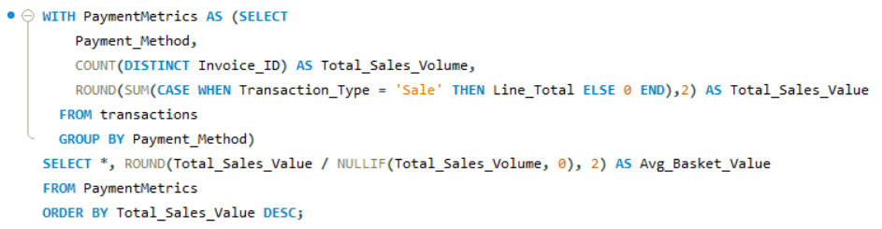
4. Payment Method Performance
Compare total sales volume and average basket value across payment methods.
Payment_Method | Total_Sales_Volume | Total_Sales_Value | Avg_Basket_Value
Credit Card | 3633549 | 621514010.4 | 171.05
Cash | 906855 | 154546512.2 | 170.42

Slide 13
Key Insights
Recommendations
Credit Card Dominates:
Credit Card transactions account for the highest sales volume (3.63M), significantly outperforming Cash payments (0.91M).
Higher Sales Value:
Credit Card payments also generate the highest total sales value (₹621.5M), contributing the majority of overall revenue.
Similar Basket Values:
Average basket value is almost the same for both methods (₹171 for Credit Card vs ₹170 for Cash), indicating consistent purchase behavior across methods.
Customer Preference:
High usage of Credit Cards suggests customer preference for digital and convenient payments over cash.
Promote Digital Payments:
Encourage credit/debit card and online payment options through cashback or loyalty points to maintain digital dominance.
Incentivize Cash Users:
Offer small discounts or reward points to shift cash users toward digital modes, improving transaction efficiency.
Monitor Transaction Fees:
Evaluate payment gateway charges for card transactions to ensure profitability is not affected.
Expand Payment Variety:
Introduce UPI or wallet-based options to further increase convenience and capture a broader audience.

Slide 14
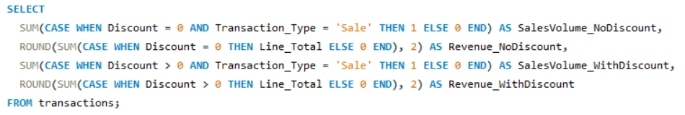
5. Promotion Impact Analysis
Compare sales volume and revenue during discount periods versus non-discount periods.
SalesVolume_ NoDiscount | Revenue_ NoDiscount | SalesVolume_ WithDiscount | Revenue_ WithDiscount
4288334 | 588589044.6 | 1788866 | 144155830.46
SalesVolume_NoDiscount | Revenue_NoDiscount | SalesVolume_WithDiscount | Revenue_WithDiscount
4288334 | 588589044.6 | 1788866 | 144155830.46

Slide 15
Key Insights
Recommendations
Periodic Promotions:
Discounts were active intermittently across the full sales duration (2023–2025), not continuously.
Uneven Sales Rows:
1,788,866 discounted sales rows (29%) vs. 4,288,334 non-discounted sales rows (71%) — indicating limited discount coverage.
Lower Sales & Revenue:
Discount periods contributed less to overall sales volume and revenue, mainly due to fewer active promotional days.
Selective Campaigns:
The smaller discount share suggests targeted or short-term promotions rather than ongoing discounts
Optimize Promotion Timing:
Extend or align discounts with high-demand periods to lift sales contribution.
Analyze Per-Transaction Metrics:
Compare average revenue per sale to assess real promotional effectiveness.
Target Smartly:
Focus discounts on high-potential products or customer groups to maximize ROI.
Monitor & Refine:
Continuously track sales and revenue trends during promotions to fine-tune strategy.

Slide 16
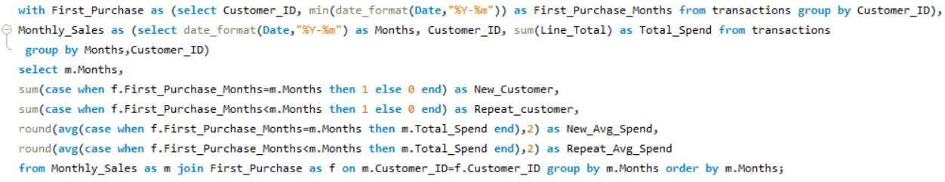
6. Customer Loyalty Tracking
Measure the proportion of new versus repeat customers each month along with their average spend.
SalesVolume_NoDiscount | Revenue_NoDiscount | SalesVolume_WithDiscount | Revenue_WithDiscount
4288334 | 588589044.6 | 1788866 | 144155830.46
Months | New_Customer | Repeat_customer | New_Avg_Spend | Repeat_Avg_Spend
2023-01 | 110456 | 0 | 125.86 | NULL
2023-02 | 68575 | 9485 | 148.02 | 125.83
2023-03 | 134769 | 29144 | 183.79 | 187.91
2023-04 | 83311 | 36317 | 195.1 | 197.03
2023-05 | 85055 | 50180 | 175.88 | 181.75
2023-06 | 47897 | 38465 | 211.94 | 216.2

Slide 17
Key Insights
Recommendations
Strong New Customer Acquisition (Early Months):
January saw the highest influx of new customers (110K+), indicating strong initial marketing or launch impact.
Growing Repeat Customer Base:
Repeat customers increased steadily from February (9K) to May (50K+), showing improving retention month-over-month.
Spending Trend – Repeat Customers Lead:
From March onward, repeat customers consistently spent slightly more per transaction (≈$188–$197) than new ones, suggesting loyalty value.
Declining New Customer Spend:
After peaking in April (~$195), average spend of new customers dipped in May (~$176), hinting at either smaller purchase sizes or promotional discounts.
Enhance Retention Campaigns:
Leverage loyalty programs, email reminders, and personalized offers to further increase repeat purchases.
Boost New Customer Conversion:
Optimize onboarding and post-purchase engagement to encourage repeat behavior from new buyers.
Analyze Spend Drivers:
Investigate factors behind lower new customer spend—review product mix, pricing, and promotion structure.
Reward High-Value Repeat Customers:
Identify top repeat spenders and offer exclusive benefits to reinforce brand loyalty and advocacy.

Slide 18
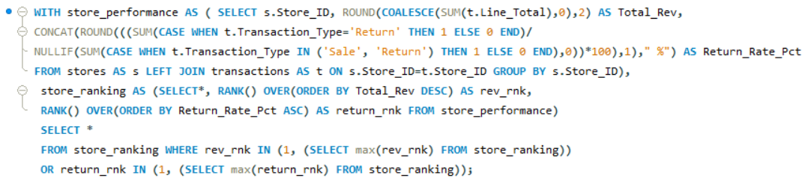
7. Store Performance Ranking
Identify the top and bottom stores by revenue and return rates.
Store_ID | Total_Rev | Return_Rate_Pct | rev_rnk | return_rnk
35 | 3916189 | 0.051 | 25 | 1
23 | 4830092 | 0.051 | 19 | 1
6 | 1.32E+08 | 0.052 | 1 | 3
18 | 2270242 | 0.053 | 35 | 13
27 | 3448816 | 0.055 | 29 | 35

Slide 19
Key Insights
Recommendations
Top revenue store:
Store 6 — ₹132,225,379.37 (highest revenue).
Bottom revenue store:
Store 18 — ₹2,270,242.02 (lowest revenue).
Best (lowest) return rate:
Store 35 — 5.1% returned (tie with Store 23 at 5.1%).
Worst (highest) return rate:
Store 27 — 5.5% returned.
Scale what’s working at Store 6:
Audit Store 6’s product mix, promotions, staffing, and footfall tactics; pilot those practices in similar-performing locations to increase revenue elsewhere.
Revive low-revenue stores (e.g., Store 18):
Run local promos, optimize assortment for local demand, and invest in staff training and visual merchandising.
Reward and replicate low-return practices:
Study Stores 35 & 23 (5.1% returns) for customer service, quality control, and packaging practices — replicate across stores.
Fix high-return stores (Store 27):
Investigate causes (product quality, incorrect items, fulfillment errors, misleading descriptions). Prioritize root-cause fixes — product checks, clearer product info, or targeted staff retraining

Slide 20
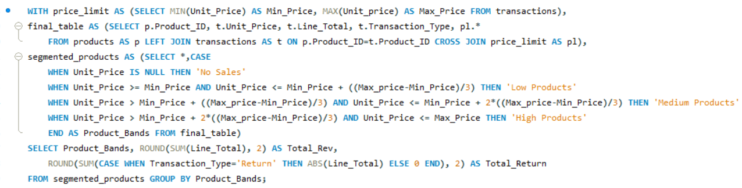
8. Price Band Contribution
Segment products into price bands and analyze their contribution to total revenue and returns.
Product_Bands | Total_Rev | Total_Return
Low Products | 390739539.1 | 23127145.03
Medium Products | 249389332.4 | 14837255.68
High Products | 92616003.47 | 5351246.92

Slide 21
Key Insights
Recommendations
Dominant Revenue Segment:
Low-priced products generate the highest revenue (~₹390.7M), contributing the largest share to total sales.
Balanced Mid-Tier Performance:
Medium-priced products contribute a significant ₹249.3M, indicating stable demand in the mid-price range.
High-Price Niche Market:
High-priced products account for only ₹92.6M, showing limited but premium-focused demand.
Return Trends:
Return amounts correlate with revenue levels — low-priced items also have the highest total returns (~₹23.1M), possibly due to higher sales volume.
Optimize Low-Price Range:
Maintain strong inventory and ensure consistent quality to minimize returns in this high-volume segment.
Boost Medium Segment Profitability:
Introduce targeted promotions to convert medium-tier customers into repeat buyers.
Expand Premium Category:
Improve product visibility, highlight premium features, and bundle offers to drive interest in high-value items.
Analyze Return Reasons:
Investigate return patterns across price bands to identify product or service issues, especially in the low-price category.

Slide 22
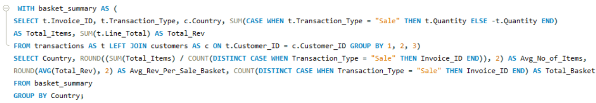
9. Basket Size Insights
Calculate the average number of items and revenue per basket across different countries.
Country | Avg_No_of_Items | Avg_Rev_Per_Sale_Basket | Total_Basket
Deutschland | 1.46 | 56.93 | 506737
EspaÃ±a | 1.45 | 57.4 | 387922
France | 1.46 | 56.99 | 438787
Portugal | 1.45 | 56.99 | 392147
United Kingdom | 1.46 | 40.07 | 423831
United States | 1.46 | 63.23 | 1139376
ä¸­å›½ | 1.46 | 488.87 | 1048470
SalesVolume_NoDiscount | Revenue_NoDiscount | SalesVolume_WithDiscount | Revenue_WithDiscount
4288334 | 588589044.6 | 1788866 | 144155830.46

Slide 23
Key Insights
Recommendations
Uniform Basket Size:
Across all countries, the average number of items per basket is nearly consistent (~1.45–1.46), suggesting similar purchasing behavior in quantity.
Revenue Variation by Country:
España (57.40) leads slightly in average revenue per basket, while United Kingdom (40.07) records the lowest, indicating possible differences in pricing or product mix.
High Transaction Volume:
Deutschland (506K baskets) has the highest total baskets, contributing significantly to overall sales volume.
Potential Pricing Gap:
Despite similar basket sizes, the UK’s lower revenue per basket may reflect cheaper product categories or stronger discounting.
Review UK Pricing Strategy:
Investigate reasons for lower basket revenue and explore upselling or premium product placement to raise per-basket value.
Replicate High-Revenue Models:
Analyze España’s approach (product mix or pricing) and apply successful tactics in lower-revenue markets.
Encourage Multi-Item Purchases:
Implement bundled offers or minimum spend incentives to increase average items per basket.
Continuous Monitoring:
Track changes in average basket metrics monthly to identify shifts in purchasing trends across countries.

Slide 24
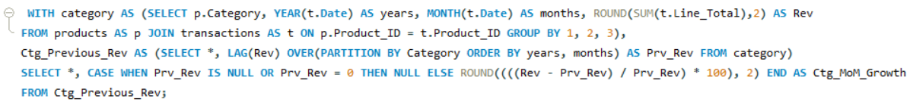
10. Monthly Growth Trends
Analyze month-over-month revenue growth overall and for the top three categories.
years | months | Rev | Prv_Rev | Overall_MoM_Growth
2023 | 1 | 13901921.78 | NULL | NULL
2023 | 2 | 11344209.79 | 13901921.78 | -18.4
2023 | 3 | 30245575.19 | 11344209.79 | 166.62
2023 | 4 | 23409291.97 | 30245575.19 | -22.6
SalesVolume_NoDiscount | Revenue_NoDiscount | SalesVolume_WithDiscount | Revenue_WithDiscount
4288334 | 588589044.6 | 1788866 | 144155830.46
Category | years | months | Rev | Prv_Rev | Ctg_MoM_Growth
Children | 2023 | 1 | 1391900.45 | NULL | NULL
Children | 2023 | 2 | 835450.99 | 1391900.45 | -39.98
Children | 2023 | 3 | 3628070.37 | 835450.99 | 334.26
Children | 2023 | 4 | 1694579.2 | 3628070.37 | -53.29

Slide 25
Key Insights
Recommendations
Overall Volatility:
Revenue fluctuated sharply — down 18% in Feb, up +167% in Mar, then dipped –23% in Apr, showing strong seasonal or promo-driven impact.
Category Variation:
Children: Highly volatile (+334% in Mar).
Feminine: More stable with mild growth shifts.
Masculine: Moderate, steady trend balancing overall sales.
March Peak:
All categories hit peak revenue in March 2023, likely due to promotions or high seasonal demand.
Stabilization After March:
Growth slowed in April–May, marking a return to normal demand post-campaign.
Replicate March Success:
Analyze what drove the March surge (promotions, new launches, marketing campaigns) and plan similar initiatives quarterly to sustain growth.
Stabilize Children Category Sales:
Since the Children category shows the highest volatility, implement steady marketing efforts — e.g., monthly mini-promotions or bundles — to reduce sharp drops.
Strengthen Feminine & Masculine Segments:
Focus on cross-category promotions (e.g., combo deals or gift bundles) to maintain balanced revenue and offset fluctuations in the Children segment.
Build Predictive Growth Tracking:
Use MoM patterns to forecast category demand cycles and optimize inventory, production, and marketing timing to align with expected peaks.

Slide 26
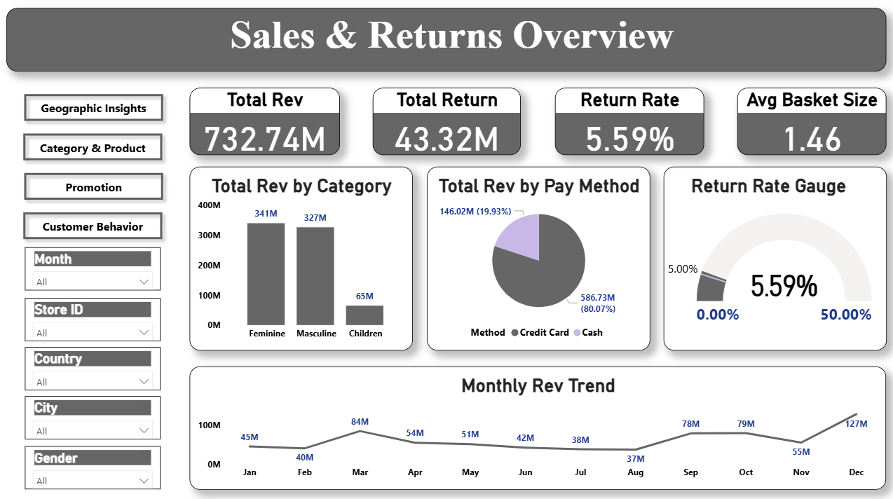

Slide 27
Key Insights
Recommendations
Total Revenue:
₹732.74M with Return Rate 5.59% — stable performance with moderate returns.
Average Basket Size:
Consistent, indicating steady purchase behavior.
Category Contribution:
Feminine (341M) and Masculine (327M) dominate; Children (65M) trails far behind.
Payment Contribution:
Credit Cards contribute ~80% of revenue, showing digital payment dominance.
Monthly Trend: Revenue peaks in December, suggesting strong seasonality or festive influence.
Launch mid-year sales campaigns to smoothen monthly dips.
Maintain credit card rewards or partnerships to retain high-value customers.
Promote Children category via bundles or discount drives.
Use return rate KPI to continuously monitor product satisfaction.

Slide 28
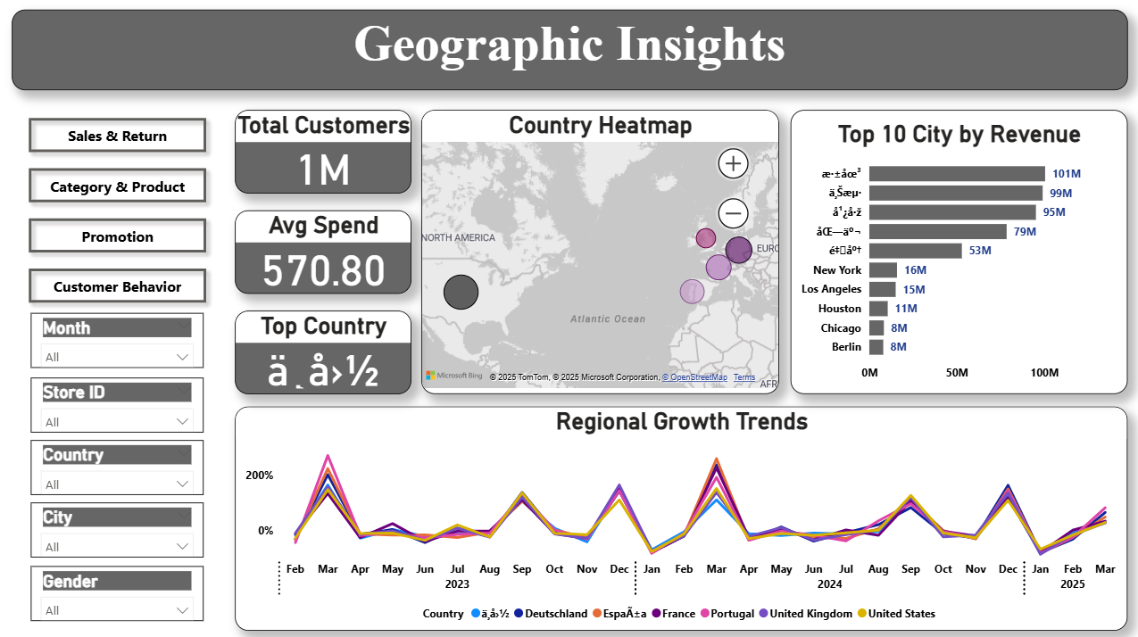

Slide 29
Key Insights
Recommendations
Customer concentration highest in European countries, with clear hotspots in a few cities.
Average spend per region shows major gaps — some cities spend nearly 3× more.
Regional growth trends indicate periodic spikes around late-year months.
Top cities (~100M each) dominate the total sales volume, showing geographical imbalance.
Focus marketing on top-performing cities while nurturing smaller regions.
Investigate pricing and demand differences between high- and low-spend regions.
Use regional filters to monitor store-level contributions monthly.

Slide 30
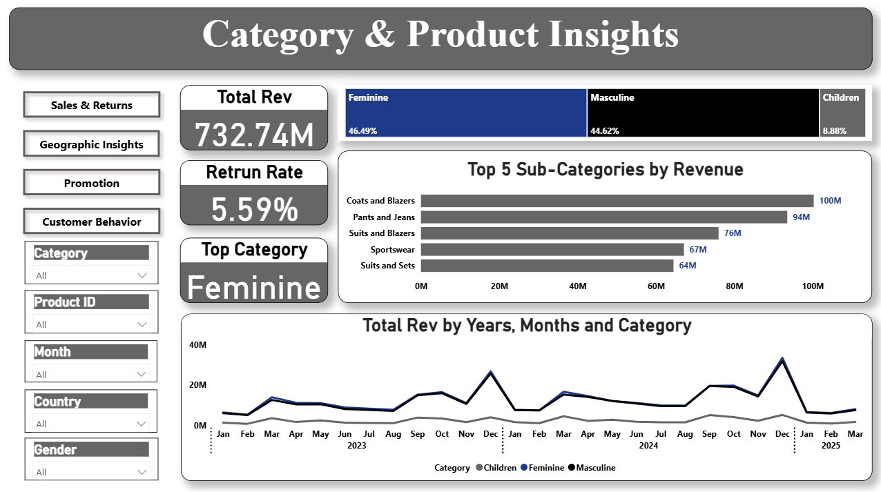

Slide 31
Key Insights
Recommendations
Feminine (46%) is the leading category by far, followed by Masculine (45%), confirming balanced gender-based performance.
Children (9%) remains underdeveloped.
Top subcategories: Coats & Blazers (₹100M), Pants & Jeans (₹94M).
Category trends show consistent year-end peaks in all major segments.
Continue product innovation and marketing in Feminine and Masculine categories.
Increase Children product visibility via seasonal campaigns or bundles.
Analyze subcategory profitability to guide future assortment planning.
Maintain return rate under 6% through tighter quality checks.

Slide 32
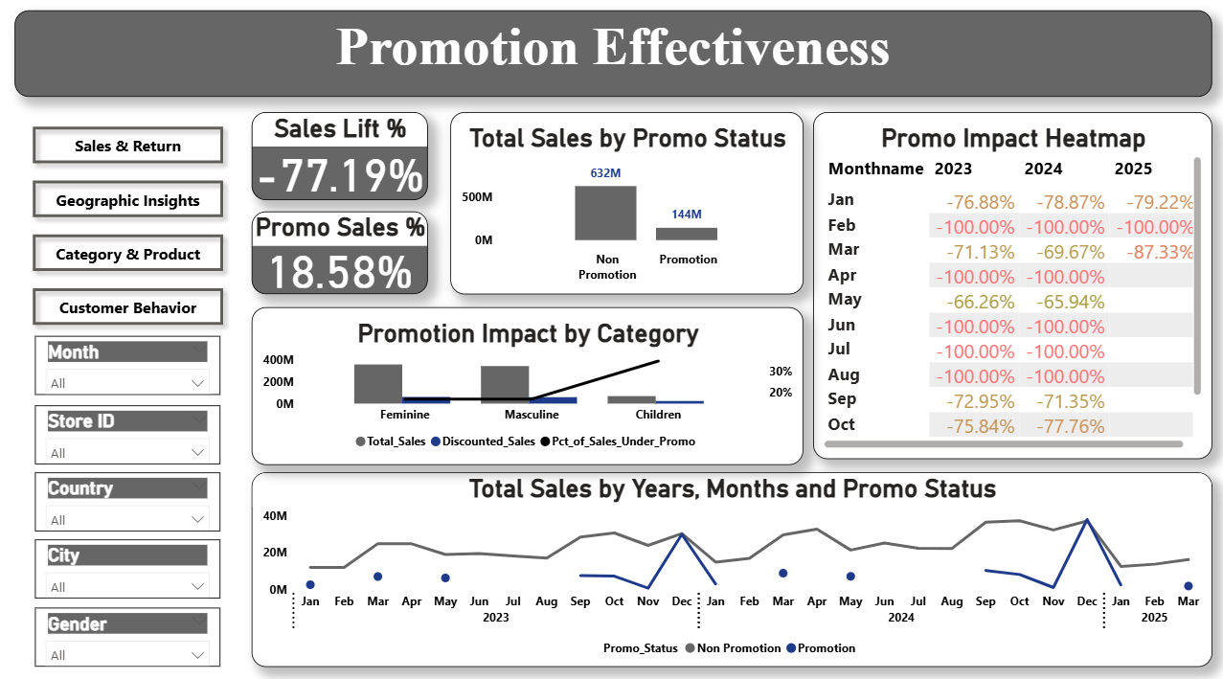

Slide 33
Key Insights
Recommendations
Promotions were irregular, active only in select months, showing non-continuous campaigns across 2023–2025.
Children category gained the highest sales under promotion, while Feminine and Masculine saw limited lift.
Only 29% of total transactions occurred during discounted periods, confirming targeted, short-term offers.
Overall sales lift (−77.19%) indicates promotions didn’t boost total revenue significantly.
Focus promotions on high-response categories like Children to sustain momentum.
Increase promo frequency and plan consistent quarterly campaigns instead of sporadic events.
Improve timing by aligning promos with peak demand months (e.g., Dec–Mar).
Evaluate promo ROI per category to refine discount depth and duration.

Slide 34
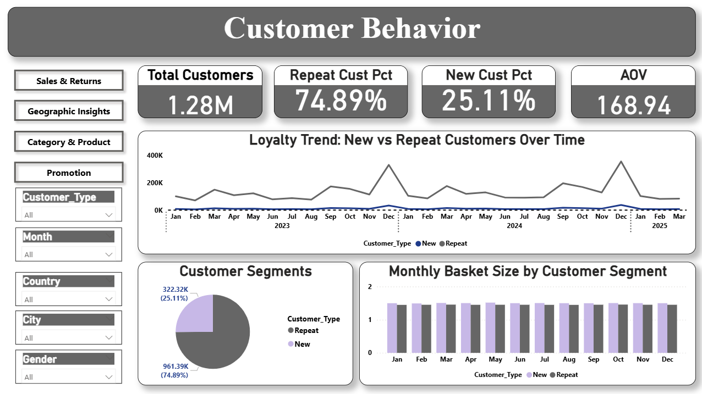

Slide 35
Key Insights
Recommendations
Repeat Customers: 74.89% — strong loyalty base.
New Customers: 25.11%, reflecting steady acquisition but lower than retention.
Average Order Value: ₹168.94, indicating consistent spending across segments.
Basket Size: Stable across months, suggesting predictable purchasing patterns.
Trendlines: Repeat customers show upward movement, confirming brand loyalty.
Maintain loyalty incentives (cashbacks, points) to reward repeat customers.
Encourage new-to-repeat conversion via onboarding offers or feedback-based engagement.
Track AOV by gender or location for more granular insights.
Launch cross-sell recommendations to slightly raise average basket size.

Slide 36
Machine Learning Overview
Machine Learning Component – Predictive Analytics
In the final stage of the project, advanced machine learning models were developed to solve two major operational challenges for Global Fashion Retail: predicting return-risk transactions and forecasting monthly demand. These models help the business proactively reduce losses from returns, optimize inventory planning, and ensure better customer experience.

Slide 37
Return Prediction Model
Classification (Logistic Regression & Random Forest)
Goal: Predict high-risk return transactions to support quality checks and proactive customer support.
Approach:
ML pipeline using Scikit-learn + SMOTE (inside Pipeline → no leakage)
21 engineered features across customer, product, store, transaction & time
Baseline: Logistic Regression
Final Model: Random Forest Classifier
Threshold tuning: Youden’s J statistic
Evaluation Metrics:
Precision – correctness of predicted returns
Recall – ability to capture actual returns
F1-Score – balance for imbalanced classes
ROC-AUC – overall model performance
Code:
GitHub → https://github.com/parvej1-7alam/WsCube-DAMP-ML-Capstone/blob/main/Notebooks/ML_Capstone_Part1.ipynb

Slide 38
Return Prediction Model – Evaluation & Summary
Goal: Predict if a transaction will be returned.
Key Metrics:
Precision: 0.30 (LR), 0.26 (RF) → Many predicted returns are false positives.
Recall: 0.90 (LR), ~1.00 (RF) → Almost all actual returns are detected.
F1 Score: 0.45 (LR), 0.41 (RF) → Balance between precision & recall.
Accuracy: 0.88 (LR), 0.85 (RF) → Misleading due to class imbalance.
ROC–AUC: 0.952 → Excellent class separation for both models.
Interpretation:
Models are tuned to maximize detection of returns.
Logistic Regression: More balanced, fewer false positives.
Random Forest: Extremely high recall, slightly better ROC–AUC, more false positives.
Recommendation:
Prioritize recall → Random Forest
Prioritize balance/interpretability → Logistic Regression
Summary: Both models effectively detect returns. Choice depends on whether catching all returns or reducing false positives is more important.

Slide 39
Monthly Demand Forecasting
Gradient Boosting Regressor (Time Series ML)
Goal: Forecast monthly units sold for each Category × Country to improve inventory planning and reduce stockouts/overstocking.
Approach:
Model Used: Gradient Boosting Regressor
Monthly demand aggregated by Category and Country
Feature Engineering:
  Lag features: Lag_1, Lag_2, Lag_3, Lag_12
  Time features: Year, Month
  Seasonality: Month_Sin, Month_Cos
  Demand & pricing behavior: Total_Sales, Avg_Unit_Price, Avg_Effective_Price, Avg_Discount, Total_Transactions, Total_Discounted_Transactions
  Category & region: Category, Country
Evaluation Metrics:
MAPE – Percent forecast accuracy
MSE – Error magnitude across months
Code:
GitHub → https://github.com/parvej1-7alam/WsCube-DAMP-ML-Capstone/blob/main/Notebooks/ML_Capstone_Part2.ipynb

Slide 40
Monthly Demand Forecasting – Evaluation & Summary
Goal: Predict monthly units sold for each Category × Country segment.
Key Metrics:
RMSE: 181.73→ Average prediction error is about ±182 units — low relative to overall demand scale.
MAPE: 1.12% → Excellent accuracy; predictions deviate from actual values by only ~1%.
Interpretation:
Model captures trend, seasonality, and non-linear patterns effectively.
Lag features (Lag_1, Lag_2, Lag_3, Lag_12) strongly drive predictive power.
Cyclical features (Month_Sin, Month_Cos) help the model recognize smooth month-to-month transitions.
Pricing & sales features improve model sensitivity to promotion-driven demand changes.
Extremely low MAPE indicates high reliability across all segments.
Recommendation:
Gradient Boosting remains the best model due to strong performance on:
1) Non-linear seasonal patterns
2) Cross-category variability
3) Price/demand interactions
Can be confidently used for inventory planning and demand-driven procurement.
Summary:
The Gradient Boosting Regressor delivers highly accurate monthly forecasts with minimal percentage error.
Its ability to learn trends, seasonal behavior, and lag relationships makes it a reliable tool for operational planning, stocking decisions, and supply chain optimization.

Slide 41
Final Strategic Recommendations (Overall)
Optimize inventory planning using ML demand forecasts → reduce stockouts, lower excess stock, and improve availability of top categories.
Reduce returns proactively using the Return Prediction model → trigger quality checks, flag risky products, and pre-alert customer support teams.
Strengthen regional strategies based on SQL + BI insights → invest more in high-performing cities, and support growing markets with targeted promotions.
Refine promotion planning by analyzing discount effectiveness → focus discounts on categories with strong uplift (e.g., Children).
Enhance customer retention by leveraging loyalty insights → reward repeat customers, introduce segment-based pricing/communication.
Improve product assortment & pricing using category-level revenue, return trends, and forecasting outputs.
Use dashboards for continuous monitoring → enable leadership to track KPIs, dive into store-level issues, and make fast data-driven decisions.
This integrated analytics solution empowers Global Fashion Retail to grow revenue, reduce returns, optimize inventory, and deliver a superior customer experience.

Slide 42



Thank You!
zzzz
Your feedback is valuable -Feel free to connect me here:
parvejalam17knp@gmail.com
https://www.linkedin.com/in/parvej-alam17/
https://github.com/parvej1-7alam

