Slide 1
Impact of climate conditions on Electricity generation and Agricultural production in Mauritius

Slide 2
Datasets used:
FAOSTAT
NASA POWER
CEB ELECTRICITY

Slide 3
Purpose of study
Analyse the effects of climate change on the production of sugarcane and electricity
Explore changes in temperature and precipitation from 2015 to 2022
Encourage climate-smart farming and renewable energy

Slide 4
Data sources and formats
An overview of Datasets used are:
CEB ELECTRICITY | CSV | Mauritius Open Data
NASA POWER | JSON | API
FAOSTAT CROPS | CSV | R directory

Slide 5
ETL Workflow Process
Extract: fread(), from JSON()
Transform: cleaning, harmonization, aggregation
Load: MySQL database with dimension and fact tables

Slide 6
Risk Mitigation
Automated validation checks and backups
Outlier management and imputation flags

Slide 7
Governance and Ethics
Open – access, non – Personally Identifiable Information datasets
SQL constraints and metadata documented
Compliance with Mauritius Data Protection Act (2017)

Slide 8
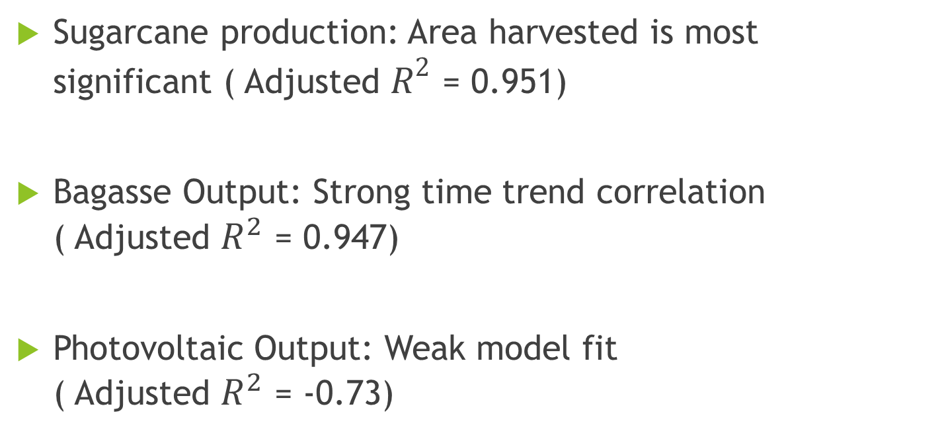
Modeling outputs
Sugarcane production: Area harvested is most significant ( Adjusted $R^{2}$ = 0.951)
Bagasse Output: Strong time trend correlation ( Adjusted $R^{2}$ = 0.947)
Photovoltaic Output: Weak model fit ( Adjusted $R^{2}$ = -0.73)

Slide 9
Interpretation of the models
Yield is slightly affected by climate, but production is influenced by harvested area
The production of electricity from bagasse evolves non linearly
Temperature and precipitation have minor impact on solar output.

Slide 10
Policy Linkage
Alignment with SDGs and National Goals:
SDG 7: Renewable energy expansion
SDG 2, 12, 13: Sustainable agriculture and climate resilience
SDG 15: Ecosystem protection and land restoration.

Slide 11
Conclusion & Recommendations
Strategic measures for Mauritius:
Invest in irrigation and agriculture that can withstand climate change.
Enhance the use of bagasse obtained via sugarcane production for electricity generation.
Incorporate climate data into energy planning.
Develop early warning and monitoring systems.

Slide 12
Thank you

