Slide 1




NEXT GEN EMPLOYABILITY PROGRAM
Creating a future-ready workforce
Team Members
College Name
Student Name :S.K.ASHIK PARVEZ
Student ID :912421104006
Shanmuganathan engineering college

Slide 2

CAPSTONE PROJECT SHOWCASE
Project Title
VOTING_APPLICATION_USING _DJANGO_FRAMEWORK_ASHIK(4006),SEC
Abstract | Problem Statement | Project Overview | Proposed Solution | Technology Used | Modelling & Results | Conclusion

Slide 3
Abstract
Abstract: In the digital era, interactive platforms play a pivotal role in engaging users and gathering valuable insights. This abstract presents the design and implementation of a polling application using Django, a high-level Python web framework.
User-focused Abstract: User-focused abstracts emphasize the functionality and benefits of the Django project from the perspective of the end-user. It highlights the key features, user experience considerations, and how the project addresses user needs or solves specific problems.
Research Abstract: Research abstracts are suitable for Django projects that involve novel approaches, methodologies, or contribute to academic or scientific fields. It outlines the research objectives, methodology, findings, and implications of the Django project.
Technical Abstract: This type of abstract provides a high-level overview of the Django project's technical aspects, such as its architecture, frameworks, libraries, and implementation details. It may discuss the specific features of Django used, any third-party packages incorporated, and the database model employed.
Business Abstract: Business abstracts are tailored for stakeholders, managers, or decision-makers interested in the Django project's business value and potential ROI (Return on Investment). It discusses how the project aligns with business goals, improves efficiency.
Source :

Slide 4
Problem Statement
The absence of a dedicated platform for conducting polls can hinder community engagement, limit data collection opportunities, and impede informed decision-making processes. Furthermore, existing polling solutions may be expensive, lack customization options, or compromise user privacy and security.
The primary goal of this project is to develop a versatile and scalable polling platform that caters to the needs of diverse user groups, including communities, organizations, and businesses. By providing an accessible and intuitive interface for conducting polls, the application will foster engagement, facilitate data-driven decision-making, and empower users to voice their opinions effectively.
the lack of accessible and user-friendly polling platforms presents a barrier to engaging communities and organizations in this process. Traditional polling methods are often cumbersome, lack real-time feedback, and may not reach a wide audience. Thus, there is a need for a modern, interactive polling application that empowers users to create, participate in, and analyze polls with ease.
Source :

Slide 5
Project Overview
Project Title: DjangoVote
Objective: Develop a robust electronic voting (e-voting) application using the Django framework to streamline the voting process, ensure security, and enhance accessibility for voters.
Key Features:
User Authentication: Implement secure user authentication for voter registration and login.
Ballot Creation: Allow election administrators to create and customize electronic ballots for different elections.
Vote Casting: Enable registered voters to cast their ballots online securely.
Expected Outcomes:
Increased Efficiency: By automating the voting process and reducing manual intervention.
Enhanced Security: By leveraging Django's built-in security features to protect against vulnerabilities.
Source :

Slide 6
Proposed Solution
The proposed solution for the Django polling application aims to address the identified problem statement by developing a feature-rich, user-friendly, and secure platform for creating, managing, and analyzing polls. Leveraging the Django framework's capabilities and best practices in web development,
User Authentication and Authorization: Implementing a robust user authentication system to allow users to create accounts, log in securely, and manage their profiles. User roles and permissions will be defined to ensure appropriate access levels for creating, editing, and participating in polls.
Poll Creation and Management: Providing users with an intuitive interface to create polls with customizable questions and answer options. Users can set parameters such as poll duration, visibility settings, and privacy preferences. Polls can be categorized, tagged, or grouped for easier management.
Real-time Voting and Results: Integrating AJAX techniques to enable real-time updates without page reloads, ensuring a seamless voting experience for users. As users vote on polls, the results will be dynamically updated and displayed in various formats such as charts or graphs for easy interpretation.
Source :

Slide 7
4.Responsive Frontend Design: Developing a responsive and visually appealing frontend using HTML, CSS, and JavaScript frameworks like Bootstrap or Vue.js. The frontend will be optimized for different devices and screen sizes to ensure a consistent user experience across desktops, tablets, and mobile devices.
5.Data Persistence and Security: Utilizing Django's built-in ORM (Object-Relational Mapping) to manage poll data efficiently and securely. Data validation and input sanitization will be enforced to prevent common security vulnerabilities such as SQL injection or cross-site scripting (XSS). Additionally, measures such as CSRF protection and secure password hashing will be implemented to safeguard user data.
Source :

Slide 8


Technology Used
Front-end
Back-end
Source :

Slide 9
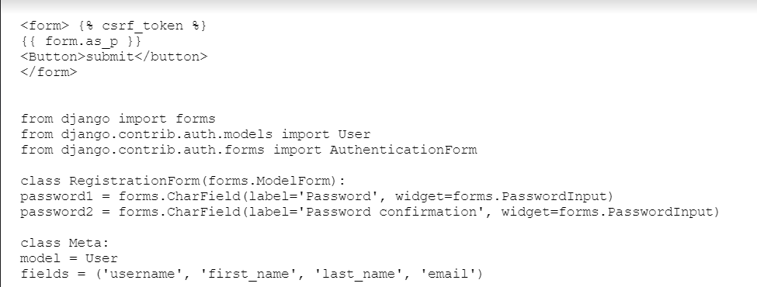
Modelling & Results
Source :

Slide 10
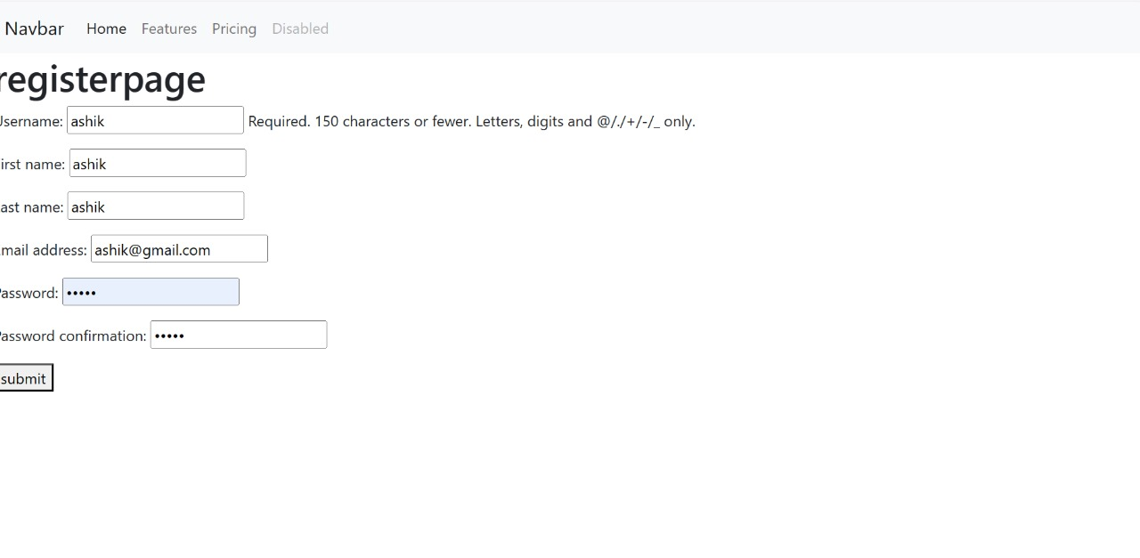
Homepage

Slide 11
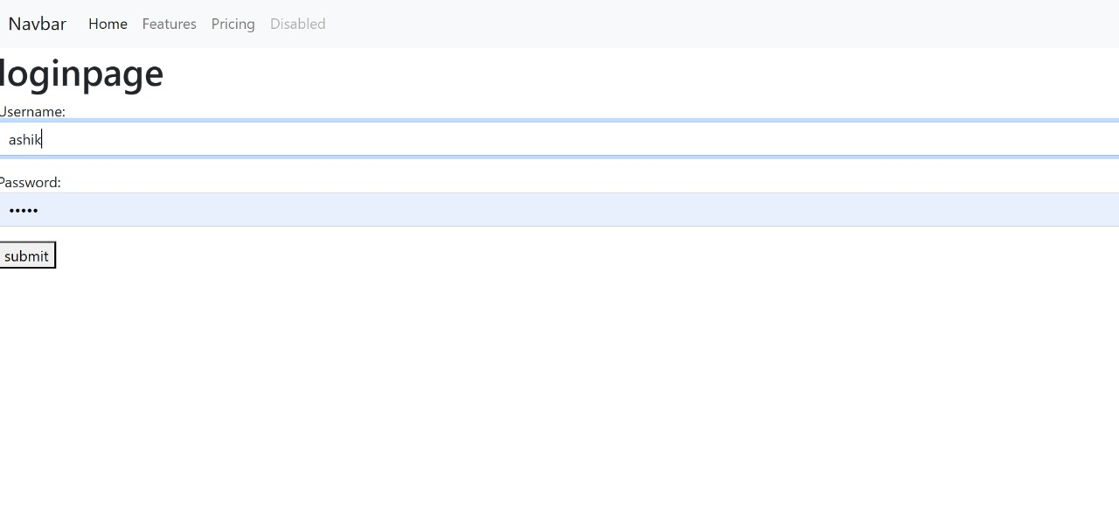
About-Us-Page

Slide 12
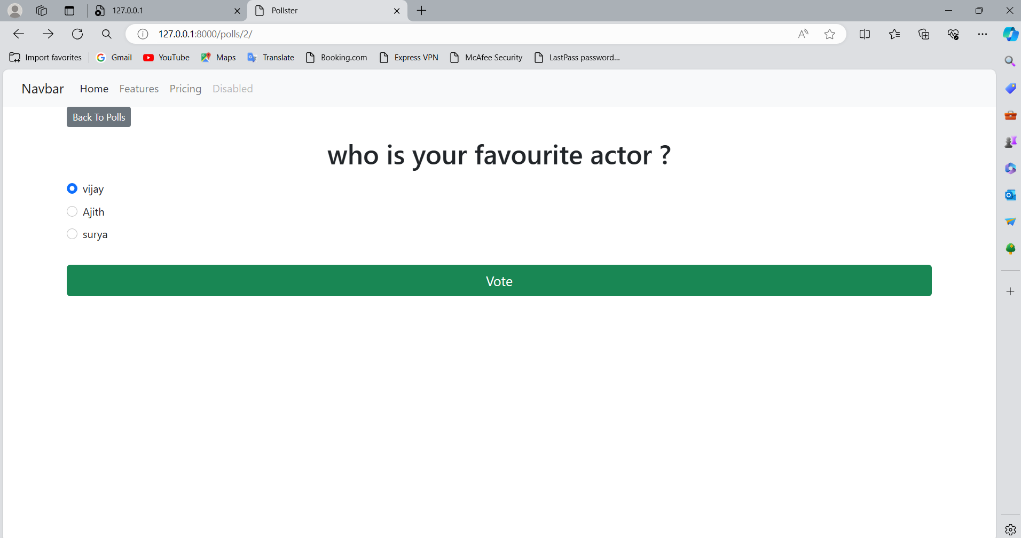
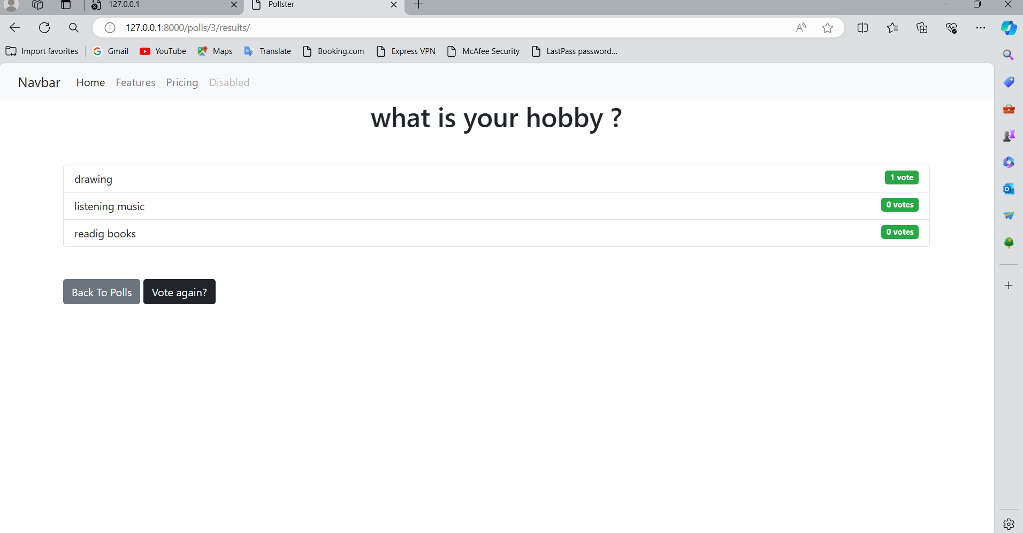
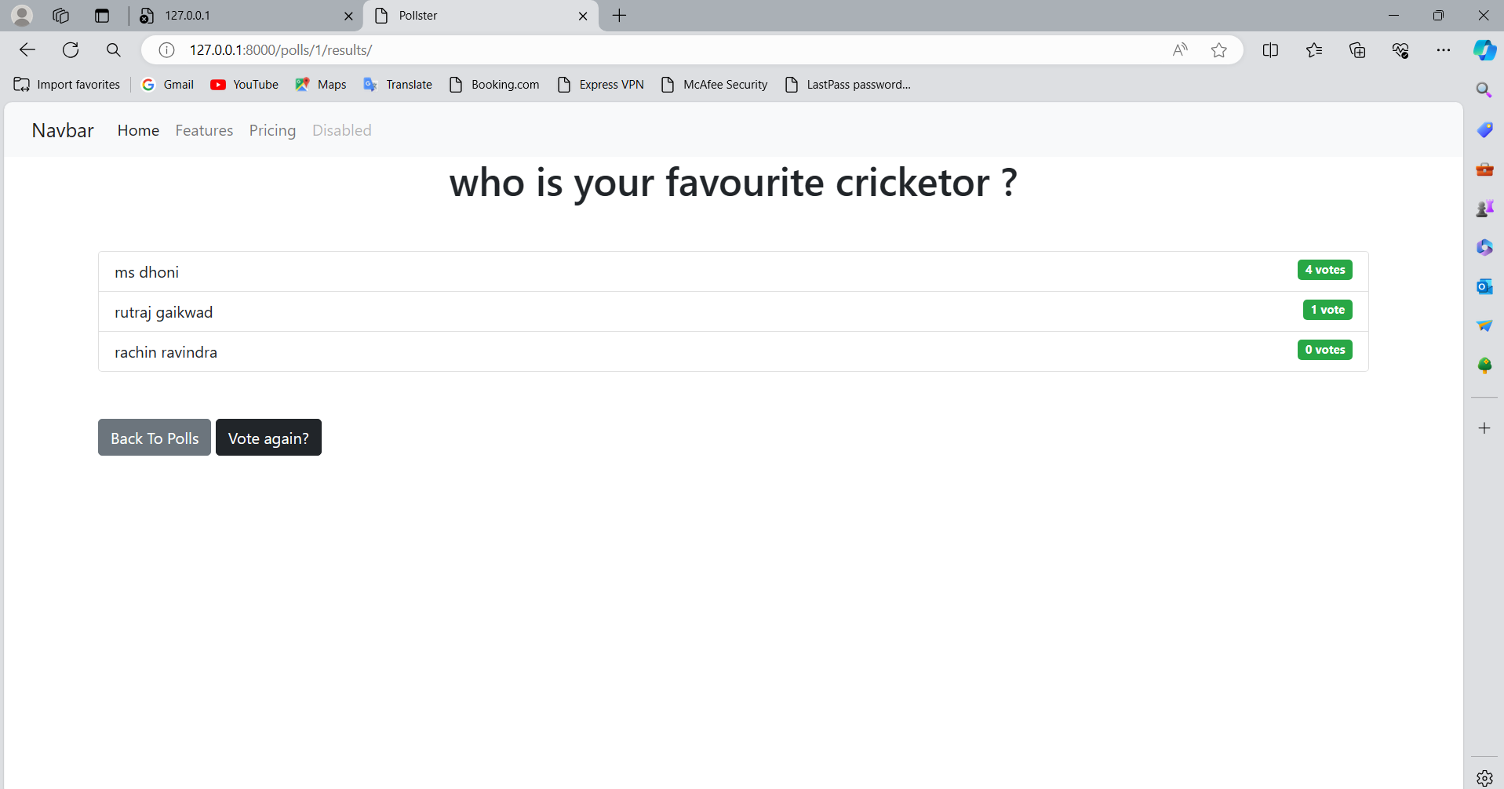
Service-Page

Slide 13
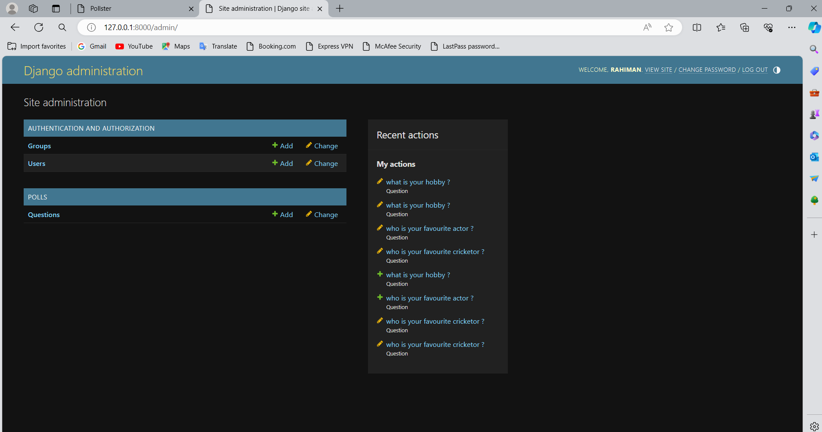
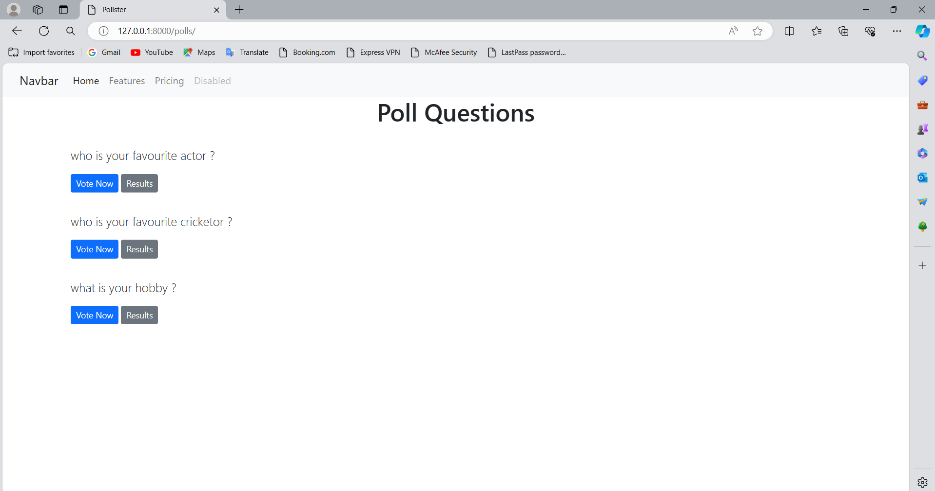
Departments-Page

Slide 14
Blog-Page
Title: "Empowering Democracy: Introducing Our Innovative Voting Application"
Introduction: In an age where technology is reshaping every aspect of our lives, it's time for democracy to catch up. Our voting application represents a leap forward in how we engage with the democratic process. In this blog post, we're thrilled to introduce you to our innovative voting application and explore how it's revolutionizing the way we participate in elections.
The Need for Change: Traditional voting methods are often cumbersome, time-consuming, and inaccessible to many. Long lines at polling stations, logistical challenges, and concerns about security and fraud have led to disenchantment with the electoral process. Our voting application seeks to address these issues by providing a modern, convenient, and secure way to cast your vote.

Slide 15
Future Enhancements:
Real-Time Notifications: Implement a notification system to alert users about new polls, voting reminders, or updates on polls they've participated in. This feature enhances user engagement and keeps users informed about relevant activities on the platform.
Advanced Analytics: Enhance the analytics module to provide more advanced data visualization options, such as trend analysis, demographic insights, and sentiment analysis of voter responses. This will help administrators derive deeper insights from poll data and make more informed decisions.
Social Media Integration: Integrate social media sharing options to allow users to easily share polls with their networks. This can increase the reach and visibility of polls, encouraging more participation and engagement from a wider audience.
Gamification Elements: Introduce gamification elements such as badges, achievements, or leaderboards to incentivize user participation and increase user retention. Users can earn rewards or recognition for active participation in polls, fostering a sense of competition and community.

Slide 16
Conclusion
, the development of a voting application using the Django framework presents a robust solution for facilitating democratic decision-making, community engagement, and data-driven insights. Through the utilization of Django's powerful features and best practices in web development, the application provides a seamless and intuitive platform for users to participate in polls, express their opinions, and analyze voting results effectively.
Source :

Slide 17
Thank You!
Notes:
Thank You !!

