Slide 1
Tower of Hanoi
Produced By : Syful Islam

Slide 2
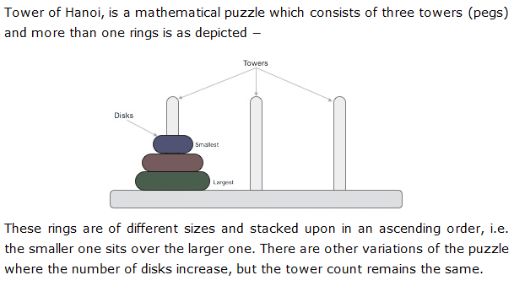
Introduction

Slide 3
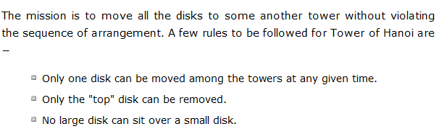
Rules

Slide 4
Recursive Solution

Slide 5
Recursive Solution

Slide 6
Recursive Solution

Slide 7
Recursive Solution

Slide 8
Tower of Hanoi

Slide 9
Tower of Hanoi

Slide 10
Tower of Hanoi

Slide 11
Tower of Hanoi

Slide 12
Tower of Hanoi

Slide 13
Tower of Hanoi

Slide 14
Tower of Hanoi

Slide 15
Tower of Hanoi

Slide 16
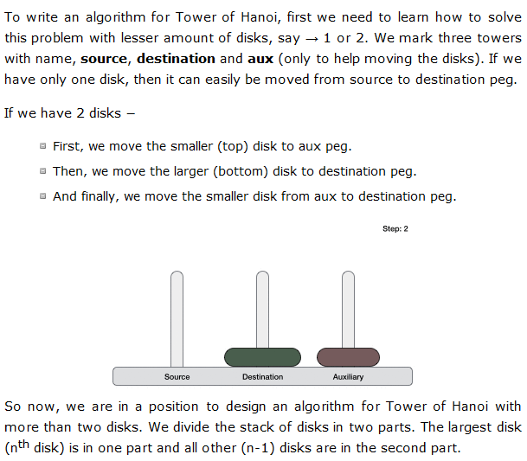
Algorithm

Slide 17
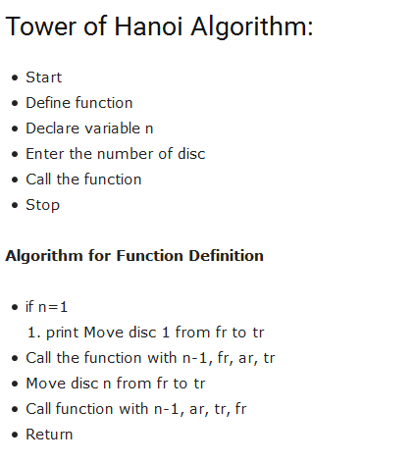

Slide 18
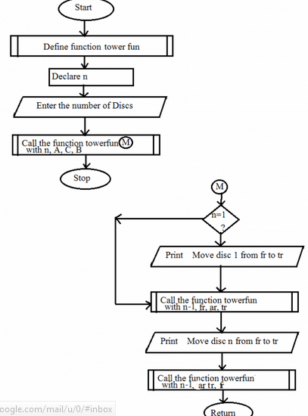
Flow Chart

Slide 19
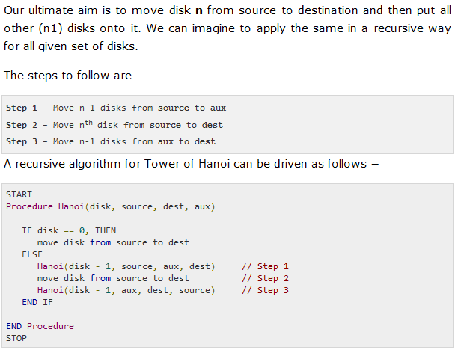
Cont.

Slide 20
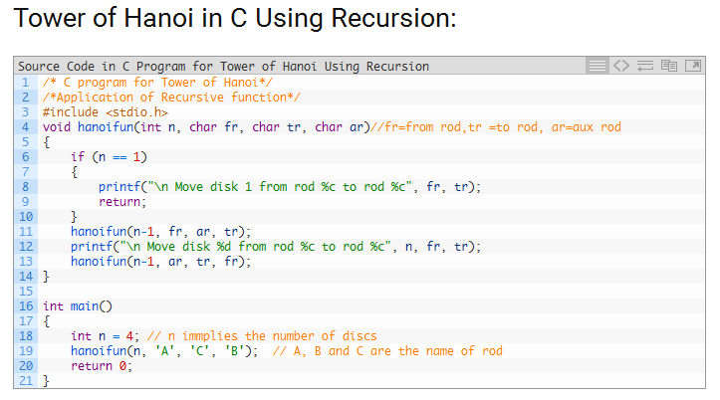

Slide 21
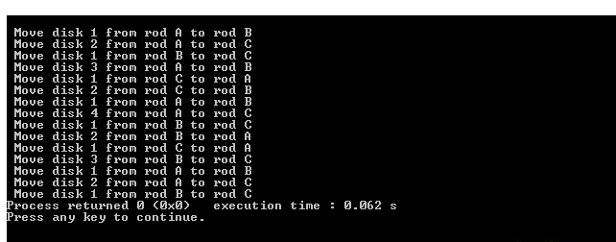
Output

Slide 22
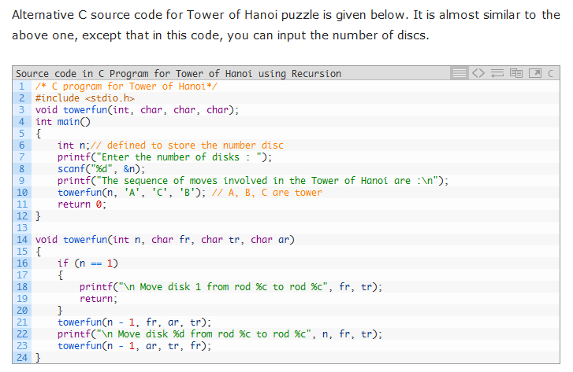

Slide 23
End

