Slide 1
Pushing & Pulling Data File From GitHub Repository
Md. Parvez Mosharaf
Department of Statistics
Rajshahi University
Date: 04-04-2018

Slide 2
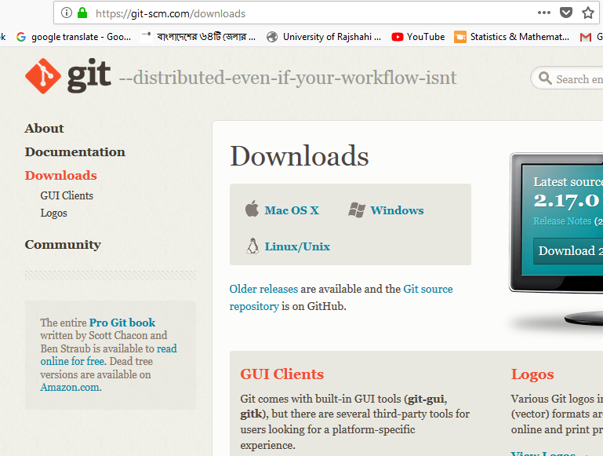
Git Bash Download

Slide 3
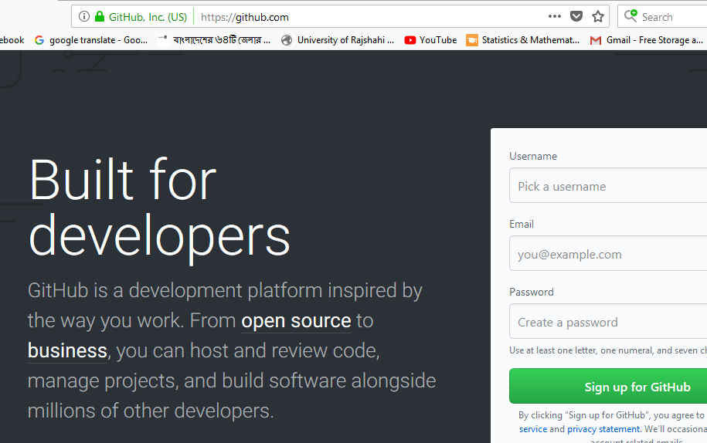
Step : 01
Create a GitHub account from www.github.com

Slide 4
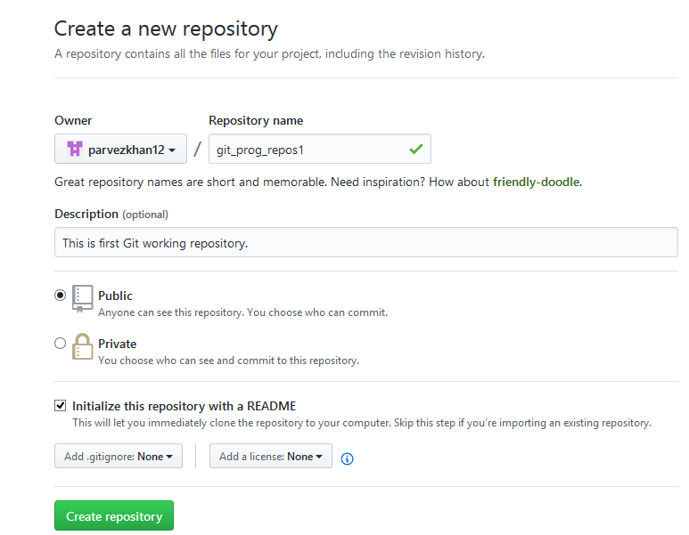
Step : 02
Go to the account to create a GitHub repository by clicking on “+”

Slide 5
Pulling Data files from Repository

Slide 6
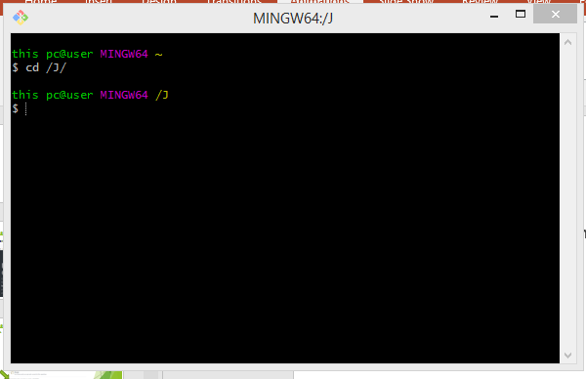
Step : 03
Go to the Git Bash command prompt as you installed before.

Slide 7

Follow the instructions below
Change the default working directory.
Clone the repository from GitHub as you mentioned.
Again change working directory to the repository directory
Check the status of your file folder whether any file to be uploaded.
Add the file(s) to the origin.(i.e the repository folder)
Make a comment (Caption) about that file.
Then PUSH the ORIGIN to the MASTER
Something to say…

Slide 8
Change Directory and Clone repository
Write on your git bash to change Directory
cd /E/folder name/
For Cloning repository
git clone http://GitHub.com/parvezkhan12/Git.git
Then again change directory to the saved repository folder

Slide 9
Checking Status
Check status of your current folder whether any new file to be uploaded to the origin i.e. to the repository folder in your PC.
To check it, type in Git Bash:
git status
If there any new file to upload, it will be showed there.

Slide 10
Adding new files
Type the following:
git add .
(Here we can also give the file name as “newfile.py”)

Slide 11
Comment about files
This is as like as caption or comment about files.
git commit –m “This is our new file of Day1”

Slide 12
Pushing files to the master
This means we want to push our new files to the GitHub server i.e to the repository as we created before.
git push origin master
Then check your repository in GitHub account.

Slide 13
Pulling repository
Write on your git bash to change Directory
cd /E/folder name/
For Cloning repository
git clone http://GitHub.com/parvezkhan12/Git
Then again change directory to the saved repository folder

Slide 14
Other necessary Commands
ls
git init
git config user.name ………………..
git config user.email…………..

Slide 15
Acknowledgement
Dr. Md. Atikur Rahman (PhD)
Youtube
All of you.
Dr. NH Mollah sir

Slide 16

Thanks to all of you

