Slide 1
Credit Card Fraud Detection
Using machine learning to identify rare fraudulent transactions
Capstone Project Presentation
284,807 transactions
Parviz Ali & Maryam Shabani
492 fraud cases
Final model recommendation: XGBoost supervised classifier
0.17% fraud rate
Credit Card Fraud Detection Capstone | Parviz Ali & Maryam Shabani | 1

Slide 2
Project Objective
Build a reproducible fraud detection pipeline
Analyze a highly imbalanced credit card fraud dataset
Create a consistent preprocessing and train/test split workflow
Compare supervised and anomaly detection models
Select a final model based on fraud-detection metrics
Prepare one-sample inference and deployment planning
Pipeline → Models → Evaluation → Recommendation
Key control: all models use the same official processed split.
Credit Card Fraud Detection Capstone | Parviz Ali & Maryam Shabani | 2

Slide 3
Business Problem
Fraud is rare, but costly to miss
Fraud causes financial loss and customer trust risk
False negatives represent missed fraud
False positives create manual review workload
Accuracy can be misleading in highly imbalanced datasets
Primary modeling tension
Catch as much fraud as possible while keeping false alerts manageable.
Credit Card Fraud Detection Capstone | Parviz Ali & Maryam Shabani | 3

Slide 4
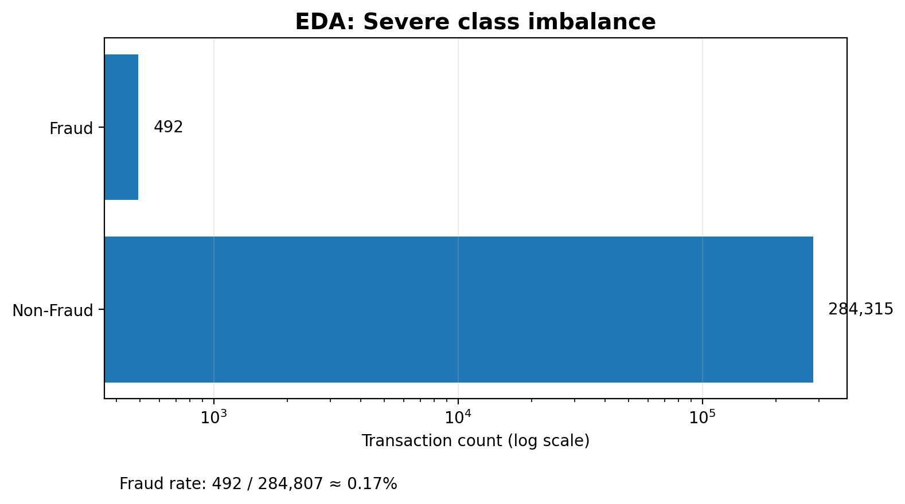
Dataset Overview
Kaggle/ULB credit card fraud dataset
Total transactions: 284,807
Fraud transactions: 492
Fraud rate: approximately 0.17%
Features: Time, Amount, V1–V28
Target: Class (0 = non-fraud, 1 = fraud)
Credit Card Fraud Detection Capstone | Parviz Ali & Maryam Shabani | 4

Slide 5
Class Imbalance Challenge
Why accuracy alone is not enough
High accuracy can still miss fraud
Fraud cases are only 492 of 284,807 transactions. Because the positive class is rare, model selection should emphasize recall, precision, F1-score, and PR-AUC.
Recall: how much fraud we catch
Precision: how many alerts are real fraud
PR-AUC: strong metric for rare positives
Credit Card Fraud Detection Capstone | Parviz Ali & Maryam Shabani | 5

Slide 6
Preprocessing Pipeline
One official split for fair model comparison
Load raw data
→
Validate columns
→
Stratified split
→
Fit scaler on train only
→
Save processed files
Script: src/preprocess.py
random_state = 42 for reproducibility
StandardScaler fitted only on X_train to prevent leakage
All models use data/processed outputs
Credit Card Fraud Detection Capstone | Parviz Ali & Maryam Shabani | 6

Slide 7
Models Built
Three approaches were compared
Logistic Regression Baseline
XGBoost Classifier
Autoencoder
Simple supervised benchmark Scaled features class_weight="balanced"
Strong tabular model Unscaled features scale_pos_weight for imbalance
Anomaly detection benchmark Trained on normal transactions Uses reconstruction error
Shared evaluation utility: src/evaluation.py → reports/metrics_summary.csv
Credit Card Fraud Detection Capstone | Parviz Ali & Maryam Shabani | 7

Slide 8
Model Comparison: How Each Model Learns
A student-friendly view of why the models behave differently
Logistic Regression Baseline
XGBoost
Autoencoder
Type: supervised classification
Learns directly from Class = 0 and Class = 1 labels
Uses a linear decision boundary
class_weight="balanced" pushes the model to catch rare fraud
Result: highest recall, but too many false positives
Type: supervised classification
Learns from labeled fraud and non-fraud examples
Uses many boosted decision trees
scale_pos_weight handles severe class imbalance
Result: best overall precision/recall/F1/PR-AUC balance
Type: semi-supervised anomaly detection
Trained only on normal transactions
Learns to reconstruct normal behavior
High reconstruction error = unusual transaction
Result: useful anomaly benchmark, but weaker than XGBoost
Key takeaway: Logistic Regression and XGBoost learn fraud labels directly; Autoencoder learns normal behavior and flags deviations.
Credit Card Fraud Detection Capstone | Parviz Ali & Maryam Shabani

Slide 9
Autoencoder Deep Dive
How the anomaly detection benchmark identifies possible fraud
What type of model is it?
A neural-network-based anomaly detection model.
Used here as semi-supervised learning: labels were used only to select normal training rows.
It did not directly train on fraud vs non-fraud classification like XGBoost.
It learned a compressed representation of normal transactions and tried to reconstruct them.
Transactions reconstructed poorly were treated as anomalies.
Scaled normal transactions
Input
Encoder
Compress
Bottleneck
Learn normal pattern
Decoder
Reconstruct
Error score
Compare input vs output
Threshold
Fraud if error ≥ 4.8042
Decision logic: low reconstruction error → normal-looking transaction; high reconstruction error → possible fraud/anomaly.
Credit Card Fraud Detection Capstone | Parviz Ali & Maryam Shabani

Slide 10
Autoencoder Results: What the Numbers Mean
Why anomaly detection helped, but did not beat the supervised model
Precision
Recall
F1-score
PR-AUC
Threshold
17.81%
66.33%
28.08%
38.00%
4.8042
Many alerts were false positives
Caught 65 of 98 fraud cases
Modest balance of precision and recall
Weaker rare-class performance
99.5th percentile of normal errors
Actual / Predicted | Non-Fraud | Fraud
Non-Fraud | 56,564 | 300
Fraud | 33 | 65
Interpretation for the cohort
The model learned normal transaction patterns, not fraud labels directly.
Some fraud looked normal → 33 missed fraud cases.
Some normal transactions looked unusual → 300 false positives.
Useful benchmark, but supervised XGBoost learned a stronger decision boundary.
Presentation line: “Autoencoder is a semi-supervised anomaly detector; it is useful, but here the labeled supervised model performed better.”
Credit Card Fraud Detection Capstone | Parviz Ali & Maryam Shabani

Slide 11
Model Tradeoff Summary
How to explain why XGBoost is recommended even though Logistic Regression recall is higher
Model | Precision | Recall | F1 | PR-AUC | What this means
Logistic Regression | 0.0610 | 0.9184 | 0.1144 | 0.7190 | Catches many fraud cases, but creates too many false alerts.
XGBoost | 0.5478 | 0.8776 | 0.6745 | 0.8547 | Best overall balance; strongest final recommendation.
Autoencoder | 0.1781 | 0.6633 | 0.2808 | 0.3800 | Good anomaly benchmark; weaker because it did not learn fraud labels directly.
How to explain LR
How to explain XGBoost
How to explain Autoencoder
Highest recall is good.
But 6.1% precision means many false alarms.
Operationally expensive for reviewers.
Slightly lower recall than LR.
Much better precision and F1.
Best PR-AUC for rare fraud class.
Learns “normal,” not fraud labels.
Can find unusual cases.
Misses fraud that looks normal.
Credit Card Fraud Detection Capstone | Parviz Ali & Maryam Shabani

Slide 12
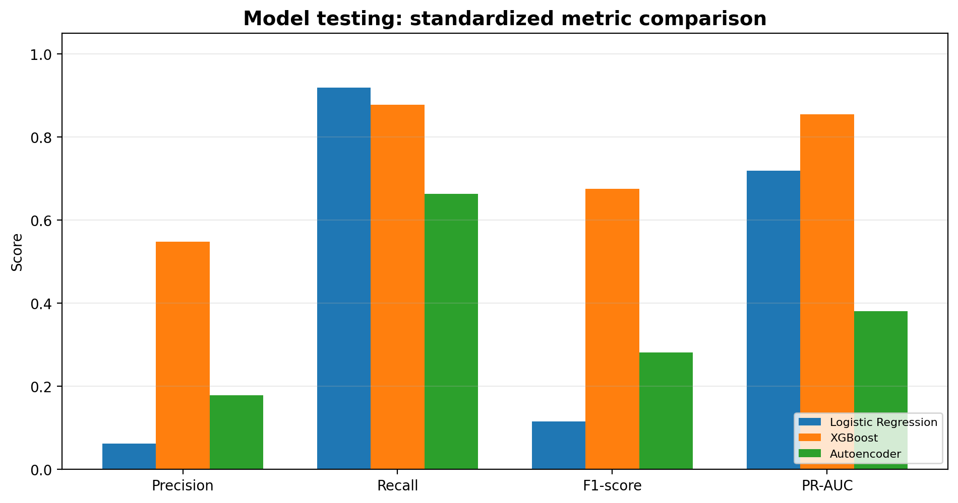
Model Results
XGBoost had the best overall balance
Model | Precision | Recall | F1 | PR-AUC
Logistic | 0.061 | 0.918 | 0.114 | 0.719
XGBoost | 0.548 | 0.878 | 0.675 | 0.855
Autoencoder | 0.178 | 0.663 | 0.281 | 0.380
Key message: Logistic Regression catches many fraud cases, but XGBoost has the strongest overall balance.
Credit Card Fraud Detection Capstone | Parviz Ali & Maryam Shabani | 8

Slide 13
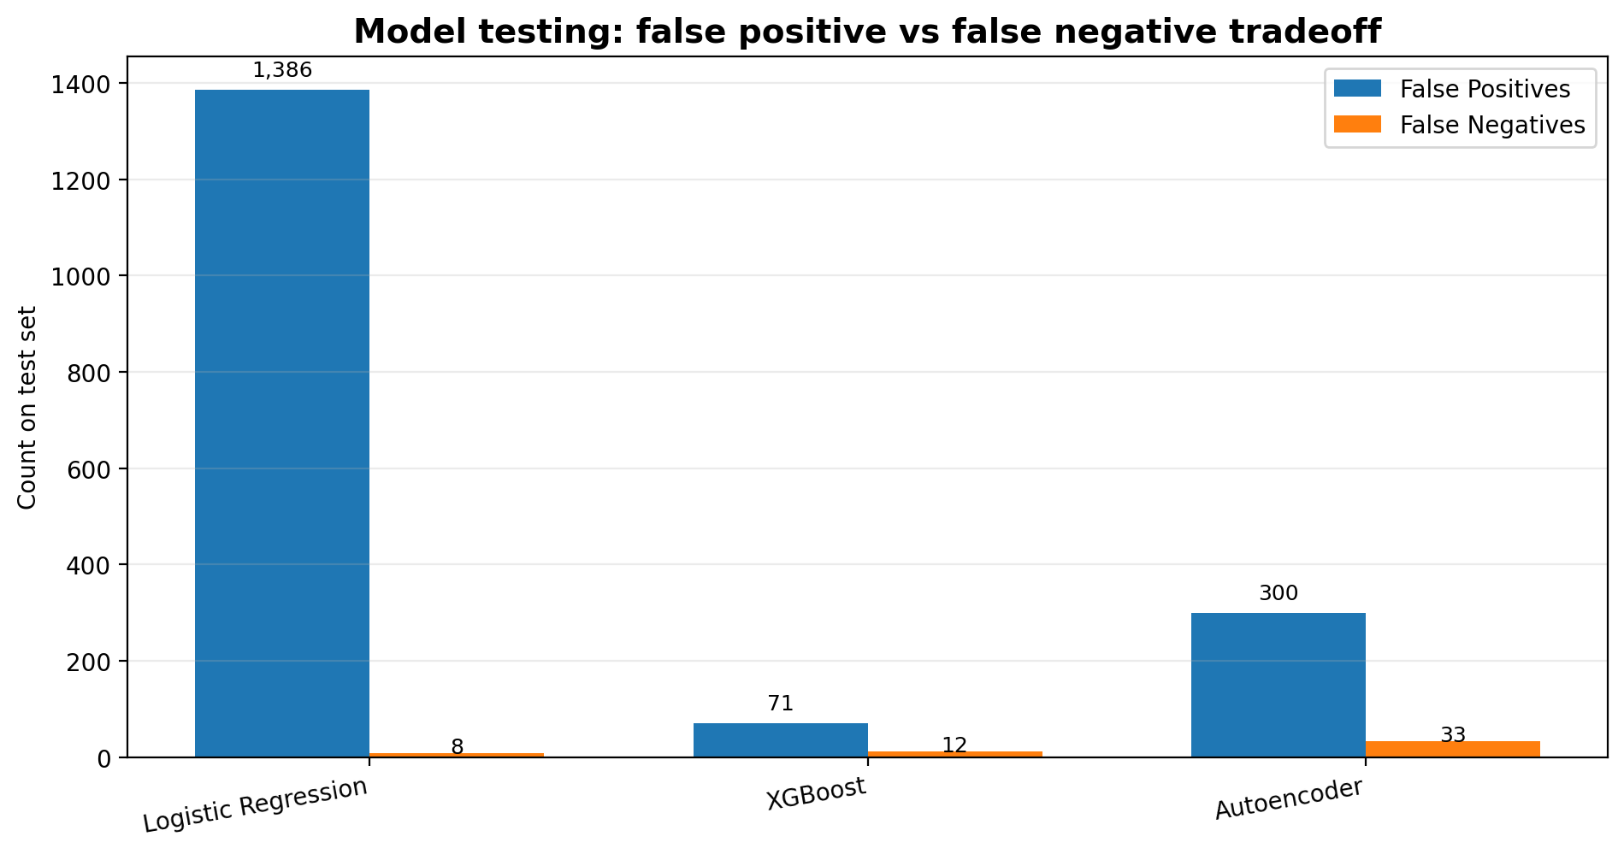
Model Testing: Error Tradeoff
False positives and false negatives on the test set
Logistic Regression: very high recall, but many false positives
XGBoost: only 12 missed fraud cases with far fewer false positives
Autoencoder: useful anomaly benchmark, but more missed fraud and false alerts
Credit Card Fraud Detection Capstone | Parviz Ali & Maryam Shabani | 9

Slide 14
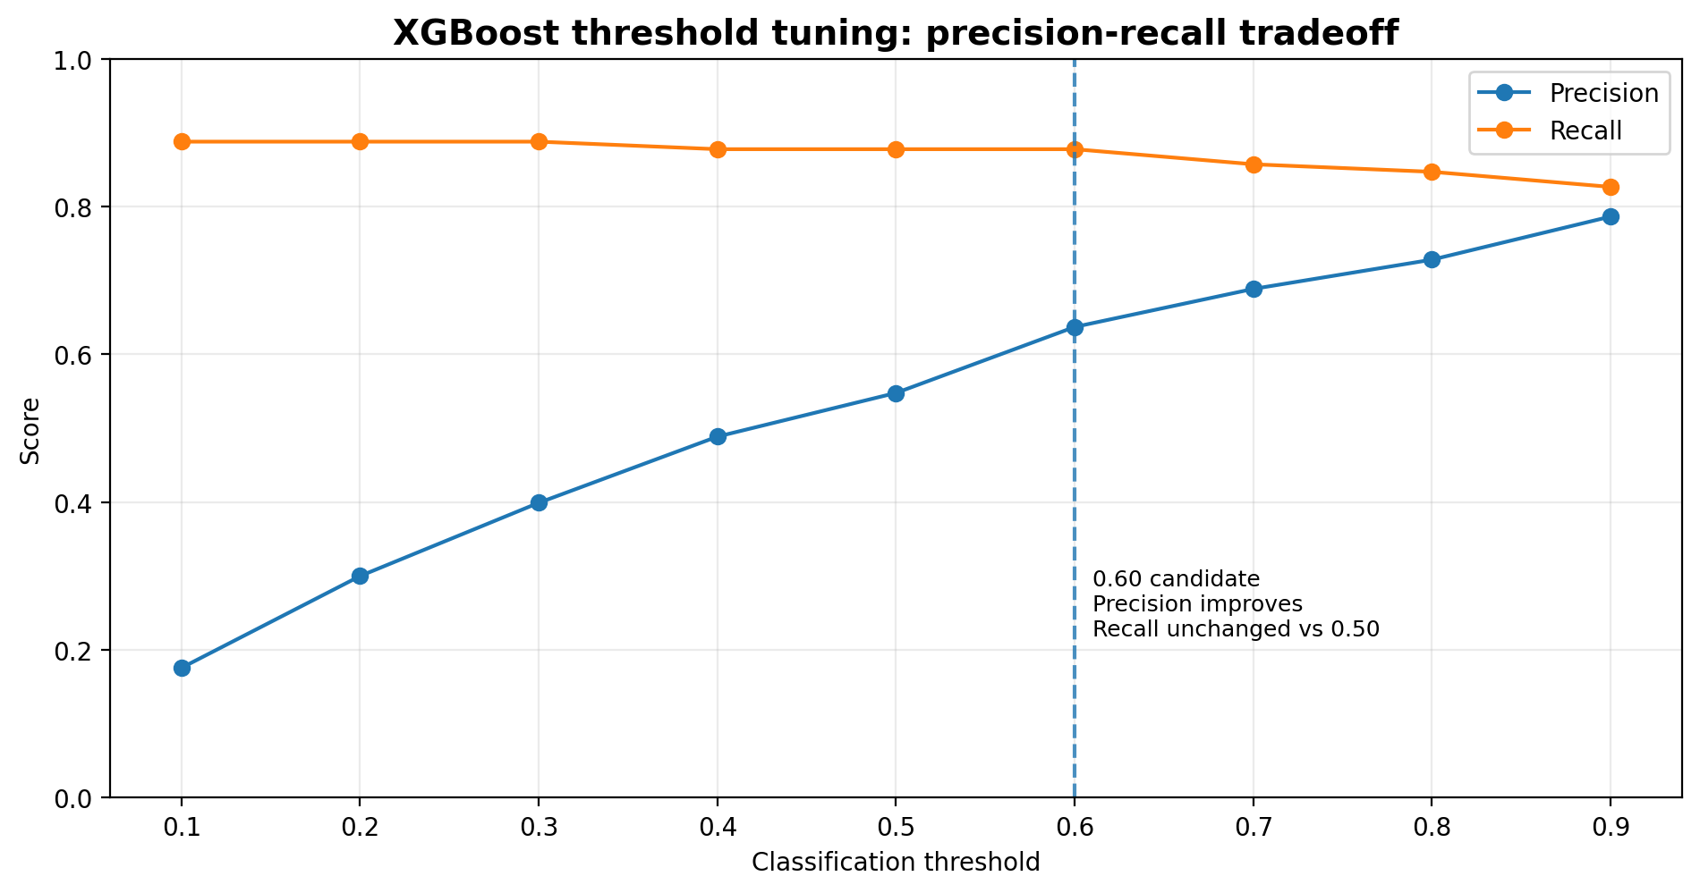
XGBoost Threshold Tuning
Precision-recall tradeoff
Default threshold 0.50: recall = 0.878, precision = 0.548
Threshold 0.60: recall stays about the same, precision improves
Final threshold should be selected using business cost of false positives vs false negatives
Credit Card Fraud Detection Capstone | Parviz Ali & Maryam Shabani | 10

Slide 15
Final Model Recommendation
Recommended model: XGBoost supervised classifier
XGBoost
Final model artifact: model_artifacts/xgboost_fraud_model.joblib
Best F1-score: 0.6745
Best PR-AUC: 0.8547
High fraud recall: 0.8776
Much stronger precision than Logistic Regression
Fewer false positives than Autoencoder
Decision rationale: best overall balance between catching fraud and controlling false alerts.
Credit Card Fraud Detection Capstone | Parviz Ali & Maryam Shabani | 11

Slide 16
Inference and Deployment Plan
Prepared for one-sample scoring and future API deployment
predict.py
→
XGBoost model
→
Fraud probability
→
FastAPI
→
Cloud Run
One-sample inference script: src/predict.py
Deployment plan: deployment/cloudrun_deploy.md
Future API accepts transaction JSON and returns fraud probability
Credit Card Fraud Detection Capstone | Parviz Ali & Maryam Shabani | 12

Slide 17
Limitations
What should be addressed before production use
Dataset features are anonymized, limiting business interpretation
Fraud patterns change over time and require monitoring
Model should be validated on newer transaction data
Threshold should be optimized using business cost
Live production API was planned but not deployed in this phase
Credit Card Fraud Detection Capstone | Parviz Ali & Maryam Shabani | 13

Slide 18
Future Work and Closing
Next steps to make the system production-ready
Add SHAP explainability for XGBoost
Optimize threshold based on false-positive and false-negative costs
Build FastAPI endpoint and deploy to Google Cloud Run
Monitor data drift and performance degradation
Create dashboard reporting for fraud prediction monitoring
Conclusion: XGBoost is the recommended final model for this capstone project.
Credit Card Fraud Detection Capstone | Parviz Ali & Maryam Shabani | 14

Slide 19
Thank You
Questions?
Credit Card Fraud Detection Capstone
Parviz Ali & Maryam Shabani
Credit Card Fraud Detection Capstone | Parviz Ali & Maryam Shabani | 15

