Slide 1

Minor Project - 2
CUR Decomposition on Air Quality Prediction
Presented by: Group 34
Name | Sap Id | Roll No. | Branch
Ratish Khandelwal | 500105448 | R2142220611 | CSE AI&ML (B-4 Non-Hons)
Abhinav | 500105549 | R2142220008 | CSE AI&ML (B-3 Non-Hons)
Parv Narang | 500107381 | R2142220590 | CSE AI&ML (B-3Non-Hons)
Ramit | 500105029 | R2142220610 | CSE AI&ML (B-4 Non-Hons)
Mentored By
Dr. Nayanatara Kotoky

Slide 2
Content
Introduction
Problem Statement
Objectives
Methodology
Models used
SWOT Analysis
Area of Applications
References

Slide 3
Introduction
Air pollution is a significant global challenge affecting public health and the environment.
Predicting air quality accurately is crucial for implementing effective control measures and reducing health risks.
Traditional models rely on complex machine learning approaches that may lack interpretability and require high computational resources.
CUR decomposition provides a more efficient and interpretable method for air quality prediction by selecting representative data points while reducing dimensionality.

Slide 4
Problem Statement
Accurate AQI prediction is essential for environmental monitoring and public health. However, existing models face several challenges:
High-dimensional data with many pollutants often contains noise and redundancy.
Missing and inconsistent values make modeling difficult.
Techniques like PCA reduce dimensionality but lose interpretability, as they transform real pollutant features into abstract components.
Most models predict only AQI, without breaking down contributions of individual pollutants.

Slide 5
Objective
Train machine learning models like Gradient Boosting on CUR-reduced data.
Apply Tensor CUR decomposition to extract key pollutant features.
Compare CUR with raw, PCA, and SVM-based models.
Visualize predictions and evaluate using RMSE & MAE.
Extend the model to predict individual pollutant concentrations (future scope).

Slide 6
Methodology
Step 1: Merge datasets (city_day, city_hour, station_hour, station_day)
Step 2: Clean data (impute missing values, drop sparse/irrelevant features).
Step 3: Apply CUR decomposition:
Select top-k columns (C), top-k rows (R)
Compute U = pinv(C) × A × pinv(R)
Approximate A ≈ C × U × R
Step 4: Train model on reduced data
Step 5: Evaluate performance using RMSE, MAE

Slide 7
Models used:
We tested 7 different setups:
Experiment | Description
Exp 1 | Raw data + Gradient Boosting
Exp 2 | Raw + CUR + GBR
Exp 3 | CUR + basic preprocessing
Exp 4 | CUR + filtered (removed sparse/bad features)
Exp 5 | CUR + full preprocessing + tuned GBR
Exp 6 | PCA + GBR (preprocessed)
Exp 7 | SVM (preprocessed)

Slide 8
SWOT Analysis
Strengths | Weakness
CUR retains real pollutant columns, making feature importance explainable. | Performance heavily depends on quality and completeness of the input datasets.
Reduces computational complexity while maintaining predictive performance. | current implementation focuses only on AQI, not yet on pollutant-specific predictions.
Opportunities | Threats
Can be extended to predict individual pollutant levels (PM2.5, NO₂, etc.). | Deep learning approaches may outperform traditional models if data scale increases.
Can be deployed as a web app (Flask/Streamlit) or integrated into smart city infrastructure. | Sudden weather changes or unrecorded events (e.g., fire, construction) may affect accuracy.

Slide 9
Areas of Application
Urban Air Quality Monitoring: Helps policymakers take proactive measures against pollution and design better regulations.
Smart Cities: Integration with IoT for real-time air quality tracking and automated alerts.
Health Sector: Provides early warning systems for respiratory disease prevention, helping vulnerable populations.
Environmental Research: Offers interpretable insights for ecological studies and long-term climate change analysis.
Industrial Emission Control: Assists industries in monitoring their pollution levels and optimizing emission reduction strategies.

Slide 10
Reference
[1] R. Yang and W. Chen, "Spatial Correlation, Influencing Factors and Environmental Supervision on Mechanism Construction of Atmospheric Pollution: An Empirical Study on SO2 Emissions in China," Article, Mar. 2019.
[2] S. Jung, J. Moon, and E. Hwang, "Cluster-Based Analysis of Infectious Disease Occurrences Using Tensor Decomposition: A Case Study of South Korea," Int. J. Environ. Res. Public Health, vol. 17, no. 13, Jul. 2020.
[3] Y. Liu, E. Jun, Q. Li, and J. Heer, "Latent Space Cartography: Visual Analysis of Vector Space Embeddings," Comput. Graph. Forum, vol. 38, no. 3, Jul. 2019.
[4] Y. Zhou, K. Gu, and T. Huang, "Unsupervised Representation Adversarial Learning Network: from Reconstruction to Generation," Article, Apr. 2018.
[5] T. Istirokhatun, I. T. Agustini, and S. Sudarno, "Investigasi Pengaruh Kondisi Lalu Lintas dan Aspek Meteorologi Terhadap Konsentrasi Pencemar SO2 di Kota Semarang," Article, Mar. 2016.

Slide 11
Thank You

Slide 12
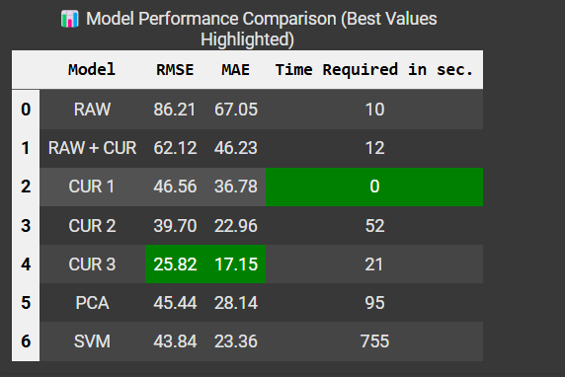
Model’s Performance

Slide 13
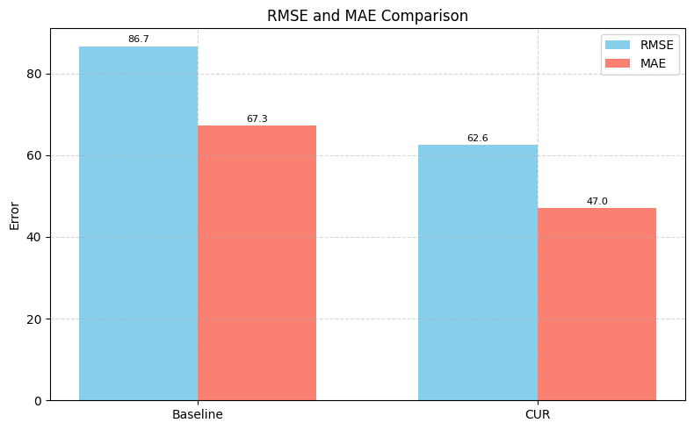
Graphical Representation
1. Raw data + Gradient Boosting

Slide 14
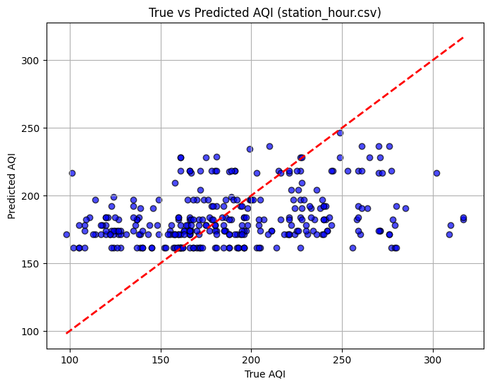
2. Raw + CUR + GBR

Slide 15
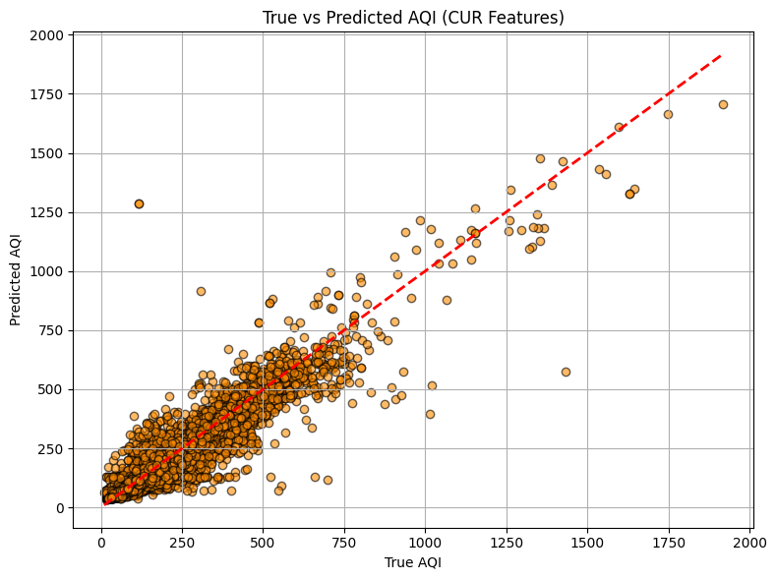
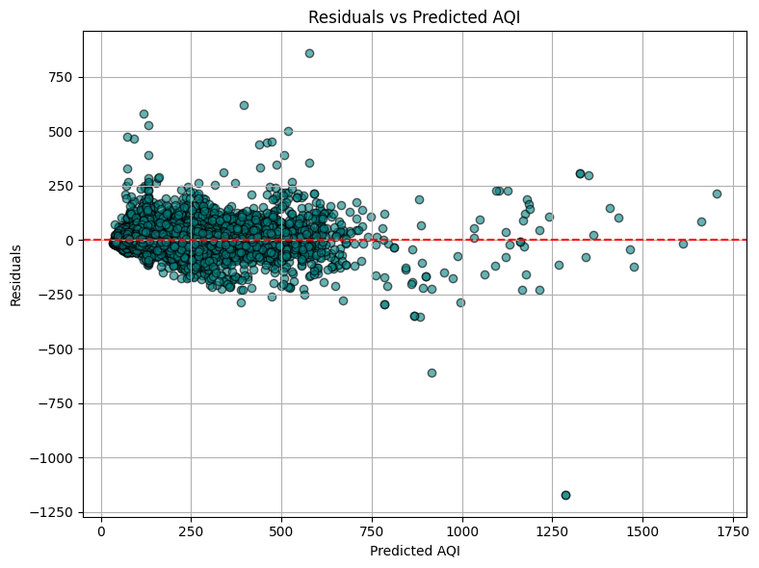
3. CUR + basic preprocessing

Slide 16
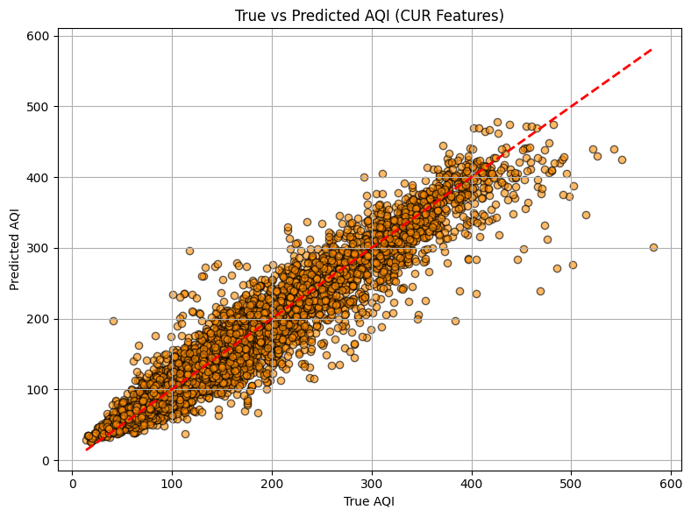
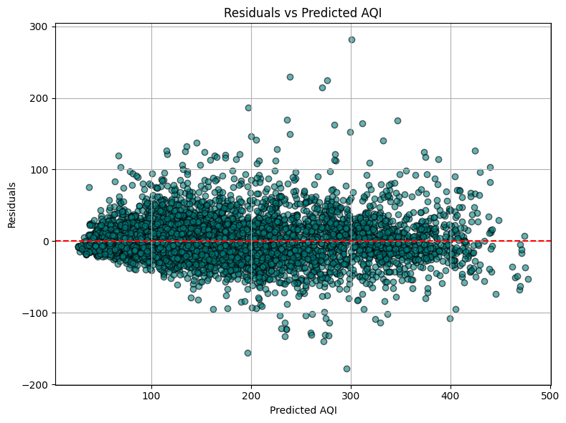
CUR + filtered (removed sparse/bad features)

Slide 17
5. CUR + full preprocessing + tuned GBR

Slide 18
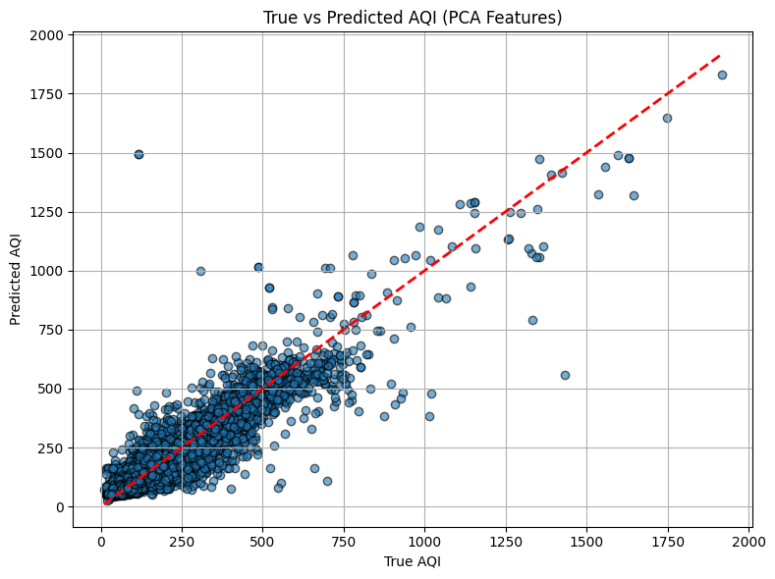
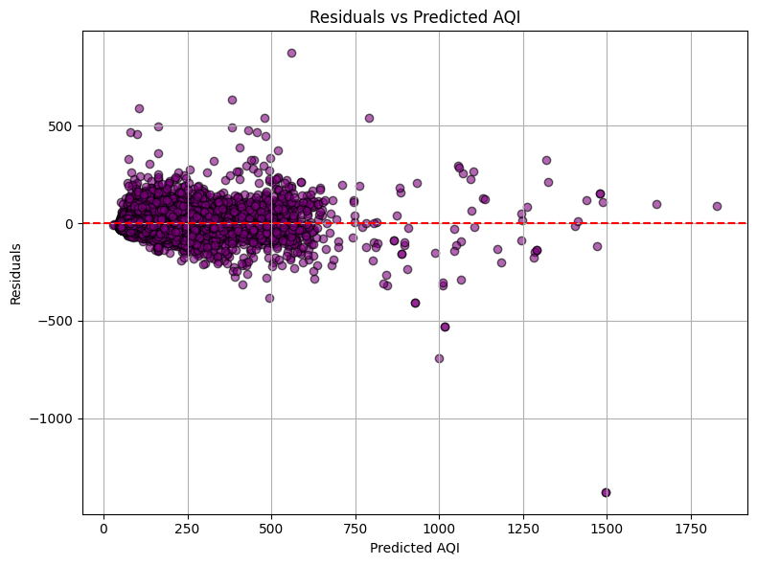
6. PCA + GBR (preprocessed)

Slide 19
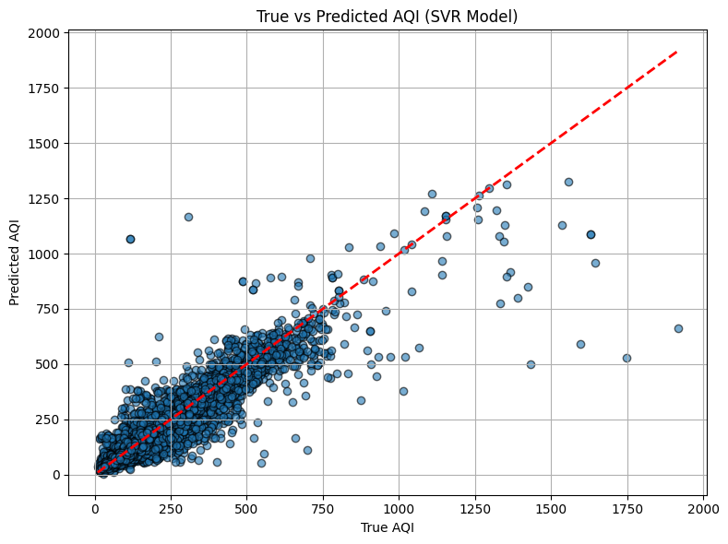
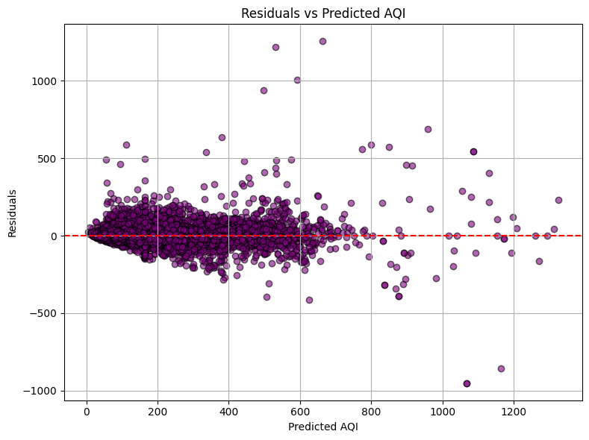
7. SVM (preprocessed)

