Slide 1


Kadi Sarva Vishwavidyalaya
S.K Patel Institute of Management & Computer Studies MCA
MCA SEMESTER - 1
MCA – 16
MINI PROJECT – 1
Name of internal Guide : Dr. A Stella
Student Name | Division
Korat Vyom Rameshbhai | A
Ladola Priya Dineshbhai | A

Slide 2

HOSTELGUARDIAN

Slide 3
Introduction
The Hostel Management system is a web platform designed to Allow student to view available rooms and register for accommodation.
Enable students to update their details and track booking.
Provide an option for students to pay fees online.
Help Hostel Management efficiently allocate rooms and manage records.
The system simplifies communication improves hostel operation and offers a seamless experience for both students and administrators.

Slide 4
Existing system
LDRP Hostel
It is manual system

Slide 5
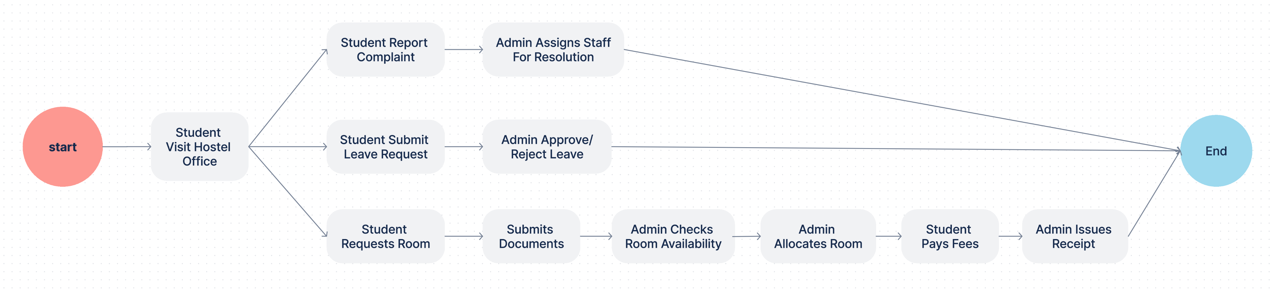

Slide 6
PROCESS OF CURRENT EXISITING SYSTEM
1.Registration and Admission:
Collect resident details, including personal information, ID proof, academic or work details, and emergency contacts.
Generate unique resident IDs for identification.
2.Room Allocation:
Assign rooms based on availability, preferences (e.g., shared or single), and any special requirements.
Maintain a record of occupied and vacant rooms for easy tracking.
3.Fee and Payment Management:
Track rent or fee payments, including due dates and amounts.
Generate payment receipts and notify residents of pending dues.
Offer multiple payment options, like online transfers or cash.
4.Attendance and Security:
Monitor daily attendance to ensure resident safety and compliance with hostel rules.
Use manual registers or automated systems like biometric scanners.
5.Complaint Handling:
Provide a system for residents to log maintenance or service complaints.
Assign staff to resolve complaints and track progress until completion.

Slide 7
6.Leave and Visitor Management:
Record leave applications from residents and get approval from hostel authorities.
Maintain a log of visitors, including details like purpose and duration of stay.
7.Inventory and Asset Management:
Track the status of hostel resources such as furniture, appliances, and utilities.
Conduct periodic checks to identify repair or replacement needs.
8.Rules and Notices:
Communicate hostel rules, schedules, and important updates through notice boards or digital platforms.
Maintain a log of announcements for future reference.
9.Health and Emergency Support:
Keep records of medical history or special needs of residents.
Ensure emergency services and contacts are accessible.
10.Reports and Auditing:
Generate reports on occupancy, revenue, maintenance issues, and resident activities.
Use the data for audits and system improvement.

Slide 8
Drawbacks of existing system
1. Manual Processes
Time-consuming tasks like paperwork for registration, room allocation, fee payments, and attendance tracking.
Increased risk of human errors in data entry and record-keeping.
2. Lack of Centralized Data
Difficulty in accessing resident information, complaints, and financial records quickly.
Data fragmentation across multiple ledgers or files.
3. Limited Accessibility
Requires residents and staff to be physically present to complete processes like registration, payment, or leave applications.
No remote access for staff to manage records or for residents to submit requests.
4. Inefficient Communication
Notices and updates rely on physical notice boards, which may not reach all residents in time.
No automated notifications or alerts for dues, events, or updates.

Slide 9
5. Security Issues
Attendance and visitor logs in manual systems are less reliable and prone to tampering.
Lack of advanced security features like biometric or digital access logs.
6. Payment Challenges
Cash-based or offline payment systems lead to difficulties in tracking and reconciling fees.
No integration with online payment gateways for convenience.
7. Difficulty in Tracking Complaints and Maintenance
Lack of a proper system to track complaints or maintenance requests, leading to delays in resolution.
No transparency for residents to check the status of their requests.
8. No Real-Time Reporting
Reports like occupancy rate, overdue payments, or maintenance expenses require manual preparation, which is time-consuming.
Lack of analytical tools to forecast trends or optimize operations.

Slide 10
Proposed System
The Online Hostel Management System is designed to simplify and automate the management of hostel operations. This system will allow administrators to manage registrations, room allocations, fees, and complaints through a centralized platform. Residents can easily register, pay fees, track complaints, and submit leave applications online.
With features like online payments, automated notifications, digital attendance, and inventory tracking, the system ensures efficient and transparent management. Accessible anytime via a mobile-friendly website, it saves time, reduces errors, and enhances convenience for both residents and staff.

Slide 11
Admin Modules
Room Management
Fee Management
Leave Management
Complaint Management
Report Generation
Student Document Verification
Notice/Announcement Management
Role-Based Access Control (Admin/Warden)
Dashboard Overview

Slide 12
Student (User) Modules
View Room Availability
Submit Personal/Admission Details
Fee Payment and Receipt Download
Apply for Leave
Submit Complaints/Feedback
View Notices and Announcements
Access Personal Dashboard

Slide 13
Admin Panel Features
User Roles and Access Control:
Admin: Has full access to all features and controls.
Warden: Can log in to the admin panel but has restricted access to specific modules like attendance, complaints, and room status.
Room Management:
Add, update, or delete rooms.
Monitor room availability and occupancy status.
Allocate rooms manually or automatically to students.
Fee Management:
Track payments, view fee status, and send reminders to students.
Generate invoices and receipts for fee transactions.
Attendance and Leave Management:
Mark daily attendance of students.
Approve or reject leave requests submitted by students.

Slide 14
5.Complaint Management:
View complaints lodged by students.
Assign complaints to maintenance staff and track resolution status.
6.Notifications:
Send announcements or reminders to students for events, fee deadlines, or policy changes.
Notifications can be sent via email, SMS, or directly on the student portal.
7.Visitor Management:
Record and manage visitor logs.
View entry/exit details for added security.
8.Reports and Analytics:
Generate detailed reports for:
Occupancy and availability.
Fees collected and pending payments.
Attendance and leave data.
Complaints and their resolution status.
Visual dashboards for quick insights into hostel performance.

Slide 15
Student Panel Features (Main Website)
Room Information and Status:
View available room details (e.g., type, facilities, and pricing).
Check room allotment status after applying.
Fee Details:
View payment history and due dates.
Pay fees online and download receipts.
Leave Requests:
Submit leave requests online with reasons and dates.
Track approval status in real-time.
Complaint Submission:
Lodge complaints about facilities (e.g., maintenance, food, or other issues).
Track complaint resolution status.
5.Notifications:
Receive alerts for fee deadlines, announcements, and leave approvals.

Slide 16
6.Student Profile:
View and update personal details like contact information.
View allocated room details and duration of stay.

Slide 17
Scope
Simplified Structure:
Two entities make the system easy to manage and use.
Admin handles backend operations; students focus on their portal.
Role-Based Access:
Warden’s restricted access ensures secure and controlled operations.
Scalability:
The system can be expanded to accommodate more hostels or new features, like biometric attendance or multi-hostel management.

Slide 18
Hardware and Software Specification:
Hardware Requirement:
Server Hardware:
Processor: Intel i5 or higher
RAM: Minimum 8 GB
Storage: SSD or HDD with 256 GB or more
Network: High-speed internet connectivity
Client Hardware:
Device: Desktop, Laptop, or Smartphone
RAM: Minimum 4 GB (for smooth browsing)
Browser: Chrome, Firefox, or any modern browser
Screen Resolution: Minimum 1366x768
Backup System:
External storage or cloud storage for regular backups

Slide 19
Software Requirement:
1.Development Tools:
Frontend: React.js with Tailwind CSS
Backend: Node.js with Express.js
Database: MongoDB
2.Hosting & Deployment:
Hosting Platform: AWS, Heroku, or Vercel
Version Control: GitHub
3.Operating Systems:
Server OS: Ubuntu/Linux
Client OS: Windows, macOS, or Android/iOS
4.Additional Software:
Browser for client access (Chrome, Edge)
Postman for API testing
Visual Studio Code for development

Slide 20
Fact-Finding Methods
Observation
Directly observe students' and admins' workflows, such as room allocation and fee payment.
2. Interviews
Conduct one-on-one discussions with students and admins to understand their challenges.

Slide 21
3.Questionnaires
1.Are you satisfied with the current room allocation process? Answer:
60% of students find it time-consuming.
Many students complain about the lack of transparency in room availability.
2.What difficulties do you face while paying fees? Answer:
70% of students find standing in long queues inconvenient.
Some students report delays in receiving receipts.
3.How do you handle complaints, and are they resolved quickly? Answer:
50% of students say complaints are resolved late.
There is no proper tracking of complaint resolution status.
4.What improvements would you expect in a hostel management system? Answer:
Students want an online portal for room allocation and fee payments.
They prefer real-time complaint tracking and better communication with admins.
5.How convenient is it to contact admins or wardens? Answer:
40% of students say it’s difficult to reach wardens during office hours.
Students suggest adding an online messaging or scheduling system.

Slide 22
Feasibility Study
1. Technical Feasibility
Utilizes the MERN stack (MongoDB, Express, React, Node.js) and Tailwind CSS for a responsive UI.
Easily deployable on cloud platforms for scalability and reliability.
Compatible with modern devices and browsers, ensuring accessibility.
2. Operational Feasibility
Streamlines manual processes like room allocation, fee payments, and complaint tracking.
Reduces the workload for admins and improves efficiency.
Enhances user experience with intuitive interfaces for both students and admins.
3. Economic Feasibility
Cost-effective development using open-source technologies (MERN stack).
Long-term savings by reducing paperwork and manual errors.
Potential to save operational costs through automation.
5. Schedule Feasibility
Development timeline estimated at 3–6 months using Agile methodology.
Tasks divided into sprints for efficient progress tracking.

Slide 23
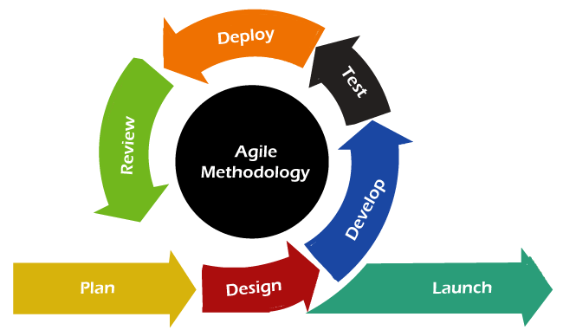
Agile Model

Slide 24
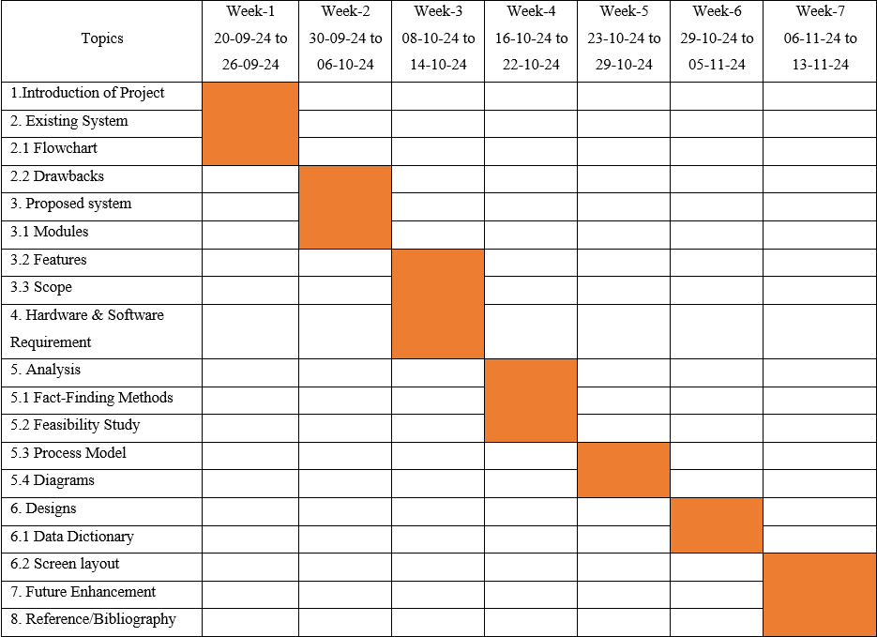
Diagram
Estimate Gantt Chart/Time line chart

Slide 25
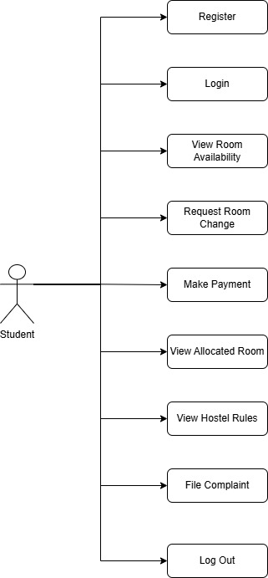
UML Diagrams
Student

Slide 26
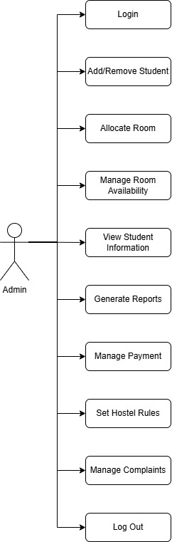
Admin

Slide 27
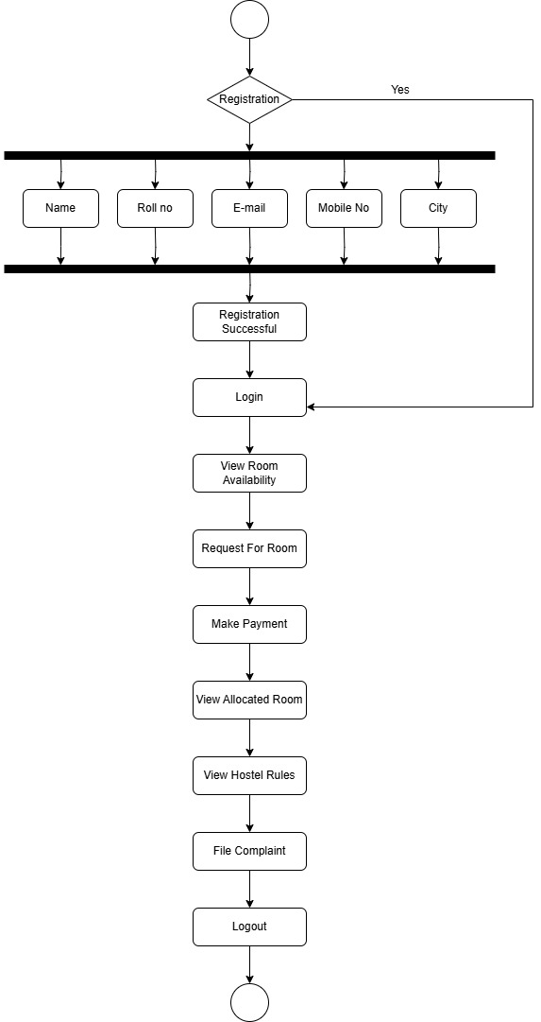
Activity Diagram
Student

Slide 28
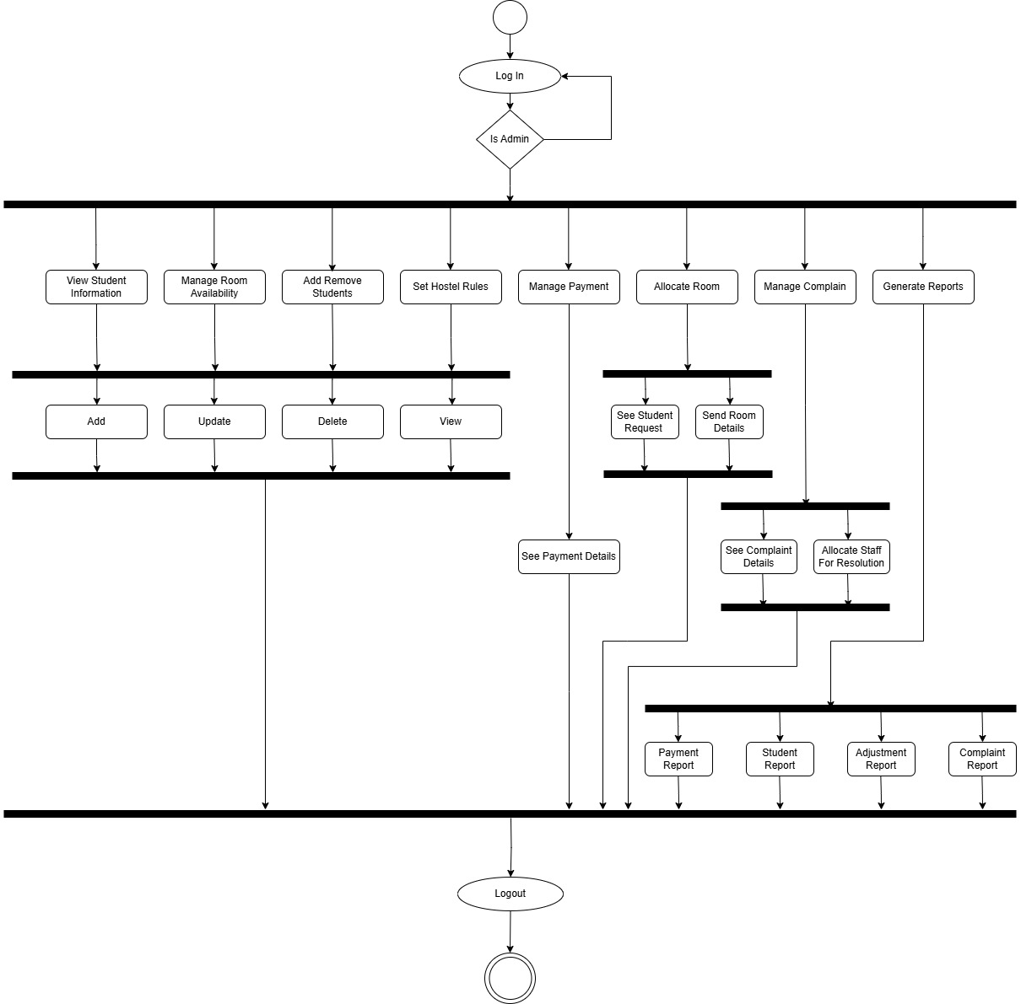
Admin

Slide 29
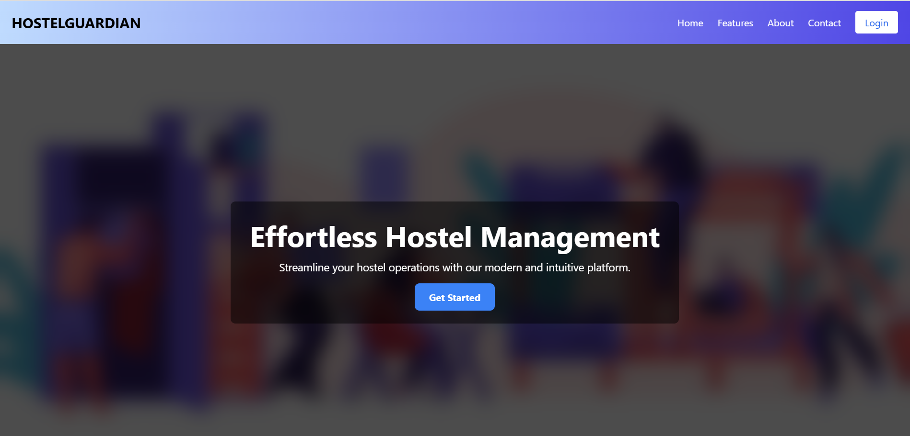
User

Slide 30
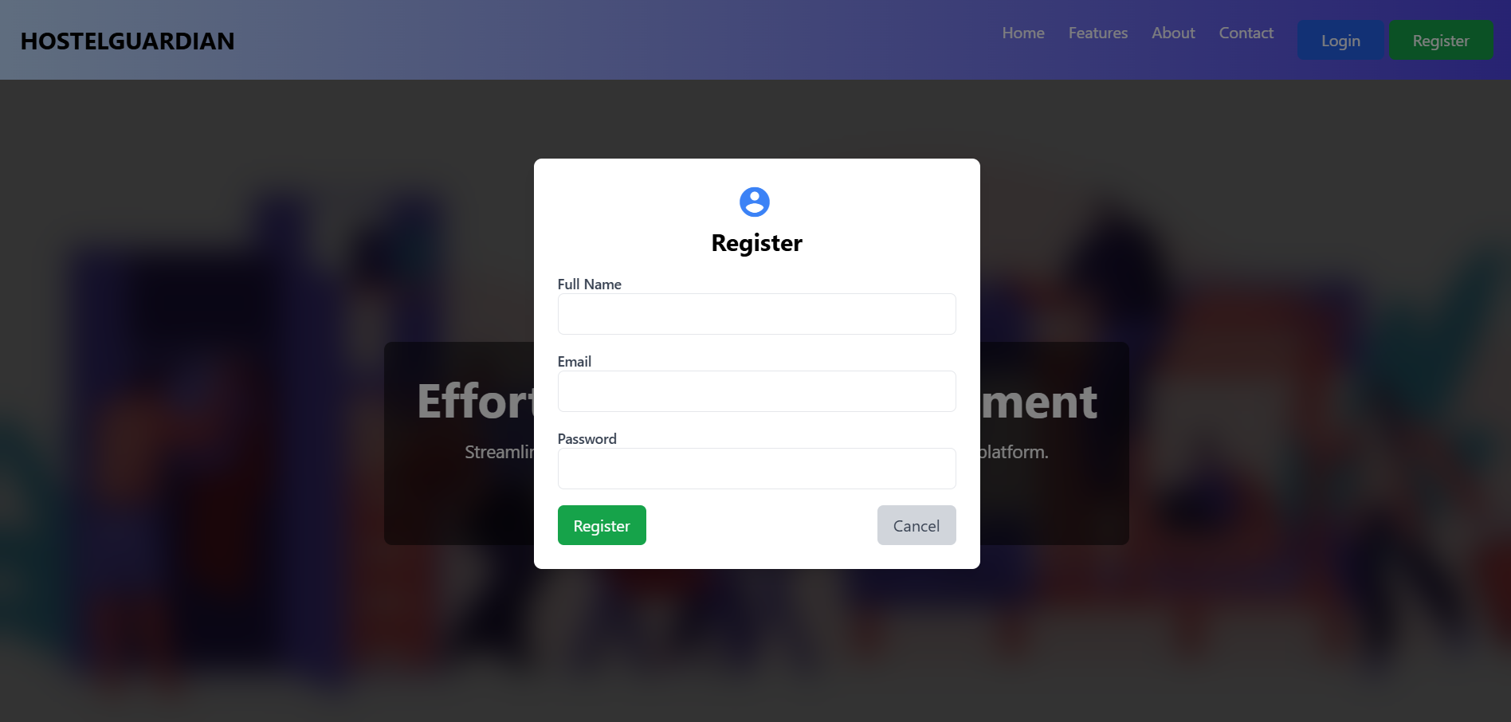

Slide 31
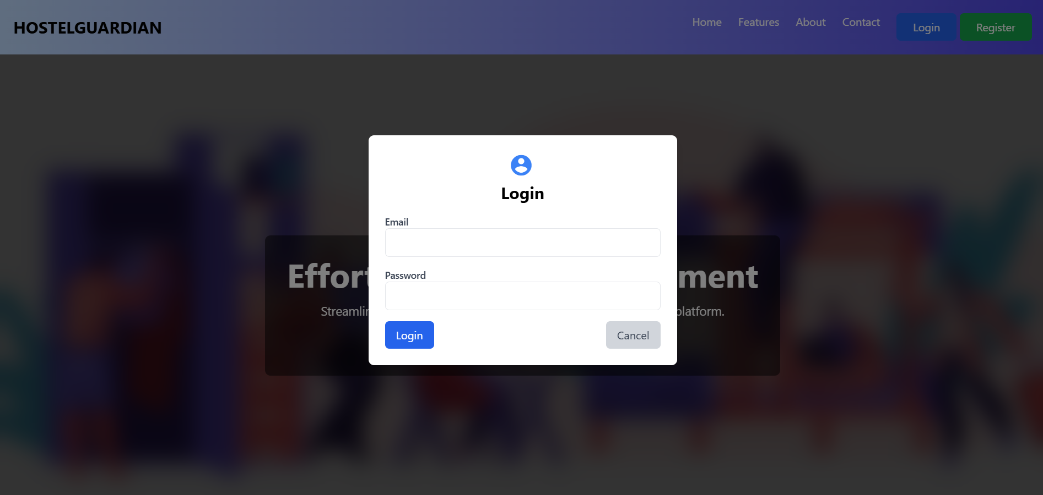

Slide 32
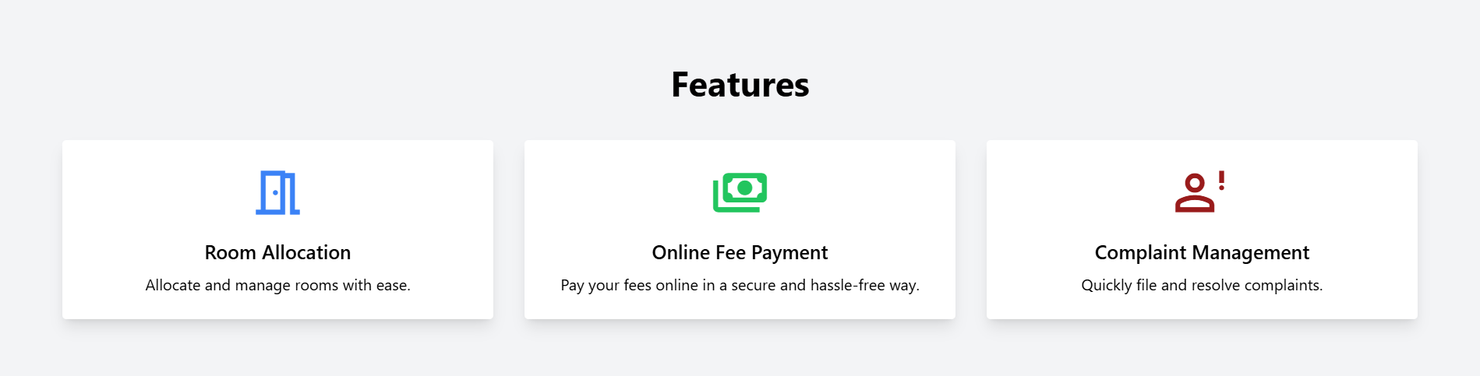

Slide 33
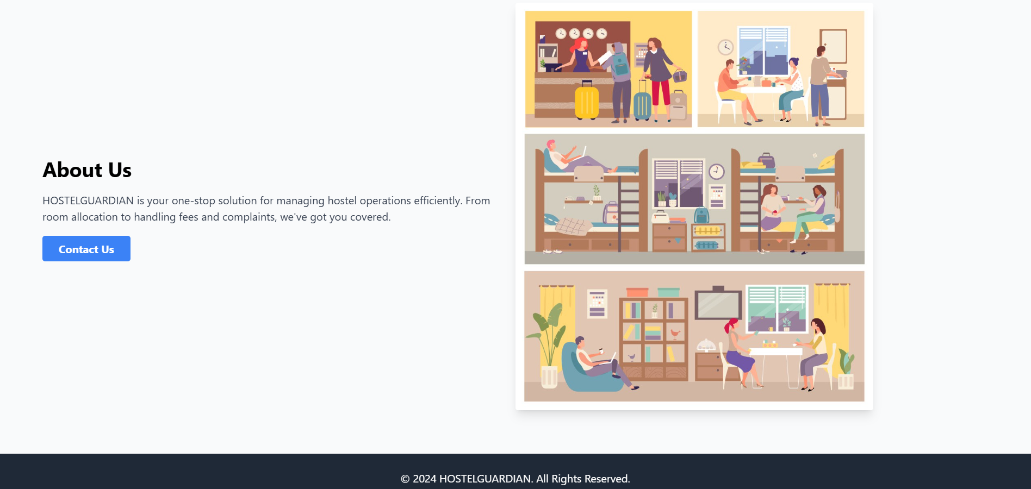

Slide 34


