Slide 1


Kadi Sarva Vishwavidyalaya
S.K Patel Institute of Management & Computer Studies MCA
MCA SEMESTER - 1
MCA – 16
MINI PROJECT – 1
Name of internal Guide : Dr. A Stella
Student Name | Division
Tharwani Mahek Kaniyalal | Div : A
Prajapati Karan Prakashbhai | Div : B

Slide 2
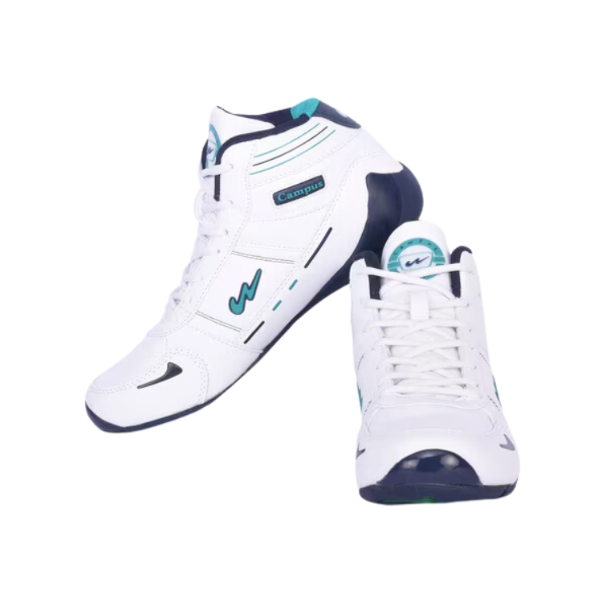
SOLE OBSESSION

Slide 3
INTRODUCTION
We are developing an “Sole Obsession” shoes selling system for “Warehouse Footwear” Store.
By Devloping an online system shoe retailers can expand their customer base beyond local boundaries .
provide 24/7 accessibility and offer a seamless shopping experience.
The System will enable retailers to manage inventory.
It incorporates various E-Commerce.

Slide 4
Current / Existing System
Our existing system is an Offline footwear shop.
In this shop manage stock, customer and billing details manually.
They Maintain several register for recording the entry of daily.
It also conducts more expenses for shop, place, rent and electricity.
To purchase something a customer has to physically go into the shop.

Slide 5
Process of Current / Existing System
Customer enter the Warehouse Footwear.
Customer specifies Shoes Preferance like Size, Style, color, brand etc .
Warehouse staff locates the requsted shoes in the inventory .
Staff shows the shoes to the customer.Customer ties on shoes to check fit and style .
Customer select shoes to buy .
Customer Complete Payment via preferred method.
Shoes are packed and receipt is provided.
Customer leave with purchased shoes.

Slide 6
Current / Existing System Drawbacks
1.No Online Orders :
- Customers are unable to place orders remotely, requiring them to visit the store in person.
2. Limited Discounts :
- Offline stores rarely offer discounts or promotions as frequently as online platforms do.
3. Fixed Hours :
- Physical stores operate within limited hours, unlike online stores that are accessible 24/7.
4. Sales Pressure :
- Customers might feel pressured by sales staff to make a purchase quickly or on impulse.
5. Limited Variety :
- In-store selections are typically smaller compared to the wide variety available on online platforms.
6. Environmental Impact :
- Large-scale production can result in overstock, waste, and adverse environmental effects.
7. Limited After-Sales Support
- The system provides limited support for handling after-sales issues, such as shoe repairs or customization requests.

Slide 7
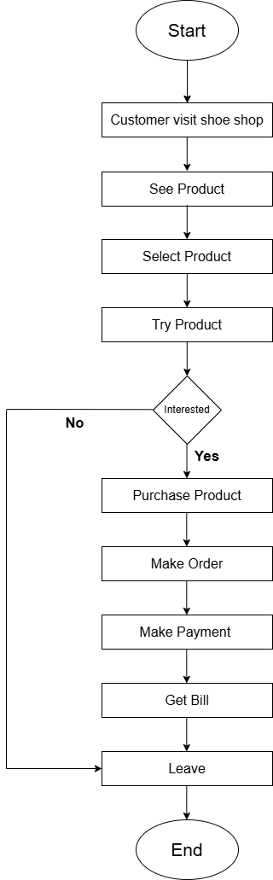
Flowchart ( Existing System )

Slide 8
Proposed System (Modules, Features, Scope)
"Sole Obsession" is an online shopping platform for Wearhouse Footwear.
The website is user-friendly, allowing customers to browse shoes by size, color, and reviews.
Secure payment options like cards, UPI, and wallets are available.
Customers can choose home delivery and track their orders.
The system works on phones, tablets, and computers.
It also helps the store manage stock, track sales, and analyze customer data for better service..

Slide 9
Modules :
Admin Modules :
1. Admin Login ( login & registration )
2. Admin user management ( User profile, Personal details)
3.Manage Category & sub-category
4.Manage Product(Add , update or delete)
5.Manage order
6.Manage Delivery

Slide 10
User Modules :
1.User register & login
2.Browse footwear
3.Search & filter Product
4.Add to cart
5.Order place
6.Order Confirmation
7.Payment
8.feedback & rating

Slide 11
Features :
1.User-Friendly Platform
- Intuitive design for customers and administrators to navigate with ease.
2. Secure Authentication
- Login and registration systems ensure data security for users and admins.
3. Product Browsing & Search
- Customers can easily explore and find products.
4. Product Management
- Admins have full control to add, edit, or remove products and categories.
5. Analytics & Reporting
- Admins can access sales reports, stock information, and order summaries.
6. Customer Feedback
- Customers can leave reviews and ratings for products.

Slide 12
Scope :
1.Scalability
- Designed to handle a growing product range and increasing user base.
2.Customer Feedback Integration
- Helps in improving products and services.
3.Notifications Support
- Email/SMS notifications for order confirmations, updates .
4.Enhanced Product Search
- Filters and sorting options by price, size, color, or brand.
5.Promotional Banners
- Displays offers or new launches to capture attention.

Slide 13
Hardware and Software Specification:
Hardware Requirement:
Server Side:
CPU - 2.66 GHZ or Higher, AMD/INTEL.
RAM - 500mb or Higher
HDD - 2gb or Higher
Internet connectivity - Stable internet connection (broadband or higher).
Client Side:
CPU - 2.66 GHZ or Higher, AMD/INTEL
RAM - 500mb or Higher
HDD - 1gb or Higher
Internet connectivity - Stable internet connection (wifi,3G,4G, or higher).

Slide 14
Software Requirement:
Server Side:
OS - Windows XP or Higher
Web browser - Chrome, Firefox, Edge etc.
Software Framework – Vscode(1.93), Xampp(8.3.12), PHP(8.3).
Database – MySQL(8.0.40).
Client Side:
Mobile OS - Android 4.4 or Higher
Mobile Browser - Chrome, Opera mini
OS - Windows XP or higher
Web browser - Chrome, Firefox, Edge etc.

Slide 15
Analysis:
Fact Finding Method:
Aspect | Existing System
System Type | Manual processes for shoe management.
User Experience | Limited functionality, often confusing or time-consuming.
Product Management | Manual tracking of inventory using spreadsheets or notes.
Order Processing | Orders are handled manually, prone to delays and errors.
Payment Options | Cash-only or limited payment methods.
Accessibility | Restricted to store operating hours.
Feedback Mechanism | No formal mechanism for customer reviews or ratings.
Report Generation | Manually created reports, often inconsistent.
Customer Engagement | Limited engagement and personalization.
Query Handling | Queries resolved in person or via phone, leading to delays.
Scalability | Difficult to scale as the business grows.
Cost Efficiency | Higher operational costs due to manual labor.

Slide 16
Feasibility Study:
Technical Feasibility:
- Requirements: Operating system and browser for customers, technical skills for employees, and developers.
- Skills Needed: Database management, programming, and problem-solving skills.
- Resources: Large database, software tools, hardware requirements, integration with systems.
Technologies:
Front-End: HTML, CSS, JavaScript, jQuery, Bootstrap.
Back-End: PHP (8.3).
Tools: XAMPP (8.3.12), VS Code (1.93), MS Word, PDF.
Economic Feasibility:
- Customer Requirements: Android, iOS device, or PC.
- Admin Requirements: Hardware and software for system maintenance.
Cost Breakdown:
- Domain Name: ₹900–₹1,200/year.
- Shared Server: ₹1,500–₹18,000/year.
- UPI Integration: No charge.

Slide 17
Operational Feasibility:
- Simple and user-friendly interface.
- Suitable for users with basic computer knowledge.
- Training: Minimal training required for employees.
- Factors Considered: User training, change management, daily operational impact.
Schedule Feasibility :
- Define development, testing, and deployment phases.
- Assess resource availability and external factors.
- Goal: Ensure the project meets deadlines within the required timeframe

