Slide 1

Omega
Leader: Parv Thacker 21bce183
Jaival Chhag 21BCE039
Niti Patel 21BCE168
Khushi Patel 21BCE204
Richa Yadav 21BCE253

Slide 2
Company Name : Revelio Labs
PeopleMetrics: Shaping the Next-Gen Workforce
01
ResumeRevealer Track: Advanced Resume Parsing Challenge
02

Slide 3
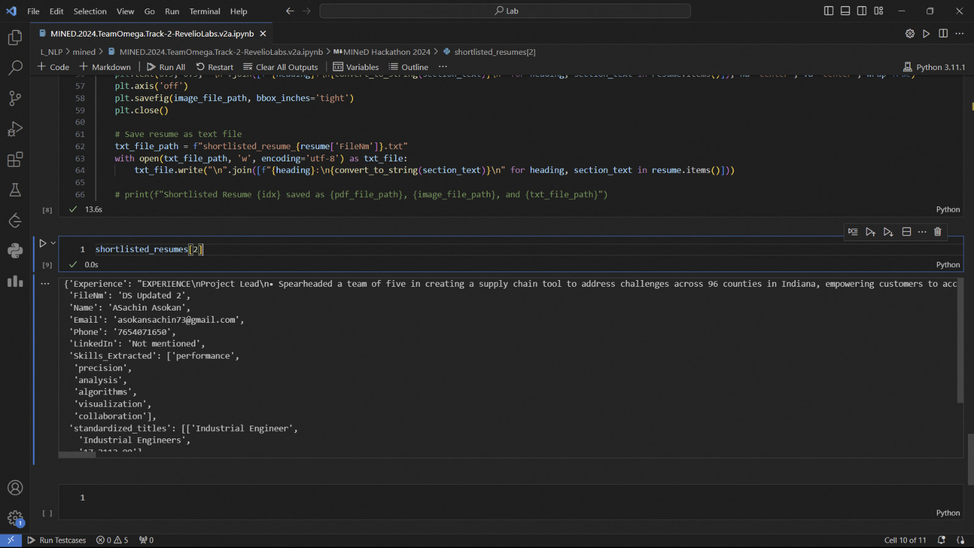

Slide 4
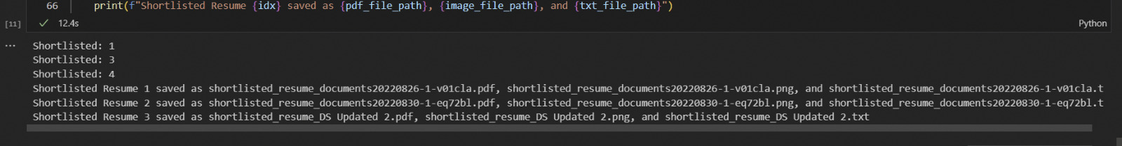
Output

