Slide 1
COMP7940 CLOUD COMPUTING
Cloud-based Intelligent Learning Assistant Chatbot System
Group AK
Luo Chenjin-25450476
Zhang Zilong-25454722
Zhang Ziru-25450492

Slide 2
PRESENTATION OUTLINE
Contents
01
Project Overview
02
Backend and Database
Introduction and key features
Chat logic implementation and data management mechanism
03
DevOps and CI/CD Workflow
04
Container and Cloud Deployment
Continuous integration and automated deployment implementation
Docker application packaging and cloud-based runtime environment

Slide 3
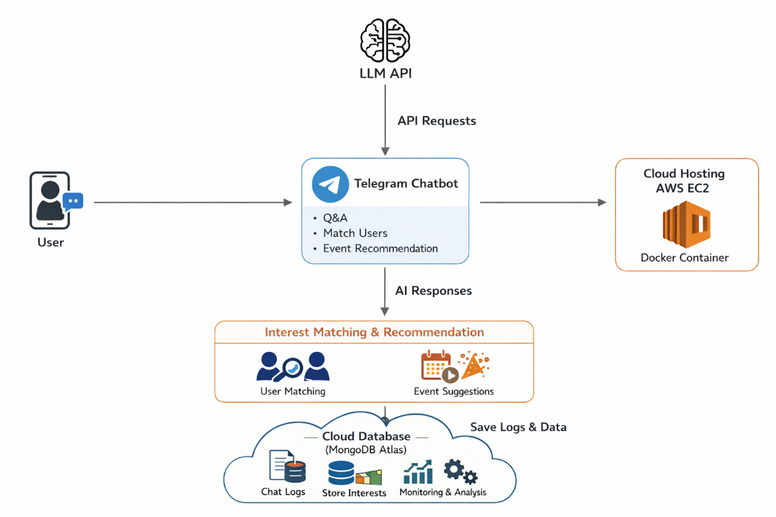
01 / PROJECT OVERVIEW
Introduction
This project developed a Telegram chatbot based on the cloud platform, which is positioned as an intelligent learning assistant. By integrating the API of the large language model, it realizes intelligent question answering and learning support functions.
The system processes user requests through the Python backend and invokes the LLM to generate responses. At the same time, the system introduces the CI/CD automation process and deploys it in the cloud environment, integrating log recording for monitoring and cost control.
Key Features
Intelligent Question Answering: Supports natural language interaction and generates responses in real time based on LLM.
Interest Matching: Identify users' learning interests and match them with users who have similar interests.
Bot Workflow
Event Recommendation: Recommend relevant activities based on users' learning interests.
Log and Monitoring: Record chat data for debugging purposes

Slide 4


01 / PROJECT OVERVIEW
Technical Stack
Python Backend
Processes user requests and manages business logic
LLM API Integration
HKBU LLM API for intelligent response generation
MongoDB Atlas
Cloud database for interaction logs and user data
Docker Containerization
Ensures portability and scalability
Project Repository: https://github.com/pary666/comp7940-group
AWS EC2 Hosting
Bot ID: @Group_AK_bot
Cloud platform for deployment and operation
GitHub CI/CD
Continuous integration and automatic deployment of the code

Slide 5
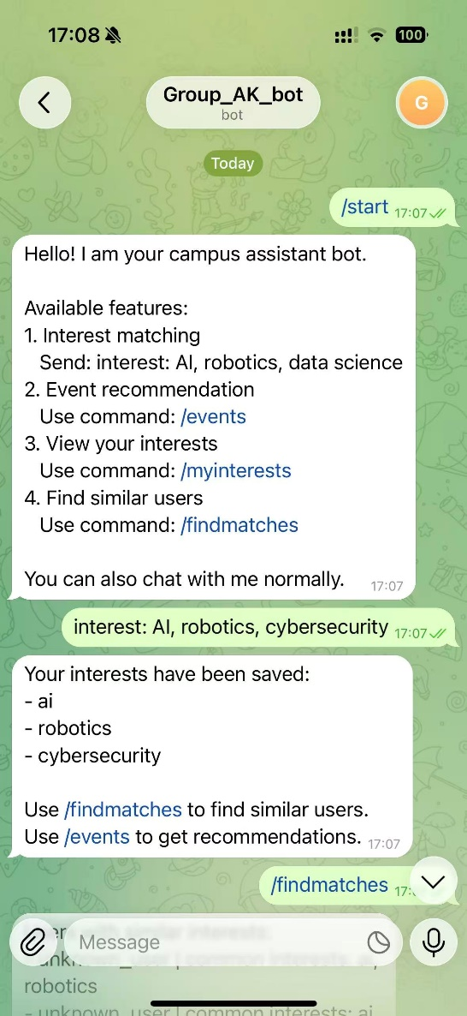
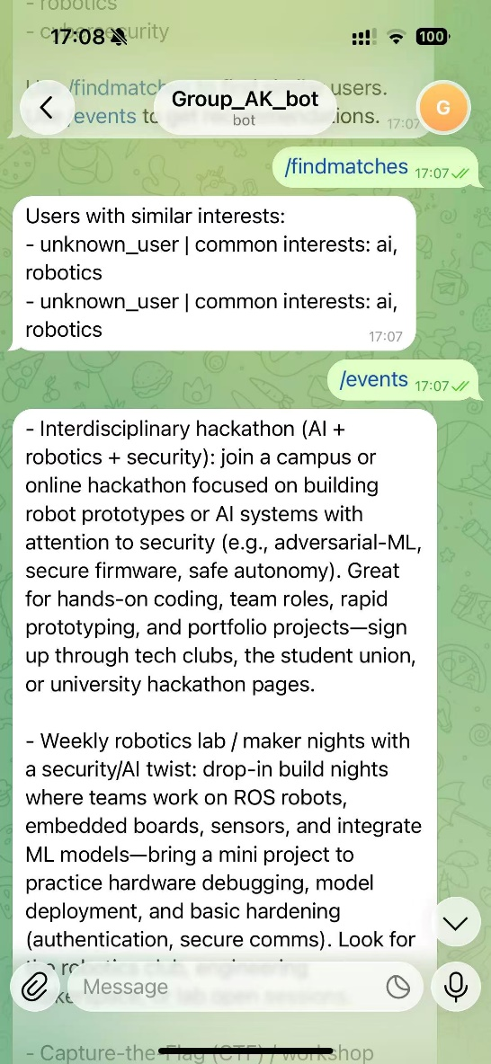
Luo Chenjin-25450476
02 / Backend and Database
Backend Design(chatbot.py + ChatGPT.py)
The backend of this system is implemented in Python and serves as the core control module of the entire chatbot, responsible for handling user requests and coordinating various functional components.
During the processing flow, the backend first parses and evaluates the user input, then constructs the appropriate request content, and calls the HKBU LLM API to generate the response result. By setting a unified system role and interaction method, the model can provide clear and contextually appropriate responses in the form of a "learning assistant".
Furthermore, the backend also implements various functional modules, including intelligent question answering, learning interest recognition and processing, as well as a event recommendation mechanism based on user interest.
Intelligent Conversations
Interest Input and Matching
Bot Chat Log on Telegram
Event Recommendations

Slide 6

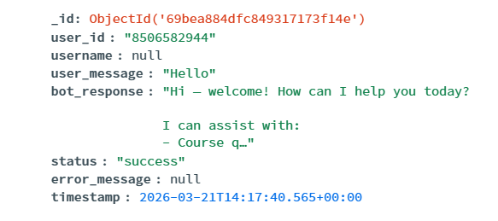
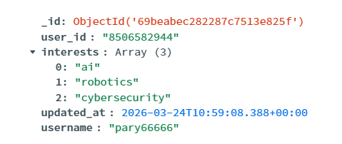
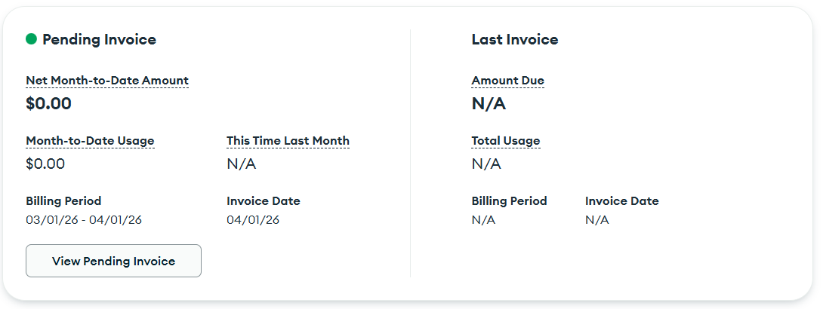
Luo Chenjin-25450476
02 / Backend and Database
Database Design(db.py)
Since the user data and log information are unstructured data, this system adopts MongoDB Atlas(Free tier) as the cloud database to achieve persistent storage of user data and log recording during the system operation. The database mainly consists of two collections: user profiles and chatting logs.
User profiles includes the basic identification of users and their interest data, which is used to support the functions of interest matching and personalized recommendations.
Chatting logs records each conversation process of the system, including user input, bot responses, and running status, etc.
Logs collection
User profiles collection
MongoDB Atlas Bill

Slide 7
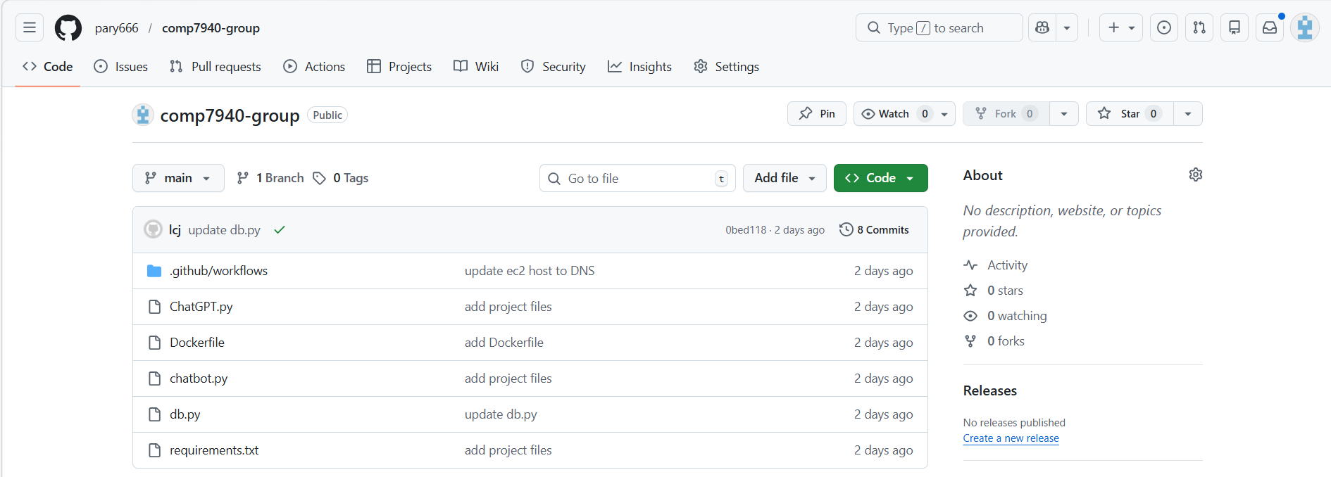
Zhang Zilong-25454722
03 / DEVOPS AND CI/CD WORKFLOW
Core Design & Git Version Management
Core Target:Fully meet the course's mandatory Git management requirement, and implement DevOps best practices to achieve fully automated, consistent and secure deployment, for course bonus points.
Standardized Git Management:
Full project code hosted on GitHub public repository
Complete traceable commit history & version iteration
Standardized team collaborative workflow
Auto Trigger Rule:
Auto-execute when code is pushed to `main` branch
Zero manual operation throughout the full process
Project Repository:github.com/pary666/comp7940-group

Slide 8
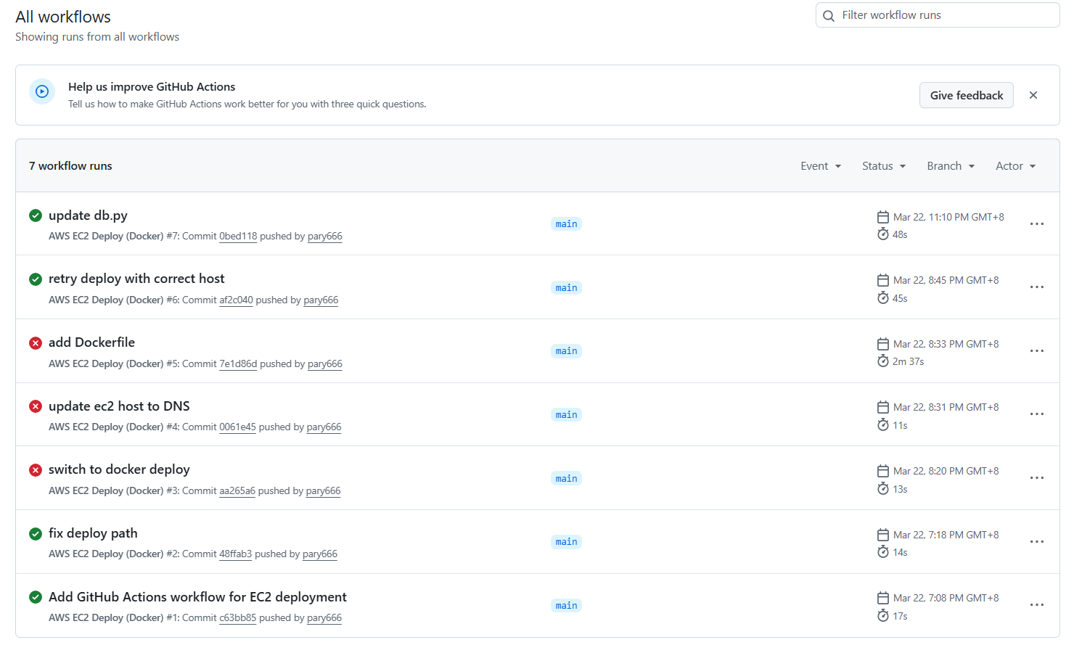
Zhang Zilong-25454722
03 / DEVOPS AND CI/CD WORKFLOW
End-to-End Automated CI/CD Pipeline
Full Automated Workflow:
Checkout latest code from the repository
Configure SSH secure access environment
Build Docker image on GitHub runner
Package image and transfer to EC2 via SCP
Load image on EC2 & clean up old container
Start new container with auto-restart configuration
Core Design Highlights:
Sensitive info fully protected via GitHub Secrets (no hardcoding)
Image build does not occupy EC2 computing resources
Configuration and image decoupled via volume mount
Guaranteed environment consistency & deployment stability
Project Repository:github.com/pary666/comp7940-group

Slide 9
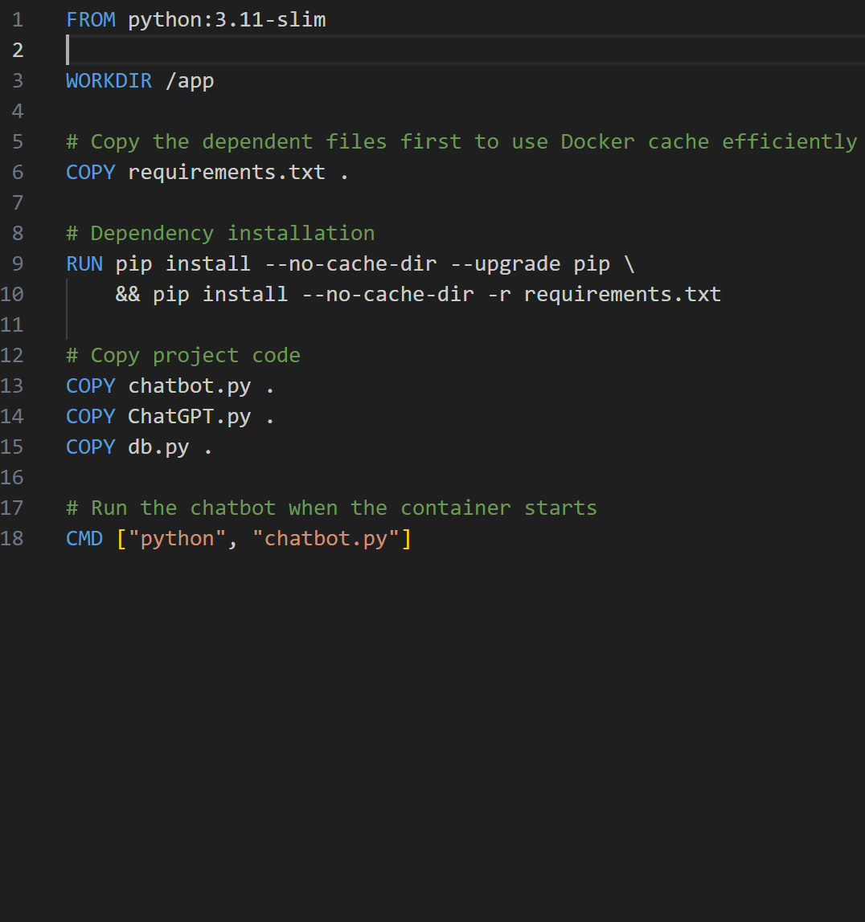
04 / Containerization Strategy & Environment Setup
Zhang Ziru-25450492
Lightweight base image：
By using python:3.11-slim, the image size is significantly reduced, improving the efficiency of pulling and deploying in a cloud environment.
Layer Caching：
Before copying the main project code, first execute `COPY requirements.txt` and install dependencies to fully utilize Docker's caching mechanism.
DevOps Practice Highlights：
By leveraging Docker's caching mechanism, the process of repeatedly installing dependencies is eliminated when only application logic is modified, greatly accelerating the CI/CD build process.
Automated service launch：
By setting the container startup entry point using CMD ["python", "chatbot.py"], you can ensure that the application is immediately available after deployment in the cloud.

Slide 10
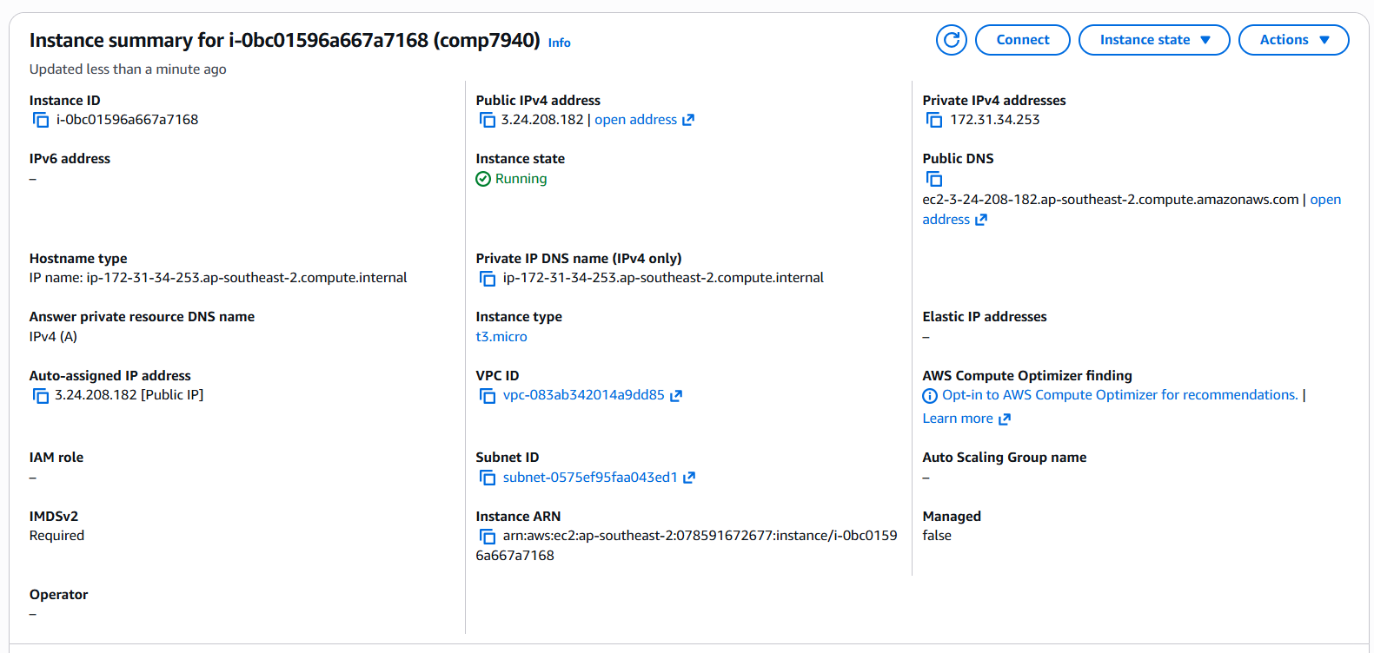
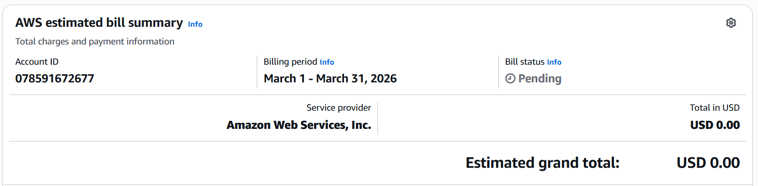
04 / Build Optimization & DevOps
Zhang Ziru-25450492
AWS EC2
The built Docker image was successfully deployed to the AWS EC2 cloud server.
The instance (i-0bc...) is in the Running state, and all network configurations and environments are ready.
Cost-Awareness
This perfectly addresses the course's technical requirement to "avoid incurring high costs."
Precisely utilizes t3.micro instances from the AWS Free tier.
The cloud platform service fee was successfully kept at $0.00 during this phase.
EC2 Instance
AWS EC2 Bill

Slide 11
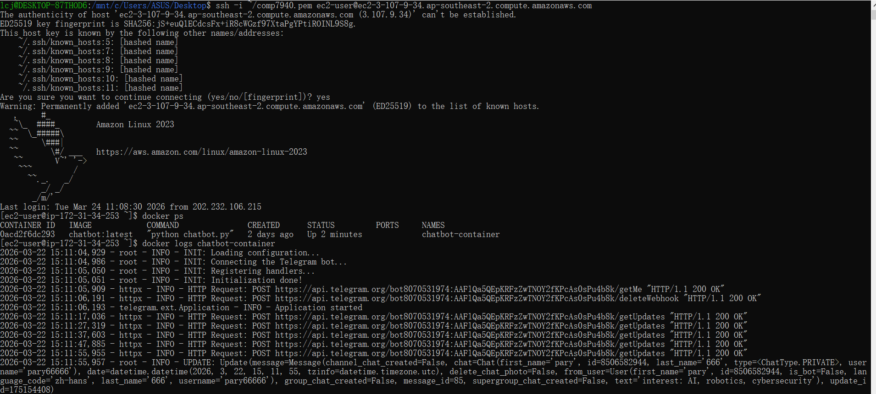
04 / System Monitoring & Observability
Zhang Ziru-25450492
Container on the EC2 Instance

Slide 12
Thank you for your attention
Project Repository: github.com/pary666/comp7940-group
Bot ID: @Group_AK_bot
Group AK
Luo Chenjin-25450476
Zhang Zilong-25454722
Zhang Ziru-25450492

