Slide 1
AI Assignment
CS22B002 Jyothiraditya
CS22B007 Anuj Sharma
AI Assignment

Slide 2
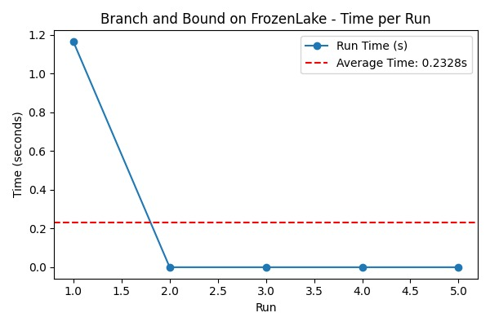
Branch and Bound
The heuristic estimates the cost from the current state to the goal using Manhattan distance. Since the environment is a 4x4 grid, each state can be mapped to a coordinate using division and modulus. For a given state, we compute its (row, column) as:
row = state // 4
column = state % 4
AI Assignment

Slide 3
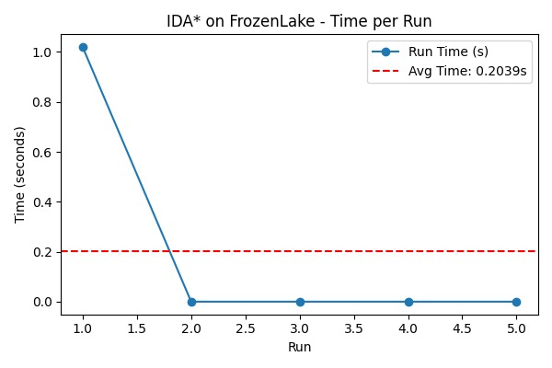
IDA*
The heuristic function in this code estimates the cost from the current state to the goal (bottom-right corner) using Manhattan distance.
The heuristic is the sum of horizontal and vertical distances from the current state to the goal.
AI Assignment

Slide 4
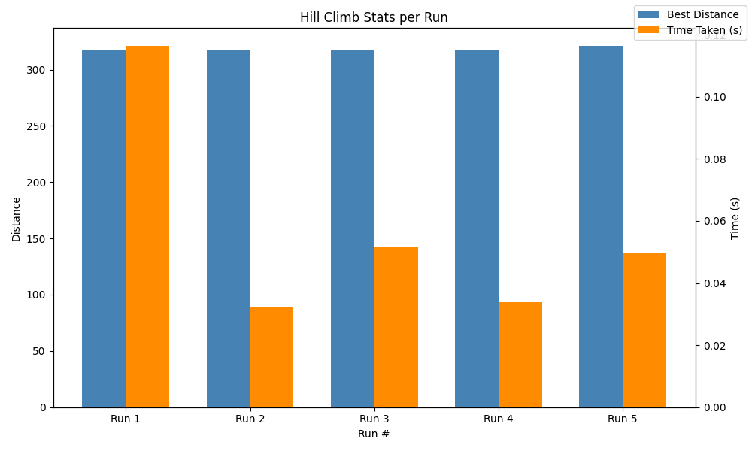
Hill Climbing
Heuristic: Total tour distance (sum of Euclidean distances between consecutive cities in the path, including the return to the starting city)
Formula: Let path = [c₀, c₁, ..., cₙ₋₁], and dist(i, j) be the Euclidean distance between cities i and j Then the heuristic H(path) is:
H(path) = dist(c₀, c₁) + dist(c₁, c₂) + ... + dist(cₙ₋₂, cₙ₋₁) + dist(cₙ₋₁, c₀)
AI Assignment

Slide 5
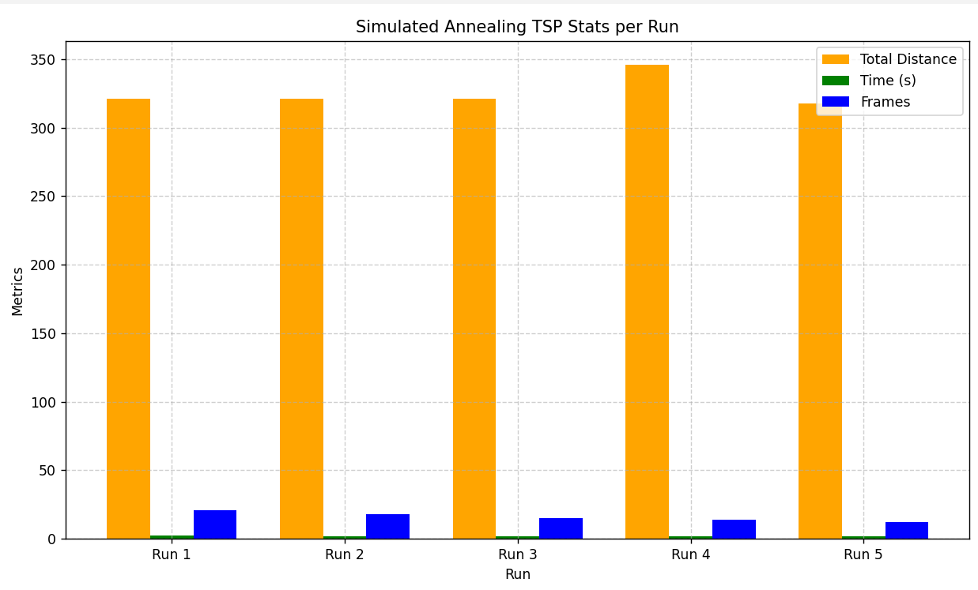
Simulated Annealing
route_cost(path, dist_table)
It calculates the sum of distances between each pair of consecutive cities in the tour:
np.roll(path, -1) shifts the route so each city is paired with its next city.
dist_table[path, shifted] gives the distance for each pair
np.sum(...) adds up all distances → total cost of that tour.
AI Assignment

