Slide 1
Generic Functions in Java
Advanced Programming – 2016 – Group 1

Slide 2
The Problem

Slide 3
Multiple Dispatch
Generic Functions
and
Methods

Slide 4
Multiple Dispatch
Argument types used to find
set of applicable methods

Slide 5
Before and After Methods
Before and After methods run
before or after the primary methods

Slide 6
Effective Method
Sorted applicable methods
produce effective method

Slide 7
Java’s current solution
Dynamic dispatch for receiver
Static dispatch for arguments

Slide 8
Java’s current solution
Device device = new Screen(); //Screen extends Device
Shape shape = new Line(); //Line extends Shape
device.draw(shape);

Slide 9
Java’s current solution
Device device = new Screen(); //Screen extends Device
Shape shape = new Line(); //Line extends Shape
device.draw(shape);
device is a Screen!

Slide 10
Java’s current solution
Device device = new Screen(); //Screen extends Device
Shape shape = new Line(); //Line extends Shape
device.draw(shape);
device is a Screen!
shape is a Shape (not a Line)!

Slide 11
Java’s current solution
Device device = new Screen(); //Screen extends Device
Shape shape = new Line(); //Line extends Shape
device.draw(shape);
device is a Screen!
shape is a Shape (not a Line)!
Java knows where it is printing,
but doesn’t know what it is printing.

Slide 12
Java’s current solution
Device device = new Screen(); //Screen extends Device
Shape shape = new Line(); //Line extends Shape
device.draw(shape);
device is a Screen!
shape is a Shape (not a Line)!
Java knows where it is printing,
but doesn’t know what it is printing.
NOT WHAT WE WANT!

Slide 13
The Solution

Slide 14
Code
The Code is available now
https://github.com/pasadinhas/MochaProtocol

Slide 15
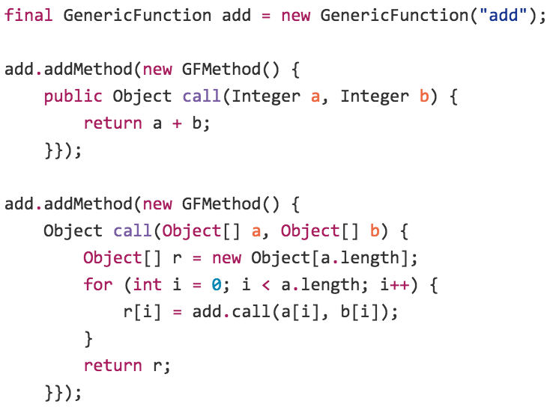
API

Slide 16
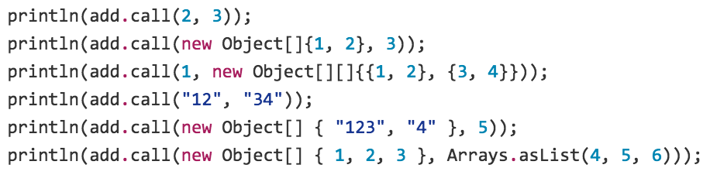
API

Slide 17
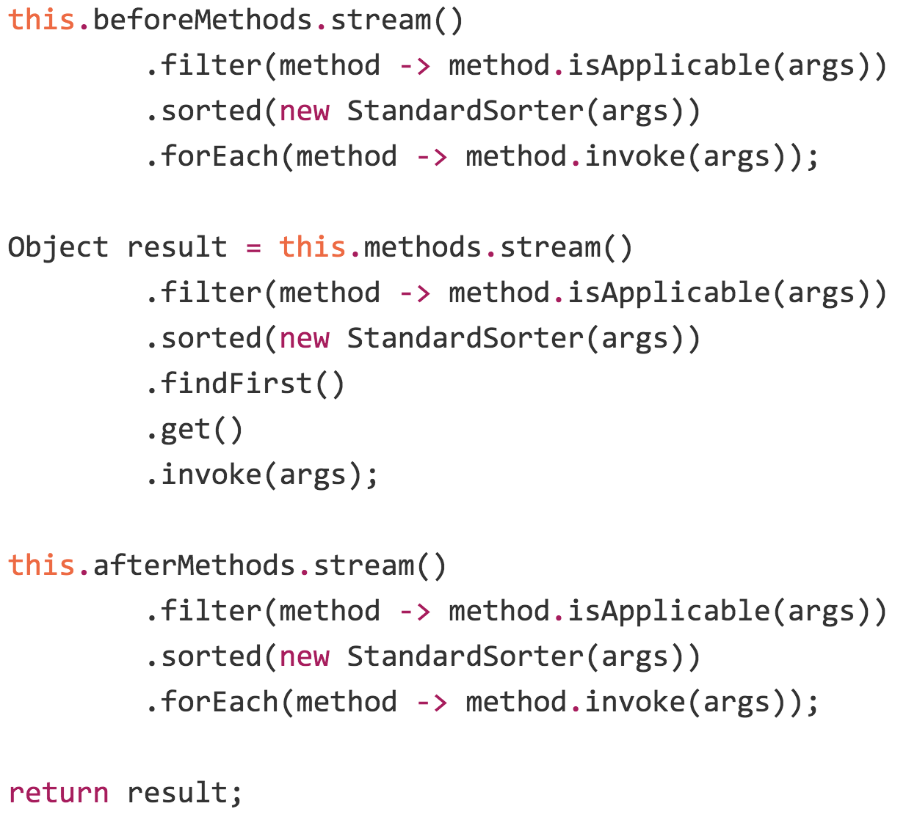
call method

Slide 18
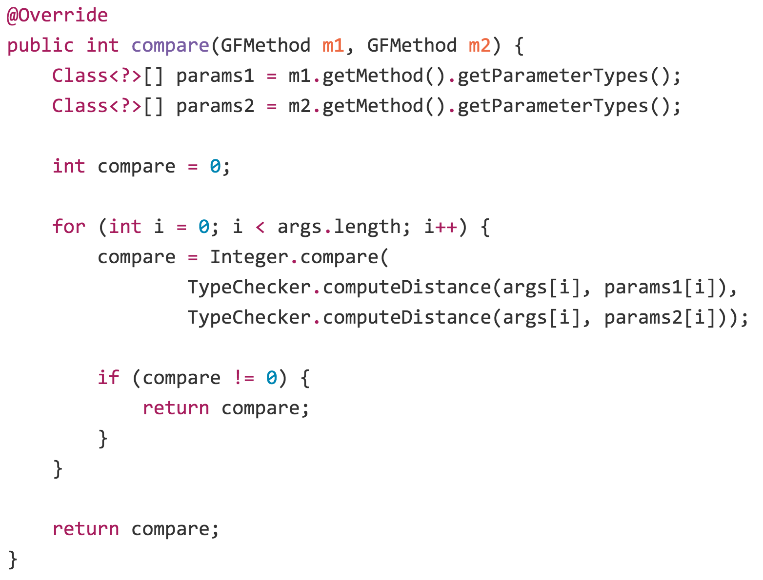
Comparing GFMethod

Slide 19
computeDistance method

Slide 20
Extended Version
Custom Method Tags
Custom Combinators
Custom Sorters
Call Next Method
Around Combinator

Slide 21
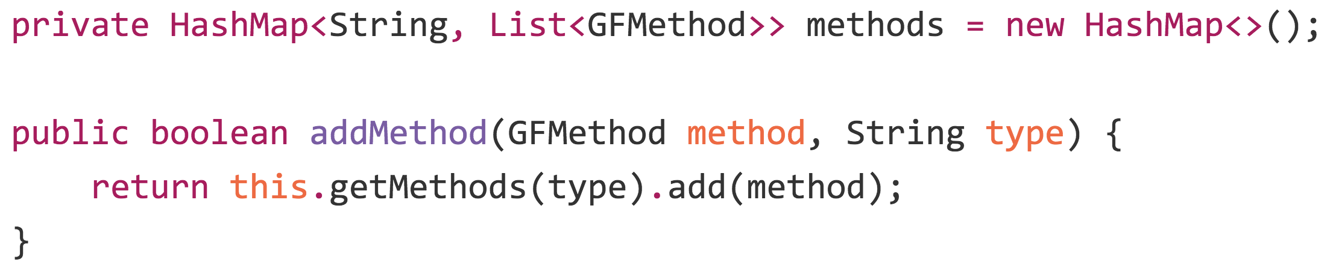
Custom Method Tags

Slide 22
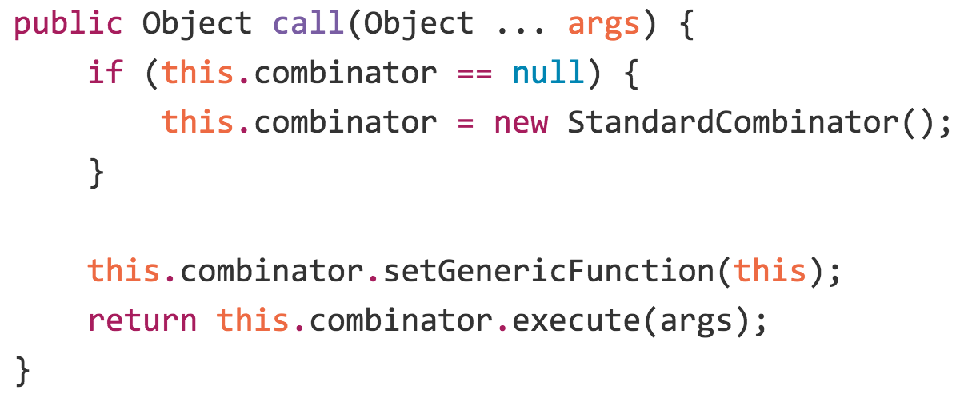
Custom Combinators

Slide 23
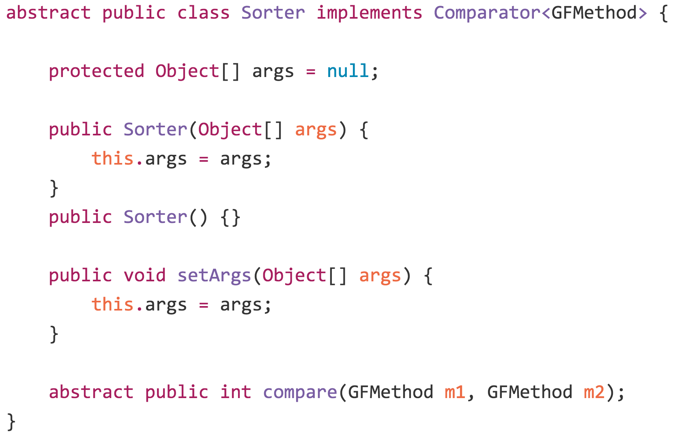
Custom Sorters

Slide 24
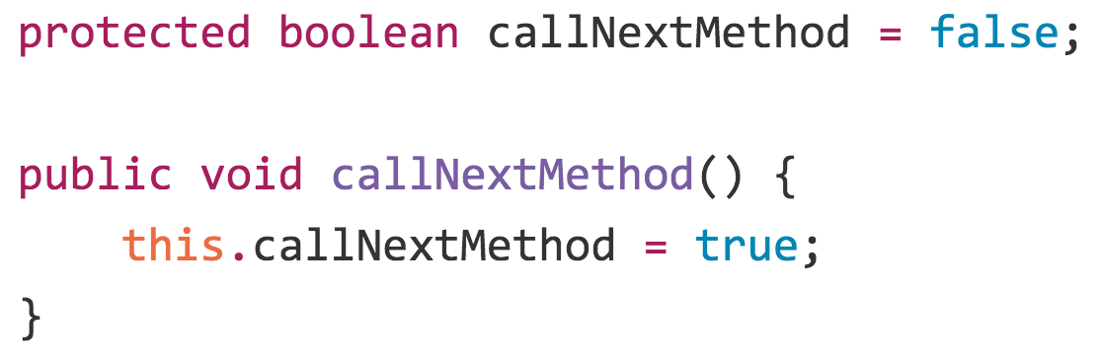
Call Next Method

Slide 25
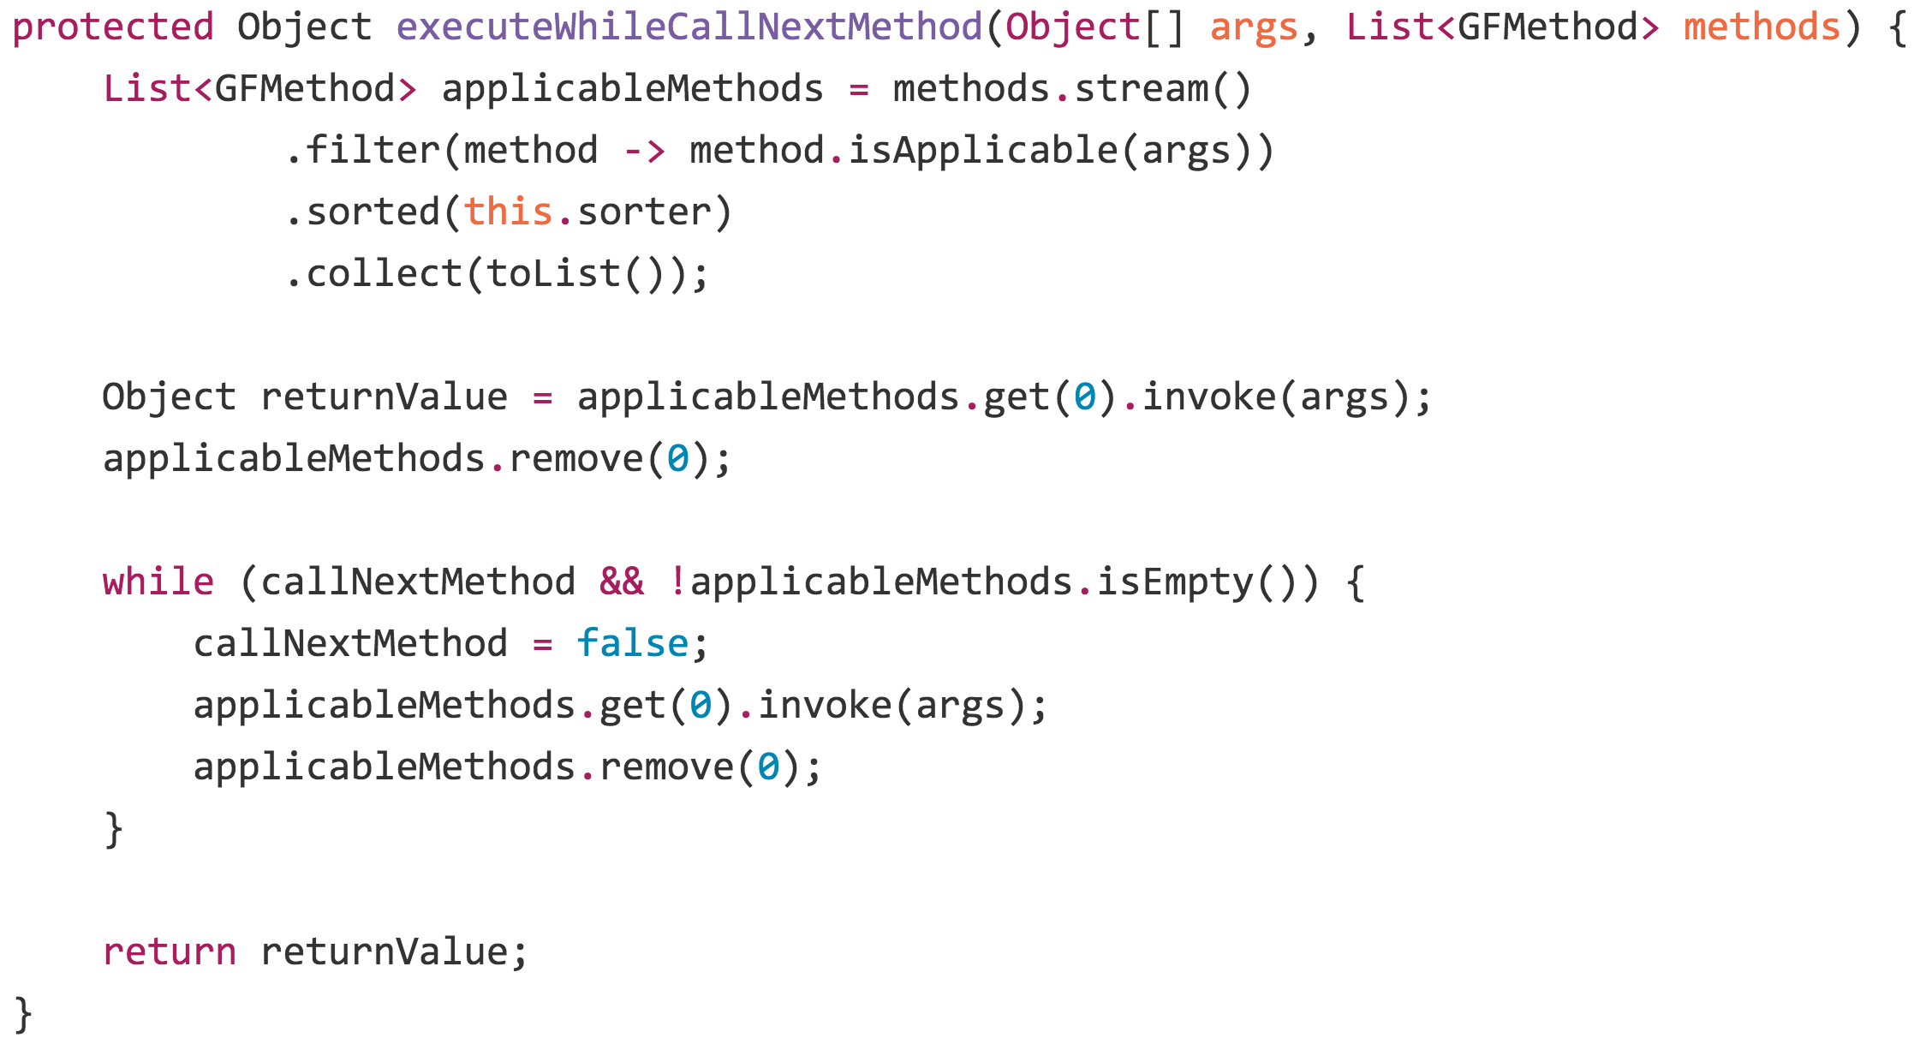
Call Next Method

Slide 26
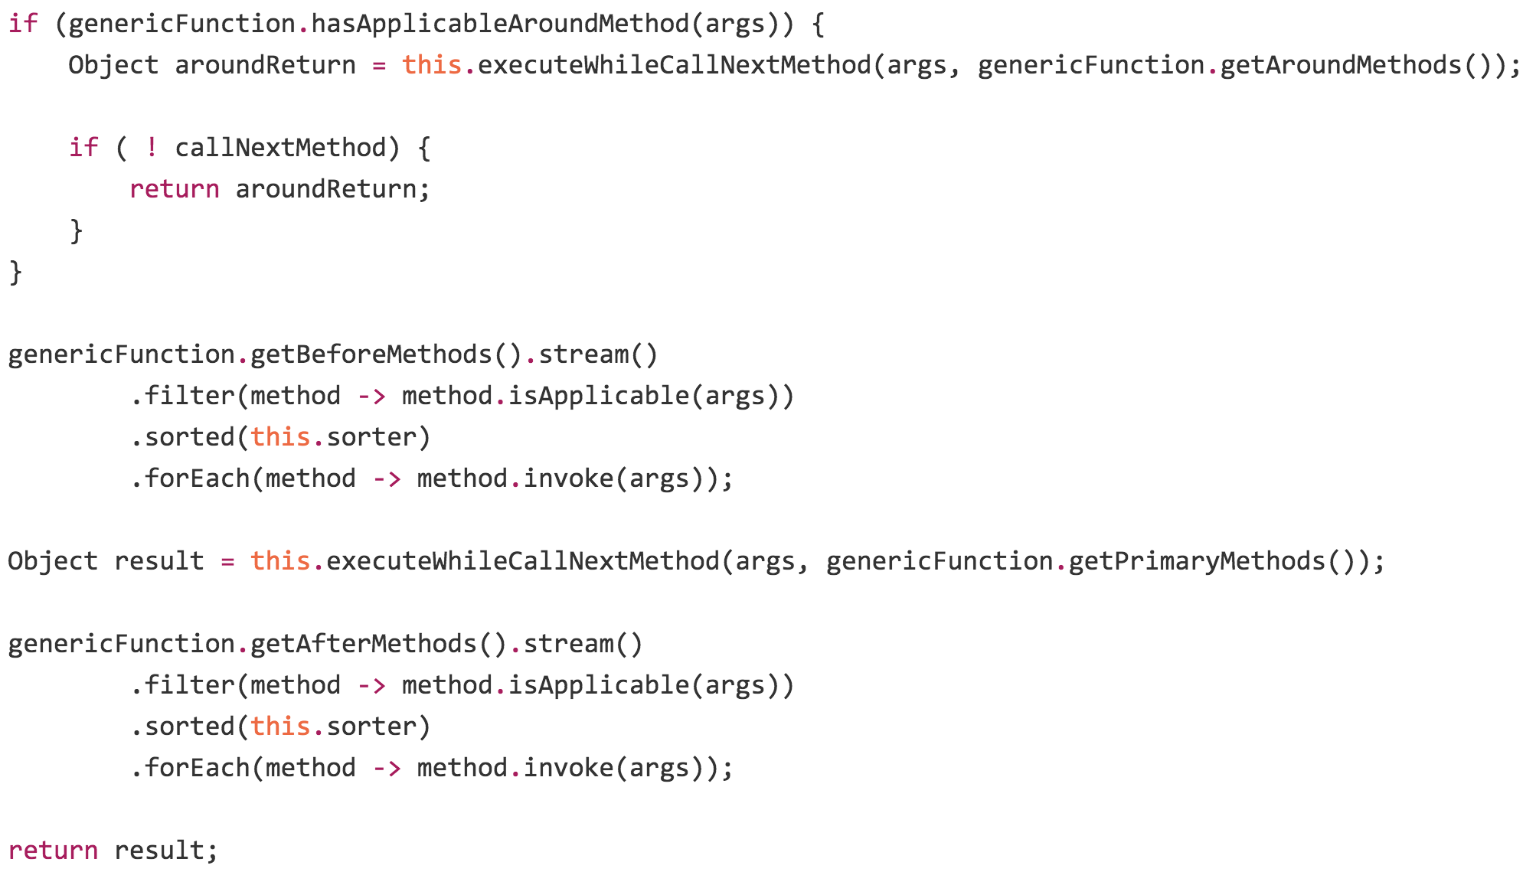
Around Combinator

Slide 27
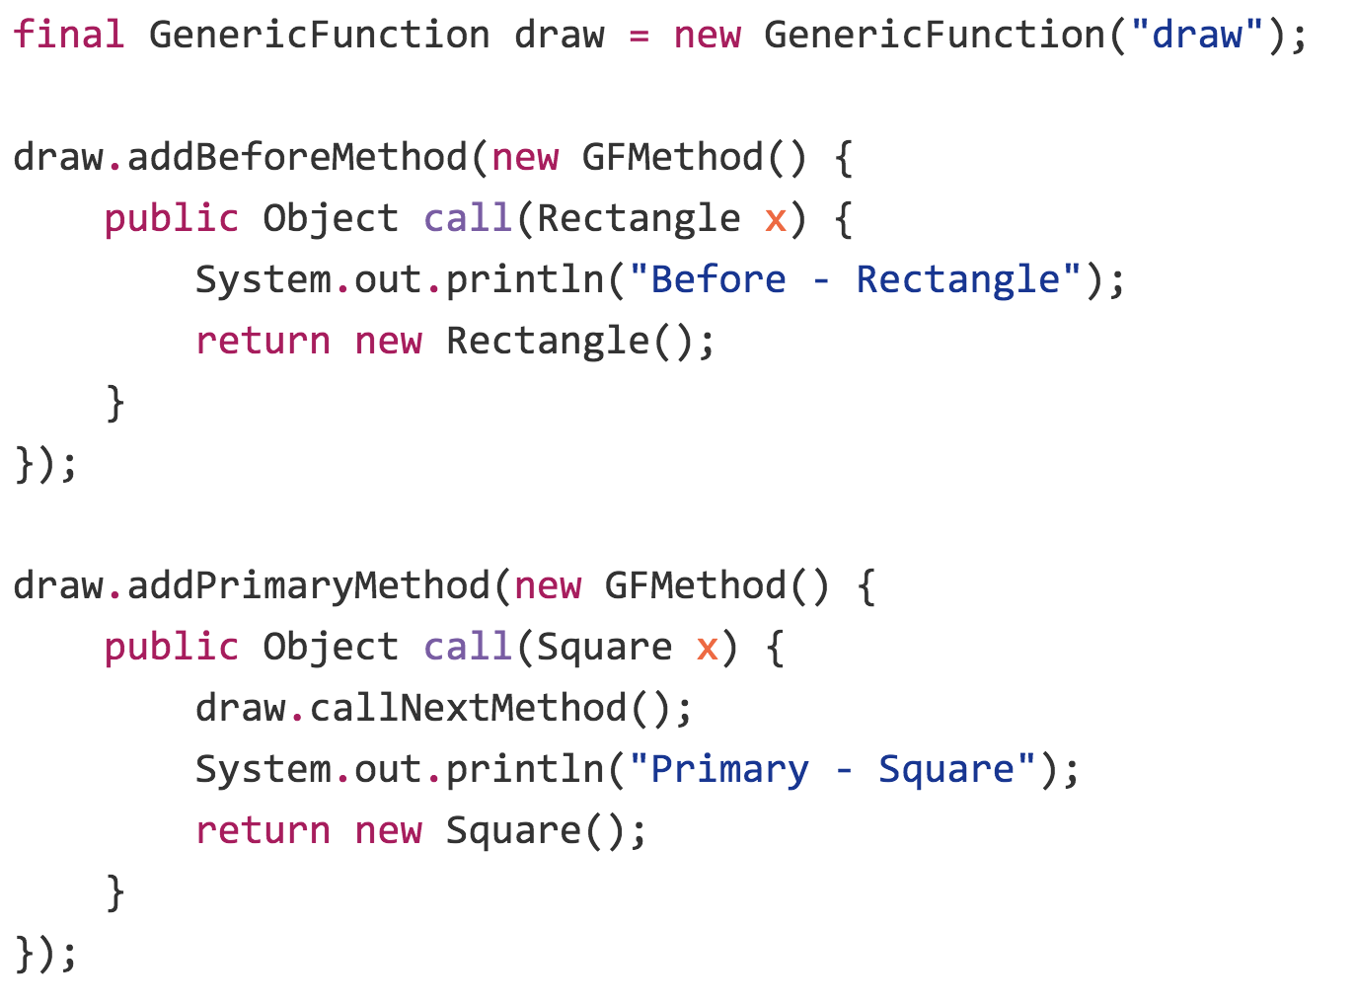
Example

Slide 28
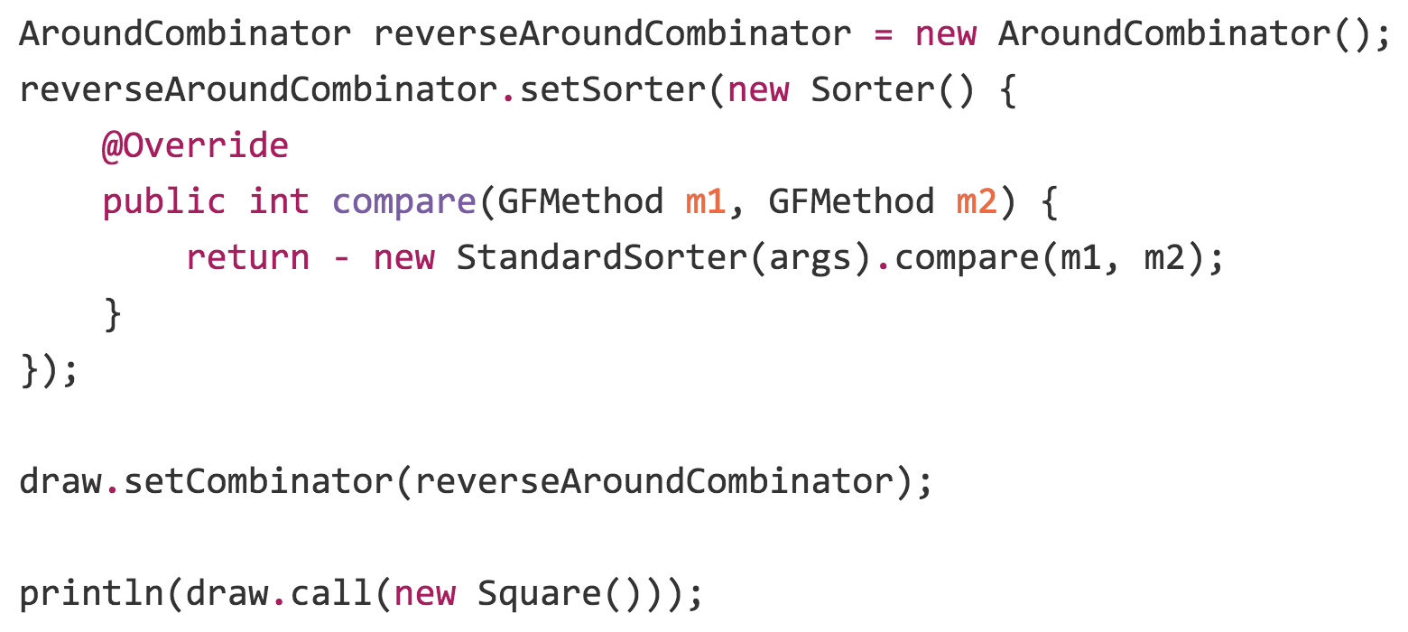
Example

Slide 29
Any Questions?
Thank you

