Slide 1


MindScan AI: Mental health detector
Project Guide: Team Members:
Mrs. R.Sudha, M.Tech S. Asha [210222104005]
A. Deepthi [210222104009]
K. Dharshini [210222104012]
R. Hemalatha[210222104021]

Slide 2
Domain/Introduction
    Artificial Intelligence (AI)- AI is about making computers and machines smart enough to do things that usually need human intelligence, like learning, solving problems, understanding language, and making decisions, often by learning from vast amounts of data
    Machine learning (ML) is a subset of Artificial Intelligence focused on building systems that learn from data, identify patterns, and improve accuracy over time without being explicitly programmed for every task.
    AI and ML help MindScan AI by analyzing complex mental health data—like text responses, speech or physiological signals—to detect early signs of stress, anxiety, or depression, and to provide personalized insights or predictions.

Slide 3
Scope of the project
    Online platform for mental health monitoring .
    Mood and stress tracking .
    Mental health self-assessment tests .
    Personalized suggestions and tips .
    Access to counseling resources and helplines .
    Secure and private data management.

Slide 4
Abstract
    Mental health disorders such as stress, anxiety, and depression require early detection for effective support. Existing mental health assessment systems mainly depend on questionnaires and clinical visits, which are subjective, time-consuming, and lack continuous monitoring. MindScan AI is proposed as an intelligent mental health detection system using Artificial Intelligence and Machine Learning techniques. The system applies Natural Language Processing (NLP) to analyze user text inputs and emotional responses. Machine learning algorithms such as Naïve Bayes, Support Vector Machine (SVM), Logistic Regression, and Random Forest are used to classify mental health conditions. Developed using Python with libraries and a web interface built with HTML, CSS, and JavaScript, the proposed system provides real-time analysis, personalized feedback, and improved early detection compared to existing systems.

Slide 5
Existing project and Limitations
    Existing :
    Traditional counseling and therapy .
    Separate mental health apps .
    Disadvantages :
    psychological assessments .
    Online resources and helplines.
    Inadequate for all age groups.
    Limited personalization.

Slide 6
Proposed project
    Proposed :
    Automated mood tracking and analysis .
    Personalized recommendations .
    Advantages:
    Real-time mental health insights.
    Activity based detection .
    Suitable for all age groups.
    Enhanced privacy and security.

Slide 7
Hardware and Software requirements
Hardware Requirements:
    Processor - Intel Core i3 or above
    RAM - 8GB
    Hard Disk - Minimum 10GB free space
    Software Requirements:
    Operating System - Windows / Linux
    Code editor - Visual Studio Code
    Frontend – React.js + HTML + CSS + JavaScript
    Backend - Node.js + Express
    Database - MySQL

Slide 8
Literature Survey
S.NO
TITLE
DESCRIPTION
MERITS
DEMERITS
Intelligent depression Prevention via LLM-Based Dialogue Analysis.
Author: Zhong & Wang
Year: 2025
An approach that uses large language models to analyze dialogue patterns, detect early signs of depression, and enable timely, through intelligent conversational support.
    Continuous monitoring.
    Higher precision (89%) than traditional ways.
    Privacy issues.
    Large models need a lot of memory, and time to run.
1.
Explainable AI for Depression Detection From Activity Data.
Author: Ahmed et al
Year: 2025
Develops and tests an interpretable machine learning system that uses wearable activity (actigraphy) data to detect whether someone is depressed.
    Provides explainable outputs.
    Good performance.
    Dependent on wearable.
    Sleep/activity patterns vary .
2.
Multi-Modal LLM for Depression Detection.
Author: Zhao et al
Year: 2025
A multi-modal large language model that combines text, audio, and visual signals to improve the accuracy of depression detection.
    Outperforms single-modality systems.
    Reduces data labeling requirements.
    Complex architecture.
    Data synchronization challenges.
3.
Advances in AI-Based Depression Diagnosis: Systematic Review.
Author: Wang & Wu
Year: 2025
Reviews voice, facial, body, and social media data approaches for depression diagnosis, summarizing methods, data sources.
    Comprehensive overview of state-of-the-art techniques.
    Highlights current performance trends.
    Focused on review — not novel experimentation.
    Doesn’t propose new models.
4.
AI-Based Screening Through Eye Tracking. Author: Chlasta
Year: 2025
AI and eye-tracking data to screen for signs of depression by analyzing eye movement patterns.
    Nonverbal and non-invasive measurement modality.
    Novel approach for ecological screening.
    Accuracy is modest.
    Requires specialized eye-tracking hardware.
5.

Slide 9
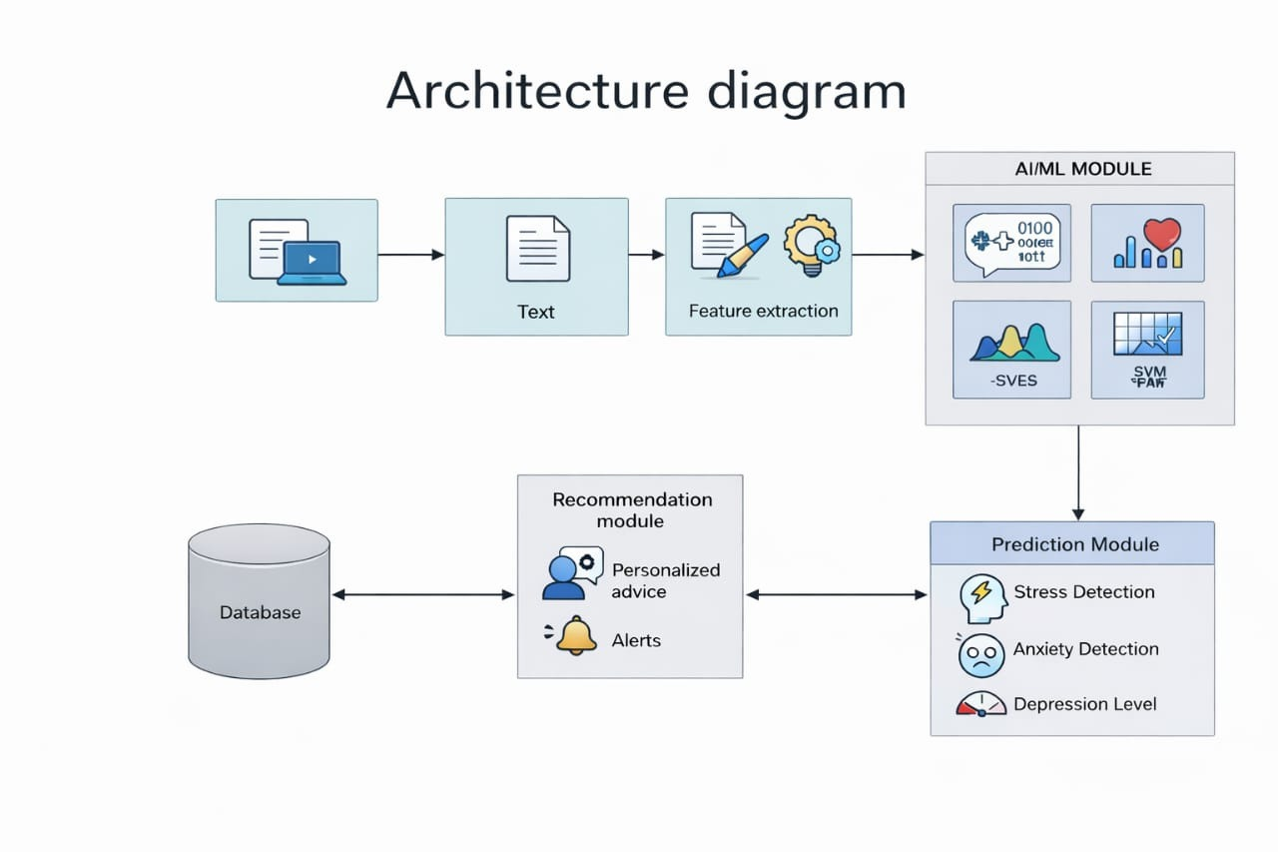
Architecture diagram

Slide 10
List of modules
1. User interface module
2. Input module
3. Data preprocessing module
4. AI/ML analysis module
5. Prediction module
6. Recommendation system module
7. Database/ cloud storage module

Slide 11
User Interface Module
    User Interface Module (Web / Mobile Application) is the primary interaction layer between the user and the MindScan AI system.
    It provides a simple, accessible, and user-friendly environment where individuals can share their emotional states and daily experiences.
    Main Functions provides login, registration, and authentication features.
    Allows users to enter emotional data through : Text messages, Voice recordings daily activity updates , Displays mental health insights and progress reports.
    Shows personalized recommendations and alerts.
    Supports real-time interaction with the AI system.
    Features responsive design for both mobile and web platforms.
    Mood tracking dashboard with charts.
    Notification system for reminders and wellness tips.

Slide 12
Input Module
    The Input Module, also known as the Data Collection Layer, is the first and foundational part of an AI system like Mindscan AI. It’s responsible for gathering all the raw data the AI needs to understand a situation, learn patterns, and generate useful outputs.
    It gathers multimodal information to improve prediction accuracy .
    Validate input before processing.
    Ensure user consent and privacy compliance.
    Advantages Multi-source data improves detection accuracy .
    Captures real-life behavioural patterns.

Slide 13
Data Preprocessing Module
    This module prepares raw data for machine learning analysis.
    Since user inputs may contain noise or inconsistencies, preprocessing ensures data quality and reliability .
    Text Processing Removal of special characters and unwanted symbols.
    Removal of special characters and unwanted symbols.
    Feature Extraction identifies emotional keywords . Extracts linguistic patterns .
    Detects frequency of emotional expressions .
    Extracts tone, pitch, and speech speed features .
    Outcome Structured datasets ready for AI/ML models.

Slide 14
AI / ML Analysis Module
    This is the main processing engine where machine learning algorithms analyse emotional and behavioural data to detect mental health patterns .
    NLP Processing understands user language and context .
    Detects hidden emotional meanings . Identifies negative thinking patterns.
    Sentiment Analysis Classifies text into : Positive, Negative, Neutral.
    Machine Learning Algorithms Naïve Bayes fast classification based on probability .
    Effective for text sentiment analysis .
    Support Vector Machine (SVM) detects complex emotional patterns .
    High accuracy for classification tasks . Emotion Detection Recognizes emotions like: Stress, Sadness, Fear, Happiness, Anger.
    Output :Emotional classification results . Behavioral insights.

Slide 15
Prediction Module
    The Prediction Module interprets AI outputs to estimate the user’s mental health condition and severity .
    Stress Detection identifies mental pressure indicators .
    Detects workload or emotional overload signals .
    Anxiety Detection recognizes patterns of worry or nervousness .
    Analyses repetitive negative expressions . Depression Level Identification estimates emotional withdrawal .
    Detects prolonged sadness or loss of interest .
    Risk Score Calculation generates numerical scores based on : Emotional intensity, Frequency of negative inputs behavioural changes,
    Categorizes risk levels : Low, Medium, High.
    Purpose: Helps the system make informed recommendations.

Slide 16
Recommendation System Module
    The Recommendation System Module is an AI component that analyzes user data, behavior, and patterns to provide personalized suggestions.
    This module provides personalized mental health guidance based on predictions and user history .
    Personalized Advice- daily wellness suggestions , Emotional coping strategies , Positive reinforcement messages.
    Stress relief techniques . High-Risk Alerts -Sends warnings to users when risk increases.
    Optionally notifies caregivers or support contacts .
    Suggests professional help if necessary .
    Benefits: Promotes emotional stability . Encourages healthy habits.

Slide 17
Database / Cloud Storage Module
    This module manages secure storage and system data operations.
    Data Storage :User profiles and emotional history .
    Activity logs and prediction results . Voice and text records (securely stored).Model Storage saves trained machine learning models .
    Stores updated AI algorithms . History & Reporting Tracks user progress over time . Generates mental health reports and graphs . Security Features data encryption .
    Access control mechanisms . Privacy protection policies . Secure cloud backup .
    Importance: Enables long-term monitoring . Supports future system improvements.

Slide 18
Conclusion
Conclusion with Feature Enhancements: MindScan AI is designed as an intelligent mental wellness assistant that analyzes user emotions, evaluates journal entries, tracks weekly mental health patterns, and provides personalized insights. By integrating AI-based emotion detection, stress relief games, interactive charts, and a modern dashboard, the system offers proactive support to help users understand and improve their mental well-being in a secure and user-friendly environment.
The application can be further enhanced by incorporating adaptive AI learning, allowing the system to learn from user history and improve emotion predictions, recommendations, and mental health scoring over time. Additionally, a weekly progress comparison feature can provide meaningful insights by comparing current and previous week mental health charts, highlighting emotional improvements, declines, and key behavioral changes.

Slide 19
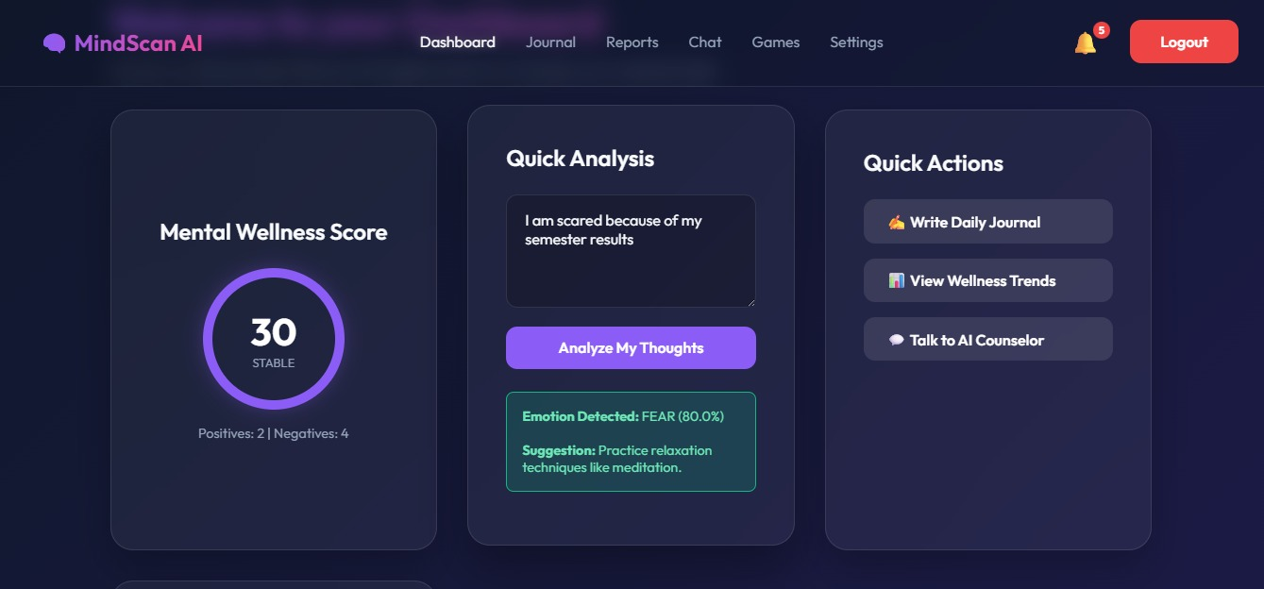
Output

Slide 20
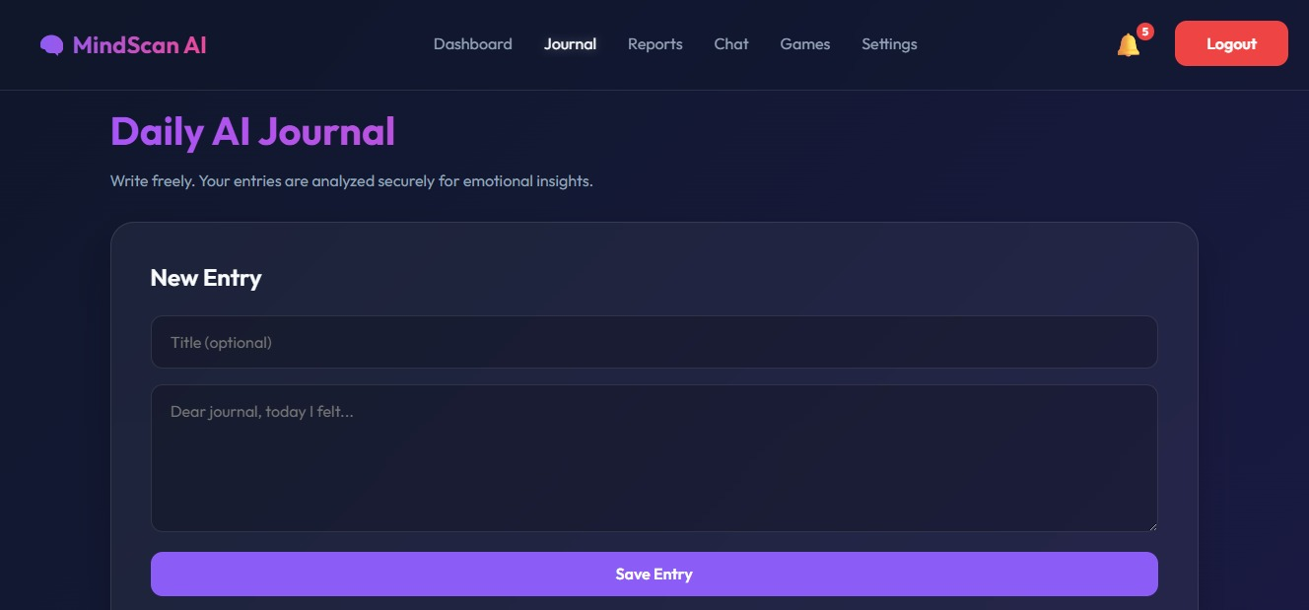

Slide 21
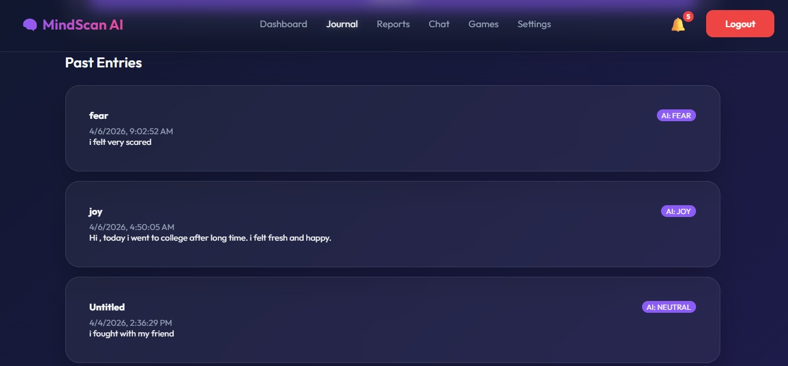

Slide 22
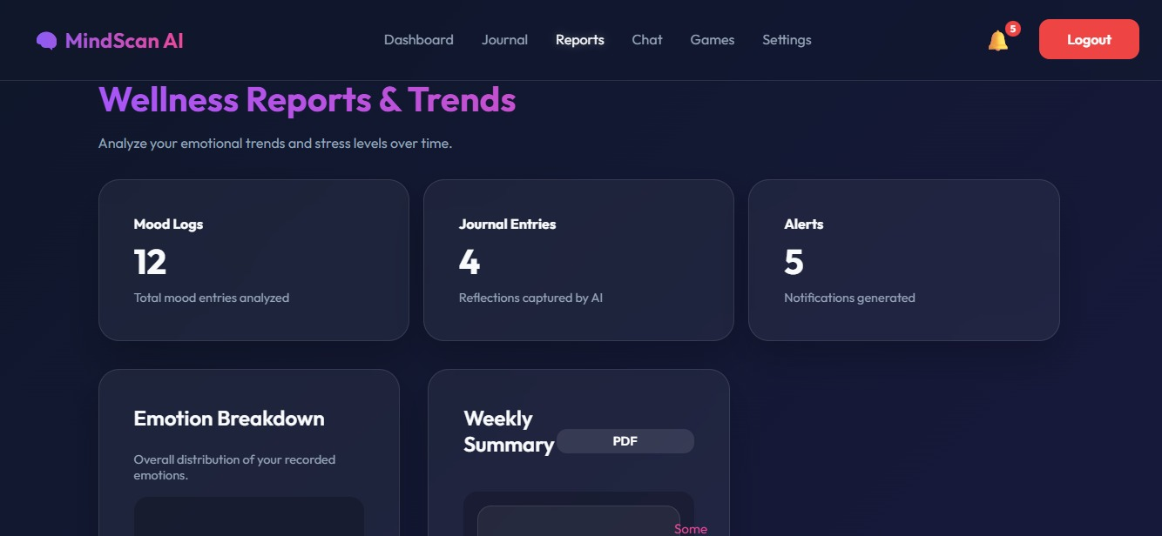

Slide 23
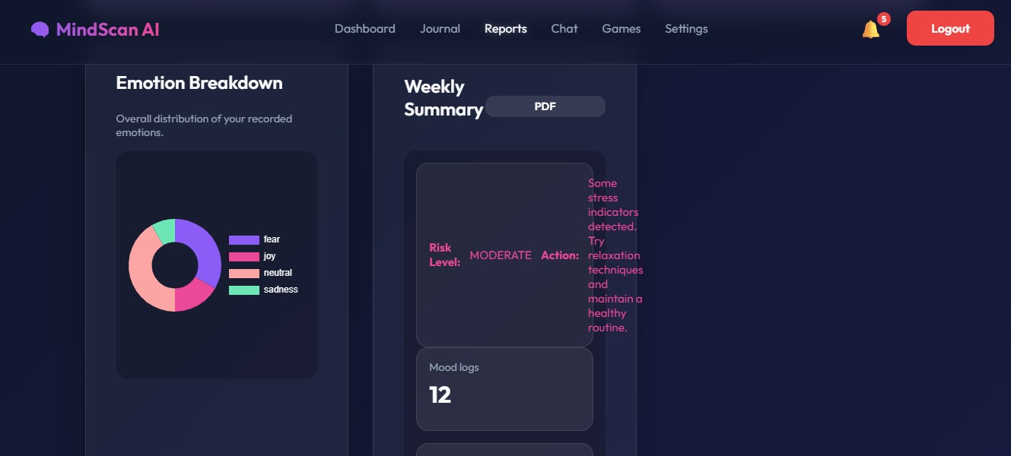

Slide 24
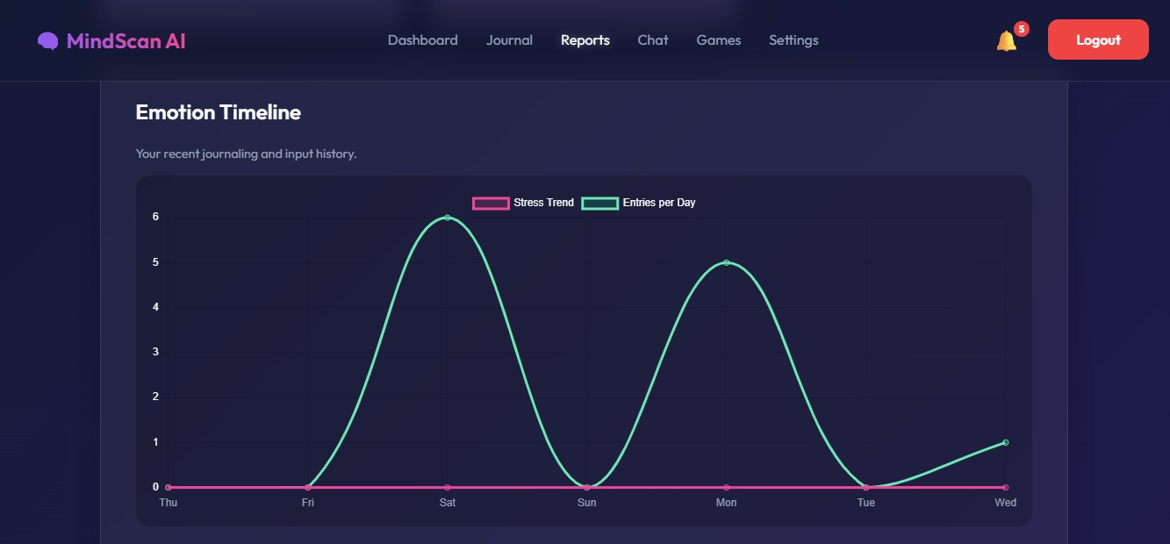

Slide 25
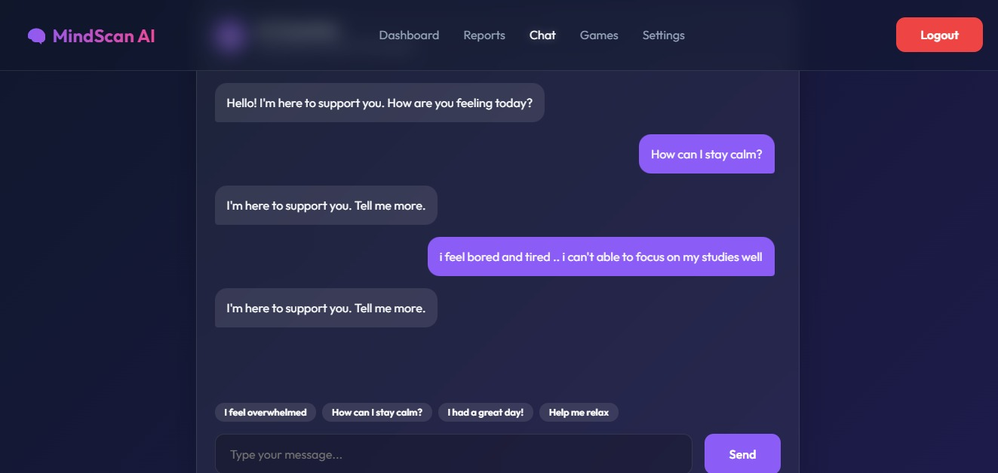

Slide 26
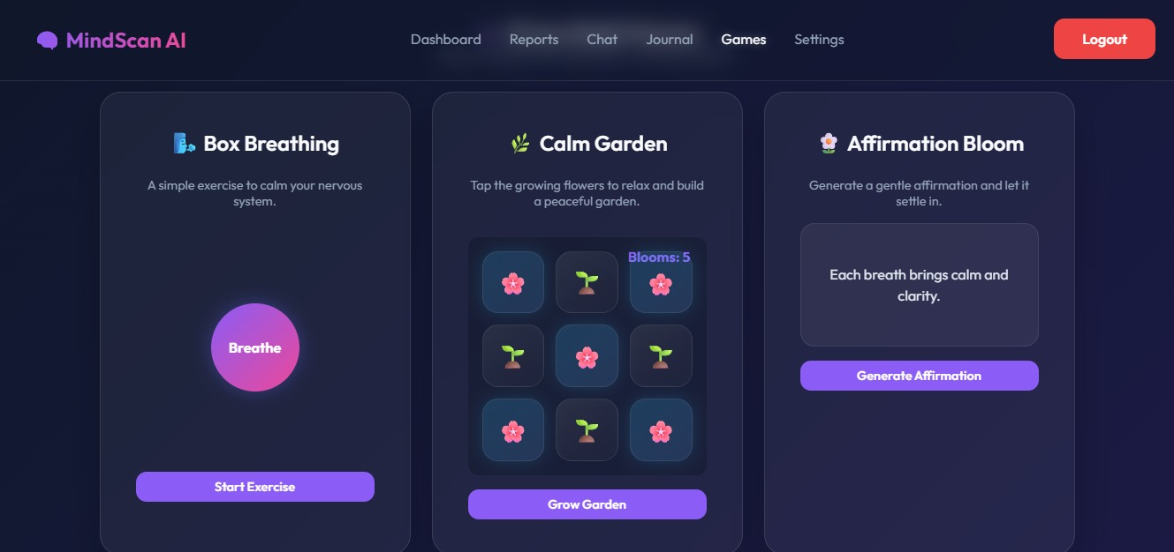

Slide 27
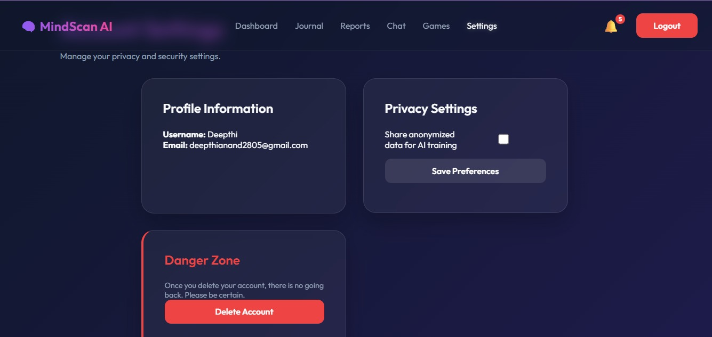

Slide 28
References
[1] B. Liu, “Sentiment Analysis and Opinion Mining,” Synthesis Lectures on Human Language Technologies, vol. 5, no. 1, pp. 1–167, 2012.
[2] M. Neethu and R. Rajasree, “Sentiment Analysis in Twitter using Machine Learning Techniques,” Proceedings of the International Conference on Computing, Communication and Networking Technologies, 2013.
[3] S. Minaee, N. Kalchbrenner, E. Cambria, N. Nikzad, M. Chenaghlu, and J. Gao, “Deep Learning-based Text Classification: A Comprehensive Review,” ACM Computing Surveys, vol. 54, no. 3, 2021.
[4] H. A. Schwartz et al., “Predicting Individual Well-Being Through the Language of Social Media,” Proceedings of the AAAI Conference on Artificial Intelligence, 2016.
[5] E. Cambria, D. Das, S. Bandyopadhyay, and A. Feraco, “Affective Computing and Sentiment Analysis,” IEEE Intelligent Systems, vol. 28, no. 2, pp. 8–17, Mar.-Apr. 2013.
[6] Y. Kim, “Convolutional Neural Networks for Sentence Classification,” IEEE Transactions on Neural Networks and Learning Systems, vol. 29, no. 4, pp. 1312–1324, Apr. 2018.
[7] S. Poria, E. Cambria, R. Bajpai, and A. Hussain, “A Review of Affective Computing: From Unimodal Analysis to Multimodal Fusion,” IEEE Transactions on Affective Computing, vol. 10, no. 2, pp. 1–17, 2017.
[8] M. M. Hassan, M. Z. Uddin, A. Mohamed, and A. Almogren, “A Robust Human Activity Recognition System Using Smartphone Sensors and Deep Learning,” IEEE Access, vol. 6, pp. 800–812, 2018.
[9] J. Tao and T. Tan, “Affective Computing: A Review,” IEEE Transactions on Affective Computing, vol. 10, no. 2, pp. 1–15, 2019.
[10] , Google LLC, 2023.

