Slide 1
Stochastic Optimization of a Campus Solar + Battery Microgrid
Two-stage stochastic programming, CVaR risk control, VSS and EVPI
21AIE321T Stochastic Decision Making · Mini Project (Assignment IV)
[Your name] · [Register No.] · SRMIST Tiruchirappalli · SDG 9 (Target 9.5)
Notes:
Introduce the problem: a campus must commit its grid purchases a day ahead without knowing weather or load.

Slide 2
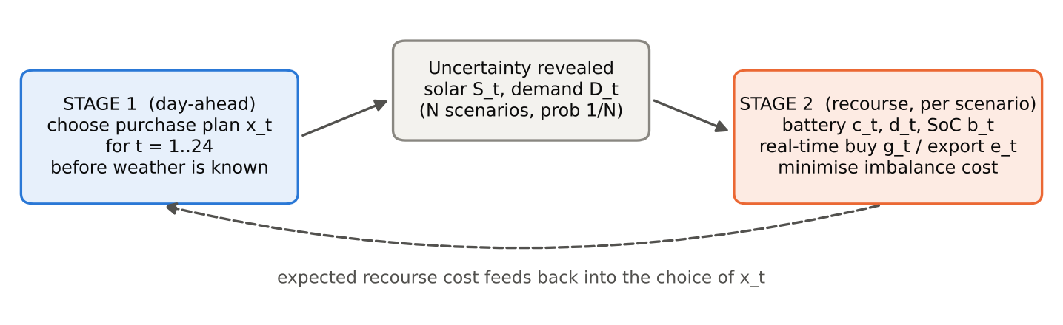
Commit tomorrow's power purchase today
Campus: 800 kWp solar, 1 MWh battery, ~0.7 MW peak load
Day-ahead hourly purchase must be fixed before weather and load are known
Shortfall costs 1.6× day-ahead price; surplus sells at ₹3/kWh
Asymmetric costs → plan for averages is not optimal
All scenario data are synthetic, generated from stated assumptions.
Notes:
Asymmetric costs: shortfall at 1.6x price, surplus sold at Rs 3.

Slide 3
Model: two-stage stochastic linear program
Stage 1 (here-and-now)
Stage 2 (recourse)
Objective
Day-ahead purchase x_t, t = 1…24, same for every scenario
Per scenario: battery charge / discharge / SoC, real-time buy g_t, export e_t
Day-ahead cost + average of real-time cost − export revenue + battery wear
Constraints: hourly energy balance, battery dynamics (η = 0.92), SoC limits, power limit
Solved as one LP by sample-average approximation: N = 200 scenarios, 24,024 variables, ~1 s (HiGHS)
Notes:
Explain first-stage vs recourse and relatively complete recourse.

Slide 4
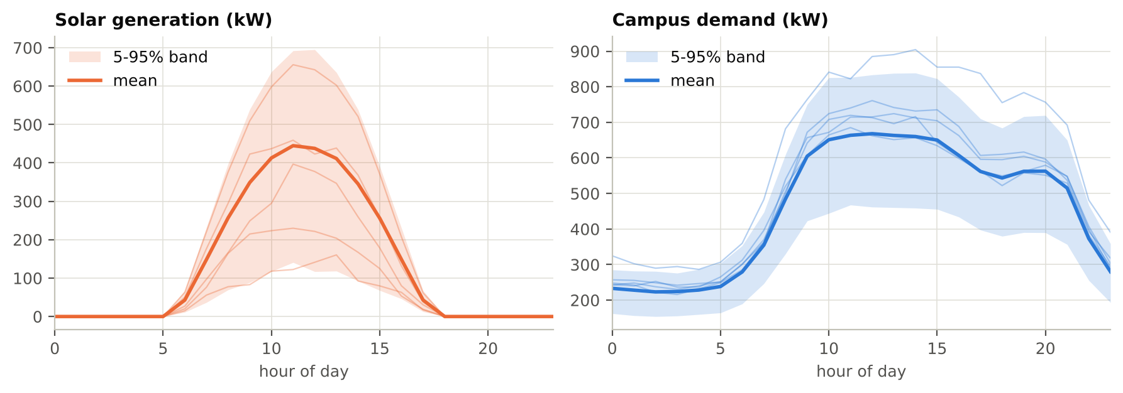
Scenarios: bimodal solar, variable demand
Weather: clear 35%, partly 40%, overcast 25%
Demand: holiday days at 0.72× load
Solar ≈ 31% of demand on average, sd 1.35 MWh/day
Training N = 200; independent test set of 500 days

Slide 5
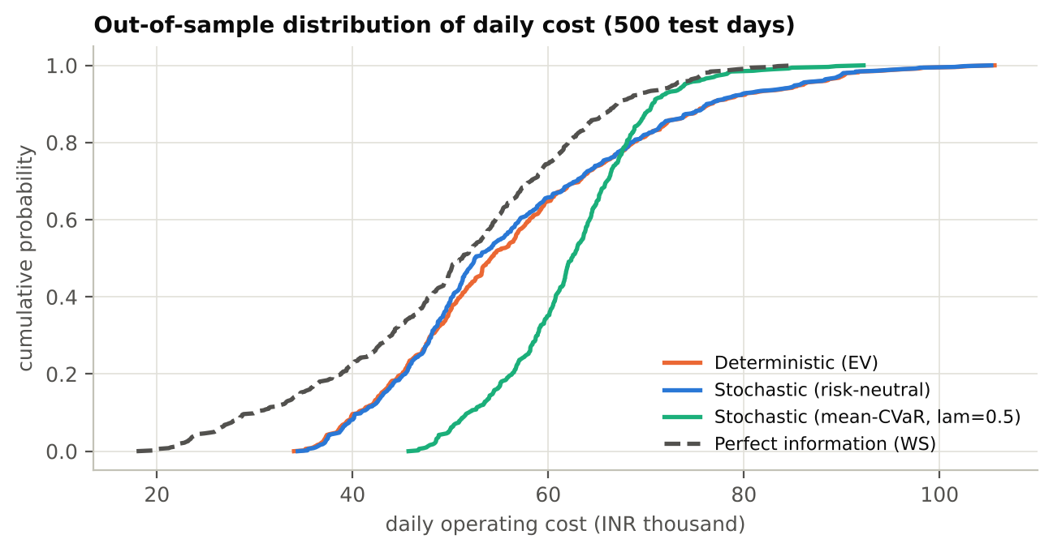
Results: value of modelling uncertainty
₹322/day
VSS vs deterministic plan (95% CI 255-389)
₹6,405/day
EVPI: 11.3% of cost, upper bound for forecasting
₹1,034/day
saved vs rule-of-thumb plan
Notes:
VSS = EEV - RP, EVPI = RP - WS, estimated on 500 unseen days.

Slide 6
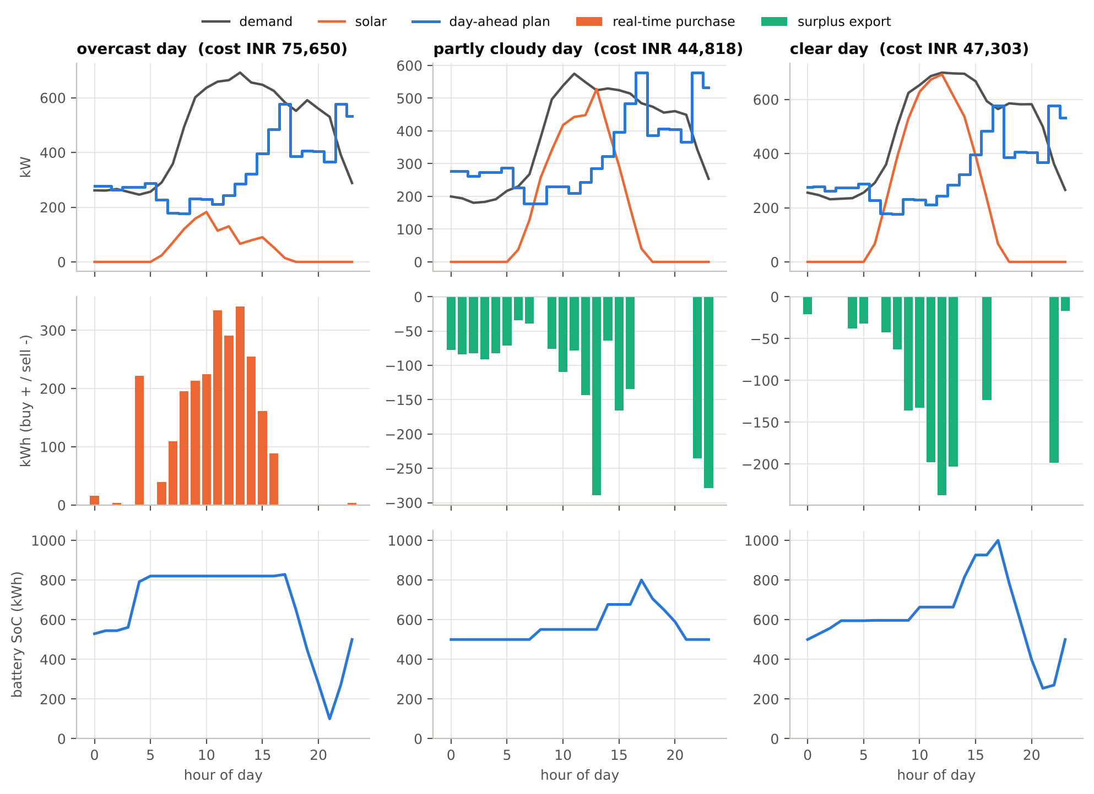
The plan hedges; the battery adapts
Overcast: pre-charge at night, heavy real-time buying
Clear: export surplus, carry solar into evening peak
Plan commits more at 17:00-20:00 than the deterministic plan

Slide 7
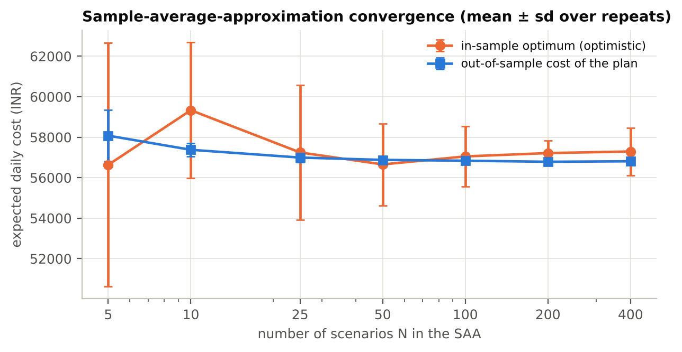
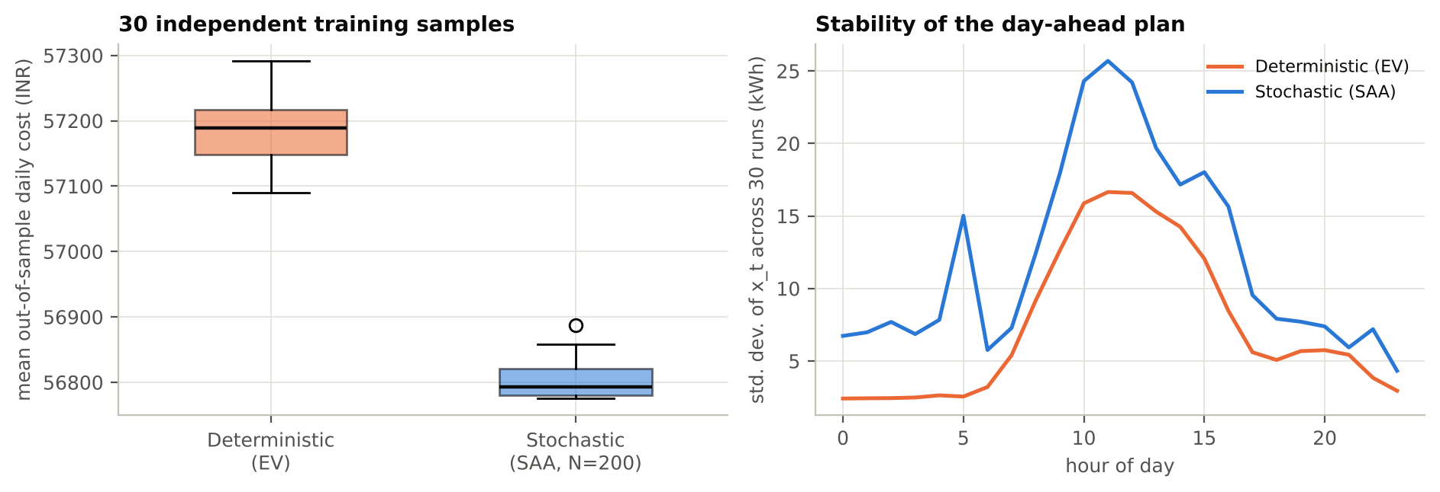
Robustness: 30 repeats, SAA convergence, risk
VSS positive in 100% of 30 repeats (mean ₹384/day)
Plan stable from N ≈ 50-100 scenarios
Mean-CVaR λ = 0.25: CVaR₉₀ −6.1% for +1.7% mean cost

Slide 8
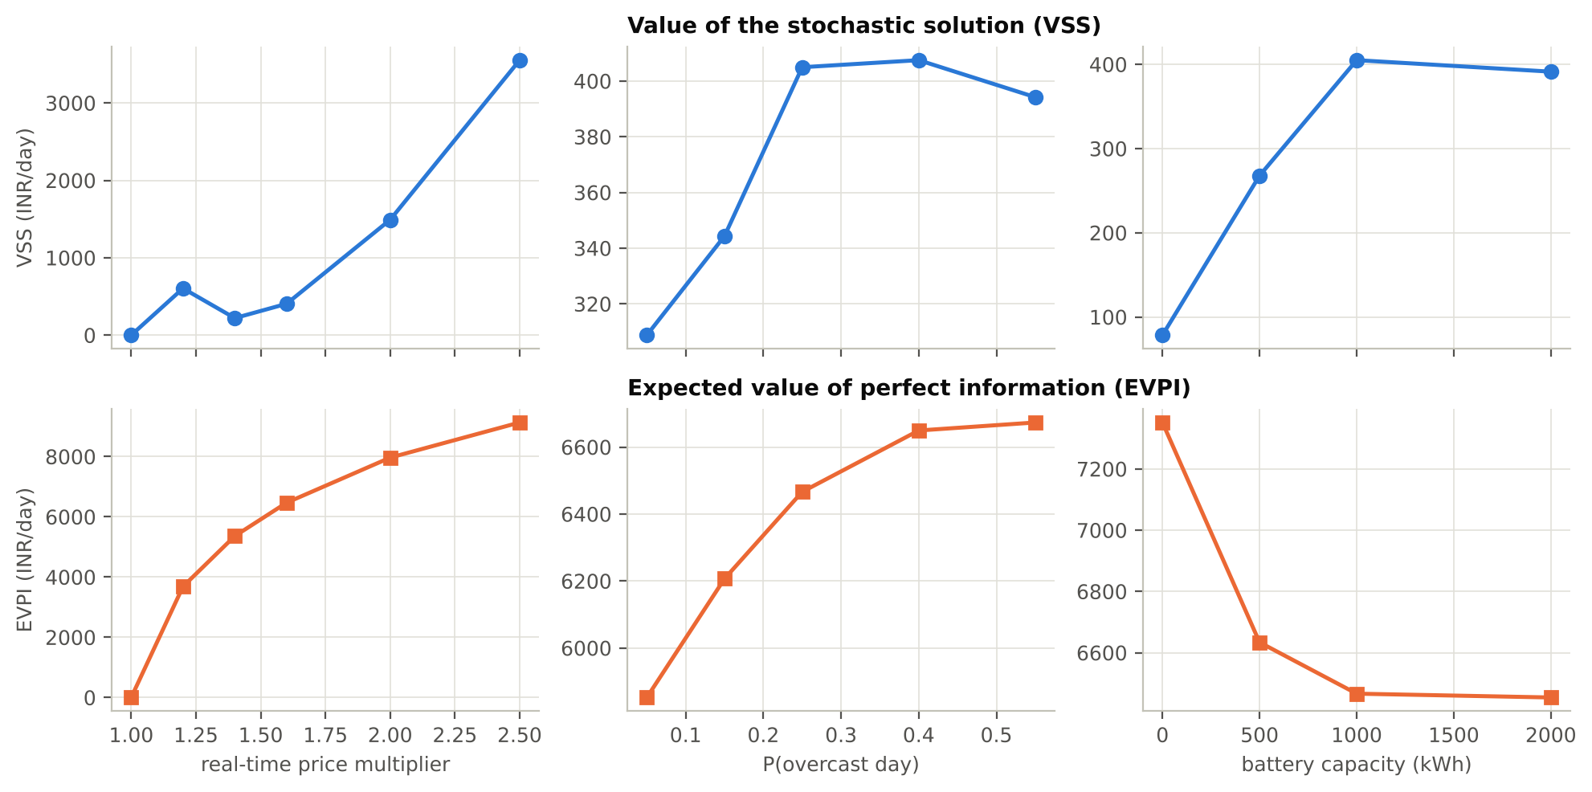
Sensitivity: price asymmetry drives the value
κ = 1.0 → VSS = EVPI = 0
κ = 2.5 → VSS ₹3,553/day (5.6%)
Battery: 1 MWh worth ≈ ₹2,273/day
Wrong weather model can cost more than VSS gains
Notes:
Without an imbalance penalty VSS and EVPI are both zero.

Slide 9
Conclusion and recommendation
Stochastic plan beats naive (₹1,034/day) and deterministic (₹322/day) plans
Benefit grows with the real-time price penalty
Perfect information worth up to ₹6,405/day: invest in forecasting
Use risk-neutral plan or small CVaR weight (λ ≈ 0.25)
Next: calibrate on metered data; multistage re-optimisation
Limitations: synthetic data; day-ahead stage only; linear battery wear.

