Slide 1
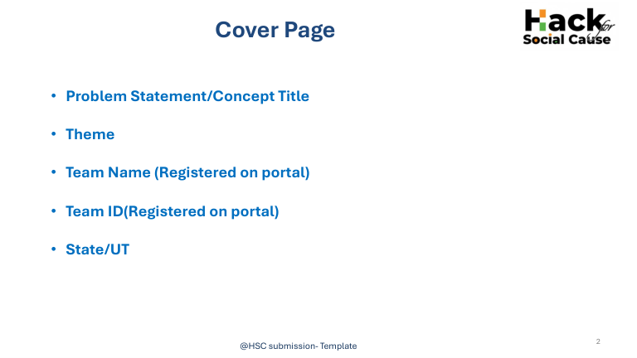
MEDI-BRIDGE
Digital Emergency Coordination for Hospitals & Police
Theme: Healthcare
Team Name: Phoenix 2.0
Team ID:
Section: SEC25IT460 | IT - D
State/UT: Not specified in source file

Slide 2
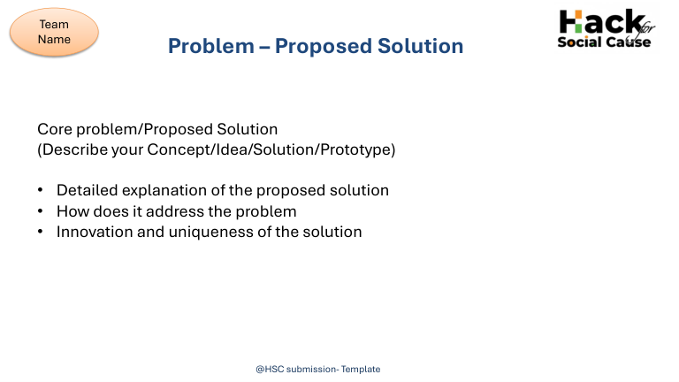
THE “GOLDEN HOUR” CRISIS
MEDI-BRIDGE APPROACH
Medico-legal formalities can delay urgent treatment and coordination during road-accident emergencies.
• One-tap emergency mode on a web/mobile platform
• Instant digital medico-legal certificate (EMLC) with unique ID
• GPS geofencing alerts the correct police station
• Dashboard tracks police acknowledgements and medical severity
• Geo-tagged, timestamped evidence and encrypted communication
• One-tap insurance-provider notification
• Physical travel to police stations to file complaints
• No real-time digital bridge between hospitals and law enforcement
• Redundant paperwork and manual errors
• Delayed police notification can stall legal and medical intervention

Slide 3
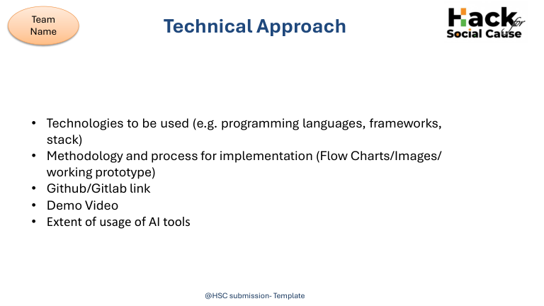
• Platform: unified web and mobile emergency interface
• Location: GPS geofencing to identify the correct jurisdictional police station
• Digital records: instant EMLC generation with a unique ID
• Coordination: real-time dashboard for police acknowledgements and medical severity tags
• Evidence: geo-tagged and timestamped accident-site data
• Security: end-to-end encryption for healthcare and legal communication
• GitHub/GitLab link, demo video, programming languages/frameworks and AI-tool usage: not provided in source

Slide 4
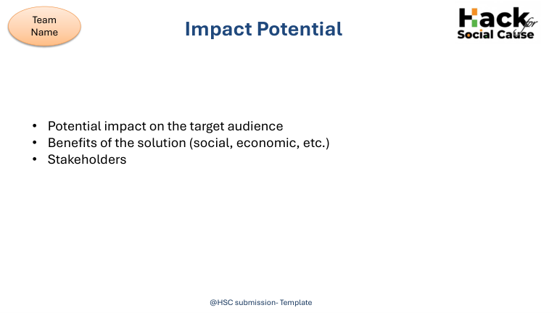
• Target audience: accident patients, hospitals, police, and insurance providers
• Faster police intimation and emergency coordination
• Helps protect the Golden Hour by reducing communication delays
• Reduces paperwork and manual errors
• Supports quicker legal communication and smart healthcare systems
• SDG 3: Good Health and Well-Being — road safety, healthcare access, emergency preparedness
• SDG 16: Peace, Justice and Strong Institutions — accountable digital reporting and coordination
• SDG 9: Industry, Innovation and Infrastructure — digital communication and resilient emergency systems

Slide 5
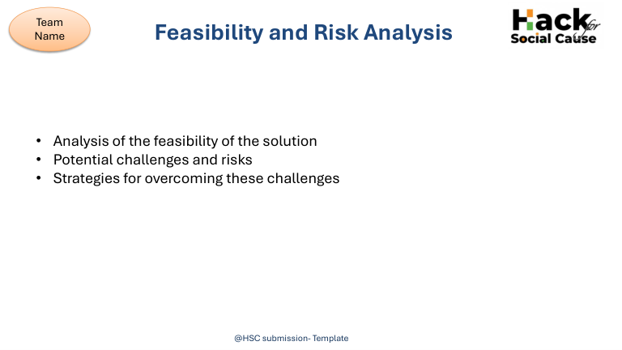
ESTIMATED PROJECT BUDGET
RISKS TO VALIDATE
• Software & app development — ₹3,000
• Internet & cloud services — ₹1,000
• UI/design & testing — ₹1,000
• Documentation & printing — ₹500
• Presentation & miscellaneous — ₹500
• Total estimated budget — ₹6,000
• Reliable integration between hospital and police workflows
• Accurate GPS-based jurisdiction identification
• Protection of sensitive medical and legal information
• Timely acknowledgement and dependable system availability
• Concept safeguards: encryption, timestamped audit trail, GPS geofencing and real-time dashboard

Slide 6
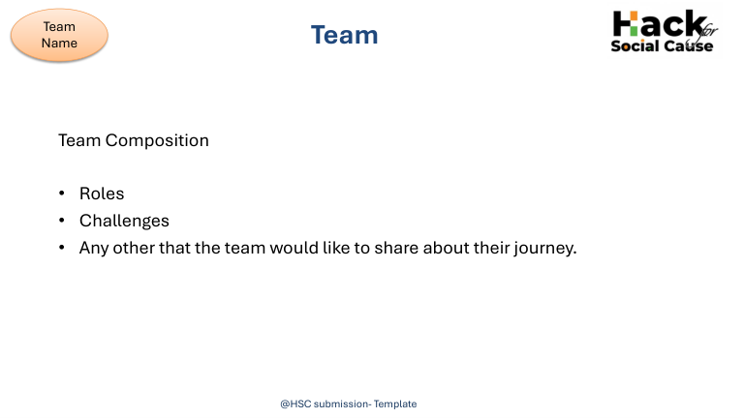
TEAM COMPOSITION
• Presenter / team member: Saranya P A
• Section: SEC25IT460 | IT - D
• Project: Medi-Bridge — digital coordination between hospitals and law enforcement
• Team roles, implementation challenges and project journey: not detailed in the source file

Slide 7
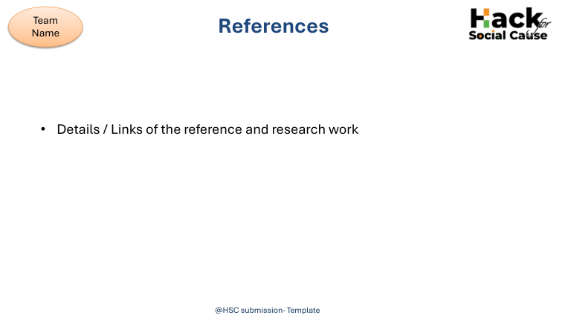
• SDG 3 — Good Health and Well-Being: Targets 3.6, 3.8 and 3.d
• SDG 16 — Peace, Justice and Strong Institutions: Targets 16.6, 16.10 and 16.a
• SDG 9 — Industry, Innovation and Infrastructure: Targets 9.c, 9.5 and 9.1
• Specific research URLs, GitHub/GitLab repository and demo-video links were not included in the source file.

