Slide 1
Predicting Seattle Traffic Incidents
Data Analysis by Phillip Asberry

Slide 2
Why is it Important to Predict Traffic Accident Severity ?
Seattle is a major metropolitan region of the United States
Millions of dollars of commerce occur in the region
Accidents can impair traffic in the region
Accidents have human cost
Know when and where an accident will occur can lead to better emergency personnel deployment

Slide 3
Data Sourcing
The data for this project came from the SDOT Traffic Management Division of the state of Washington.

Slide 4
Data Methodology
The data for the project is broken into a Training, Dev, and Testing sets.
The Training Set is comprised over 80% of the data
The Dev Set is comprised of approximately a third of the data.
The Test Set is comprised of 10% of the data.

Slide 5
Data Analysis
What exactly did we learn looking at the data ?

Slide 6
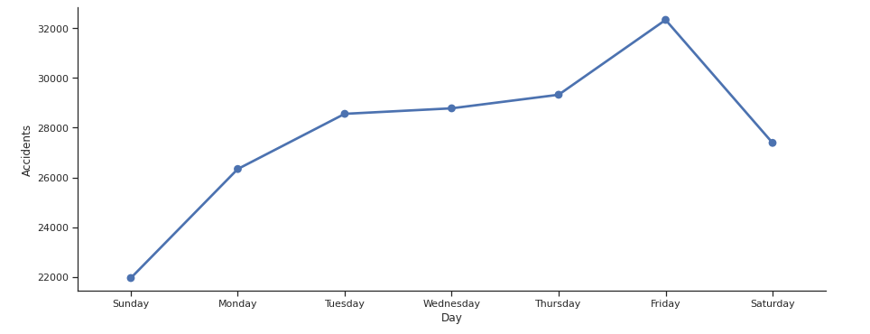
Most Accidents Occur on Fridays.

Slide 7
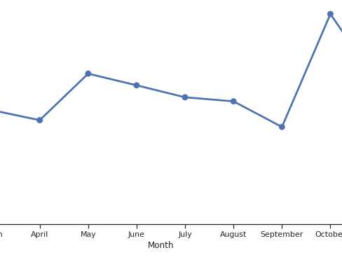
Looking for a Fender Bender? Try October, it has the most accidents by far.

Slide 8
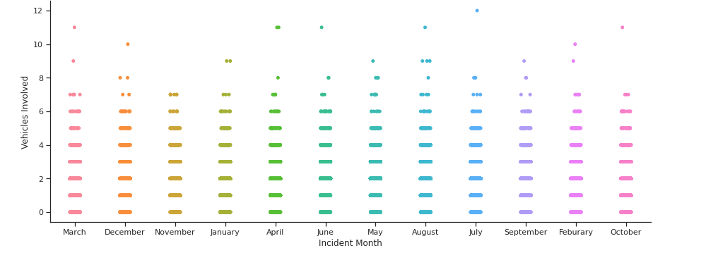
Multi-Car Accidents Can Occur at Any Month

Slide 9
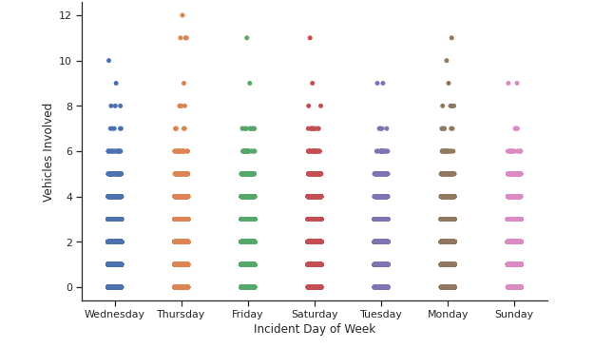
Multi-Car Accidents Can Occur Any Day Of The Week

Slide 10
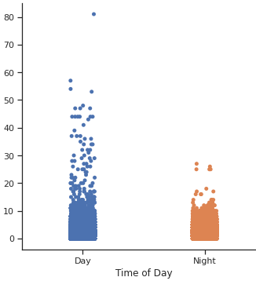
More Accidents Happen During the Day

Slide 11
Logistic Regression
Accuracy 0.75344
ROC 0.3639
F1 0.363

Slide 12
Weighted Logistic Regression
Accuracy 0.7142
ROC 0.715
F1 Score 0.4972

Slide 13
Support Vector Machine (Linear Kernel)
Accuracy 0.7539
ROC 0.753
F1 Score 0.3450

Slide 14
Weight SVM (Linear Kernel)
Accuracy 0.71933
ROC 0.71394
F1 Score 0.4934

Slide 15
Random Forest
Accuracy 0.7300
ROC 0.999
F1 Score 0.444

Slide 16
Weighted Random Forest
Accuracy 0.6835
ROC 0.999
F1 Score 0.4954

Slide 17
Gradient Boosting Classifier
Accuracy 0.7563
ROC 0.7589
F1 Score 0.3788

Slide 18
Deep Neural Network
Accuracy 0.75249
ROC 0.7366
F1 Score 0.388

Slide 19
Shallow Neural Network
Accuracy 0.7525
ROC 0.7243
F1 Score 0.390

Slide 20
Conclusion
The data presented in this report is helpful in identifying factors that can precipitate traffic accidents in the city of Seattle. Factors like season, time of year and day of the week were shown to be just as important as obvious markers as vehicles and persons. City officials can use the insights learned in this report to plan emergency response, traffic planning, and staffing of emergency personnel.
The classification models in the project made predictions that were better than random chance but have plenty of room for improvement. A larger collection of data in the dataset would be a start. More data would give an opportunity to train larger models.
The fine tuning of metrics and potentially finding more numerical data points could make the models more robust. An example of such data points to collect in the future include but not limited to age of cars involved, street of incident, and age of driver. Another change to the models in the project would be shifting the allocations of the Train/Dev/Test split. Using more data for validation and tuning of hyperparameters could have created more predictive models.
In conclusion no model is completely accurate, but hopefully they can be useful.

