Slide 1
Loan Eligibility Prediction
James Fuerte

Slide 2
Problem
As financial institutions receive a large volume of loan applications daily, a challenge to to evaluate each applicant quickly while maintaining accuracy and fairness exists
As a result, there is a growing need for intelligent tools that can assist in the preliminary screening of loan applicants.

Slide 3
Goal and Audience
The goal of this project is to build a predictor that can classify loan approval status
Financial services companies could benefit from utilizing this predictor to
quickly screen applications and minimize applications that require in depth manual review
and approval.

Slide 4


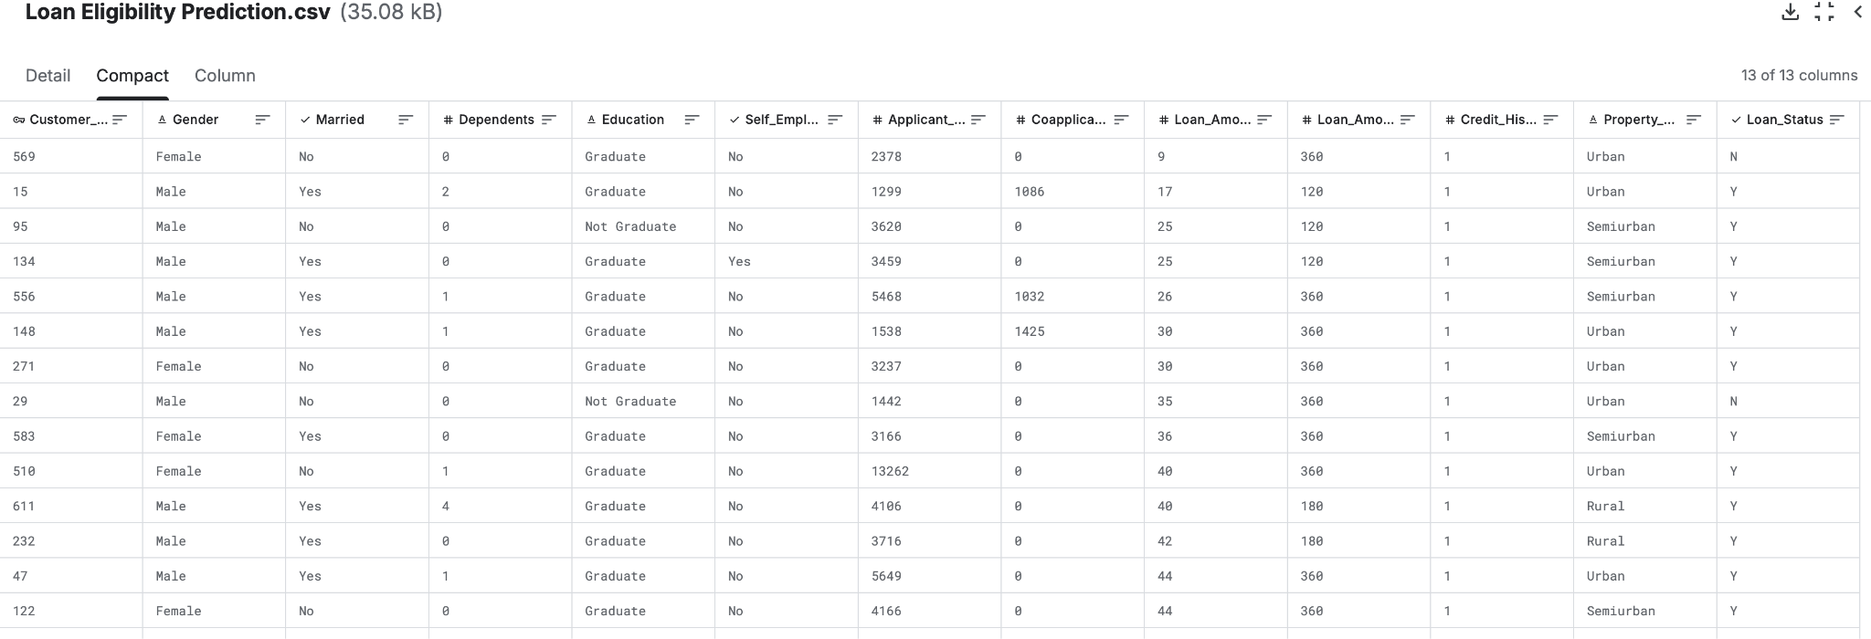
Data Source
Existing data was sourced from Kaggle with 615 rows of historical loan application data. Our target variable for prediction is Loan_Status

Slide 5
Data Exploration
How clean is the data? Fortunately the data required minimal cleaning
How balanced is our dataset? A larger number of observations representing loan rejections (69%) than approvals (31%)
Can we create new features that we deem important when predicting loan application status? Additional features were engineered to better reflect financial

Slide 6
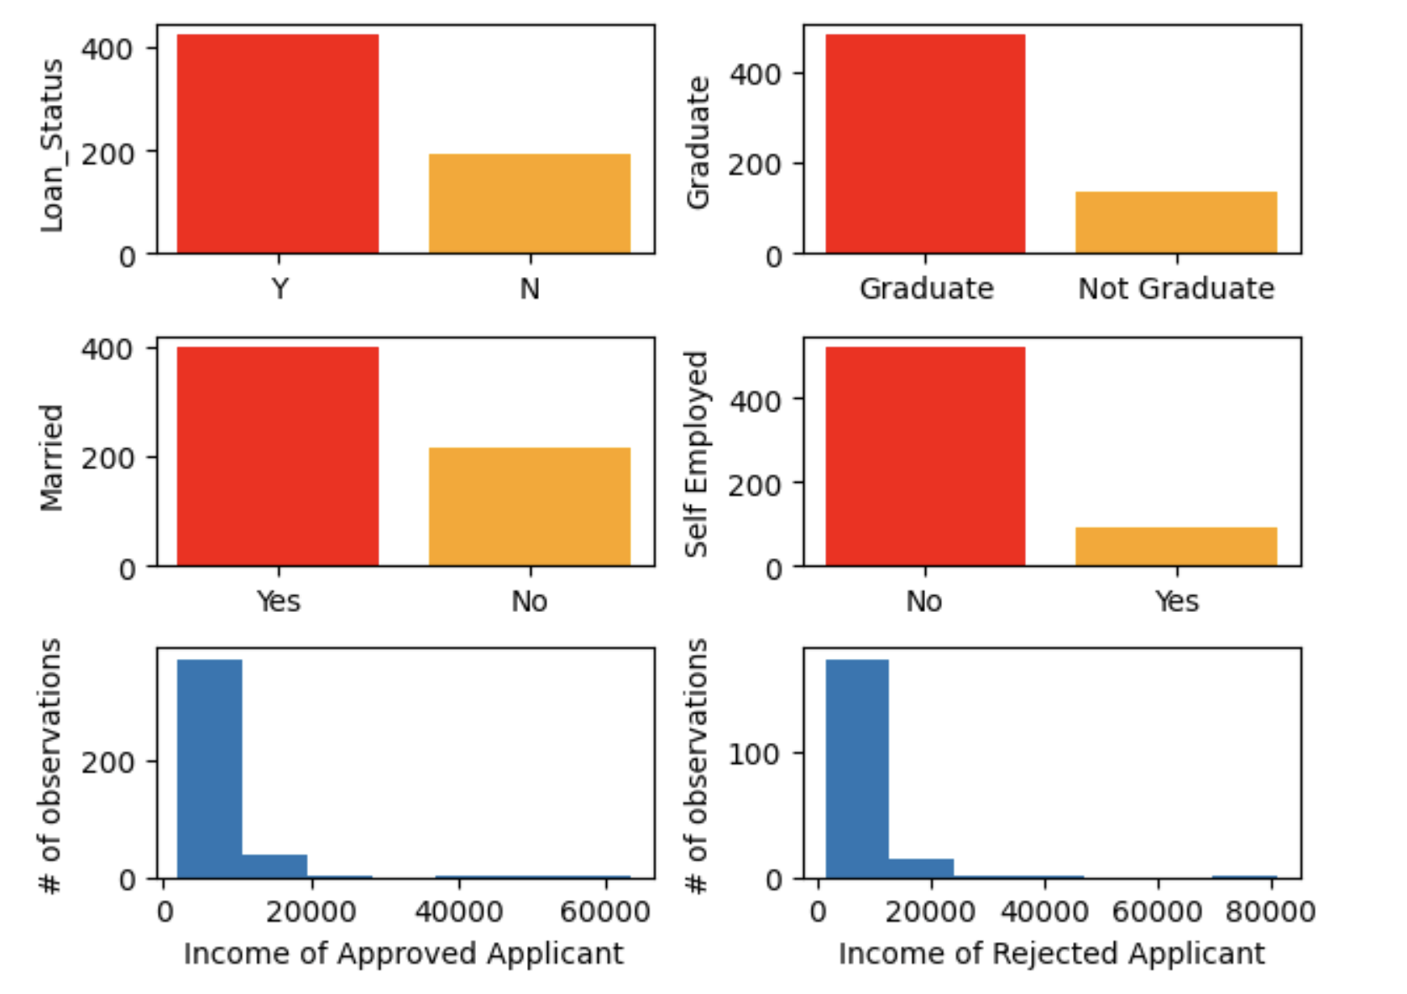
Anything glaring about the data?
(Nothing initially)
Note
Due to the high imbalance, our target variable (Loan_Status) was stratified for modeling

Slide 7
What features are missing based on limited real world experience?
Total Income Applicant + Coapplicant Incomes
Monthly Payment Full Loan Amount / Loan Amount Term
Debt To Income Ratio Monthly Payment / Total Income
Note
Some values were standardized (in the thousands) for easier initial data interpretation

Slide 8
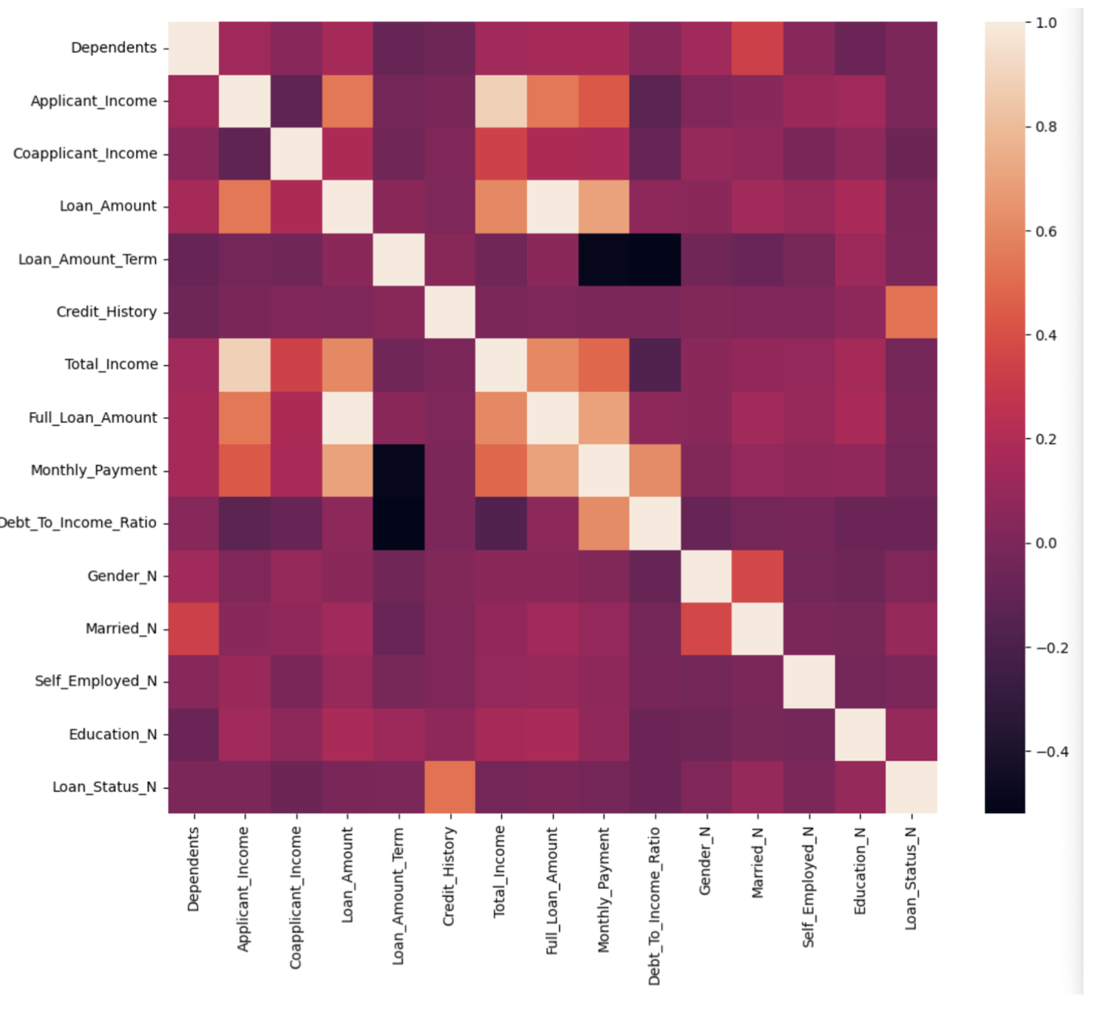
Dive into correlation with new features
Credit_History
shows strong
correlation

Slide 9
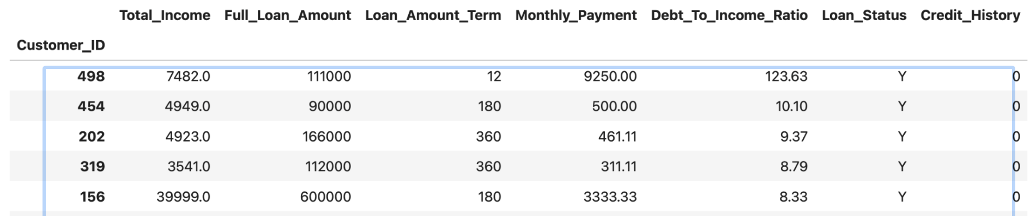
Data deep dive
(still with assumption Debt_To_Income ratio is a strong factor)
An anomaly Record ID 498 showed:
Debt to income ratio > 100%
No credit history (a strong correlation)
Loan was approved
Approved loans without credit history have debt to income ratio < 11%
Due to record 498 violating this patter, it was classified as bad data

Slide 10
Modeling Overview
Dataset is imbalanced Target variable was stratified
Binary Classification 1 for Approved and 0 for Rejected
Algorithms
Logistic Regression
Random Forest
Gradient Boosting

Slide 11
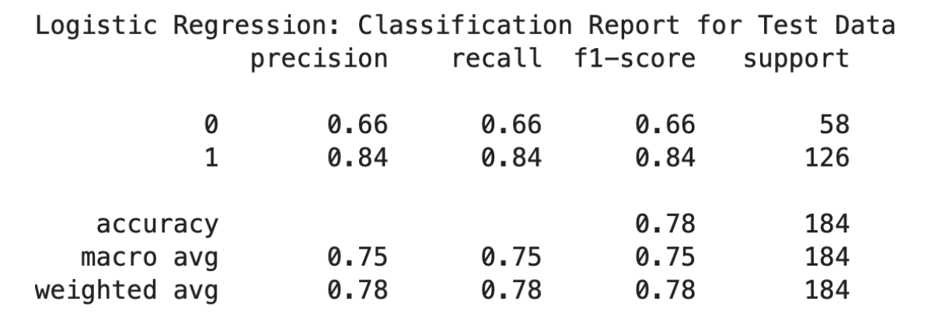
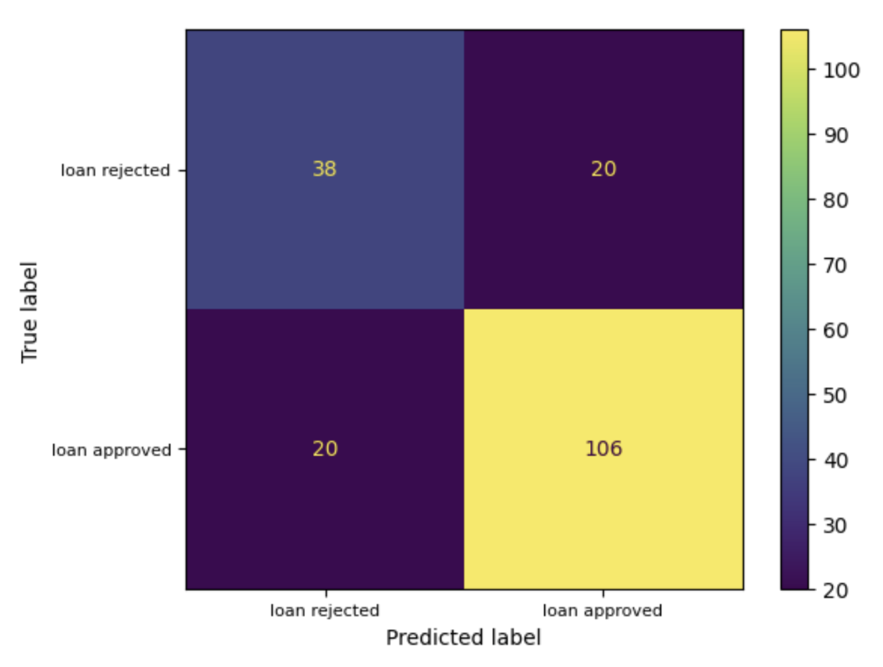
Logistic regression
GridSearchCV tuning:
C = 10
Penalty = ‘l1’
Solver = ‘liblibear’
Accuracy: 0.78

Slide 12
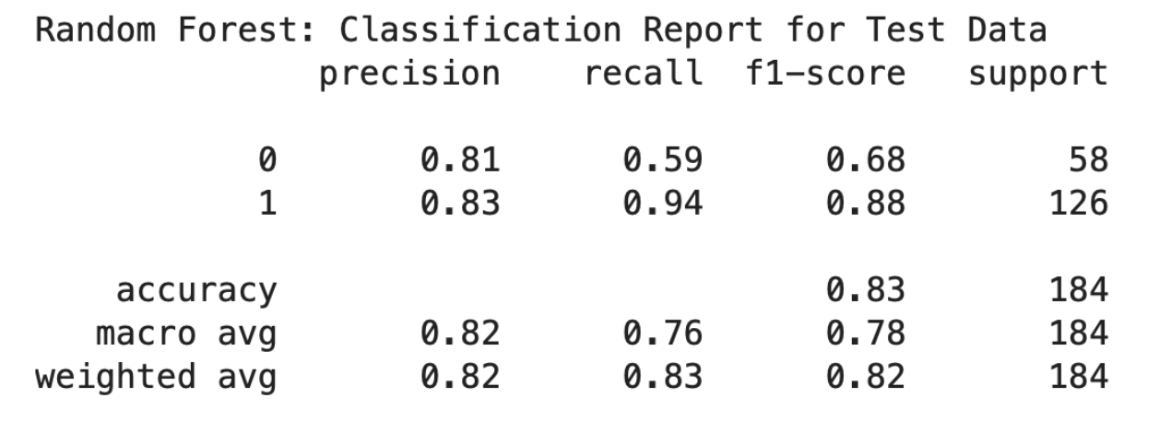
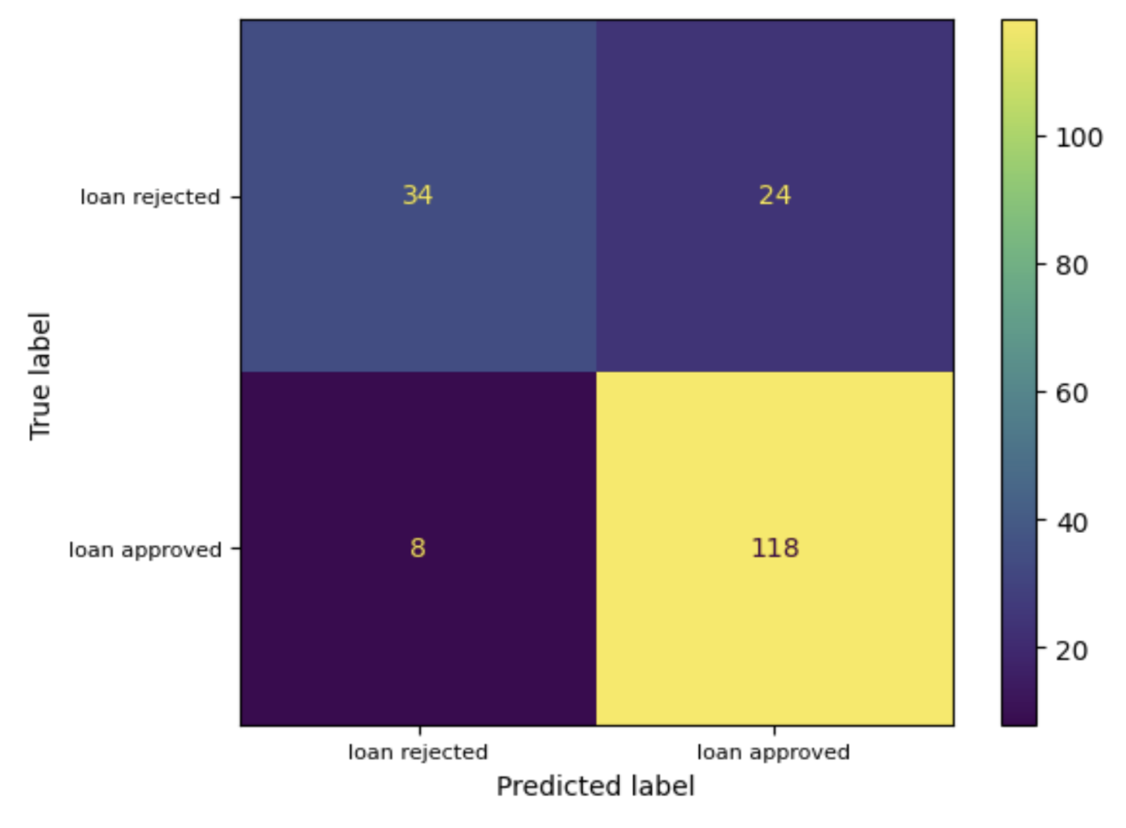
Random forest
Accuracy: 0.826
F1-score: 0.817

Slide 13
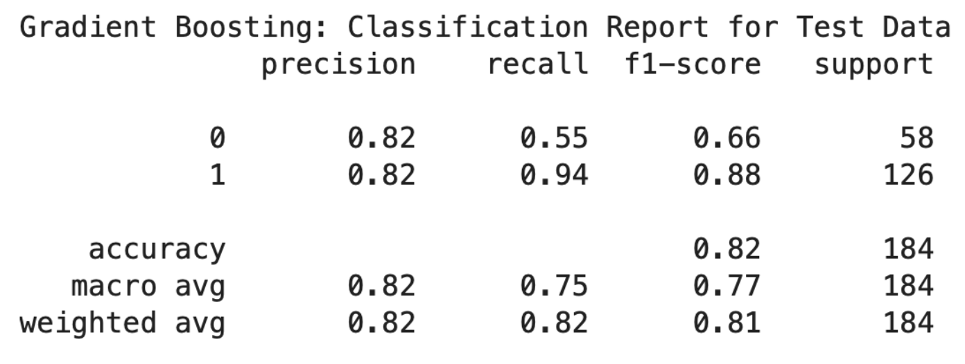
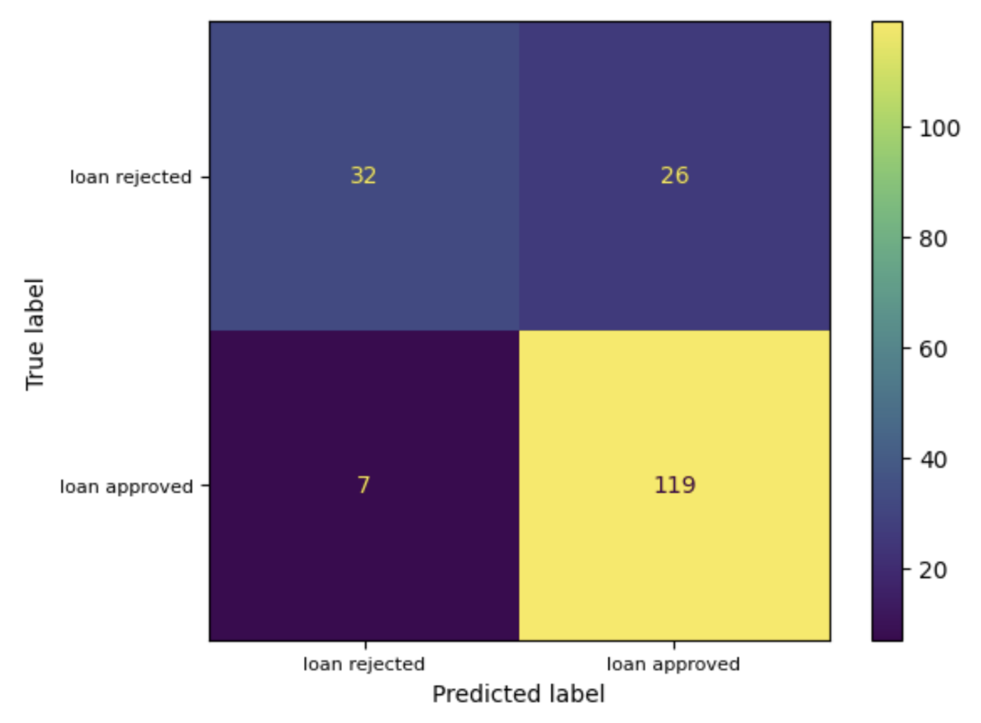
Gradient boosting
Accuracy: 0.82

Slide 14
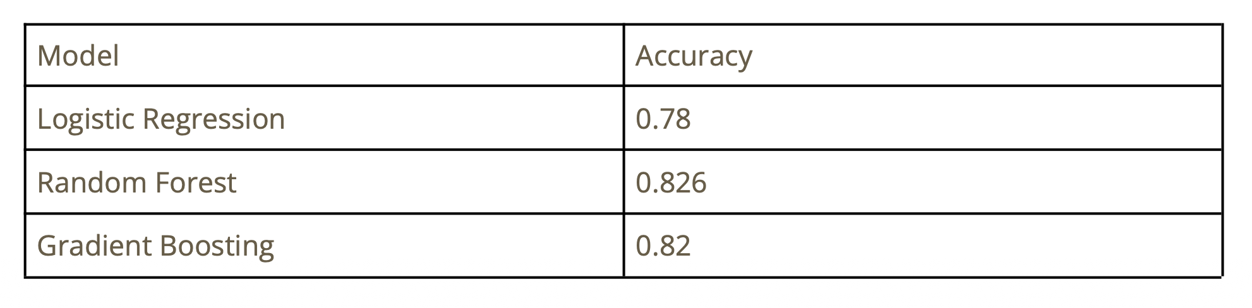
Results
The Random Forest model produced the best performance and demonstrated the strongest ability to classify loan approval outcomes.

Slide 15
Future Improvements
Larger and more diverse datasets
Apply SMOTE or other techniques to address class imbalance
Perform feature importance analysis
Others
Deploy the model as a web application for real-time predictions
Incorporate additional financial indicators such as credit score or employment
stability

