Slide 1
Static Circuits
Results from Lab3 (Strong inversion+Early)
Intrinsic gain of a transistor (take 2)
Diode-connected transistor
Current mirrors & Scaling (tilted) current mirrors
Differential pair
Current correlator
Bump-Antibump circuit
Transconductance amplifier (and its g_{m} and A)
Wide range transamp

Slide 2
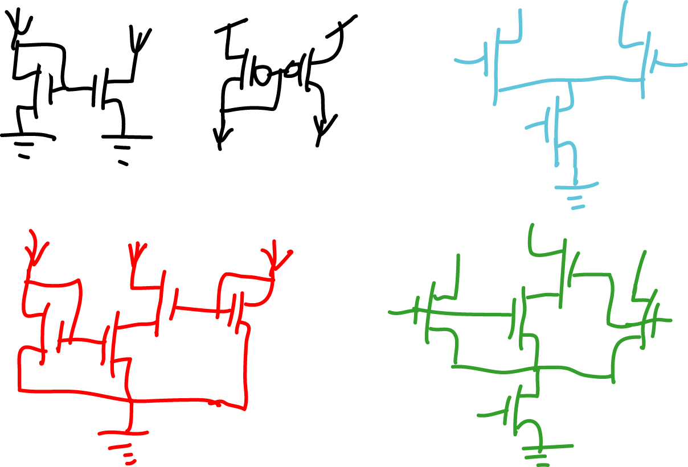
Current mirror, diff-pair, current correlator, bump-antibump circuit

Slide 3
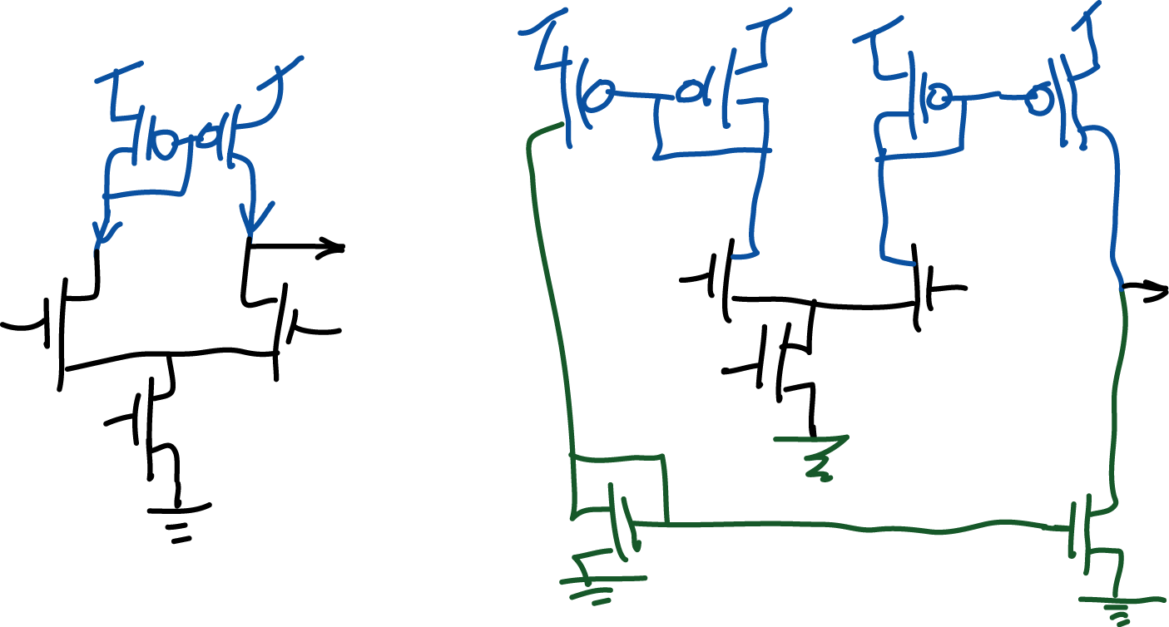
Transconductance amplifier and wide range transconductance amplifier

Slide 4
Results from lab 3 Above-threshold transistor characteristics

Slide 5
How does I_{dlin} scale with V_{g}-V_{T}?
V_{ds}=50mV
Mobility
degradation
μ cm²/V/s | Meas | Bulk
N | 335 | 1450
P | 113 | 500
nFET
pFET

Slide 6
What is μ as function of V_{g}?

Slide 7
How does scale with V_{g}-V_{T}?
Saturation current

Slide 8
How does I_{ds} scale with L?
L=2
L=4
L=16
L=32

Slide 9
How does V_{E} change with L?
16V/μ
0.73u

Slide 10
Is V_{E} constant with I_{dsat}?
nFET 32/8 V
Early
vs. I
dsat
120
100
80
V
E
60
40
20
0
10
-8
10
-7
10
-6
10
-5
10
-4
10
-3
I
(A)
dsat

Slide 11
pFET V_{E} vs. I_{dsat}

Slide 12
Solution: Intrinsic transistor voltage gain
I
I
V_{d}
V_{d}
V_{g}
I_{dsat}

Slide 13
Intrinsic transistor voltage gain
I
I
V_{d}
I_{dsat}=g_{m}V_{g}
V_{d}

Slide 14
Intrinsic transistor voltage gain
I_{b}
V_{d}
V_{g}
Typical value:
The same equation A=g_{m}/g_{out} applies to any amplifier, e.g. transamp.
g_{out} refers to the total output conductance.

Slide 15
Current mirror, diff-pair, current correlator, bump-antibump circuit

Slide 16
Current Mirror
The output current is a copy of the input current.
It is mirrored because it is sunk, not sourced.
Saturated
I_{in}
I_{out}
V_{g}
V_{s}

Slide 17
Diode-connected transistors
V_{g}
I
V_{s}

Slide 18
pFET mirror
I_{in}
I_{out}

Slide 19
How about these configurations?
I_{in}
I_{out}
I_{in}
I_{out}
V_{gs}=0, so I_{out}=I₀

Slide 20
Current mirror with gain (tilted mirror) (I)
How do you make an output current that is M times the input current?
METHOD 1: USE TRANSISTOR GEOMETRY
I_{in}
I_{out}
Not very accurate when M!=1
METHOD 2: USE MULTIPLE TRANSISTORS
I_{in}
I_{out}
More accurate

Slide 21
Current mirror with gain (tilted mirror) (II)
METHOD 3: USE A DIFFERENT V_{s}
I_{in}
I_{out}
V_{g}

Slide 22
Differential Pair (I)
Saturated drains
I₁
I₂
V₁
V₂
V
I_{b}
Two
Source-followers
V_{b}
Electrons flow up,
split between I₁ and I₂

Slide 23
Differential Pair (II)
I₁
I₂
V₁
V₂
V
I_{b}
V_{b}

Slide 24
Differential Pair (III)
FERMI
FUNCTIONS

Slide 25
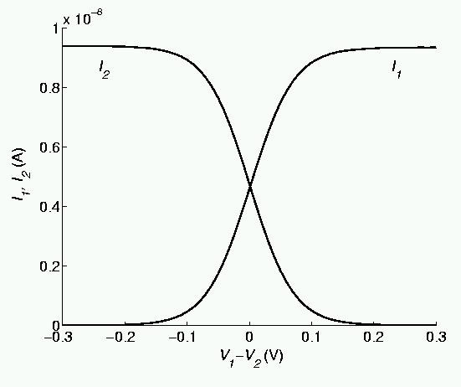
Differential Pair (IV)

Slide 26
Digression: Hyperbolic functions
4
2
tanh: compressive
sinh: expansive
x
-2
-1
1
2
-2
-4

Slide 27
Differential pair in strong inversion (V)
In strong inversion, solve for I₁ & I₂ this way:
You eventually obtain

Slide 28
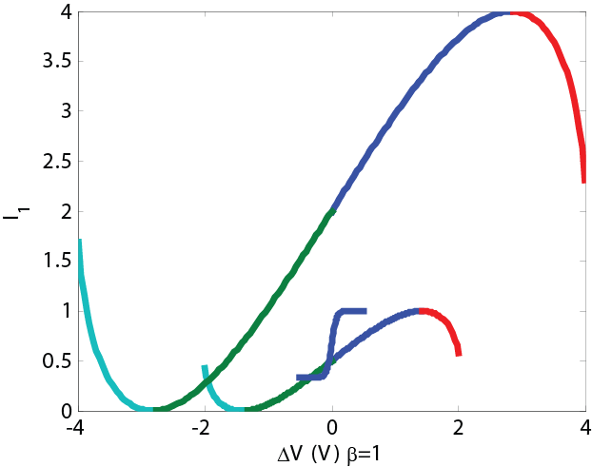
Differential pair in weak and strong inversion
Weak inversion (normalized)

Slide 29
Differential pair transconductance (VII)
Transconductance of differential tail current
Weak inversion
Strong inversion

Slide 30
Current Correlator
Transistor M₁ is in ohmic region and transistor M₂ is in saturation.
I_{out}
V₂
M₂
V₁
V
M₁
I₁
I₂
Self-normalized product

Slide 31
Bump-Antibump circuit
Similarity
I_{out}
Dissimilarity
I₁
I₂
V₁
V₂
I_{b}
V_{b}

Slide 32
Bump Circuit
I_{out}
M₄
I₁
I₂
V₁
M₃
V₂
M₁
M₂
V
I_{b}
V_{b}

Slide 33
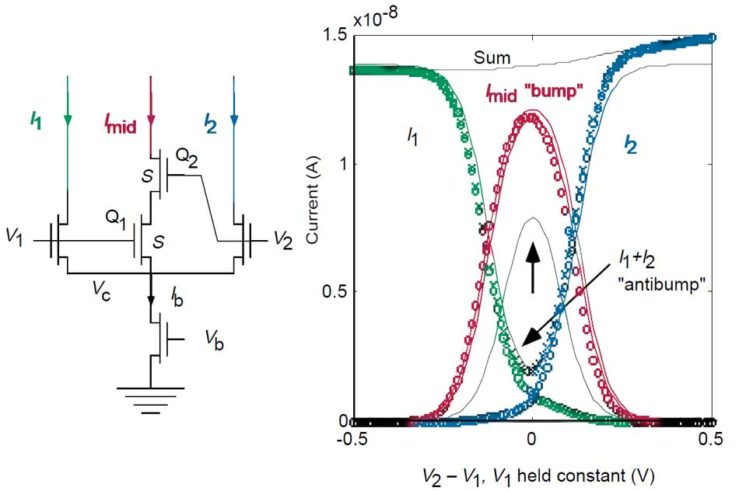
Bump Circuit

Slide 34
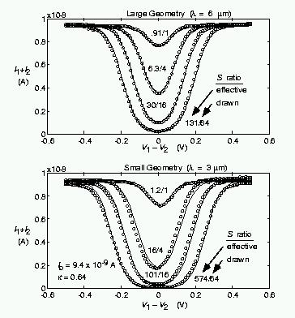
Anti-Bump Circuit

Slide 35
Transconductance amplifier
I_{out}
I₁
I₂
V₂
Good: Simple, cheap
Bad: output voltage is restricted, voltage gain is limited
V₁
V
I_{b}
V_{b}

Slide 36
Wide-range transconductance amplifier
I₂
I₂
I₁
I₁
V₂
V₁
I_{out}
I_{b}
Good: output voltage is unrestricted, gain can be >10⁴
Bad: larger, more mismatch
V_{b}
I₂

Slide 37
nFET Conductances
Gate Transconductance
V_{d}
V_{g}
I
V_{s}
Drain Conductance

Slide 38
THE END
Next week: Linear systems, follower-integrator, follower-differentiator

Slide 39
pFET V_{E} vs L

Slide 40
pFET normalized I_{ds} vs V_{ds}
V_{g} 0.7 to 4 by .1V

Slide 41
pFET I_{ds} vs V_{ds}
V_{g} 0.7 to 4 by .1V

Slide 45
Current source
Subthreshold nFET Equation
Above Threshold nFET Equation
V_{d}
V_{s}
V_{g}
I
V_{g}
I
V_{s}
V_{d}

Slide 46
pFET normalized I_{ds} vs V_{ds}

Slide 47
pFET V_{E} vs I_{dsat}

Slide 48
Transistor Equations
Subthreshold nFET Equation
Above Threshold nFET Equation

Slide 49
Linear Resistor
Subthreshold nFET Equation
Ohmic region
Above Threshold nFET Equation
V_{d}
V_{s}
V_{g}
I
V_{g}
I
G
V_{s}
V_{d}

Slide 50
Diode-connected transistor
Nonlinear Voltage-Current/Current-Voltage Converter
Transistor operates in saturation and uses negative feedback
Subthreshold: Logarithmic I-V Converter
Above Threshold: Square root I-V Converter
V_{g}
I
V_{s}

Slide 51
Current Mirror
The output current is a copy of the input current.
V_{g}
V_{s}
I_{in}
I_{out}
I_{in}
I_{out}
V_{g}
V_{s}

Slide 52
Source Follower
Subthreshold nFET Equation
V_{in}
M₁
I₁
V_{out}
I_{b}
V_{b}

Slide 53
Source Follower
Subthreshold pFET Equation
V_{b}
I_{b}
V_{out}
I₁
V_{w}
V_{in}
M₁

Slide 54
Source Follower
Subthreshold pFET Equation
V_{b}
I_{b}
V_{out}
I₁
V_{in}
M₁

Slide 55
Inverting Amplifier
V_{gp}
M_{p}
I_{p}
V_{out}
I_{n}
V_{gn}
M_{n}

Slide 56
Inverter
Basic building block of CMOS Logic
M_{p}
V_{in}
I_{p}
V_{out}
I_{n}
M_{n}

Slide 57
Differential Pair (III)
I₁
I₂
V₁
V₂
M₁
M₂
V
I_{b}
V_{b}

Slide 58
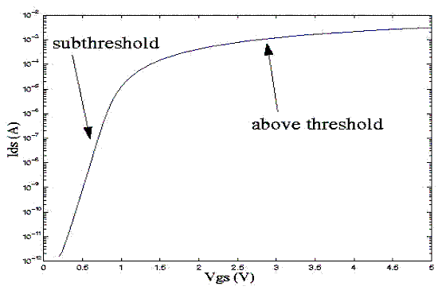
nFet curve: I vs V_{gs}
V_{T} (Threshold voltage)
Threshold voltage is the voltage where the measured I is half of the I computed from the exponential equation.

Slide 59
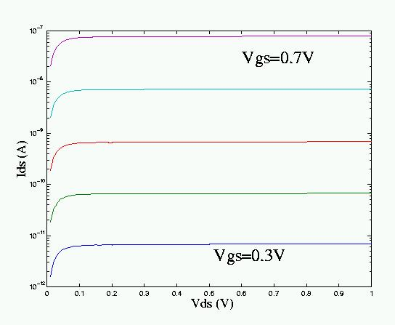
nFET curve: I vs V_{ds}
Ohmic
region
Saturation
region

Slide 60
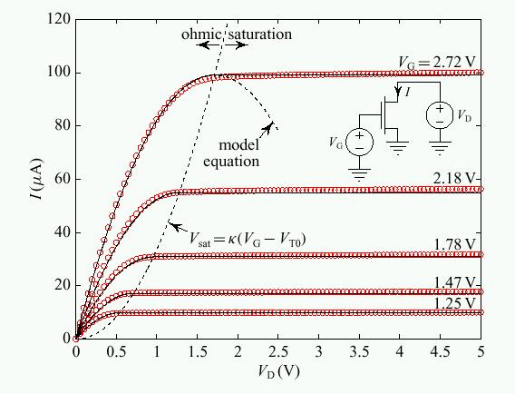
Above Threshold nFET curve: I vs V_{ds}

Slide 61
Body Effect
What is body effect?
In subthreshold, for a constant I, a ΔV change in the source voltage means that the gate voltage has to increase by κ ΔV and not just ΔV.
In above threshold, this effect is often taken to mean that the threshold voltage of the transistor increases with the source voltage.

