Slide 1
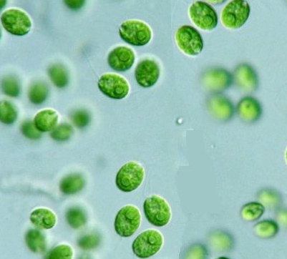
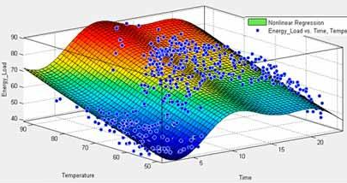
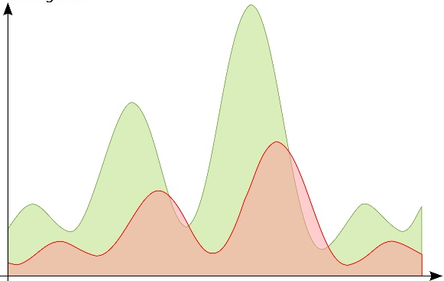
Fitting an ecologic ODE model to real world data
Pascal Bärtschi

Slide 2
Introduction
Motivation
Research internship in ecology
Value of ecologic models
Science:
Simplifying reality to understand interactions and predict behaviour
Society:
Eutrophication
Hunting
Notes:
Research internship in ecology
Oxic anoxic regime shifts in microbial communities
Interactions described by ODEs
Value:
Science
Coral reefs, lakes, Wastewater systems
Society:
Eutrophication: increas of nutrients lead to plant grwoth
Consume most of oxygen, harms otherbio
Effect of neobiota and how to êncounter
Control populations by hunting

Slide 3
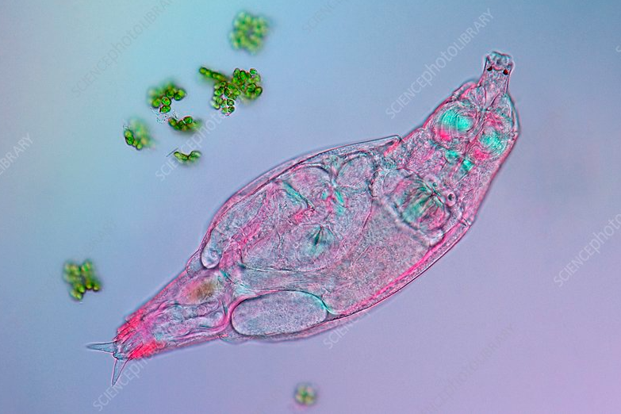
Dataset
Potential for long term persistence of predator cycles
Expermental: stable environmental conditions
Short generation time: many cycles in little time
Freshwater organisms
Prey: unicellular green algae
Predator: planktonic rotifers
Notes:
data collected by uni oldenburg
Do research on long cyclic peristence in an experimental predator prey system
Held organism under stable cond
Advantage of raised data: short gen time

Slide 4
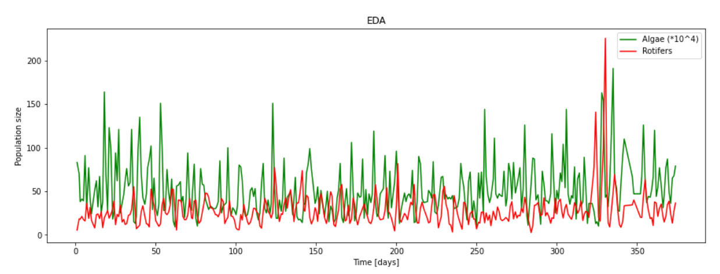
Dataset
Notes:
Repeated oscillations of prey and predator
50 cycles, 300 predator generations
Always return to dominatn regime
Cyclic dynamics arise from trophic intertactions between pop prey and predator
Regime durations of 58 days
Breaks in oscillation regimes explained by stochasticity

Slide 5
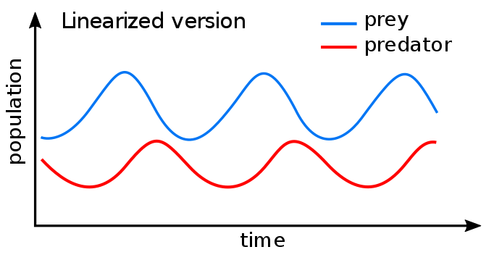
Methods
Lotka-Volterra ODE system
Prey-predator dynamics
Described by a pair of first order differential equations
Notes:
Lotka Volterra Introdtion
Properties
Assumptions
The prey population finds ample food at all times.
The food supply of the predator population depends entirely on the size of the prey population.
The rate of change of population is proportional to its size.
During the process, the environment does not change in favour of one species, and genetic adaptation is inconsequential.
Predators have limitless appetite.
https://en.wikipedia.org/wiki/Lotka%E2%80%93Volterra_equations → interpretations

Slide 6

Methods
α
Prey
β & δ
Predator
γ
$$\frac{dx}{dt}= αx − βxy$$
$$\frac{dy}{dt}= δxy − γy$$
Notes:
Alpha = reproction rate of prey without interruption and enough nutrient supply
Beta = dying rate prey per predator
Gamma = dying rate of predator if no prey
Delta = consumption rate by pred und assumption enough prey

Slide 7
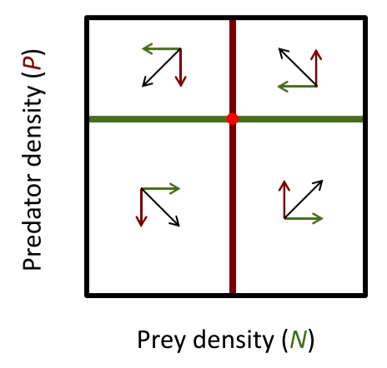
Methods
dx/dt = 0
dy/dt = 0

Slide 8
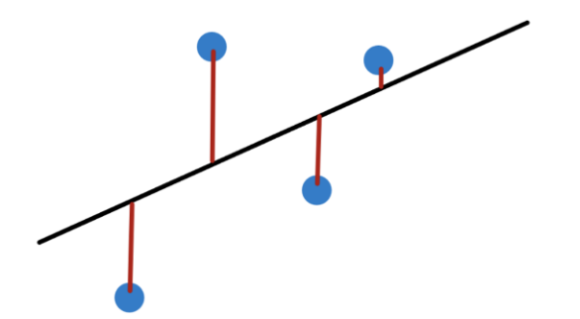
Methods
OLS regression
Goal: minimize resdiuals (red)
Notes:
Least Sqaures between true data point and simulated one
Sum of squared residuals

Slide 9
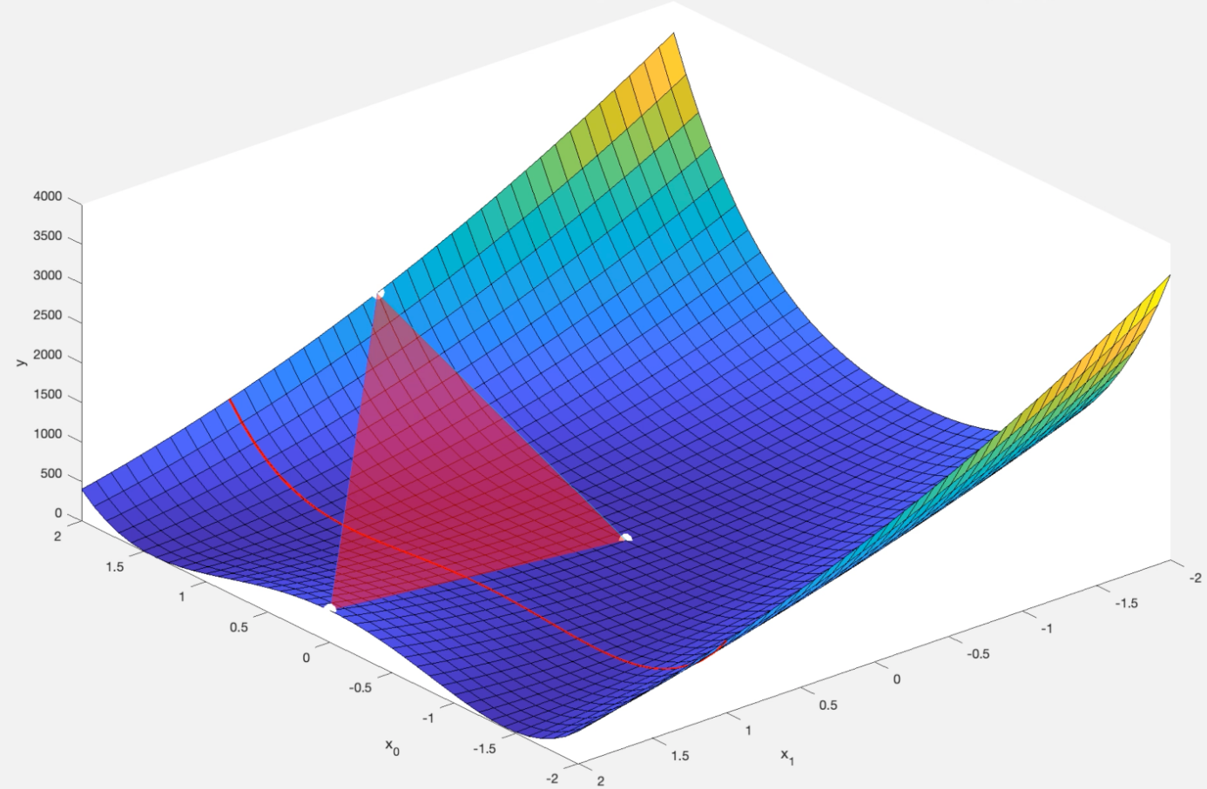
Methods
Nelder-mead method
Downhill simplex method to minimize objective function
Notes:
Numerical method to find minimum of objective function (OLS)
Non linear optimizaton problem
Y : funtion value, x0, x1 = parameters
Test points aranged as simplex: Simplex: polytope of n + 1 in n-dimennsions
In each iteration ist exptrapolates the behaviour of the objective function of each of the points to find new one
The if the new point is the better than the worst current point the worst gets replaced
Like a ball rolling down the hill towards a local or global minimum (goal)

Slide 10
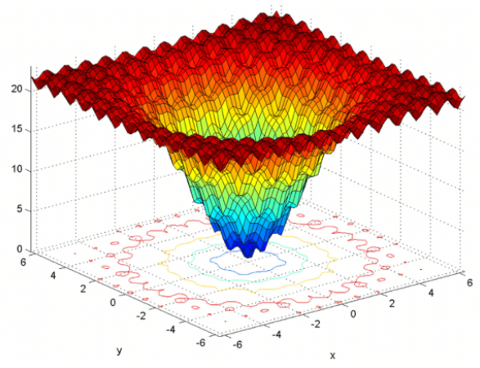
Methods
Nelder-mead density
Notes:
Strongly dependent of inital guess

Slide 11
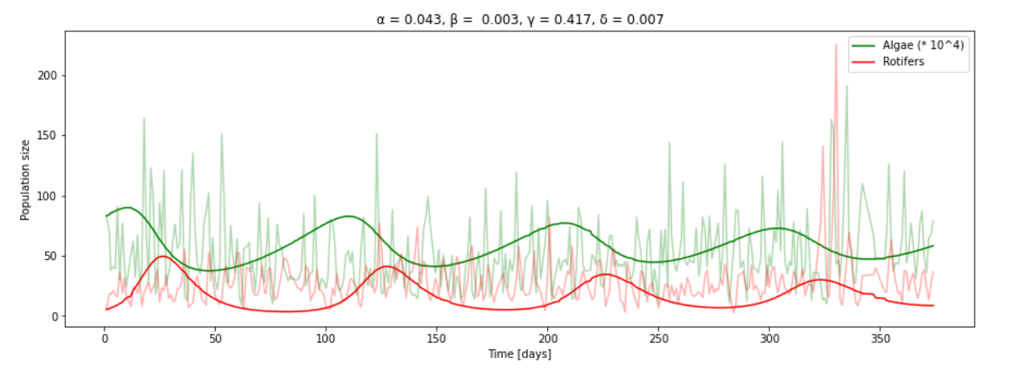
Results
Data vs. Simulation
Notes:
+ : oscillation high, stability of system, algae peaks preceed the predation
- To few cycles, random peaks not included

Slide 12

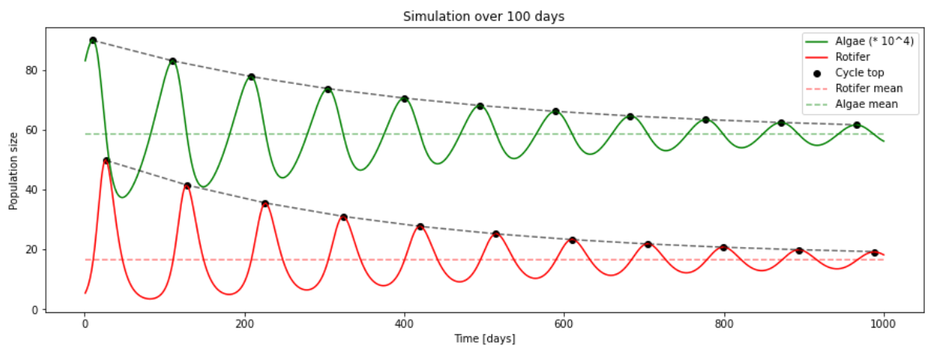
Discussion
Simulation behaviour
Simulation for 1000 days

Slide 13
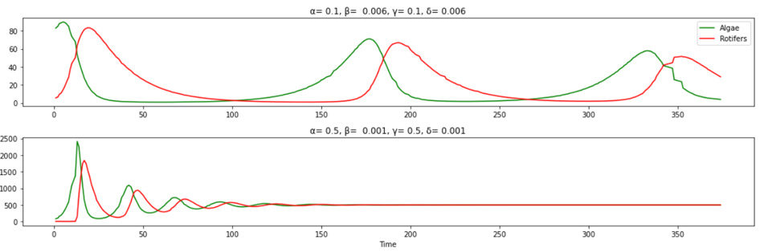
Discussion
Tradeoff between cycle length and time to reach euqilibrium

Slide 14
Conclusions
Lotka-Volterra not sufficient
Not built for microbiota
Assumptions not met
Lots of excluded information
Inconstant nutrient availability
Secreted metabolics
‘Quorum sensing’
Morphogenesis of rotifers
Notes:
Not for micobiota: short generation time, fast proliferation

Slide 15
Outlook
Additonal ODEs describing nutrient availability or behaviour of different rotifer stages
Including stochasticity

Slide 16
Credit
Data: https://figshare.com/articles/dataset/Time_series_of_long-term_experimental_predator-prey_cycles/10045976/1

