Slide 1
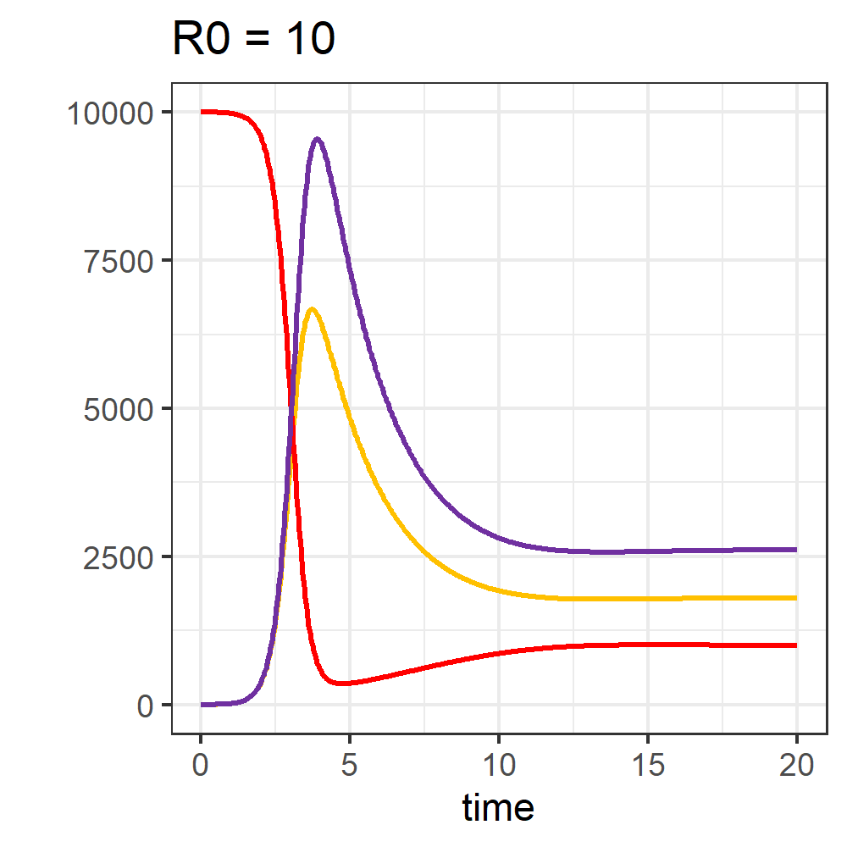
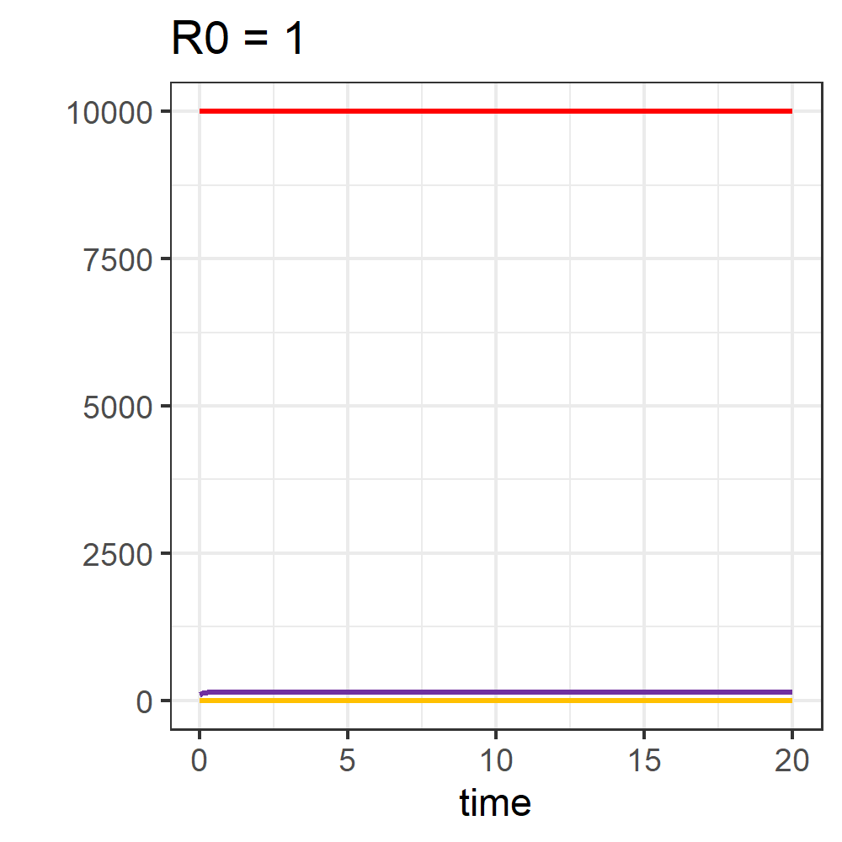
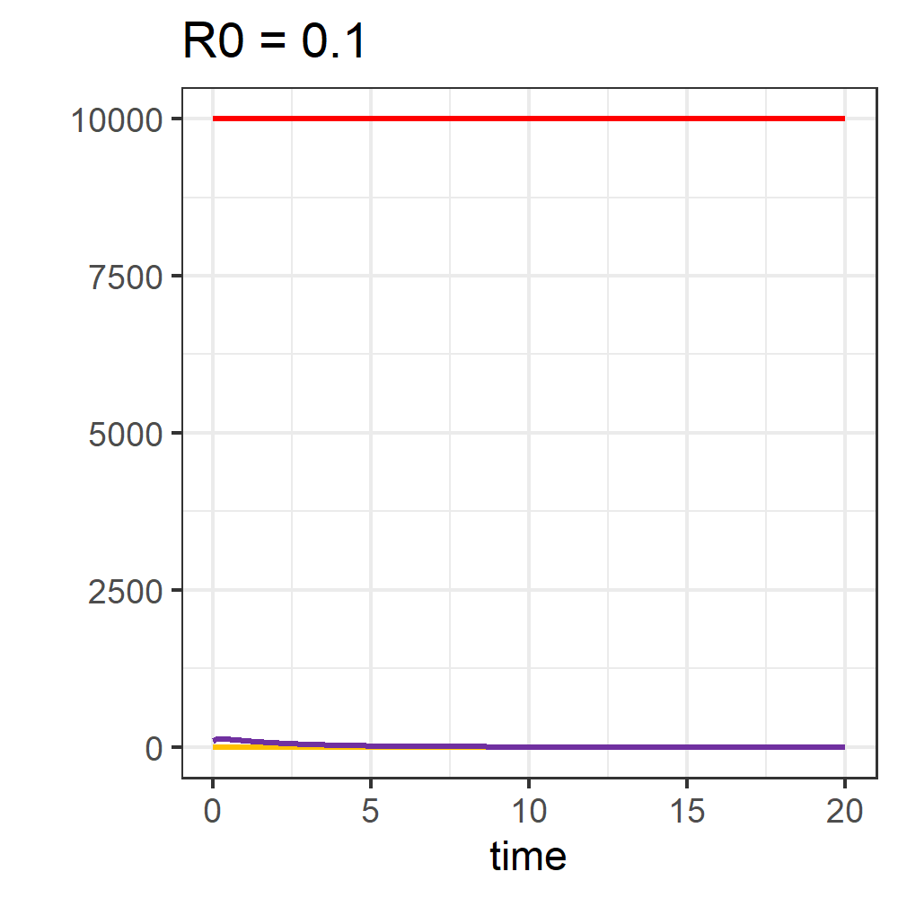







R0 acts as a predictor for dynamics in epidemiologic TIV-model
TIV-model
$$R_{0}= \frac{Λ∗β∗p}{δ_{T}{∗δ}_{T}∗δ_{T}}$$
$$Λ$$
T
I
(1)
$$β∗T∗V$$
$$p∗I$$
Figures: Color coding as on the left, R0 estimates result from formula (1). To obtain these dynamics, parameter β was varied. At R0 = 0.1 virion density declines, R0 = 1 virion density stagnates and R0 = 10 results in strong virion replication and cell infection.
$$∂_{T}∗T$$
$$∂_{I}∗I$$
V
$$∂_{V}∗V$$
Derivation of R0
R0 describes the quantity of target cells infected by an infected cell and can be derived from the model parameters. Multiplying the infection rate per T, available T and death rate of virions results in R0. Calculating this value prior to a simulation renders an informative estimate of resulting dynamics. Despite complex TIV-model dynamics, interpretation of R0 stays trivial. R0 has positive influence on virion dispersal if greater 1.

