Slide 1
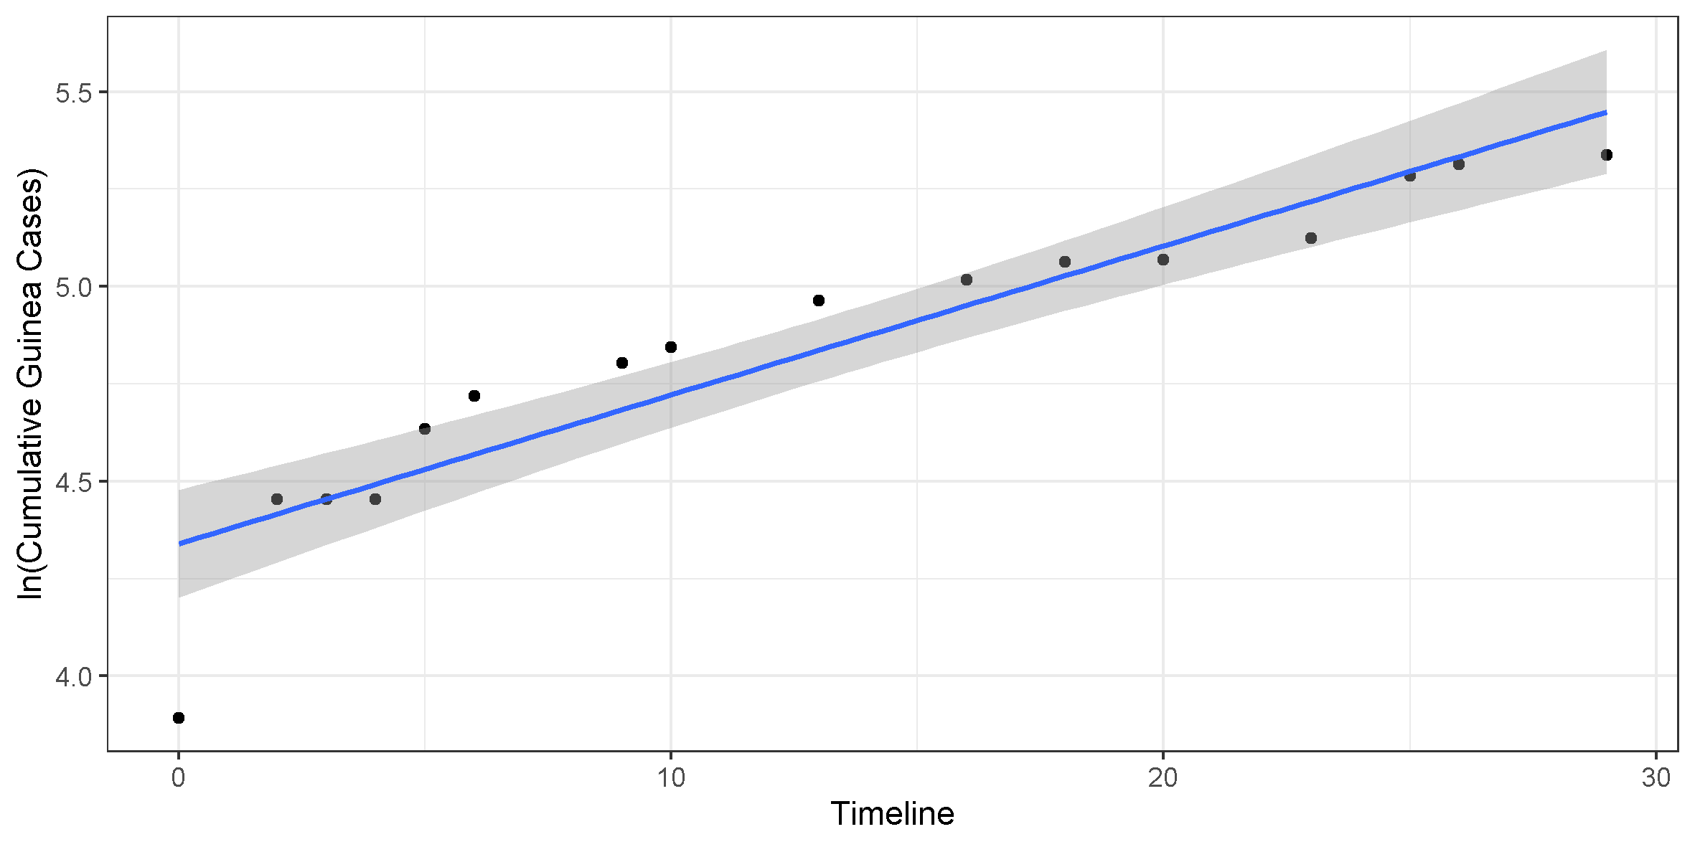

Extraction of epidemic growth rate to estimate R0
SIER model parameters
The four compartments of this epidemiologic model are changed over time by four parameters , three of which are constant (σ, γ, δ) and one (β) a function of time (Althaus et al, 2014).
1/ σ and 1/ γ describe the incubation and the infectious period respectively, whereas δ describes the epidemiologic growth rate. During the initial stages of the epidemic there is a linear relationship between the natural log of the cumulative number cases and δ. Combining knowledge about σ, γ and δ allows one to extract the basic reproduction number (R0).
Figure: δ in blue describes the increase of Guinea Cases (ln – transform). Based on the formula on the left, R0 = 1.46, which is close to the literature value 1.51 (Althaus et al, 2014), was extracted. This makes sense as a positive epidemiologic growth infers an basic reproduction number greater than 1.
$$R_{0}=\left(1+ σ ∗ δ\right)∗(1+ γ ∗ δ)$$

