Slide 1
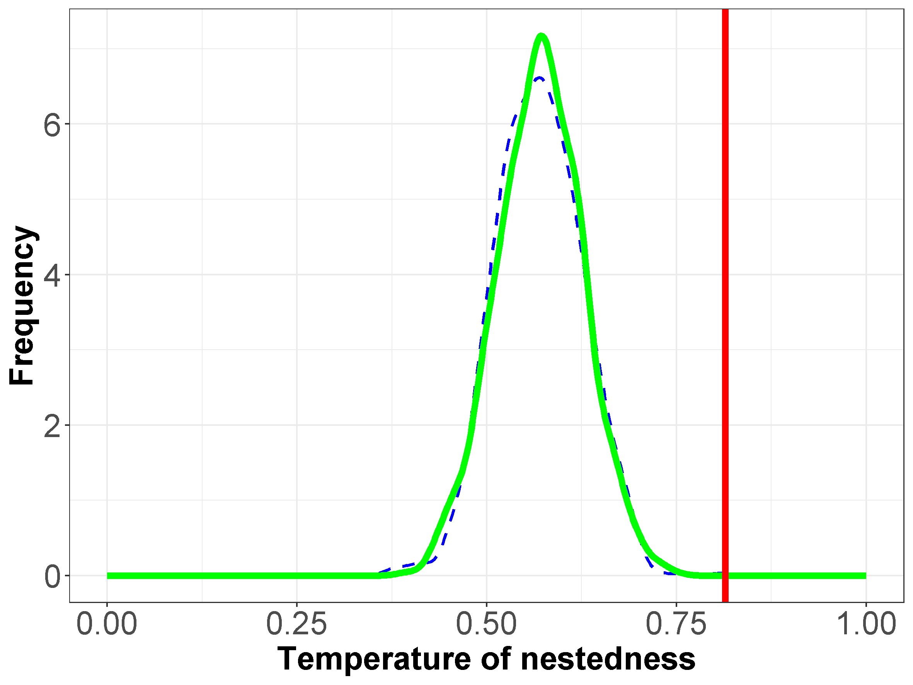
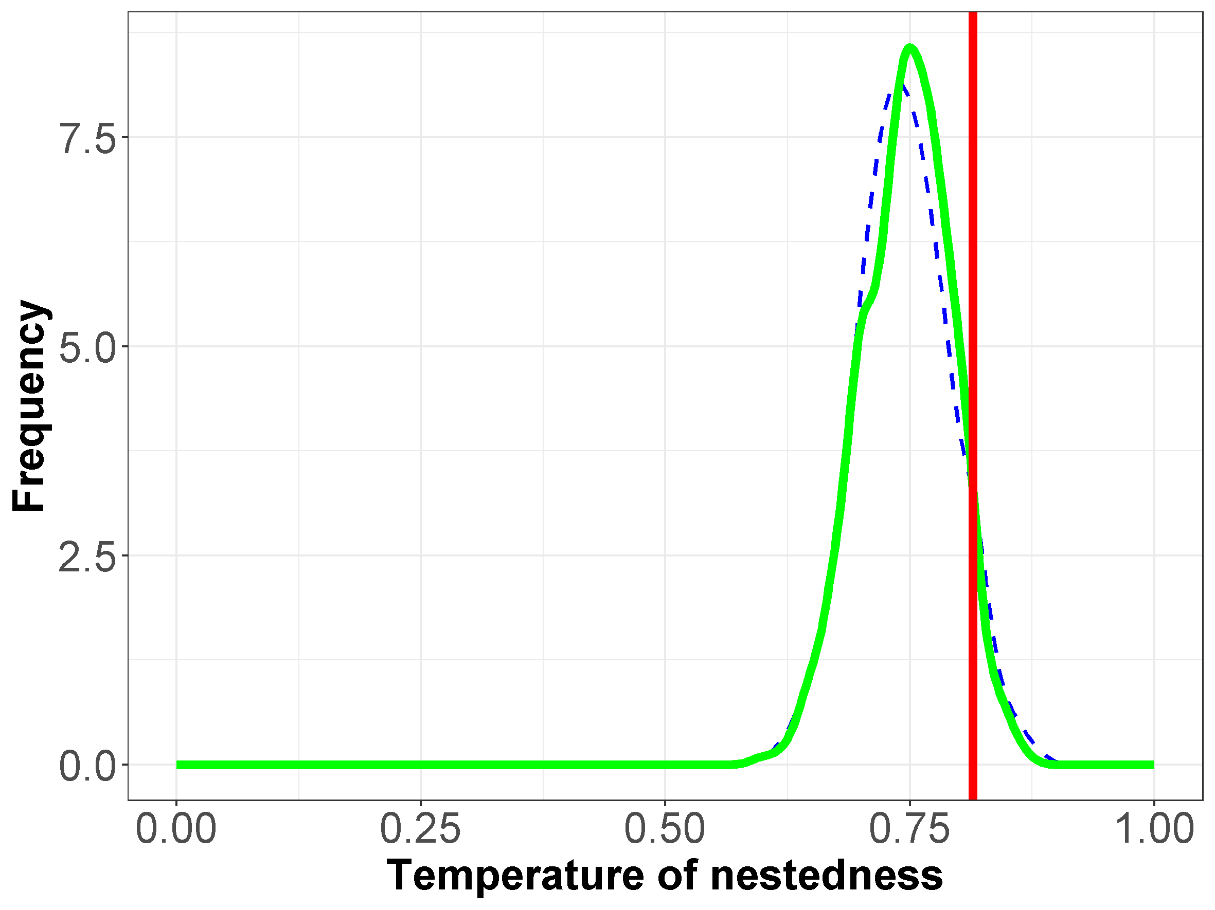
P-value estimation becomes more precise with more complex approaches
Null Model 1
Gaussian Approximation
Simulation distribution
P-Value = 10^-6
Null Model 2
Gaussian Approximation
Simulation distribution
P-Value = 0.07
Null models
To estimate the significance of a network nestedness it is compared to randomly generated network, called null model. In null model 1 the probability of edge occurrence is calculated from the total number of “1s” divided by total number of cells. Null model 2 is less general as the probability of each cell being occupied is the average of the probability of occupancy of its row and column. Thus, null model 2 contains more data specific information of the original network, as the averages are taken over subsets instead of the whole set. Therefore, null model 2 contains also more structural information of the original network.
P-value estimation
The simulation distribution was obtained by simulating each model for 1000 times, The p-value was then calculated by a Gaussian approximation of these distribution. We see that simulation with the more complex null model result in a p-value that seems of higher representative power for the network.

