Slide 1
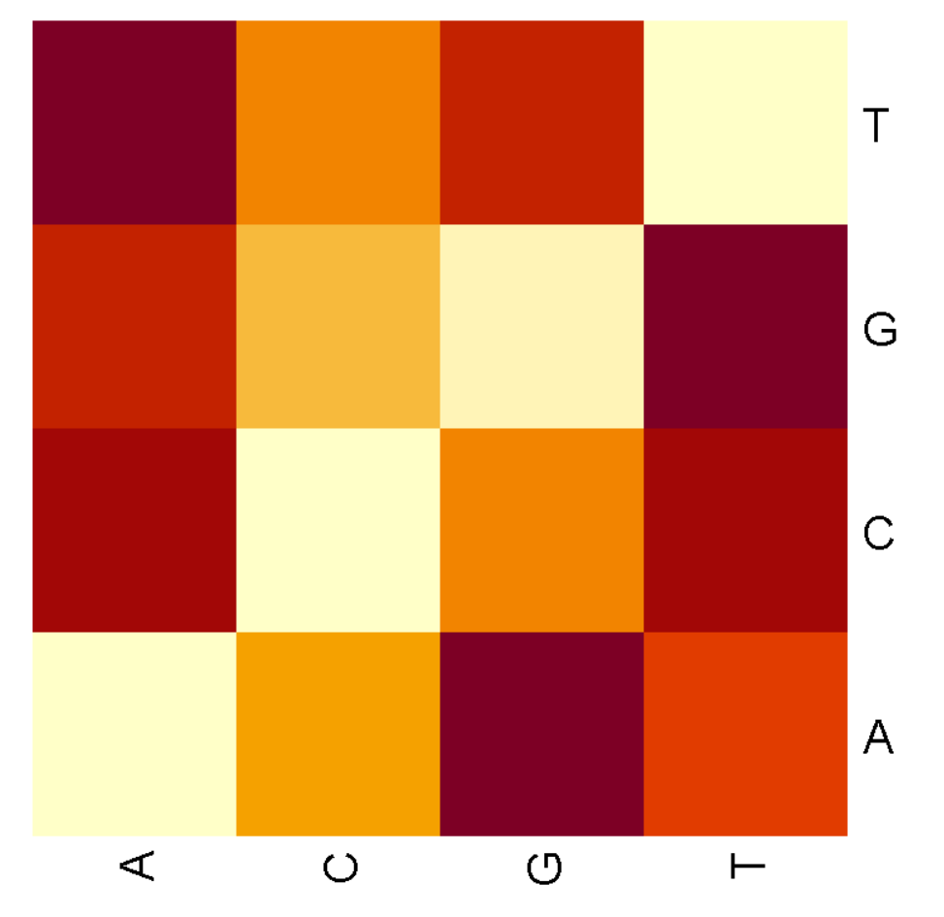
Estimations of the errors of base calling do not follow any pattern, meaning that they are uniformly distributed
Hypothesis
Error rates differ between pyrimidines and purines
Method
The errors describe the incorrect base calling by estimating different OTUs.
The resulting error matrix was then estimated by a machine learning algorithm.
The errors were standardized according to the OTU group, the later sum these probabilities up for every base
Y-axis shows the expected base at position N and X-axis the estimated error with which another base appears at position N.
Correct estimates were set to zero
Conclusions
Errors seem to be uniformly distributed
Errors are not distinguishable between pyrimidines and purines
Read length: >200b, Q-Scores: >20

