Slide 1
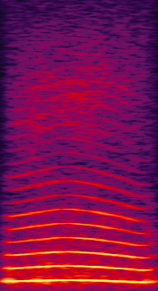
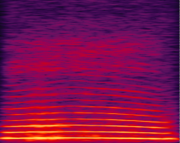
OMM TASK 4
Case Target first
NO RESPONSE
Aborted trial
(not counted in perf)
2-s timeout
RESPONSE
ON TARGET
reward
2-s black screen
RESPONSE
ON DISTRACTOR
2-s timeout
DETECTION
TARGET
DISTRACTOR
RESPONSE WINDOW
1000ms
Notes:
Here we present 2 consecutive stim in a random order: one Target, one Distractor
Only the Target is rewarded
5 steps with distractors of increasing loudness
TARGET = CooA (Average 16 coos)
DISTRACTOR = CooB (Random_coo_2.5_0004.wav)

Slide 2
OMM TASK 4
Case Target second
NO RESPONSE
Aborted trial
(not counted in perf)
2-s timeout
RESPONSE
ON TARGET
reward
2-s black screen
RESPONSE
ON DISTRACTOR
2-s timeout
DETECTION
DISTRACTOR
TARGET
RESPONSE WINDOW
1000ms
Notes:
Here we present 2 consecutive stim in a random order: one Target, one Distractor
Only the Target is rewarded
5 steps with distractors of increasing loudness
TARGET = CooA (Average 16 coos)
DISTRACTOR = CooB (Random_coo_2.5_0004.wav)

Slide 3
OMM TASK 4
Toujours 1 cible (Avg16), nombre grandissant de distracteurs
Task4: 1 distracteur (Coo_01): 5 niveaux de volume (niveau 5: même niveau sonore)
Task4_1: 2 distracteurs (Coo_01, Coo_02)
Task4_2: 4 distracteurs(Coo_01->04)
Task4_3: 16 distracteurs (Coo_01->Coo_16)
Task4_4: 16 distracteurs ( Morph 25, 50, 75, 100% pour Coos: 08, 12, 15 et 16)
Task4_5: 16 distracteurs ( Morph 25, 50, 75, 100 avec AVGf0 ou avgF; Coo 12 et Coo 15)
Blocks de 64 essais

Slide 4
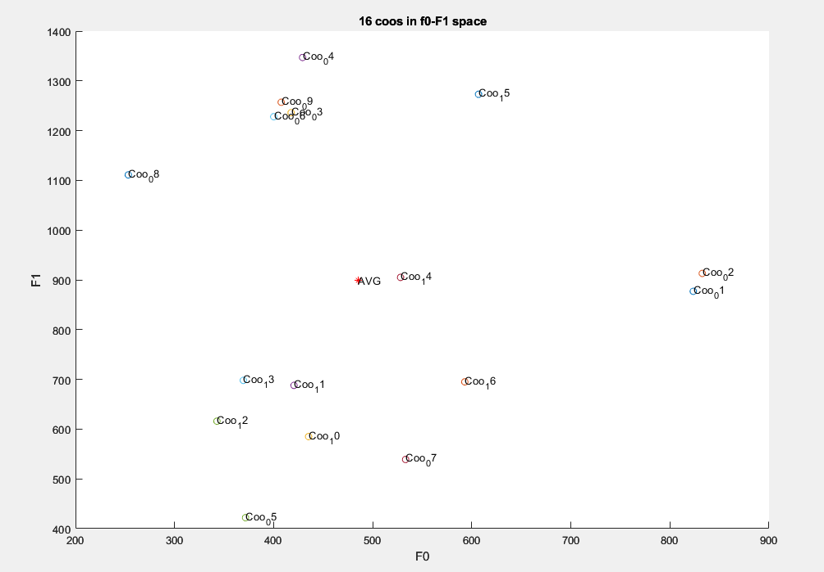
Selection of 4 coos for morphing with AVG
(both F and f0 cues)
Coo_15, Coo_08, Coo_12, Coo_16

