Slide 1
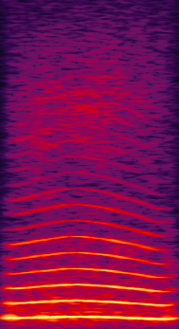
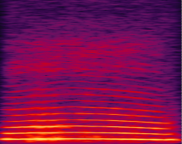
OMM TASK 4
Case Target first
NO RESPONSE
Aborted trial
(not counted in perf)
2-s timeout
RESPONSE
ON TARGET
reward
2-s black screen
RESPONSE
ON DISTRACTOR
2-s timeout
DETECTION
TARGET
DISTRACTOR
RESPONSE WINDOW
1000ms
Notes:
Here we present 2 consecutive stim in a random order: one Target, one Distractor
Only the Target is rewarded
5 steps with distractors of increasing loudness
TARGET = CooA (Average 16 coos)
DISTRACTOR = CooB (Random_coo_2.5_0004.wav)

Slide 2
OMM TASK 4
Case Target second
NO RESPONSE
Aborted trial
(not counted in perf)
2-s timeout
RESPONSE
ON TARGET
reward
2-s black screen
RESPONSE
ON DISTRACTOR
2-s timeout
DETECTION
DISTRACTOR
TARGET
RESPONSE WINDOW
1000ms
Notes:
Here we present 2 consecutive stim in a random order: one Target, one Distractor
Only the Target is rewarded
5 steps with distractors of increasing loudness
TARGET = CooA (Average 16 coos)
DISTRACTOR = CooB (Random_coo_2.5_0004.wav)

Slide 3
OMM TASK 4
Always the same Target (Avg16), various Distractors
Task4: 1 Distractor (Coo_01): 5 amplitude levels (5: same level as Target)
Task4_1: 2 Distractors (Coo_01, Coo_02)
Task4_2: 4 Distractors(Coo_01->04)
Task4_3: 16 Distractors (Coo_01->Coo_16)
Task4_4: 16 Distracteurs ( Morph 25, 50, 75, 100% for Coos: 08, 12, 15 et 16)
Task4_5: 16 Distractors ( Morph 25, 50, 75, 100 with either Avgf0 or avgF; Coo 12 et Coo 15)
Blocks of 64 trials

Slide 4
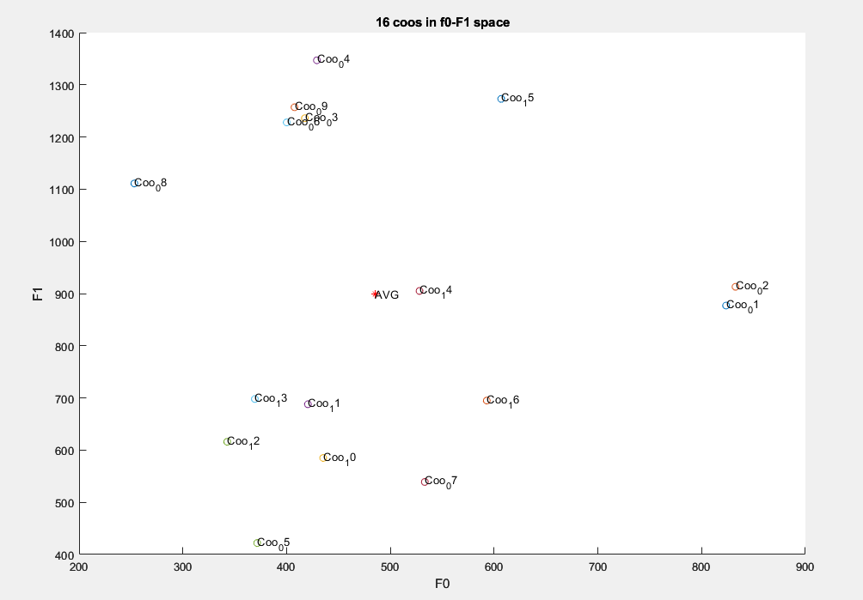
75%
50%
25%
0

Slide 5
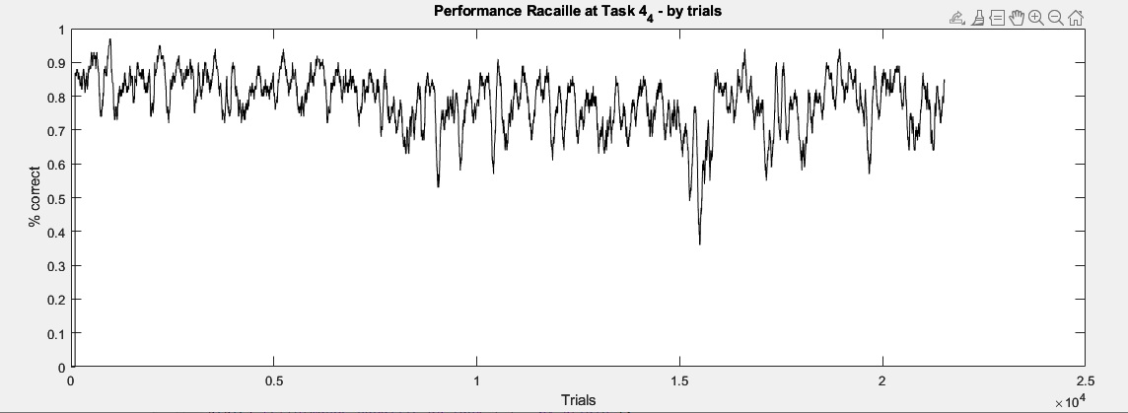
Racaille Task4_4 15/08/23 – 12/10/23
21524 trials in 2 months (~400 trials/day)
78.6% correct

Slide 6
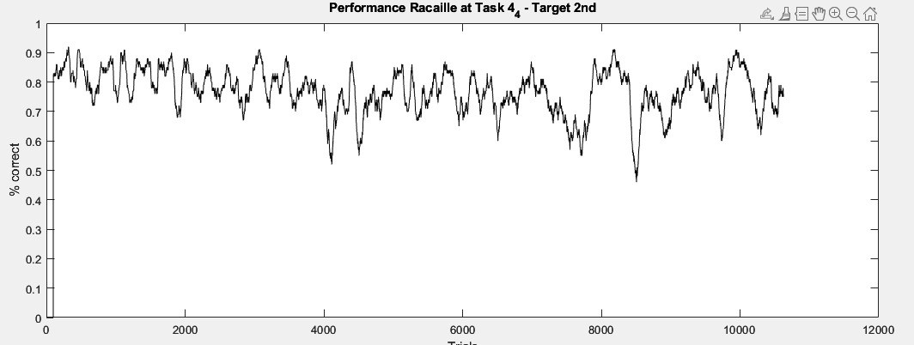
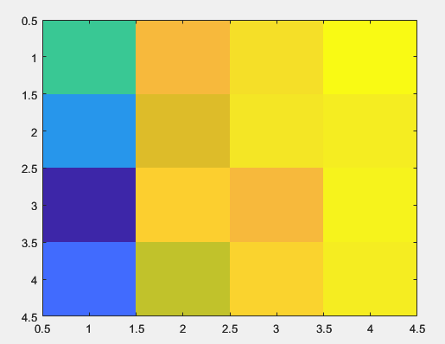
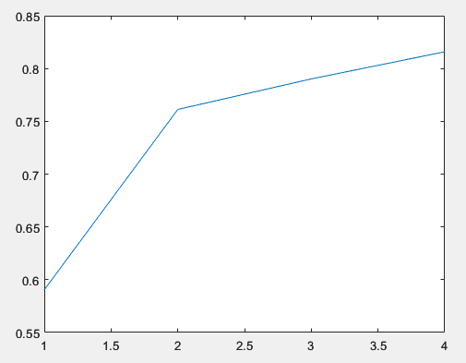
Target second
% 76.9% correct over 10628 trials
Coo 08
Coo 12
Coo 15
Coo 16
25% 50% 75% 100%
25% 50% 75% 100%

Slide 7
OMM TASK 4 – Background Task
NO RESPONSE
Aborted trial
(not counted in perf)
2-s timeout
RESPONSE
ON TARGET
reward
2-s black screen
DETECTION
TARGET
RESPONSE WINDOW
1000ms
Notes:
Here we only present the target sound
Touch in response window: reward, else green screen

