Slide 1
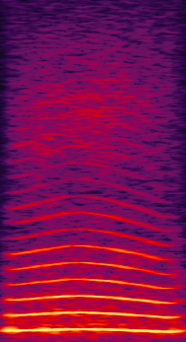
BACKGROUND TASK
NO RESPONSE
Aborted trial
2-s timeout
CORRECT RESPONSE
reward
2-s black screen
CooB
DETECTION
CooB
onset
~200ms
RESPONSE WINDOW
3000ms
Notes:
The monkey has to press the screen during a 3-s window after a random coo begins to play in order to get a reward (3s baclk screen); if no response a green screen appears (aborted)

Slide 2
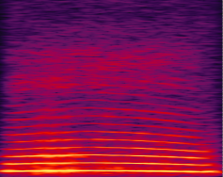
TASK 1_part 1
10 levels
EARLY RESPONSE
2-s timeout
NO RESPONSE
Aborted trial
CORRECT
2-s black screen
CooA
CooB
DETECTION
Onset
CooA
Onset
CooB
CooA
Duration
Increased from
50 to 500ms
Response
window
Reduced from
3000 to 500ms
Notes:
Here the monkey learns to repond only to the second sound
we introduce an increasing duration of CooA before CooB: if the monkey presses during CooA: green screen (early response)
And we progressively reduce the response window to 500ms (inter-onset-interval for the later sequences)
cooA duration: 50*level 50-500ms
response_window=3000-250*level

Slide 3
TASK 1_part 2
6 Levels
EARLY RESPONSE
2-s timeout
NO RESPONSE
Aborted trial
CORRECT
2-s black screen
CooA
CooA
CooA
CooB
DETECTION
Onset
CooB
Number of CooA
Increased from
1 -2 to 1-7
Response
window
Reduced from
1240 to 500ms
Notes:
Here the monkey learns to respond to the last (different) sound of a sequence
Now we introduce an increasing number of full CooA before CooB: if the monkey presses during CooA: green screen (early response)
cooA number: between 1-2 (level 11) to 1-7 (level 16)

