Slide 1
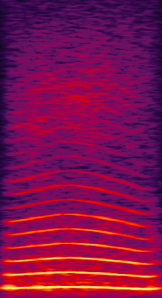

BACKGROUND TASK
RESPONSE
OFF BUTTON
2-s timeout
NO RESPONSE
Aborted trial
CORRECT RESPONSE
reward
1-s black screen
DETECTION
COO ONSET
DELAY
~200ms
RESPONSE WINDOW
2000ms
Notes:
The monkey has to learn to press the screen during a 2-s window after a random coo begins to play
(nothing happens if press before coo onset – unlike Task1_1)
The coo is played right after the button display (with the uncompressible delay caused by the server-client dialogue) and there is a large 2000ms response window after stimulus onset

Slide 2
TASK 1_1
EARLY RESPONSE
2-s timeout
NO RESPONSE
Aborted trial
CORRECT RESPONSE
$$
1-s black screen
DETECTION
COO ONSET
DELAY
~200-1000ms
Progressively increased
RESPONSE WINDOW
2000-500ms
Progressively shortened
Notes:
Now the monkey learns :
- to dissociate the response button form the coo: random delay distribution progressively increased to 1s between button and coo, with green screen and timeout if early response;
- and to respond fast, during the vocalization: response window progressively shortened to 500ms (coo duration)

Slide 3
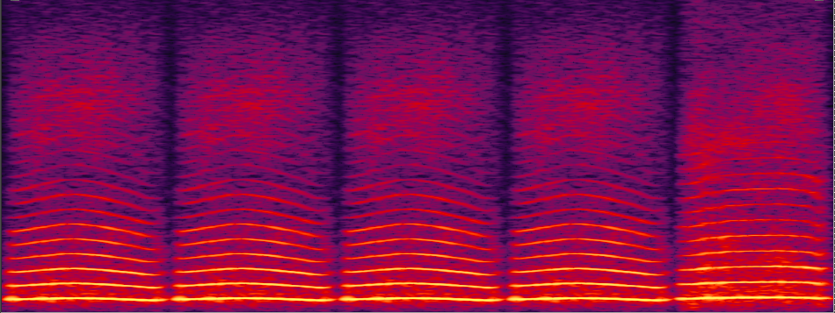
OMM TASK 1
$$
touché
<500ms ?
OUI
NON
Timeout 3s

Slide 4
OMM TASK 1
Phase 1
$$
touché
<500ms ?
OUI
NON
Timeout 3s

Slide 5
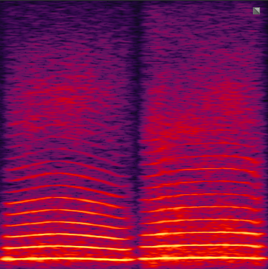
OMM TASK 1
Phase 2
$$
touché
<500ms ?
OUI
NON
Timeout 3s

