Slide 1
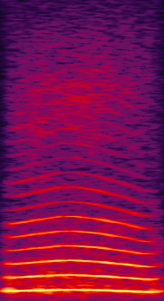

BACKGROUND TASK
NO RESPONSE
Aborted trial
2-s timeout
CORRECT RESPONSE
reward
2-s black screen
DETECTION
COO ONSET
DELAY
~200ms
RESPONSE WINDOW
3000ms
Notes:
The monkey has to learn to press the screen during a 3-s window after a random coo begins to play
(nothing happens if press before coo onset – unlike Task1_1)
The coo is played after the button display (with several 100ms delay caused by the server-client dialogue) and there is a large 3000ms response window after stimulus onset

Slide 2
TASK 1 - Phase 1
EARLY RESPONSE
2-s timeout
NO RESPONSE
Aborted trial
CORRECT RESPONSE
reward
2-s black screen
DETECTION
COO ONSET
DELAY
~200-1000ms
Progressively increased
RESPONSE WINDOW
2500-500ms
Progressively shortened
Notes:
Now the monkey learns :
- to dissociate the response button form the coo: random delay distribution progressively increased to 1s between button and coo, with green screen and timeout if early response;
- and to respond fast, during the vocalization: response window progressively shortened to 500ms (coo duration)

Slide 3
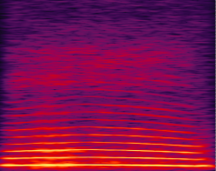
TASK 1 - Phase 2
EARLY RESPONSE
2-s timeout
NO RESPONSE
Aborted trial
CORRECT
2-s black screen
DETECTION
2nd COO ONSET
DELAY
500-1000ms
RESPONSE
WINDOW
500ms
Notes:
Now a different coo is introduced before the target coo, repeated 1-7 times in steps of increasing numbers,.
The monkey must learn to respond to the last – different – coo
Levels 1-6: progressively increase numbers of repetitions of coo1 from a single one to up to 6 before target coo

