Slide 1
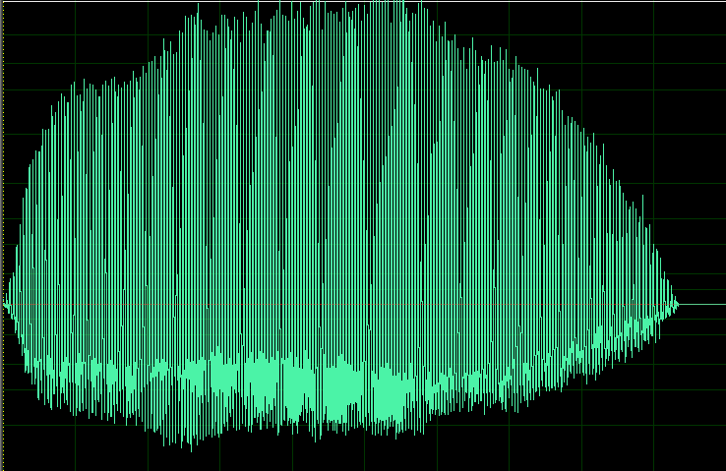
TASK 3_part 1
7 levels
EARLY RESPONSE
2-s timeout
NO RESPONSE
Aborted trial
CORRECT
2-s black screen
Coo1
Coo
DETECTION
Onset
Target
Variable Delay
Max: level *500ms
500ms to 3500ms
Response window
Reduced from
2000 to 500ms in 250 ms steps
Notes:
The monkey first learns to wait increasingly longer for the coo that opens the (decreasing) response window
Random delay: N*500ms ; N = random between 1-Level
Response_window=2250-250*level

Slide 2
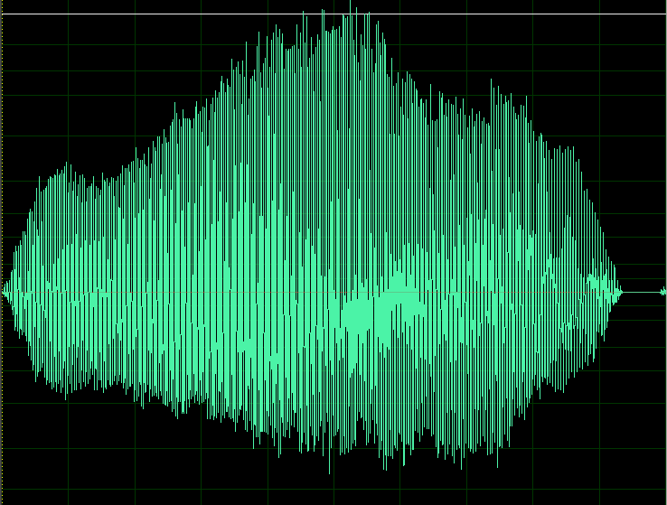
TASK 1_part 2
5 Levels
EARLY RESPONSE
2-s timeout
NO RESPONSE
Aborted trial
CORRECT
2-s black screen
Coo1
Coo1
Coo1
Coo2
DETECTION
Onset
Target
1-7 Distractors Amplitude increased
Response
window
500 ms
Notes:
Here the monkey learns to respond to the target while withholding response to the distractors
Distractors are decreasingly attenuated from -40dB (level 1) for 0 dB (level 5)

