Slide 1
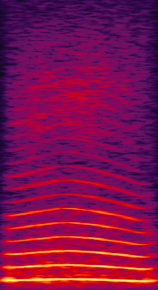
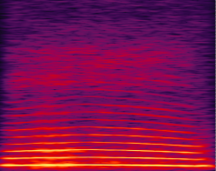
OMM TASK 4
Case Target first
RESPONSE
ON DISTRACTOR
2-s timeout
NO RESPONSE
Aborted trial
(not counted in perf)
2-s timeout
RESPONSE
ON TARGET
reward
2-s black screen
DETECTION
TARGET
DISTRACTOR
RESPONSE WINDOW
1000ms
Notes:
Here we present 2 consecutive stim in a random order: one Target, one Distractor
Only the Target is rewarded
5 steps with distractors of increasing loudness

Slide 2
Variantes Task 4
OMM TASK 4
Toujours 1 cible (CooA), nombre grandissant de distracteurs
Task4: 1 cible, 1 distracteur (CooB): 5 niveaux de volume (niveau 5: même niveau sonore)
Task4_1: 1 cible , 2 distracteurs (CooB, CooC)
Task4_2: 1 cible, 4 distracteurs(CooB, C, D, E)
Task4_3: 1 cible, 4 distracteurs (COOB et 3 morphs CooA-CooB)

