Slide 1
Waves and Optics
Lecture 7
WAVES, RAYS AND THE DOPPLER EFFECT

Slide 2
Waterfronts and Rays

Slide 3
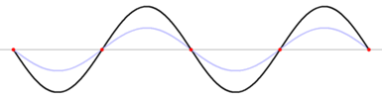
Wavefronts and Rays
So far we have used a wave on a string to illustrate most of the wave principles. We will now look at representing a wave via wavefronts and rays. This will be useful when we examine sound waves and optic phenomena.

Slide 4
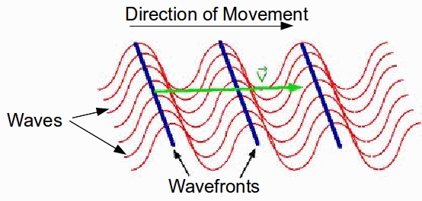
Wavefronts and Rays
Wavefronts:
Surfaces over which the oscillations of the particles of the medium transporting the wave (e.g. air) have the same value.
Rays:
Directed lines perpendicular to the wavefronts that indicate the direction of travel of the wavefronts.
CHAPTER 17 – FUNDAMENTALS OF PHYSICS

Slide 5
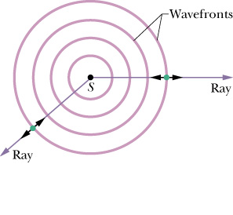
(a) Spherical Wavefronts
Consider a point source S. It emits (for e.g. sound) in all directions. We represent the direction of travel and the spread of the waves by the diagram shown.

Slide 6
(a) Spherical Wavefronts
The spherical lines are the wavefronts.
Wavefronts are like contours of a specified value of displacement of the particle e.g. the amplitude.
Therefore distance between wavefronts =
Because of the 3 dimensional nature, the wavefronts are spherical.
wavelength

Slide 7
(a) Spherical Wavefronts
The farther from the source the curvature gets less.
Rays are perpendicular to the wavefronts.
If the wave is a sound wave, the particles of air oscillate parallel to the direction of the ray.

Slide 8
(b) Planar Wavefronts
Consider 5th point above. Sufficiently far away the source, the curvature becomes so gradual that the wavefront is like a straight line. Wavefronts represented by straight lines are called planar wavefronts.
ray
wavelength

Slide 9
In course Information
Test Date is October 6
10:00-11:00
Venue: Chem/Phys

Slide 10
Doppler Effect
Consider a police car with a blaring siren. You are standing at your gate. What do you hear:
(i) When the car is far away?
(ii) As the car approaches?
(ii) After the car passes you and is driving away?
Low Frequency
Frequency gets higher pitched
Frequency gets lower

Slide 11
Doppler effect
The Doppler Effect is the change/modification in the observed frequency of a wave that occurs when the source (e.g. the car) or the detector, or both move relative to the transmitting medium (air). (However: If the transmitting medium is stationary then it can be seen as due to relative motion between the detector and source).

Slide 12
Doppler effect
The difference between the actual frequency and the observed frequency is called the Doppler Shift.
The Doppler Effect holds for sound waves, electromagnetic waves including microwaves, radio waves, and even visible light. Practical uses: Astronomy, and more importantly in speed traps.
We are only going to consider sound waves.

Slide 13
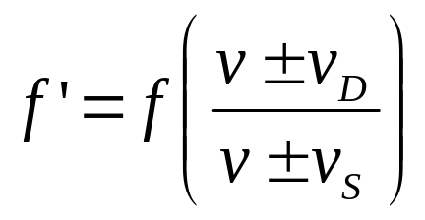
Doppler effect
Can we write an equation for the frequency we hear relative to the actual frequency?
In writing this equation we have assumed that the transmitting medium is air and air is at rest with respect to ground.
f’ →
Perceived frequency (by detector)
f →
Actual frequency (from source)
v_{D} →
Speed of detector
v_{S} →
Speed of the source
v →
Speed of sound in air = 343 m/s

Slide 14
How do we use the equation?
Note first that the detector controls the numerator. The source controls the denominator.
(b) Now consider the motion of the detector and source independently (i.e. irrespective of what the other is doing) and its effect on f to determine the correct sign.

Slide 15
How do we use the equation?
(c) So (for example) consider first the detector:
If the detector is moving toward the source, we expect the frequency of the sound heard to be getting higher/lower i.e. f ‘ is increasing/decreasing.
Detector can only achieve this by sign in numerator. Why?
f’ > f
+
Detector only controls the numerator.
- Way to get f’ bigger

Slide 16
How do we use the equation?
If the detector is moving away from the source, we expect the frequency of the sound heard to be higher/lower
i.e. f ‘ is increasing/decreasing.
Detector can only achieve this by sign in numerator. Why?
f’ < f
-
Detector only controls the numerator.
- Way to get f’ smaller

Slide 17
How do we use the equation?
Consider now the source:
If the source is moving toward the detector, we expect the frequency of the sound heard to be higher/lower
i.e. f ‘ is increasing/decreasing.
Source can only achieve this by sign in denominator. Why?
f’ > f
-
Source controls the denominator.

Slide 18
How do we use the equation?
If the source is moving away from the detector, we expect the frequency of the sound heard to be higher/lower i.e. f ‘ is increasing/decreasing
Source can only achieve this by sign in denominator. Why?
f’ < f
+
Source controls the denominator.

Slide 19
How do we use the equation?
Note then that toward => Doppler shift up to higher frequencies.
Away from => Doppler shift down to lower frequencies.

Slide 20
Class Question
Write the equation to describe the scenarios below. (Remember consider what detector is doing irrespective of what the source is doing and its effect on f and vice versa).

Slide 21
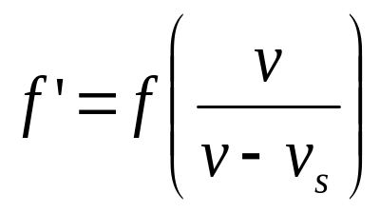
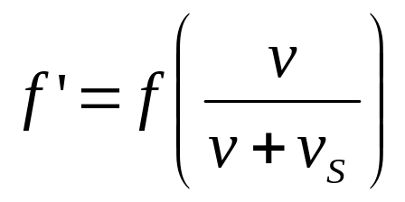
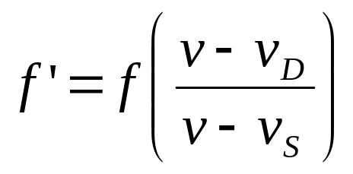
Class
Question
Source
(a)
(b)
(c)
Detector
0 speed
0 speed
Equation

Slide 22
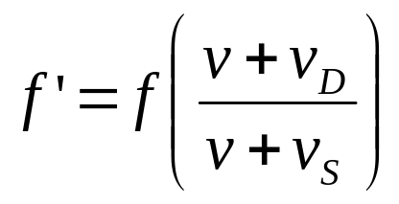
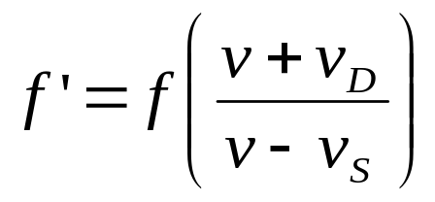
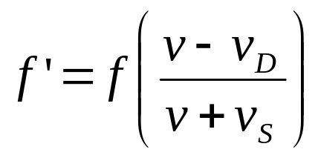
Class
Question
Source
(d)
(e)
(f)
Detector
Equation

Slide 23
LECTURE 8 (REVIEW)
What is the Doppler effect?
The Doppler Effect is the change/modification in the observed frequency of a wave that occurs when the source or the detector, or both move relative to the transmitting medium (air).

Slide 24
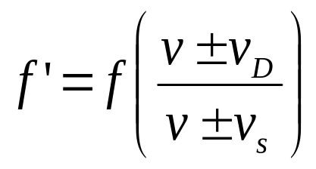
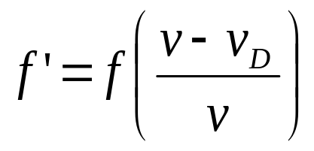
LECTURE 8(REVIEW)
The general Doppler effect is given by the equation:
If the source is stationary and the detector is moving away, the equation would become

Slide 25
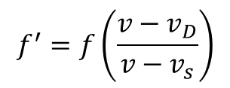
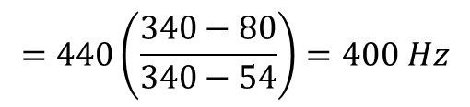
Review Question (Tutorial Q.21)
A police car is chasing a speeding Porshe 911. Assume that the Porshe’s maximum speed is 80.0 m/s and the police car’s is 54.0 m/s. At the moment both cars reach their maximum speed, what frequency will the Porshe driver hear if the frequency of the police car’s siren is 440 Hz? Take the speed of sound in air to be 340 m/s.
Detector: Porshe moving at 80.0 m/s
Source: Police moving at 54.0 m/s emitting 440 Hz
Police
Porshe

Slide 26
Using Wavefront analysis to prove the Doppler Equation
Wavefronts:
Surfaces over which the oscillations of the particles of the medium transporting the wave (e.g. air) have the same value.
Wavefronts are like contours of a specified value of displacement of the particle e.g. the amplitude.

Slide 27

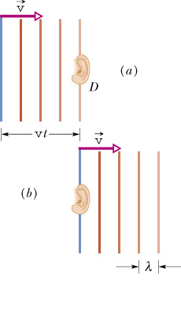
(a) Detector and Source Stationary
No Doppler Effect. Why?
The detector is represented by an ear.
Wavefronts are drawn one wavelength apart.
Waves move with speed v.
Neither moving relative to the other

Slide 28
Where we are heading
The frequency detected by detector D is the rate at which D intercepts wavefronts (or individual wavelengths).

Slide 29
Where we are heading
If D were stationary the rate would be f (source frequency), but if D is moving into the wavefronts, the rate of interception is greater and thus the detected frequency f’ is greater than f.

Slide 30

Who intercepts more waves?

Slide 31


(a) Detector and Source Stationary
vt/λ is the no. of wavefronts moving to right over time t
In time, t, the frequency is the rate at which wavefronts are intercepted by the detector
i.e. f = no of wavefronts/ t
Did you expect this solution?
In time t the wavefronts move to the right a distance vt.
The number of wavelengths in that distance vt is the number of wavelengths intercepted by D.
Yes! v = fλ (no Doppler Effect)

Slide 32
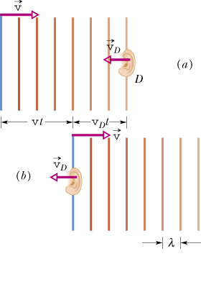
(a) Detector Moving to Stationary Source
In time t, the detector intercepts waves moving to right plus an additional amount of wavelengths due to its motion to the left.
Additional amount
= v_{D}t/λ

Slide 33
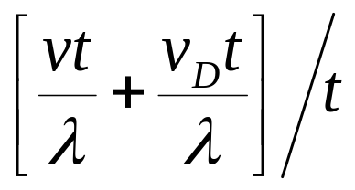
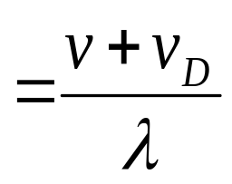
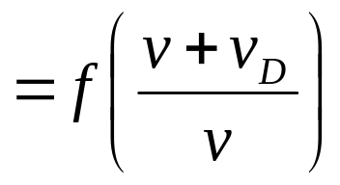
(a) Detector Moving to Stationary Source
Therefore, frequency is now the new rate of interception of wavelengths:
i.e. f’ =
(λ= v/f)

Slide 34
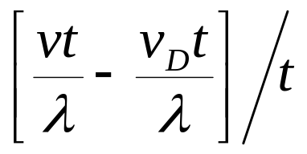
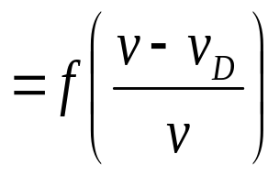
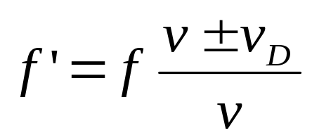
(a) Detector Moving to Stationary Source
Could do the same if detector had been moving away from the source i.e. would intercept less wavefronts so:
f’ =
Generalizing:
(1)

Slide 35
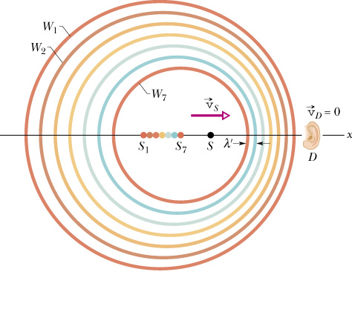
(a) Source Moving to Stationary Detector
Source moving from position S₁ to S₇
Detector stationary, source moving with v_{S}
W₁ was emitted when at S₁
Consider one period, T , later.
By then source moves to S₂ and emits W₂.
One more period later the source moves to S₃ by which time it emits W₃.
What do you notice about distance between wavefronts on right side (i.e. near to detector)?
Closer!!

Slide 36
(a) Source Moving to Stationary Detector
But distance between wavefronts is the
The motion of S is changing the wavelength of the sound waves heard by the detector and therefore the frequency heard by the detector.
wavelength

Slide 37
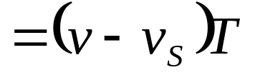
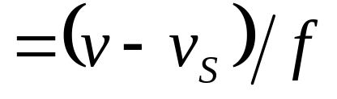
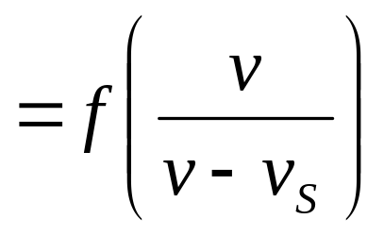
(a) Source Moving to Stationary Detector
The new wavelength λ’
= distance between wavefronts
= vT – v_{S}T
Hence the new frequency, f’ = v/λ’

Slide 38
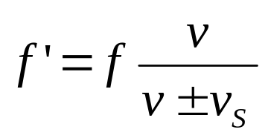
(a) Source Moving to Stationary Detector
Could do the same if source had been moving away from the detector (put detector on left side of diagram).
Therefore motion of S causes wavelengths to increase: f’ = fv/(v+v_{S})
Generalizing: -----(2)

Slide 39
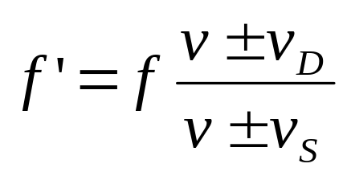
(a) Source Moving to Stationary Detector
Combining two scenarios we get the general equation for the Doppler Effect which we noted before.
Reading Assignment: Read on “beats” from your text or from any other text.

