Slide 1
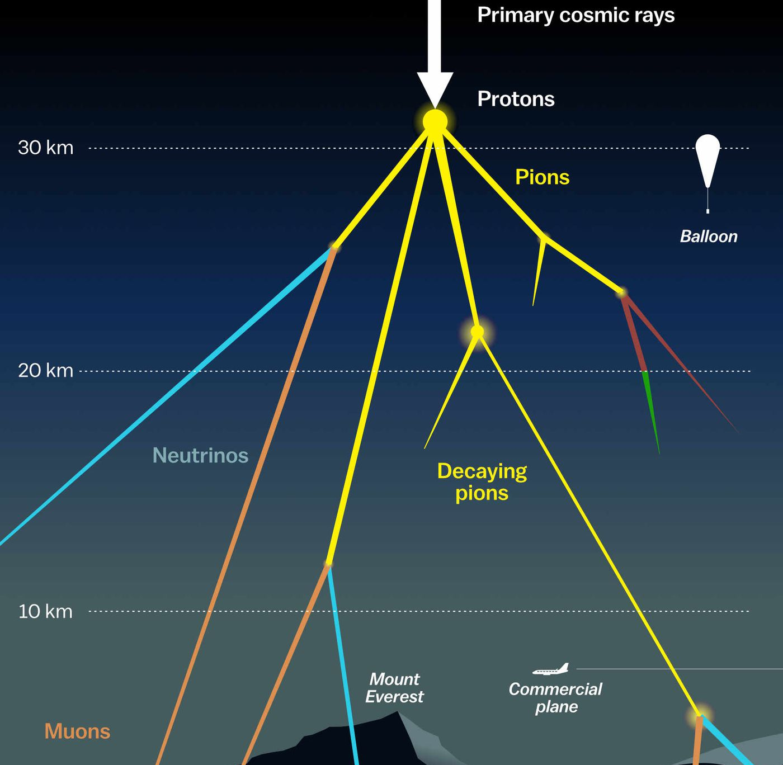
Updates on prompt atmospheric muon analysis Ludwig Neste and Pascal Gutjahr
CR-Call September 22, 2023
Source: NASA

Slide 2

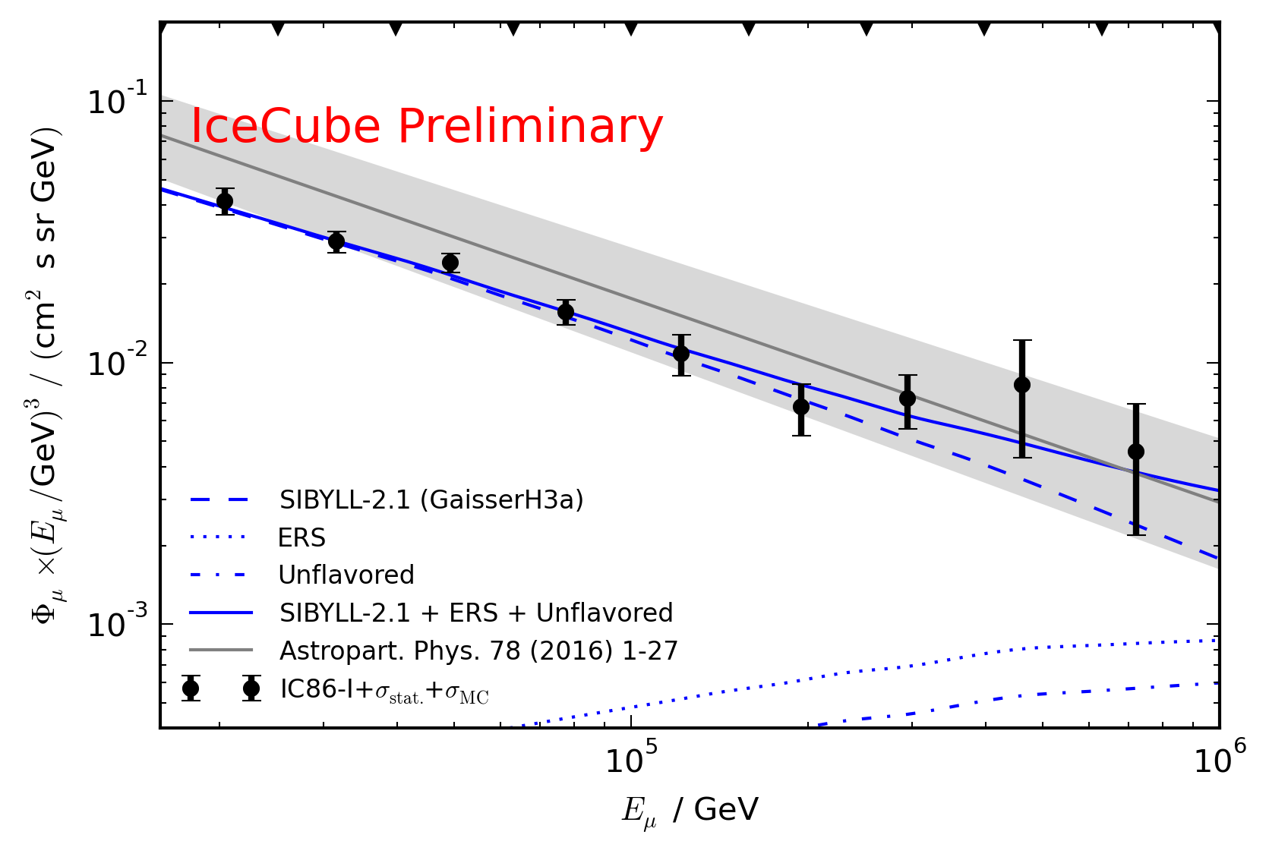
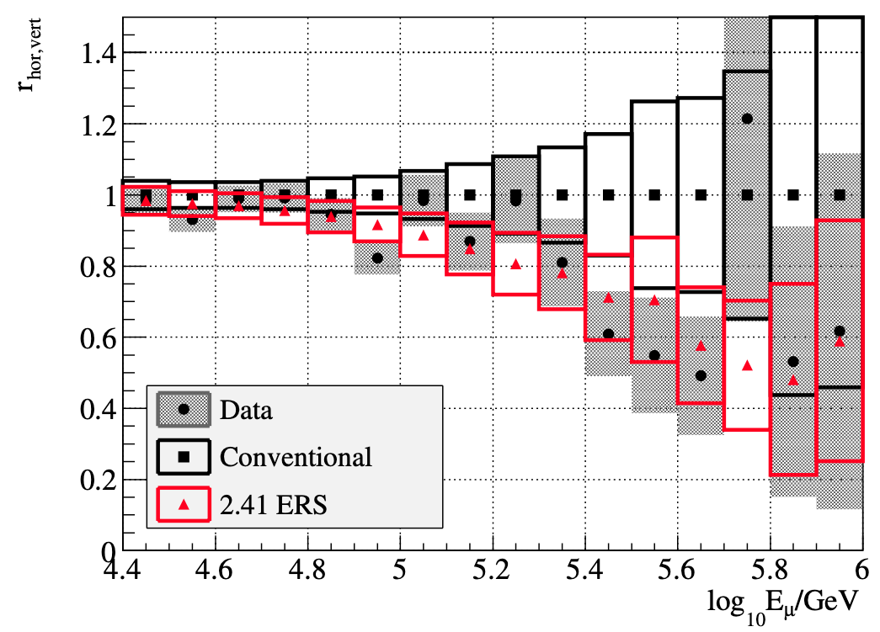
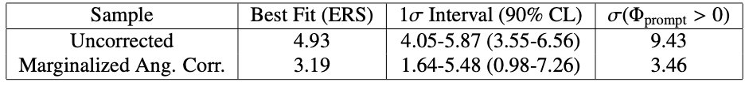
Motivation
Goal
Measure prompt normalization
Unfold energy spectrum
Prompt atmospheric muons have never been significantly measured
Old analyses:
Leading muon analysis: limited MC statistics (by Tomasz Fuchs, https://wiki.icecube.wisc.edu/index.php/Analysis_of_Leading_Muons)
Characterization of the muon flux: zenith problem (by Patrick Berghaus, https://arxiv.org/abs/1506.07981)

Slide 3
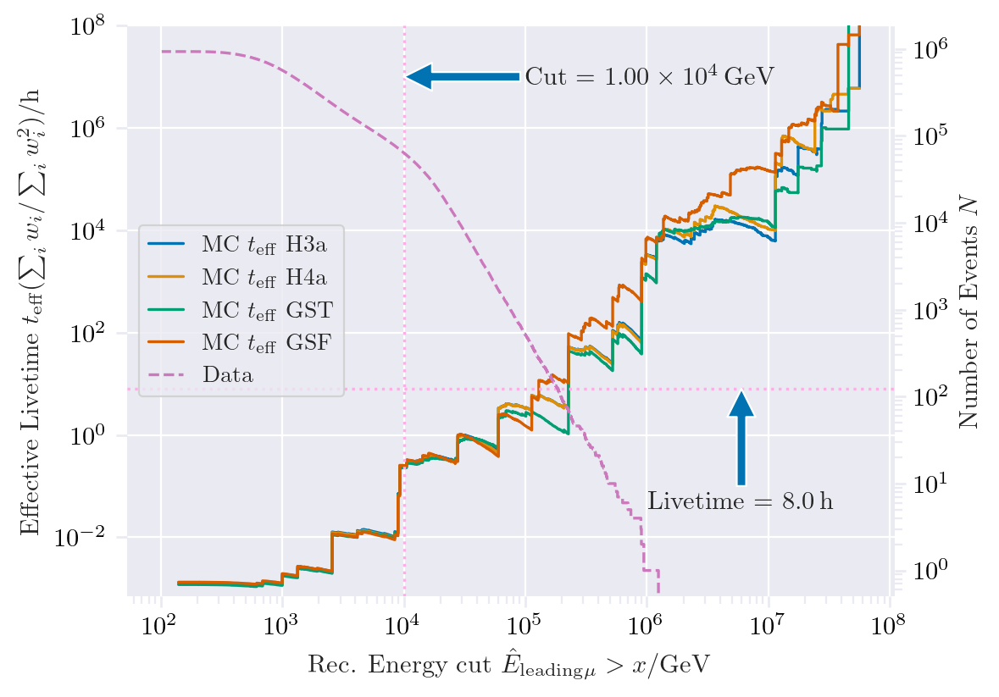
New CORSIKA extended history simulations
CORSIKA 77420
SIBYLL 2.3d
Icetray 1.5.1
5 components (p, He, N, Al, Fe)
Polyplopia: True
Trimshower: True
Ecuts1: 273 GeV (hadron min energy)
Ecuts2: 273 GeV (muon min energy)
Ecuts3: 10²⁰ GeV (electron min energy)
Ecuts4: 10²⁰ GeV (photon min energy)
4 datasets:
30010: 600 GeV – 1 PeV
30011: 1 PeV – 100 PeV
30012: 100 PeV – 1 EeV
30013: 1 EeV – 50 EeV
/data/sim/IceCube/2023/generated/CORSIKA_EHISTORY/
Reconstructed energy used here?! -> create this plot with MC primary energy!
Please go ahead and test the datasets

Slide 4
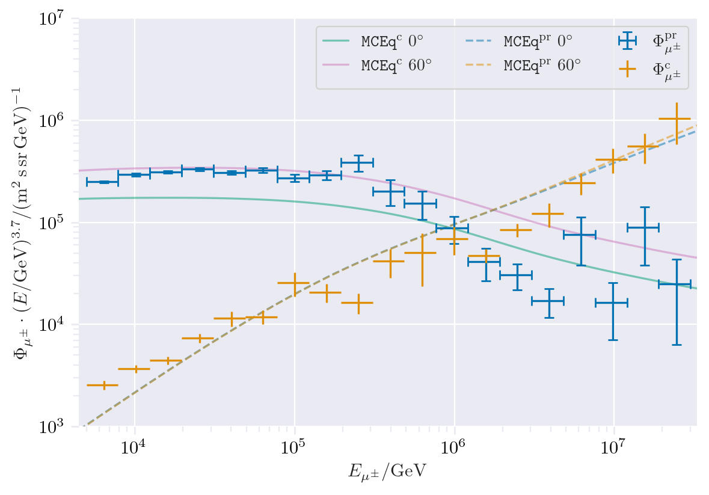
CORSIKA vs. MCEq
Prompt definition:
IceCube CORSIKA step 0
Insert plot: corsika standalone vs. mceq
For detailed information, see the talk by Ludwig Neste at the upcoming collaboration meeting

Slide 5
Expected muons for 10 years: leading vs. bundle energy
Show 2 plots: number of muons in 10 years as a function of the energy (Mcleading muon energy at entry and mc bundle energy at entry)
Use 4 weighting models
Show, that the leading energy is more senstive to detect prompt

Slide 6
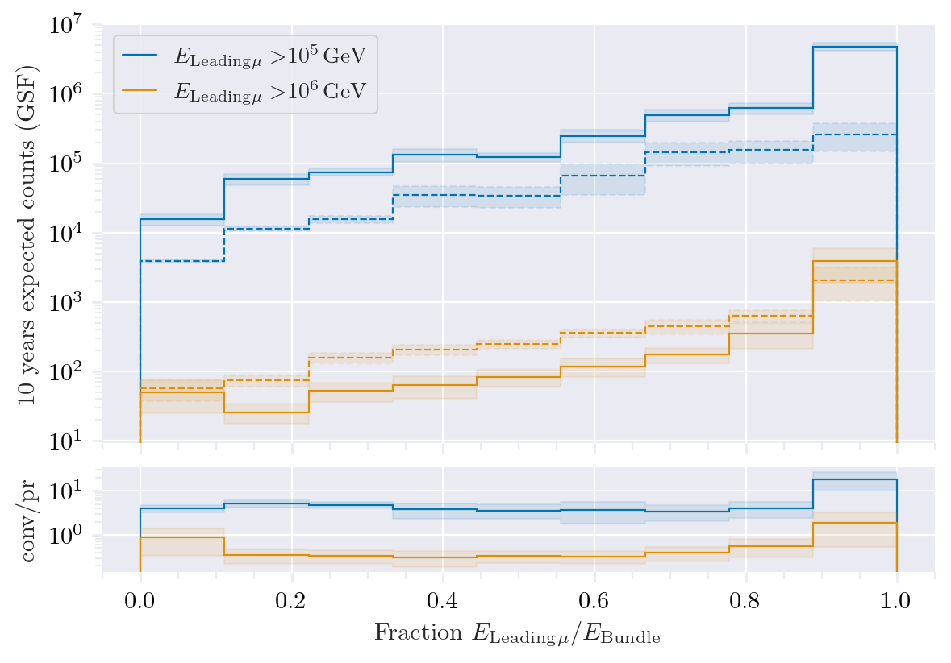
Leading muon energy fraction
Prompt dominates for energies > 1 PeV
Leading energy sweet spot: 0.1 – 0.9
Solid: conventional
Dashed: prompt

Slide 7
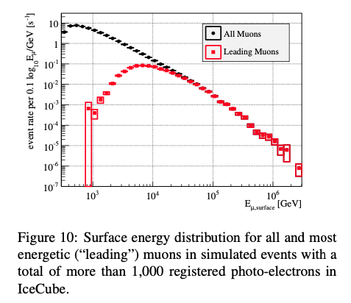
Leading muon contribution
Muons with energies between 100 TeV and 10 PeV dominate the bundle by more than 90%
Conventional muons are more dominant than prompt
High leading energy fraction does not lead to more sensitivity to detect prompt

Slide 8
Filters
3 plots:
1. total flux, muon filter and HQ filter, user MC primary energy
2. prompt and conv flux, muon filter and HQ filter, use MC leading energy
3. prompt and conv flux, muon filter and HQ filter, use MC bundle energy

Slide 9
Data-MC agreements
Two bachelor students worked on reconstructions using the dnn_reco framework:
Leander Flottau
Benjamin Brandt
Reconstructions:
Leading energy
Leading fraction
Bundle energy
Multiplicity
Azimuth
Zenith
General:
Trained on uncleaned and 6µs cleaned muon pulses
Processed 1 day of experimental data from 2011 to 2020 (July 4th)
Work in progress

Slide 10
Data-MC: HitStatistics
Insert plots with hit statistics

Slide 11
Data-MC: cos(zenith)
2 plots:
1. reconstructed cos_zenith for data and MC GST and GSF
2. reconstructed cos_zenith with energy cut (reconstrcuted bundle energy > 1e4?)

Slide 12
Data-MC: energy spectrum
2 plots: leading energy and bundle energy spectrum

Slide 13
Pseudo analysis

Slide 14
Pseudo data sampling

Slide 15
Test bias

Slide 16
Test background statistics

Slide 17
Discovery potential and sensitivity

Slide 18
Conclusion and outlook
New CORSIKA EHIST simulations
CORSIKA vs. MCEq agreement
DNN angular and energy reconstructions
First data-MC comparisons
Pseudo analysis set up
Wiki page
Data-MC agreement of dnn input
Optimize DNN reconstructions
Include systematics (snowstorm)
Scattering
Absorption
Anisotropy
Hole ice 1
Hole ice 2
Dom efficiency
Conventional normalization
We do not include systematics of the primary fluxes, instead we perform the analysis several times for different flux models
Entire analysis is based on CORSIKA 7 and SIBYLL 2.3d, perform “minor” simulation with another hadronic model?

Slide 19
Backup

Slide 20
Add backup slides:
Evluation of models used for this talk

Slide 21
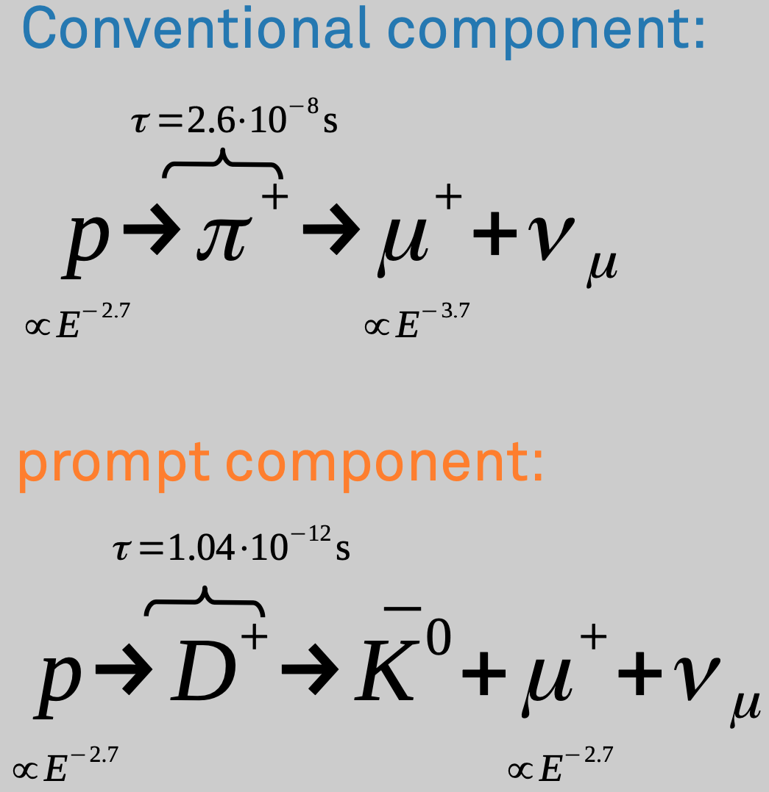
Definition of the muon flux
$φ_{tot}=φ_{conventional}+φ_{prompt}$
$π, Κ$ ∝ E^{-3.7}
“not” $π, Κ \text{∝ }\text{E}\text{−}\text{2}\text{.7}$

Slide 22
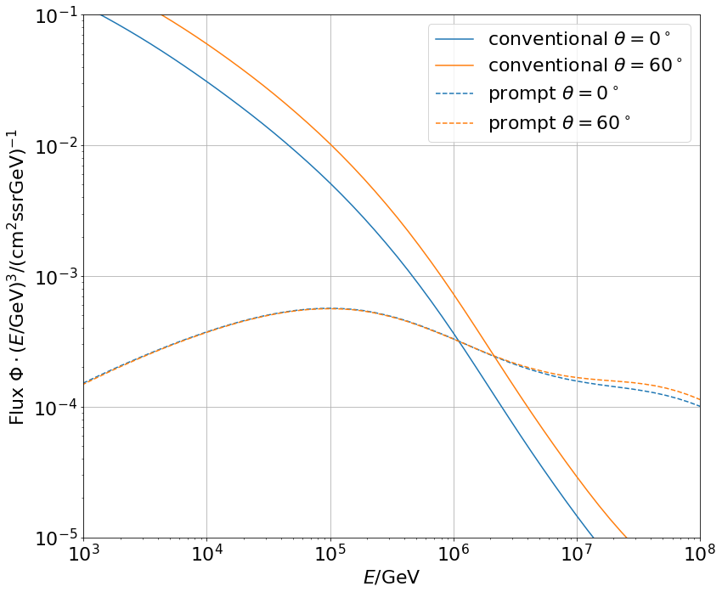
Muon flux
0°: perpendicular to Earth’s surface
$$φ_{tot}=φ_{conv}+φ_{prompt}$$
Prompt dominates at energies larger than PeV
Conventional particle flux depends on zenith angle
conventional
prompt
We can measure prompt muon energies from ~1 PeV to ~100 PeV

Slide 23
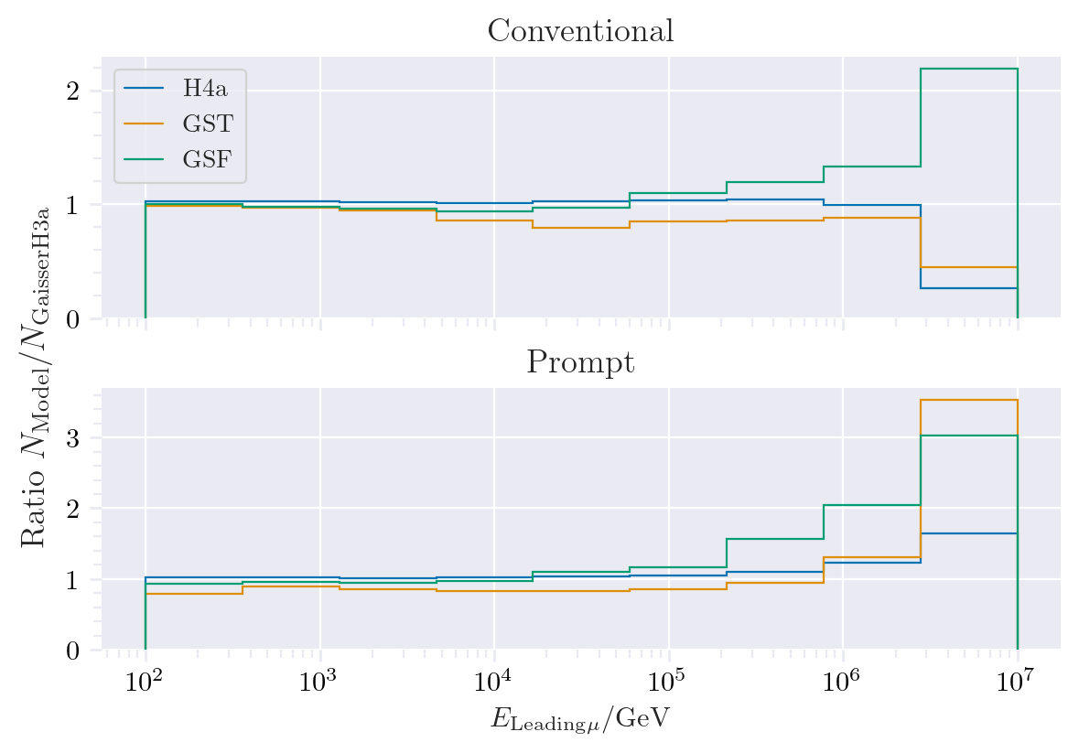
Muon production – different weightings
GST predicts most prompt
MCLabelsLeadingMuons_entry_energy

Slide 24
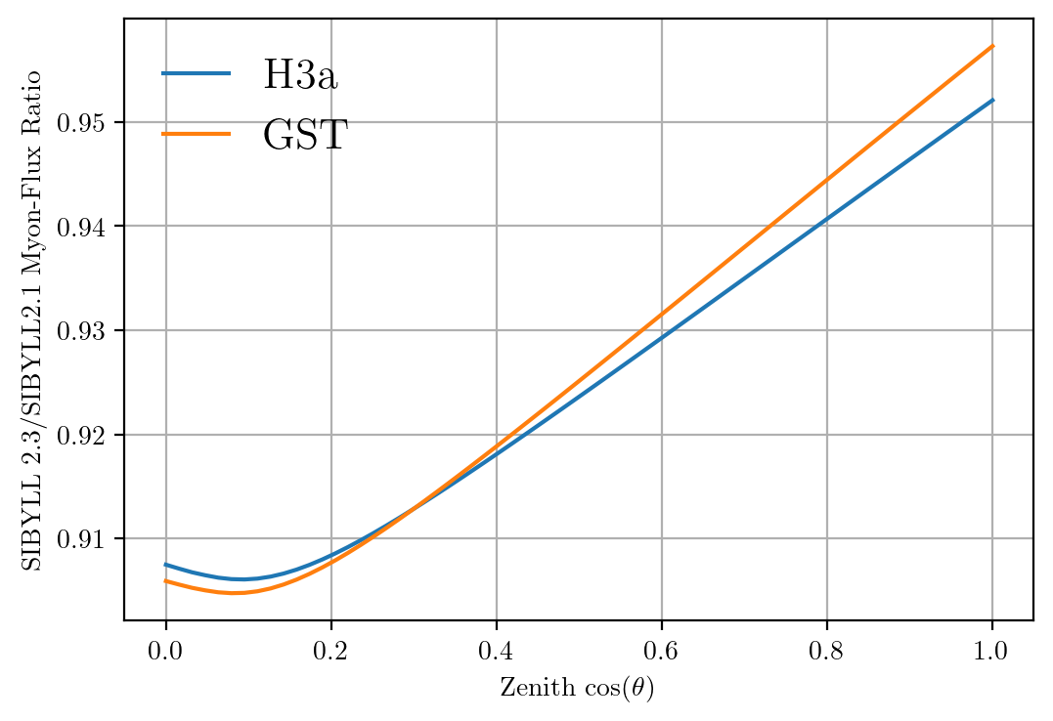
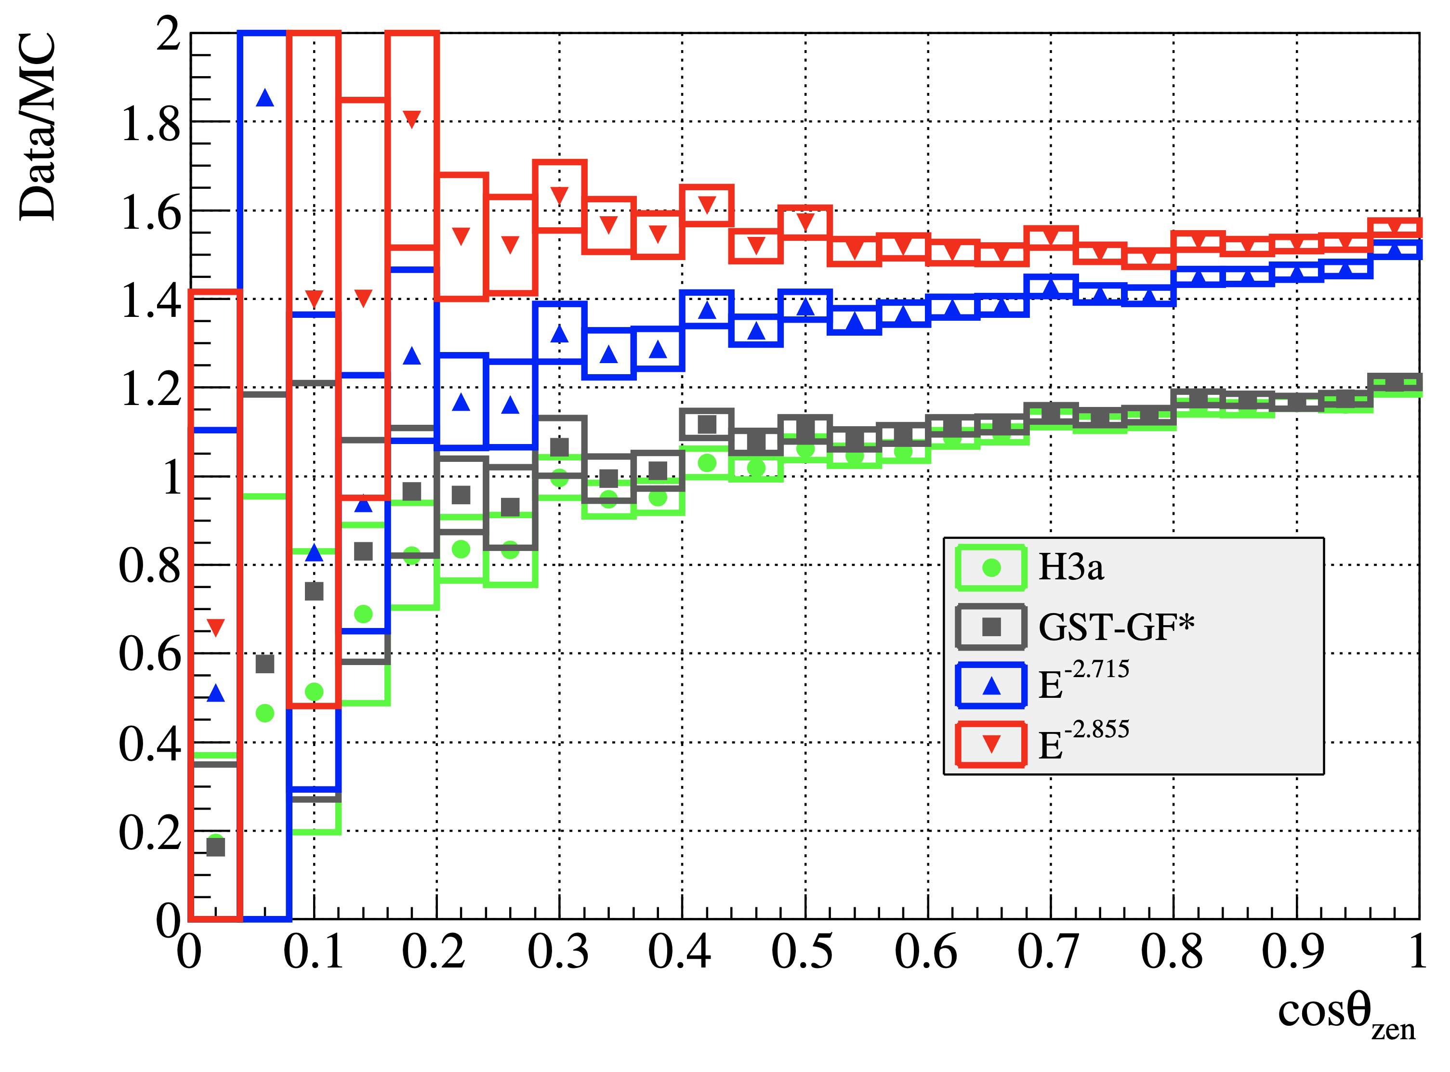
Solution to zenith problem?
No complete solution, but a step in the right direction

