Slide 1
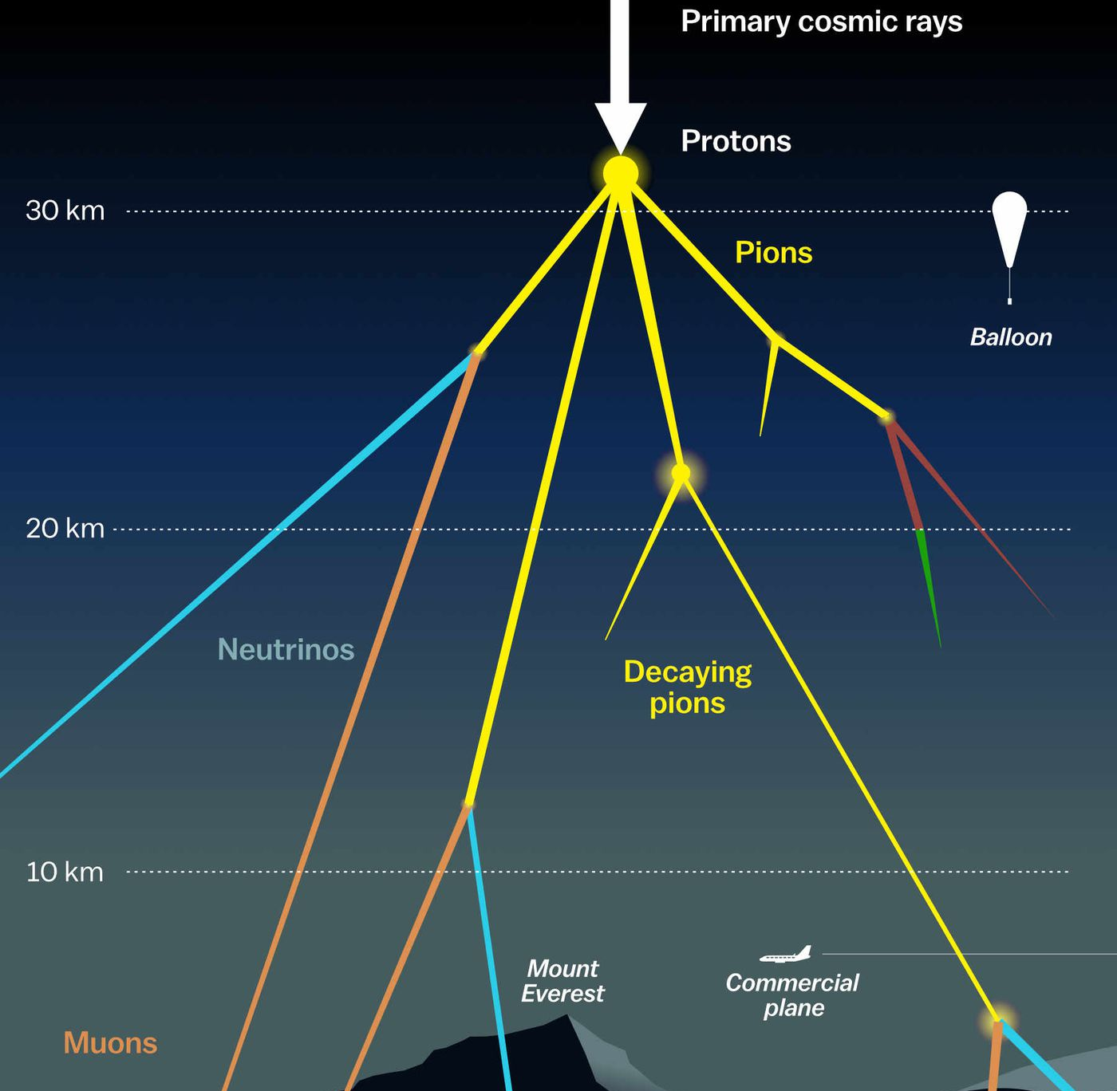

NuGen Multiplicity Pascal Gutjahr
April 23, 2024
Source: NASA

Slide 2
All neutrino flavors

Slide 3
Muon neutrinos

Slide 4
Atmospheric neutrinos – GaisserH3a
efficiency: 0.06 || expected events: 28 || minimum energy cut: 3.37 TeV (min zenith: 0°, max zenith: 90°, uncertainty < 0.1, n_muons < 1)
efficiency: 0.05 || expected events: 21 || minimum energy cut: 3.98 TeV (min zenith: 0°, max zenith: 90°, uncertainty < 0.1, n_muons < 2)
efficiency: 0.05 || expected events: 21 || minimum energy cut: 3.98 TeV (min zenith: 0°, max zenith: 90°, uncertainty < 0.1, n_muons < 5)
efficiency: 0.05 || expected events: 21 || minimum energy cut: 3.98 TeV (min zenith: 0°, max zenith: 90°, uncertainty < 0.1, n_muons < 10)
efficiency: 0.05 || expected events: 21 || minimum energy cut: 3.98 TeV (min zenith: 0°, max zenith: 90°, uncertainty < 0.1, n_muons < 100)
efficiency: 0.29 || expected events: 93 || minimum energy cut: 6.58 TeV (min zenith: 0°, max zenith: 90°, uncertainty < 0.5, n_muons < 1)
efficiency: 0.22 || expected events: 46 || minimum energy cut: 15.20 TeV (min zenith: 0°, max zenith: 90°, uncertainty < 0.5, n_muons < 2)
efficiency: 0.22 || expected events: 46 || minimum energy cut: 15.20 TeV (min zenith: 0°, max zenith: 90°, uncertainty < 0.5, n_muons < 5)
efficiency: 0.09 || expected events: 11 || minimum energy cut: 35.11 TeV (min zenith: 0°, max zenith: 90°, uncertainty < 0.5, n_muons < 10)
efficiency: nan || expected events: 0 || minimum energy cut: 511.79 TeV (min zenith: 0°, max zenith: 90°, uncertainty < 0.5, n_muons < 100)
efficiency: 0.31 || expected events: 78 || minimum energy cut: 10.87 TeV (min zenith: 0°, max zenith: 90°, uncertainty < 1, n_muons < 1)
efficiency: 0.29 || expected events: 55 || minimum energy cut: 17.97 TeV (min zenith: 0°, max zenith: 90°, uncertainty < 1, n_muons < 2)
efficiency: 0.32 || expected events: 55 || minimum energy cut: 21.25 TeV (min zenith: 0°, max zenith: 90°, uncertainty < 1, n_muons < 5)
efficiency: 0.30 || expected events: 36 || minimum energy cut: 35.11 TeV (min zenith: 0°, max zenith: 90°, uncertainty < 1, n_muons < 10)
efficiency: nan || expected events: 0 || minimum energy cut: 511.79 TeV (min zenith: 0°, max zenith: 90°, uncertainty < 1, n_muons < 100)
efficiency: 0.31 || expected events: 78 || minimum energy cut: 10.87 TeV (min zenith: 0°, max zenith: 90°, uncertainty < 5, n_muons < 1)
efficiency: 0.41 || expected events: 78 || minimum energy cut: 17.97 TeV (min zenith: 0°, max zenith: 90°, uncertainty < 5, n_muons < 2)
efficiency: 0.40 || expected events: 55 || minimum energy cut: 29.70 TeV (min zenith: 0°, max zenith: 90°, uncertainty < 5, n_muons < 5)
efficiency: 0.49 || expected events: 45 || minimum energy cut: 49.08 TeV (min zenith: 0°, max zenith: 90°, uncertainty < 5, n_muons < 10)
efficiency: nan || expected events: 0 || minimum energy cut: 511.79 TeV (min zenith: 0°, max zenith: 90°, uncertainty < 5, n_muons < 100)
efficiency: 0.31 || expected events: 78 || minimum energy cut: 10.87 TeV (min zenith: 0°, max zenith: 90°, uncertainty < 10, n_muons < 1)
efficiency: 0.41 || expected events: 78 || minimum energy cut: 17.97 TeV (min zenith: 0°, max zenith: 90°, uncertainty < 10, n_muons < 2)
efficiency: 0.40 || expected events: 55 || minimum energy cut: 29.70 TeV (min zenith: 0°, max zenith: 90°, uncertainty < 10, n_muons < 5)
efficiency: 0.49 || expected events: 45 || minimum energy cut: 49.08 TeV (min zenith: 0°, max zenith: 90°, uncertainty < 10, n_muons < 10)
efficiency: nan || expected events: 0 || minimum energy cut: 511.79 TeV (min zenith: 0°, max zenith: 90°, uncertainty < 10, n_muons < 100)

Slide 5
Astrophysical neutrinos – gamma = 2.6
efficiency: 0.01 || expected events: 11 || minimum energy cut: 3.37 TeV (min zenith: 0°, max zenith: 90°, uncertainty < 0.1, n_muons < 1)
efficiency: 0.01 || expected events: 7 || minimum energy cut: 3.98 TeV (min zenith: 0°, max zenith: 90°, uncertainty < 0.1, n_muons < 2)
efficiency: 0.01 || expected events: 7 || minimum energy cut: 3.98 TeV (min zenith: 0°, max zenith: 90°, uncertainty < 0.1, n_muons < 5)
efficiency: 0.01 || expected events: 7 || minimum energy cut: 3.98 TeV (min zenith: 0°, max zenith: 90°, uncertainty < 0.1, n_muons < 10)
efficiency: 0.01 || expected events: 7 || minimum energy cut: 3.98 TeV (min zenith: 0°, max zenith: 90°, uncertainty < 0.1, n_muons < 100)
efficiency: 0.13 || expected events: 78 || minimum energy cut: 6.58 TeV (min zenith: 0°, max zenith: 90°, uncertainty < 0.5, n_muons < 1)
efficiency: 0.06 || expected events: 28 || minimum energy cut: 15.20 TeV (min zenith: 0°, max zenith: 90°, uncertainty < 0.5, n_muons < 2)
efficiency: 0.06 || expected events: 28 || minimum energy cut: 15.20 TeV (min zenith: 0°, max zenith: 90°, uncertainty < 0.5, n_muons < 5)
efficiency: 0.02 || expected events: 6 || minimum energy cut: 35.11 TeV (min zenith: 0°, max zenith: 90°, uncertainty < 0.5, n_muons < 10)
efficiency: 0.00 || expected events: 0 || minimum energy cut: 511.79 TeV (min zenith: 0°, max zenith: 90°, uncertainty < 0.5, n_muons < 100)
efficiency: 0.21 || expected events: 105 || minimum energy cut: 10.87 TeV (min zenith: 0°, max zenith: 90°, uncertainty < 1, n_muons < 1)
efficiency: 0.19 || expected events: 78 || minimum energy cut: 17.97 TeV (min zenith: 0°, max zenith: 90°, uncertainty < 1, n_muons < 2)
efficiency: 0.23 || expected events: 91 || minimum energy cut: 21.25 TeV (min zenith: 0°, max zenith: 90°, uncertainty < 1, n_muons < 5)
efficiency: 0.21 || expected events: 67 || minimum energy cut: 35.11 TeV (min zenith: 0°, max zenith: 90°, uncertainty < 1, n_muons < 10)
efficiency: 0.00 || expected events: 0 || minimum energy cut: 511.79 TeV (min zenith: 0°, max zenith: 90°, uncertainty < 1, n_muons < 100)
efficiency: 0.27 || expected events: 136 || minimum energy cut: 10.87 TeV (min zenith: 0°, max zenith: 90°, uncertainty < 5, n_muons < 1)
efficiency: 0.25 || expected events: 105 || minimum energy cut: 17.97 TeV (min zenith: 0°, max zenith: 90°, uncertainty < 5, n_muons < 2)
efficiency: 0.27 || expected events: 91 || minimum energy cut: 29.70 TeV (min zenith: 0°, max zenith: 90°, uncertainty < 5, n_muons < 5)
efficiency: 0.25 || expected events: 66 || minimum energy cut: 49.08 TeV (min zenith: 0°, max zenith: 90°, uncertainty < 5, n_muons < 10)
efficiency: 0.12 || expected events: 6 || minimum energy cut: 511.79 TeV (min zenith: 0°, max zenith: 90°, uncertainty < 5, n_muons < 100)
efficiency: 0.27 || expected events: 136 || minimum energy cut: 10.87 TeV (min zenith: 0°, max zenith: 90°, uncertainty < 10, n_muons < 1)
efficiency: 0.25 || expected events: 105 || minimum energy cut: 17.97 TeV (min zenith: 0°, max zenith: 90°, uncertainty < 10, n_muons < 2)
efficiency: 0.27 || expected events: 91 || minimum energy cut: 29.70 TeV (min zenith: 0°, max zenith: 90°, uncertainty < 10, n_muons < 5)
efficiency: 0.25 || expected events: 66 || minimum energy cut: 49.08 TeV (min zenith: 0°, max zenith: 90°, uncertainty < 10, n_muons < 10)
efficiency: 0.12 || expected events: 6 || minimum energy cut: 511.79 TeV (min zenith: 0°, max zenith: 90°, uncertainty < 10, n_muons < 100)

Slide 6
Efficiency uncertainty cut (NuGen)

