Slide 1
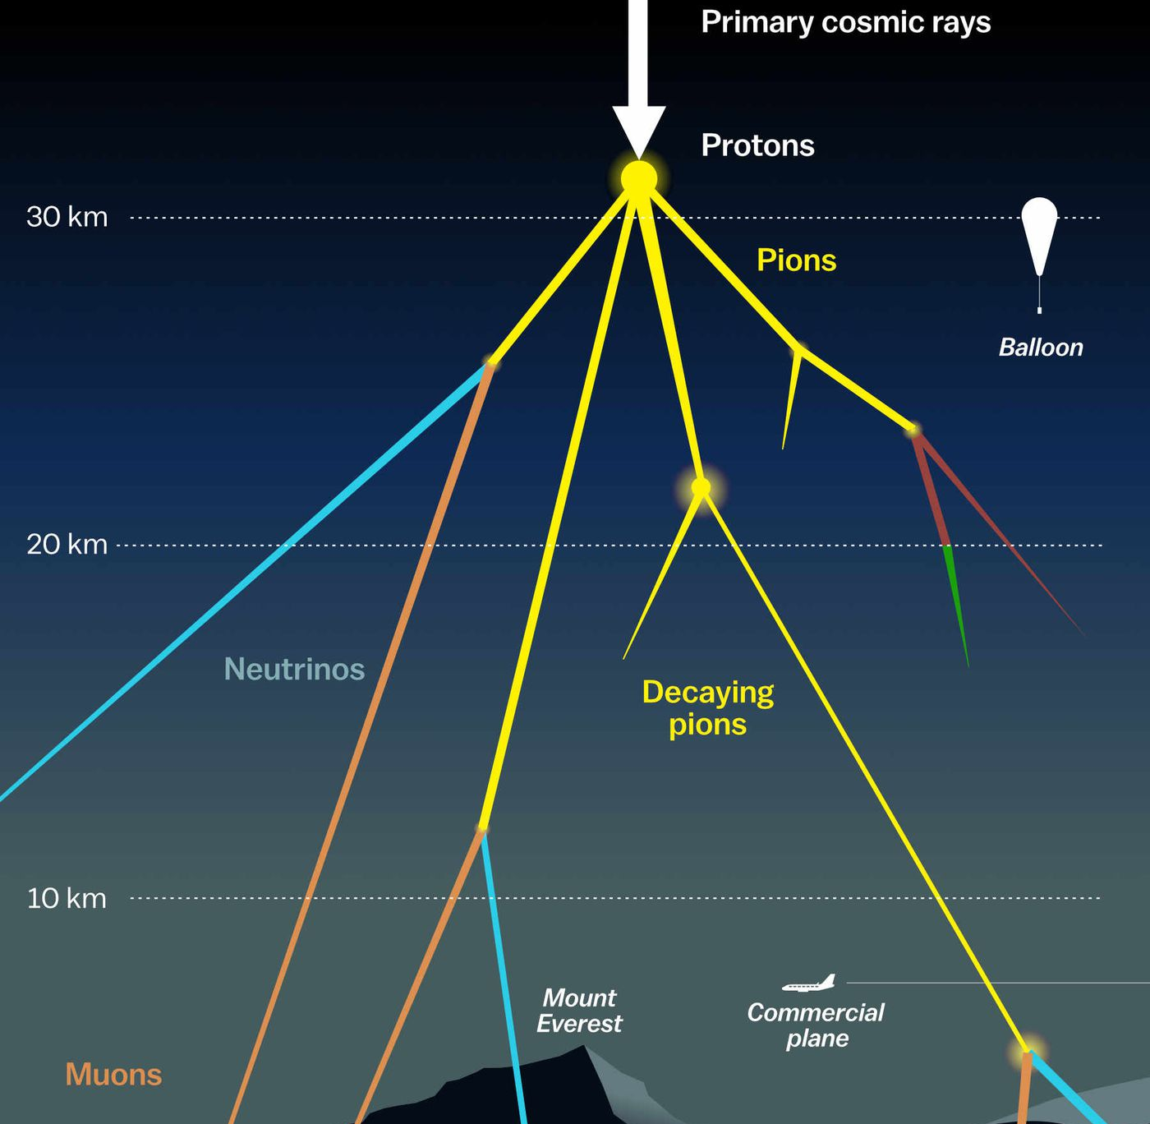

Measuring the prompt component of the atmospheric muon flux Pascal Gutjahr
March 5, 2024
Source: NASA

Slide 2
Cos(zenith) – 200 TeV bundle cut at surface
Ehistory dataset 2023
GSF
H3a
H4a
Network 1
GSF
H3a
H4a
Network 2

Slide 3
Cos(zenith) – quality cuts
Ehistory dataset 2023
GSF
H3a
H4a
Network 1
GSF
H3a
H4a
Network 2

Slide 4
Cos(zenith) – 200 TeV bundle cut at surface
CORSIKA v191
GSF
H3a
H4a
Network 1
GSF
H3a
H4a
Network 2

Slide 5
Cos(zenith) – quality cuts
CORSIKA v191
GSF
H3a
H4a
Network 1
GSF
H3a
H4a
Network 2

