Slide 1
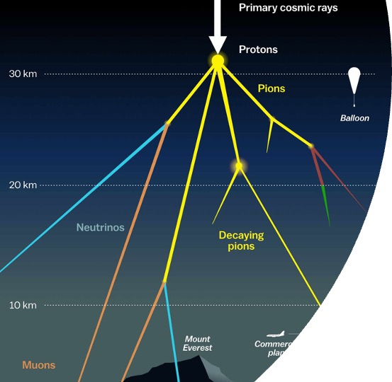
Prompt 31.08.2023
Evaluation of Ludwig’s, Ben’s and Leander’s results

Slide 2
Outline
How many events do we expect? –> Which label shall we use for this?
Show effect of filters
What is our prompt definition? –> Why?

Slide 3
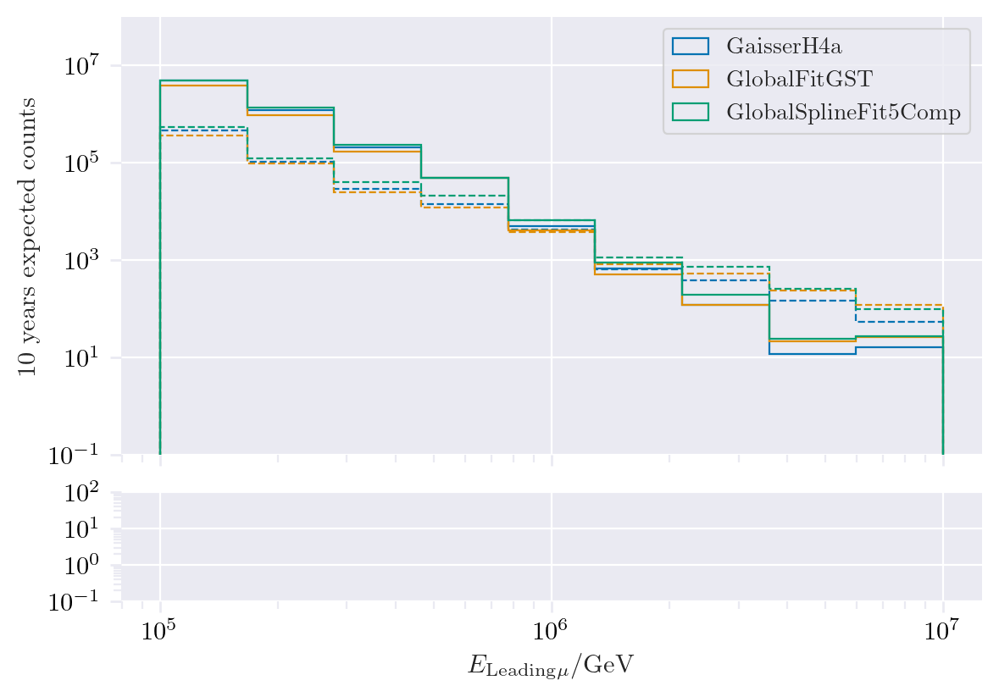
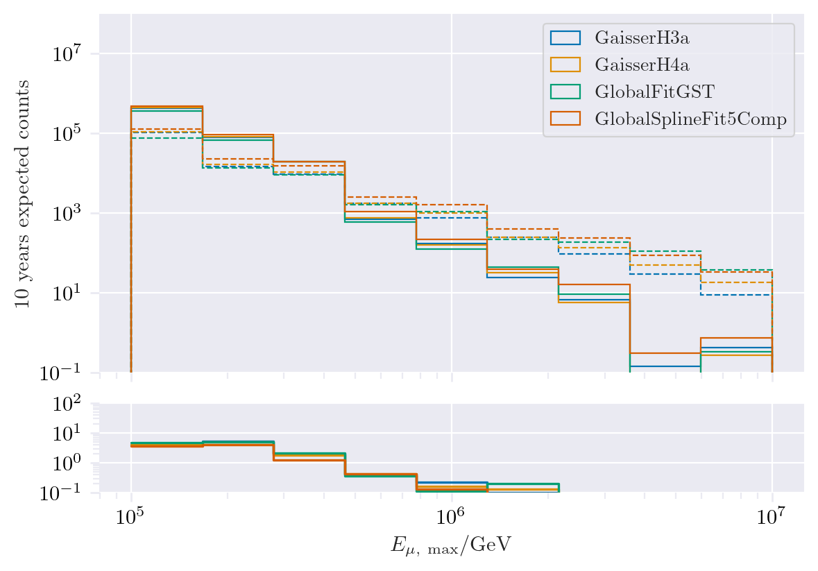
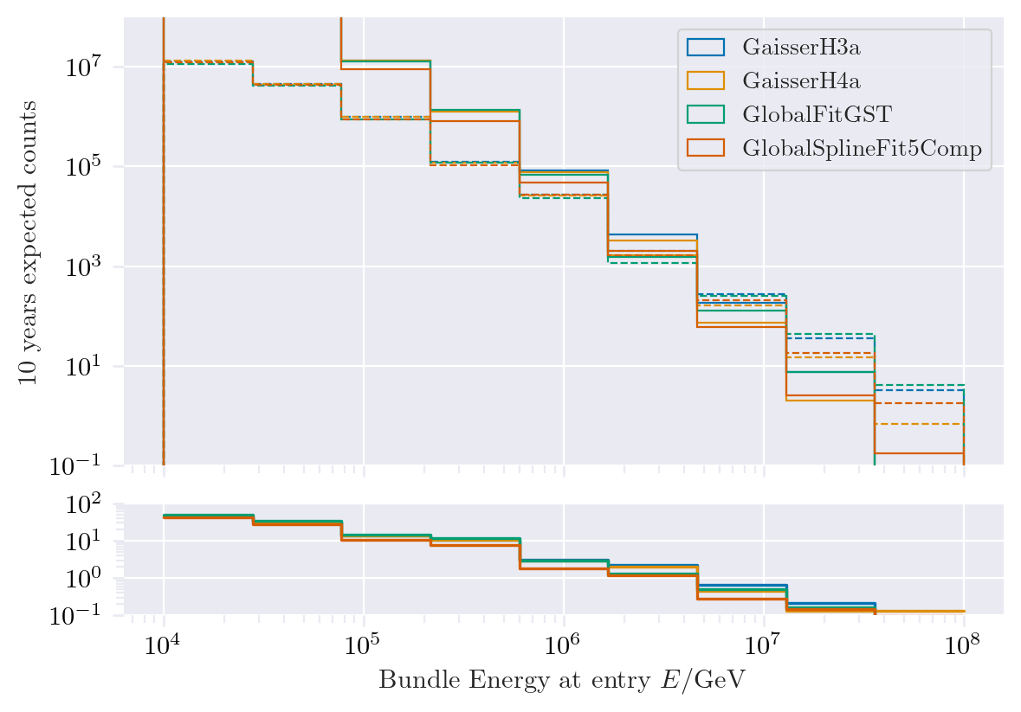
Expected muons for 10 years
MostEnergeticMuonInside_energy
MCLabelsLeadingMuons_entry_energy
MCLabelsLeadingMuons_bundle_energy_at_entry

Slide 4
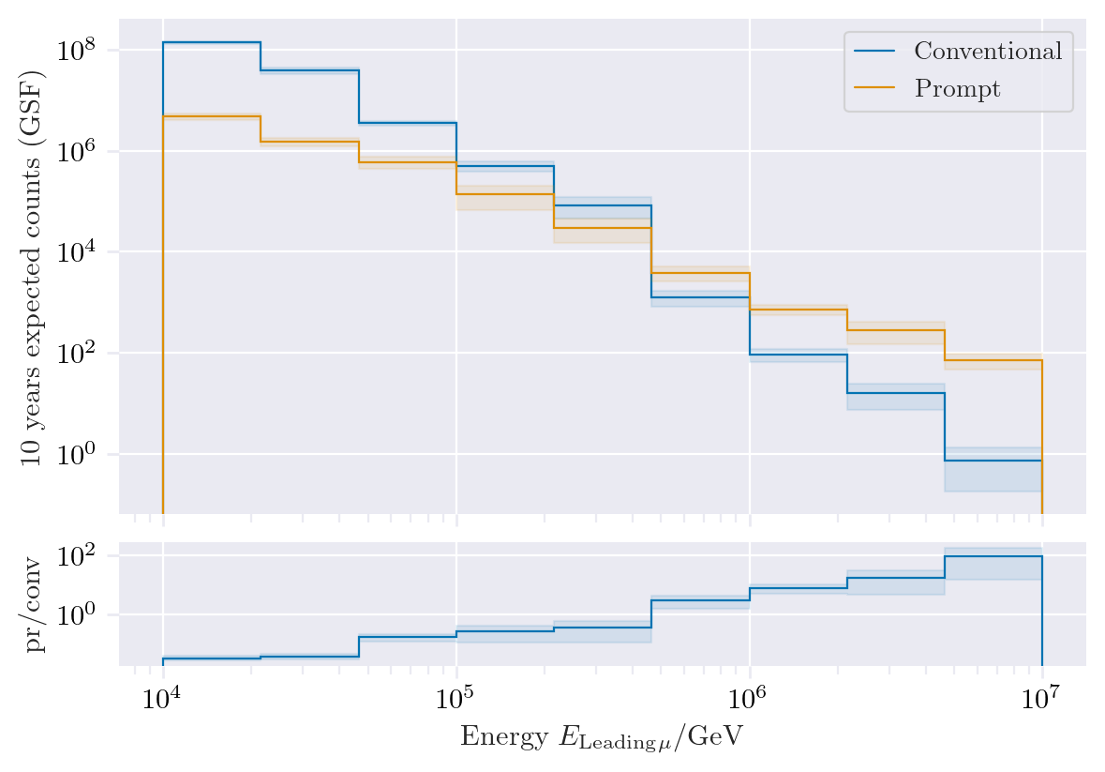
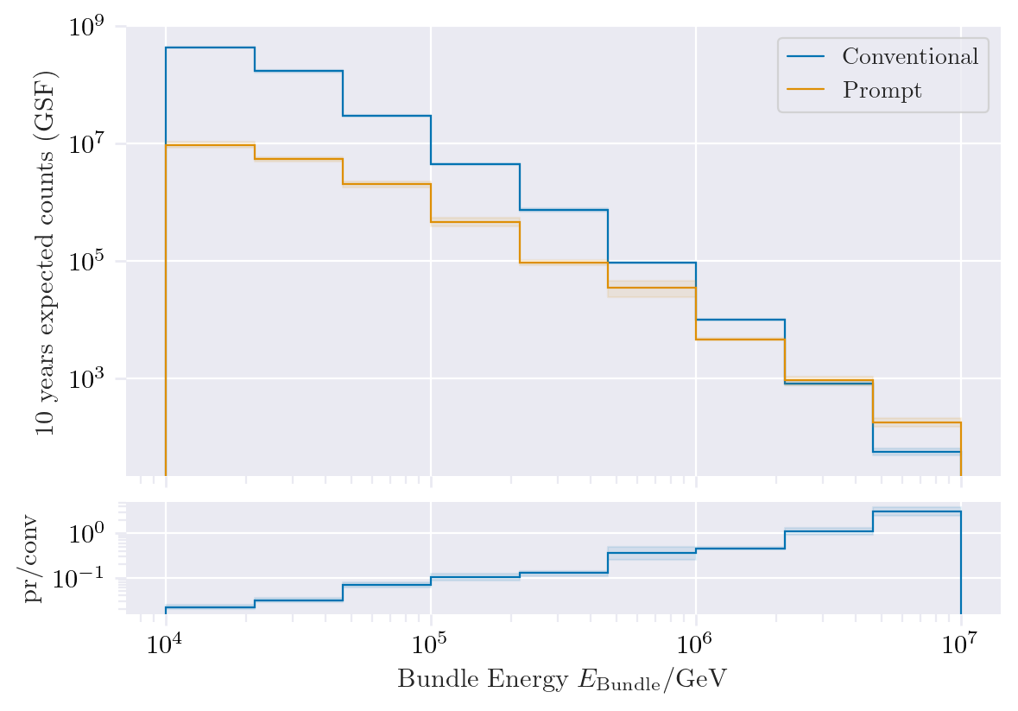
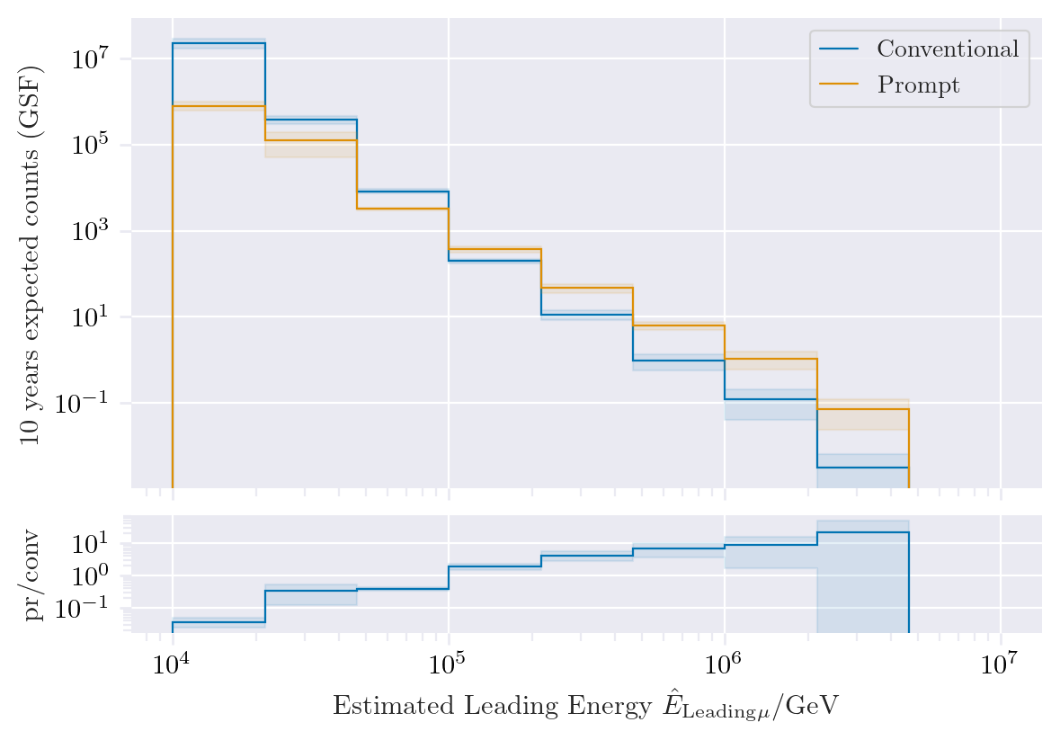
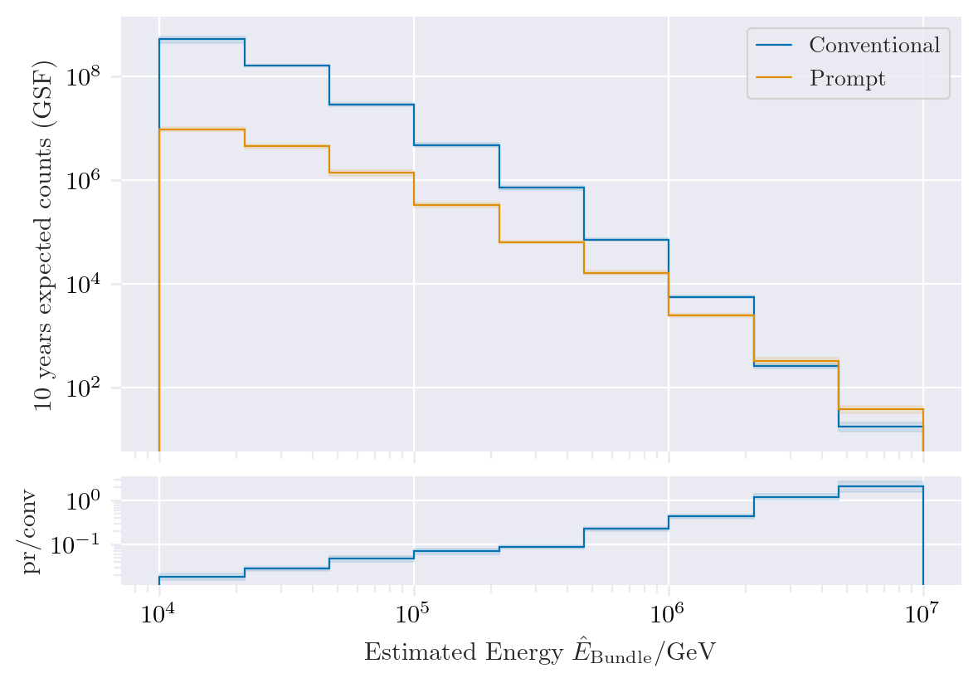
Leading vs. bundle energy
MCLabelsLeadingMuons_entry_energy
MCLabelsLeadingMuons_bundle_energy_at_entry
Leading muon energy is more sensitive to measure prompt
But it is more difficult to reconstruct the leading muon energy accurately
DeepLearningReco_energy_bigger_model_bundle
Issues in leading energy reconstruction

Slide 5
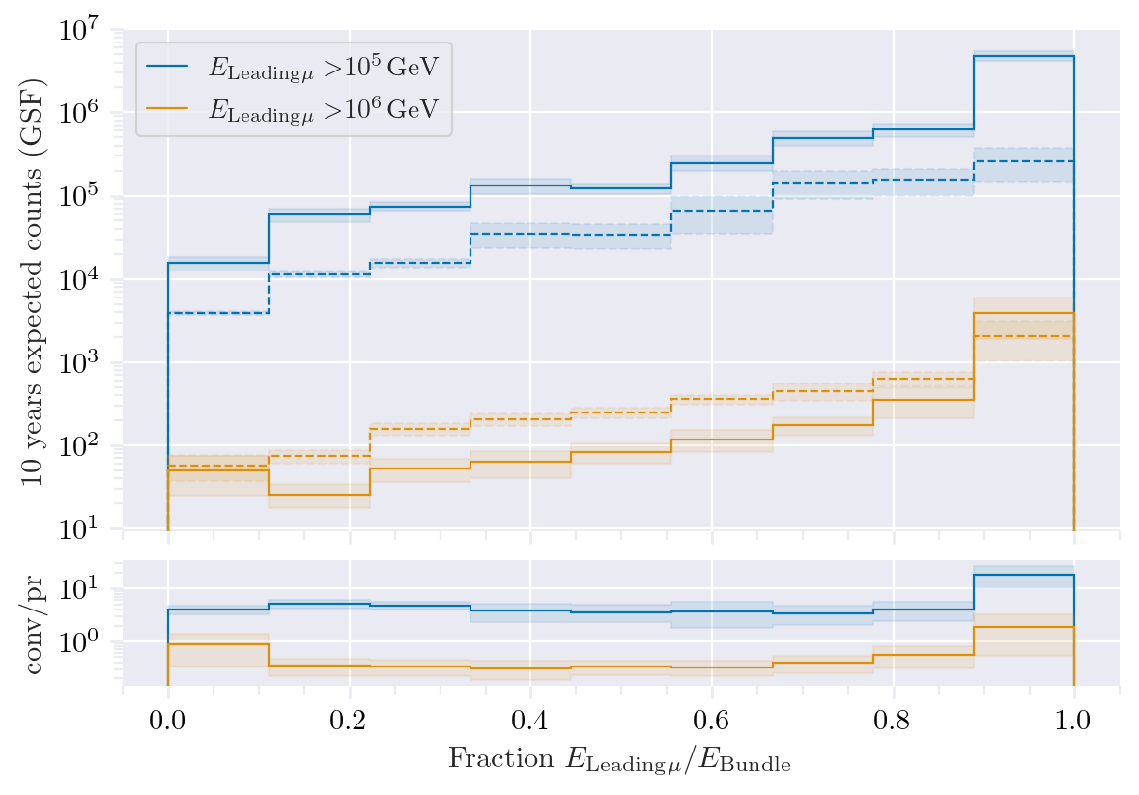
Leading energy fraction
Solid: conventional
Dashed: prompt
Prompt dominates for energies > 1 PeV
Leading energy fraction sweetspot between 0.1 – 0.9

Slide 6
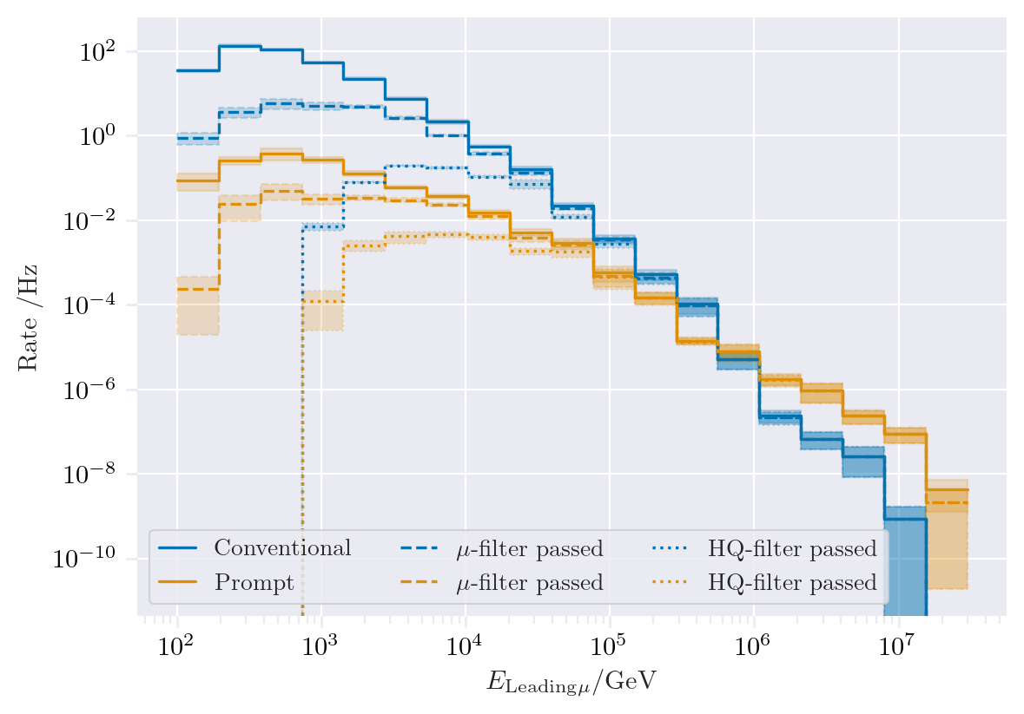
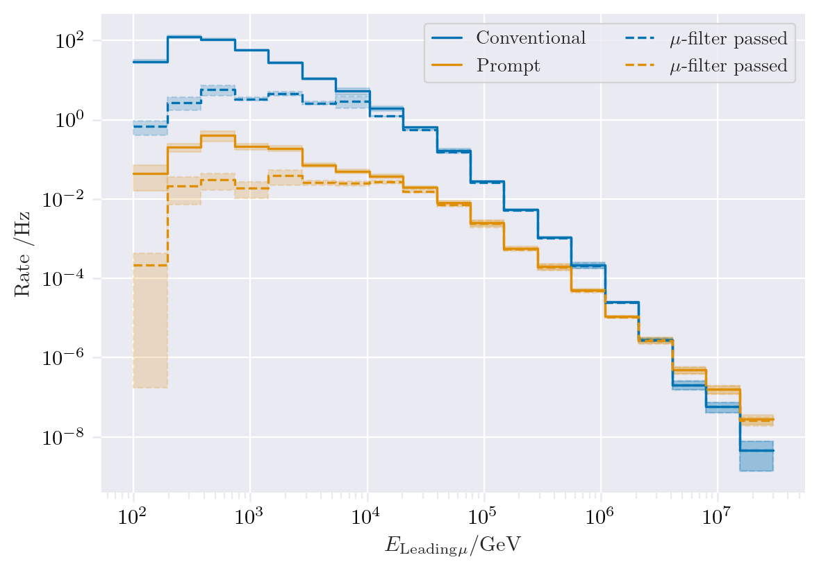
Filter Muon filter if E > 1e4 GeV HQ filter similar to muon filter for E > 1e5 GeV
MCLabelsLeadingMuons_entry_energy
MCLabelsLeadingMuons_bundle_energy_at_entry

Slide 7
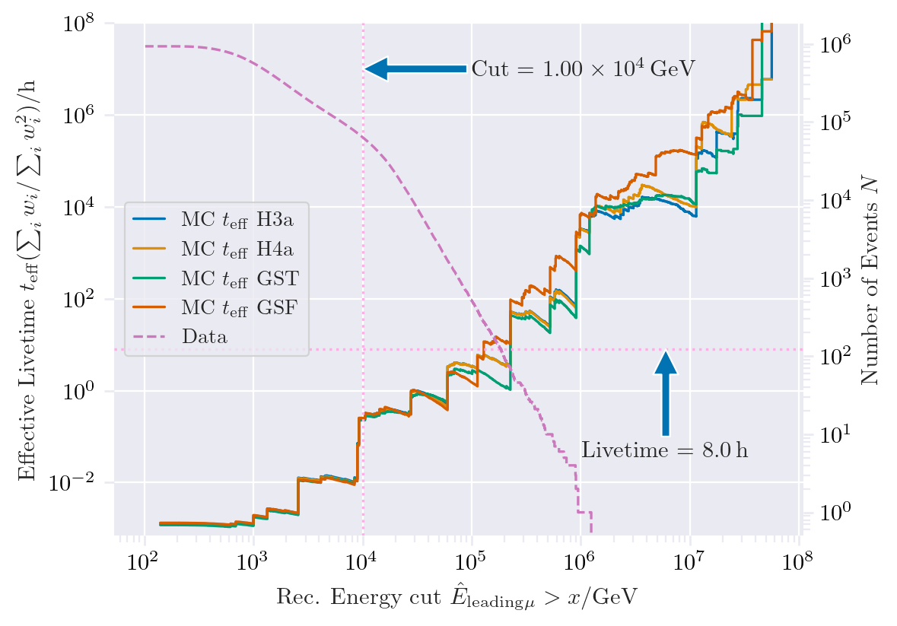
How many events do we need to simulate?
Enough events at high energies
-> More events at energies lower 1 PeV needed
Which primary energy leads to which leading energy?

Slide 8
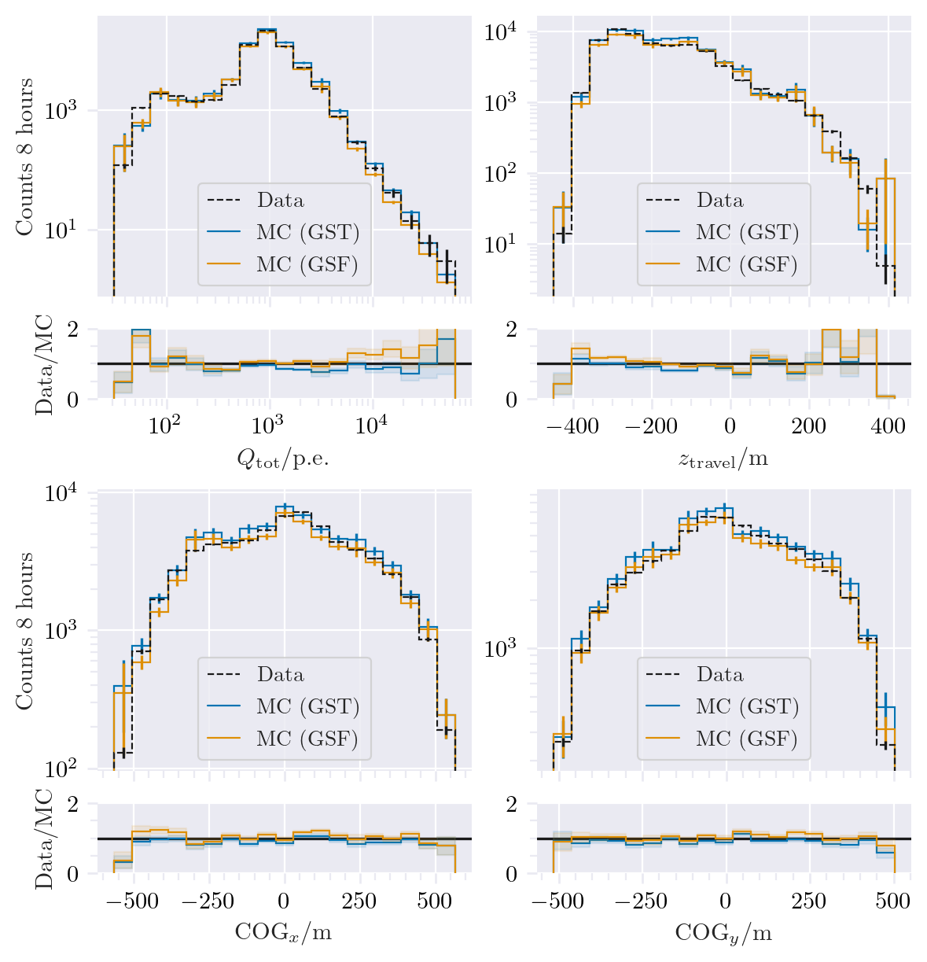
Data-MC (charge)
Cut: DeepLearningReco_exported_model_PromptMu_L2_energy_bundle_energy_at_entry > 1e4 GeV

Slide 9
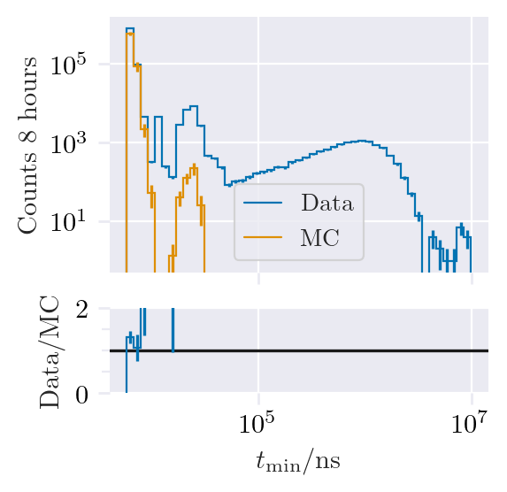
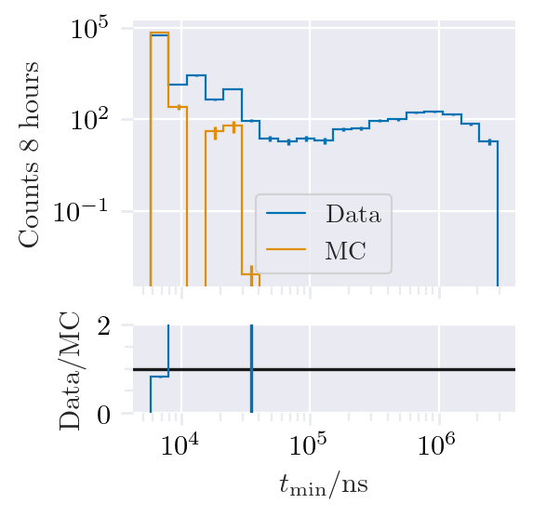
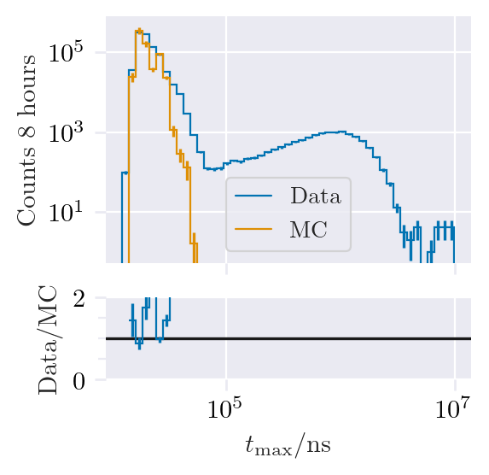
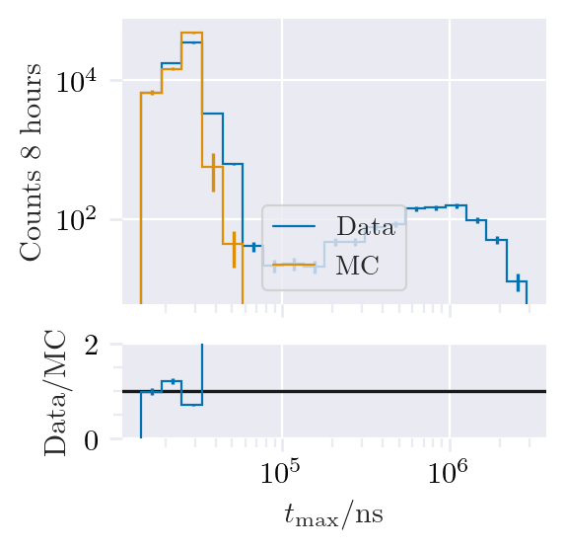
Data-MC (pulses)
No cut
Cut E > 1e4 GeV
Other events
Pulse cleaning needed
Pulse cleaning: 6000 ns

Slide 10
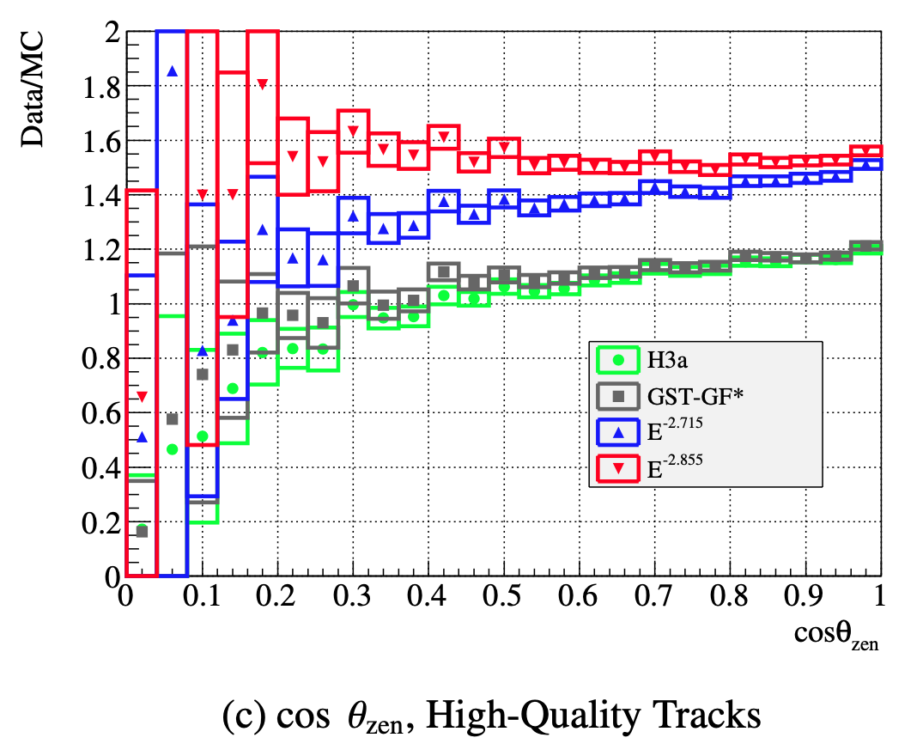
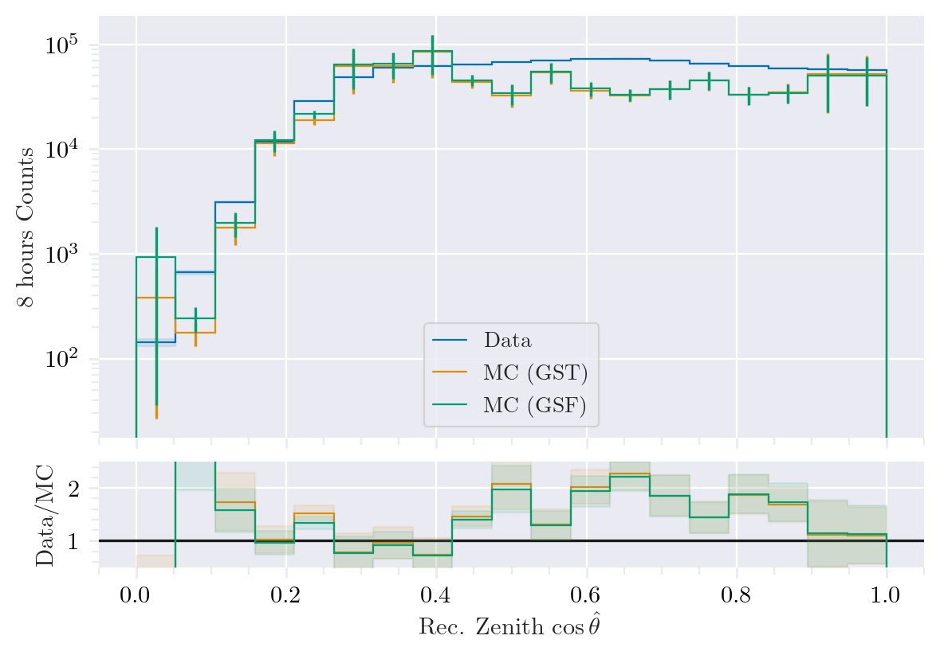
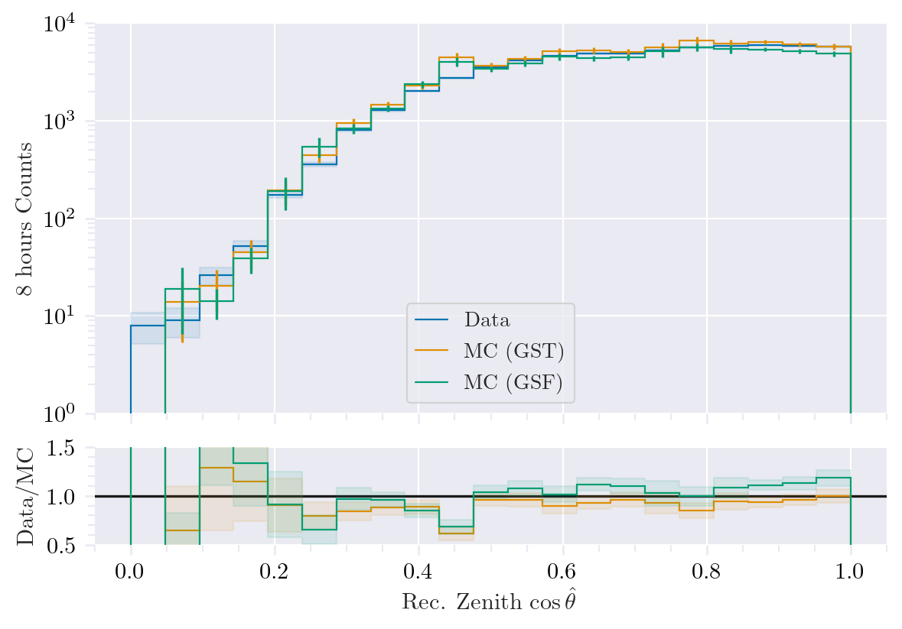
Data-MC (cos zenith)
No cut
Cut E > 1e4 GeV
Mismatch, but low statistics!

Slide 11
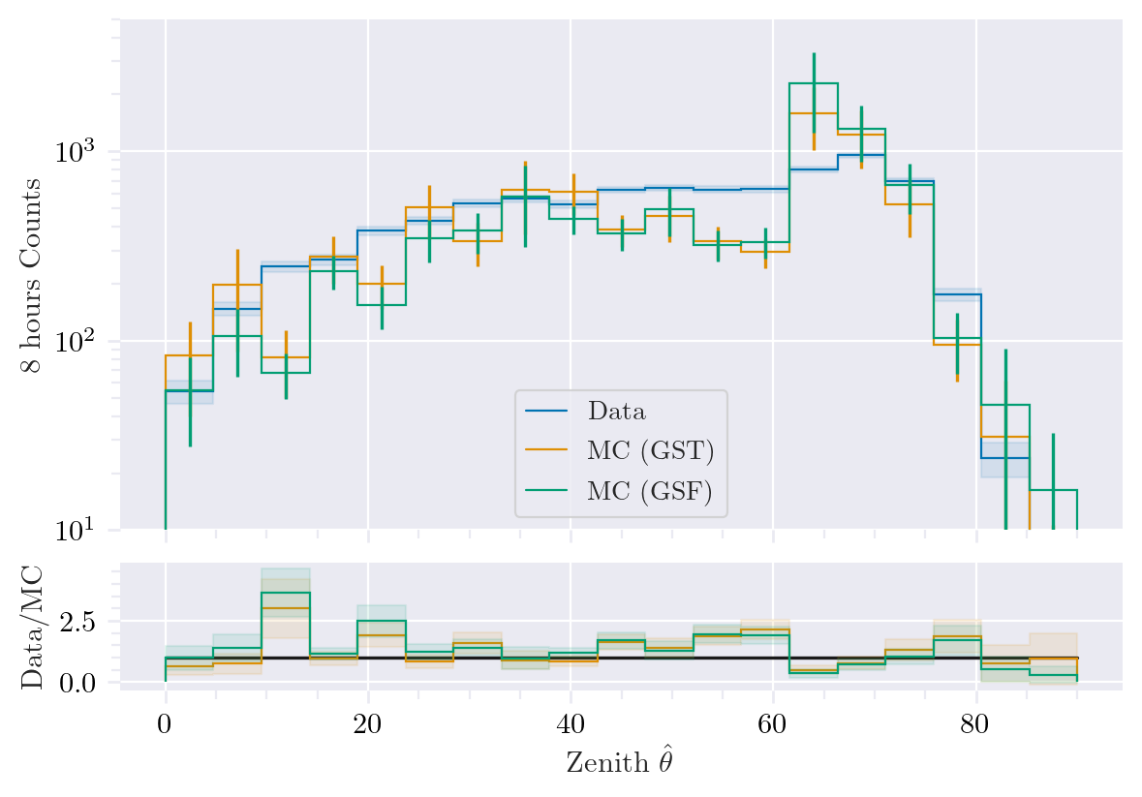
Data-MC (zenith)
Excess?
DNN uncertainty cut: < 3.14/180

Slide 12
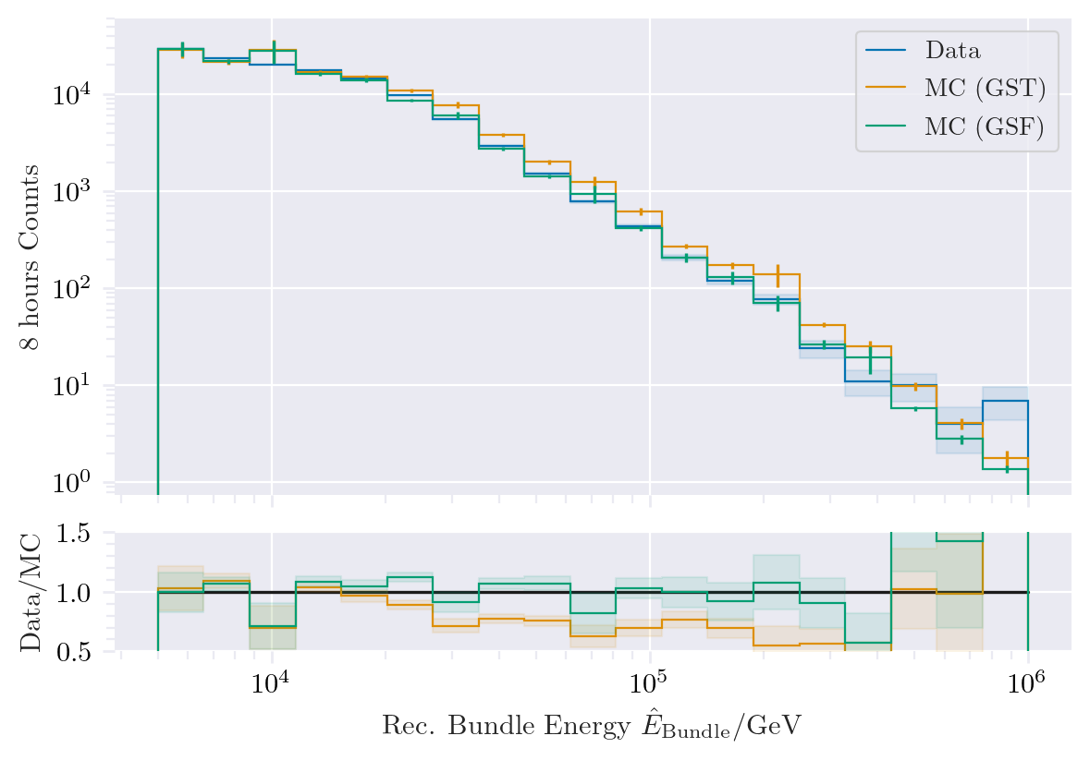
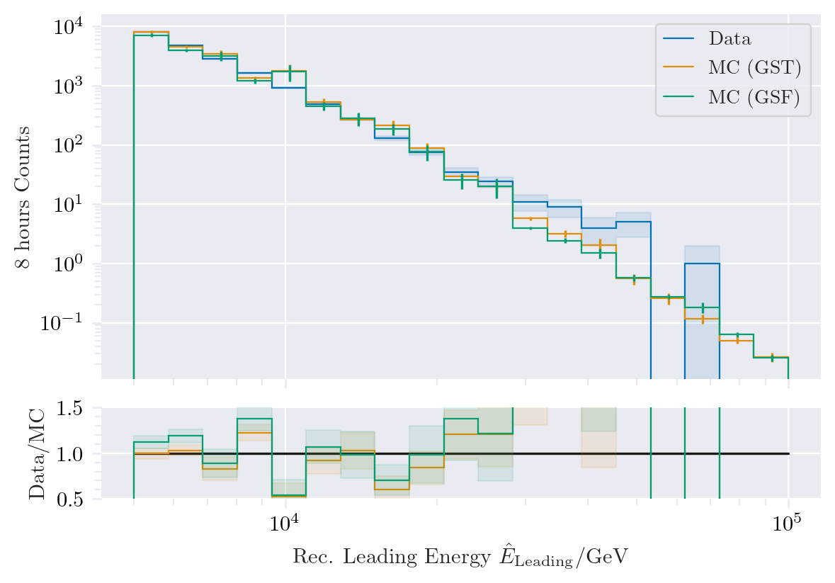
Data-MC (energy spectrum)
Bundle: GSF better than GST

Slide 13
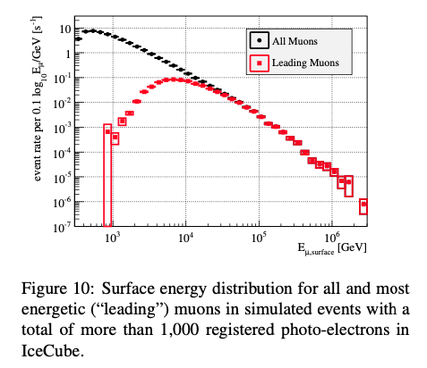
Leading muon fraction
What happens at energies < 1e5 GeV

Slide 14
Backup

Slide 15
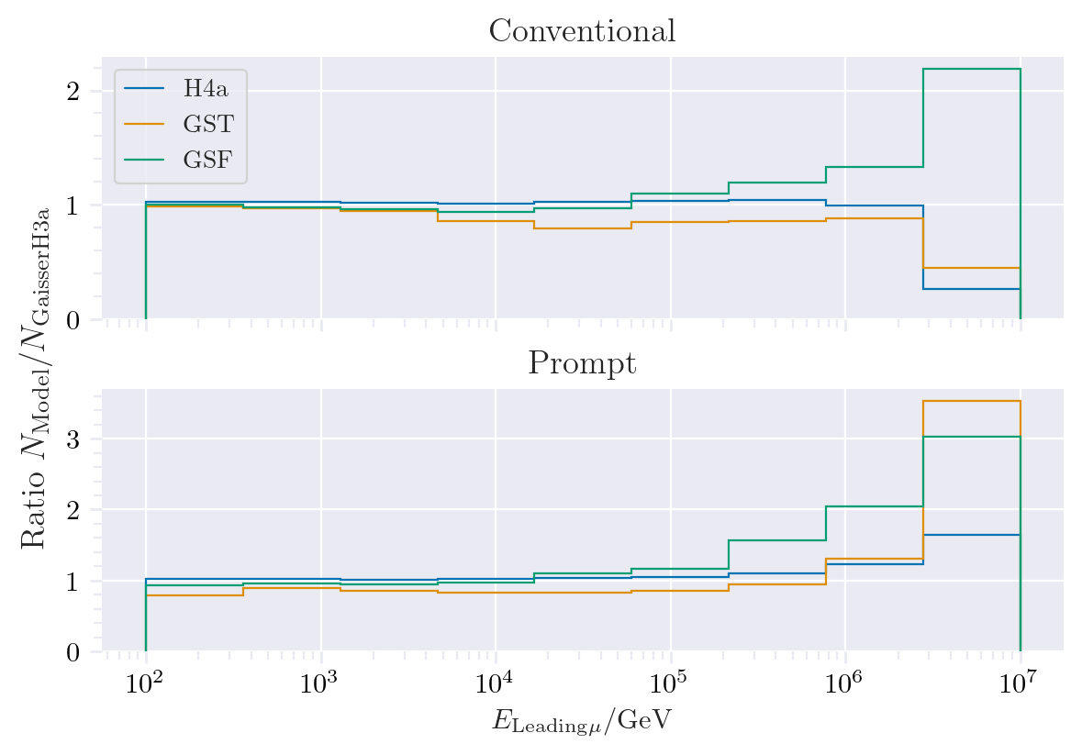
Muon production – different weightings
GST predicts most prompt
MCLabelsLeadingMuons_entry_energy

Slide 16

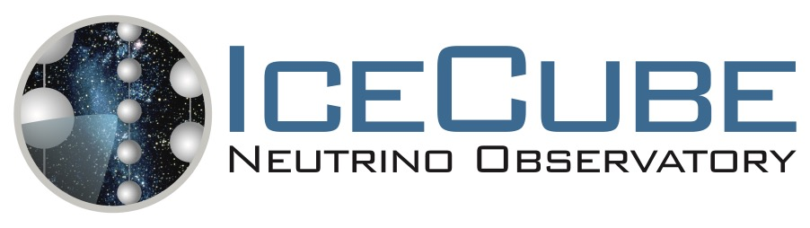

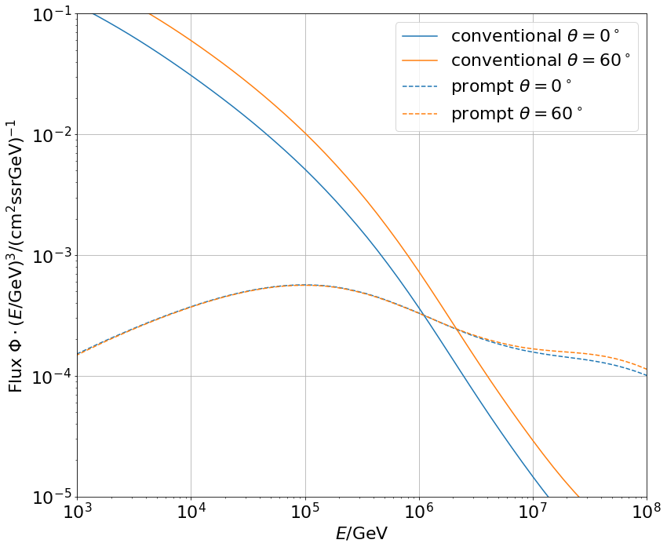
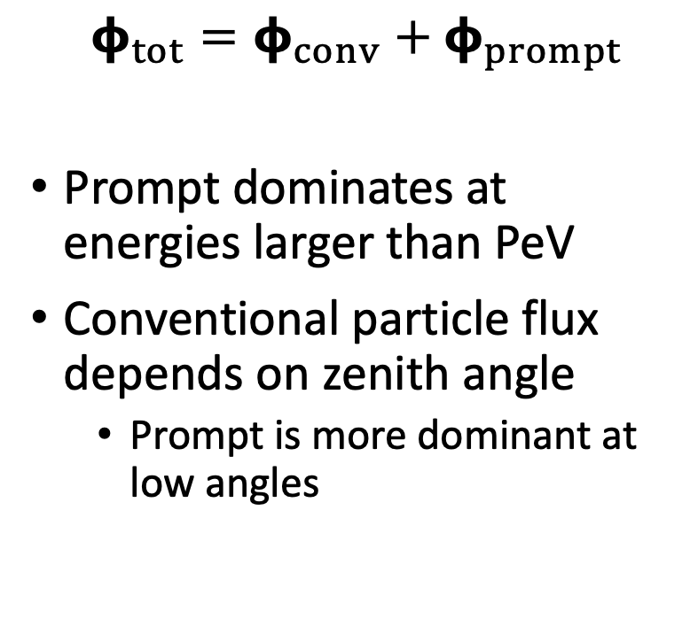
Muon flux
0°: perpendicular to Earth’s surface
$$φ_{tot}=φ_{conv}+φ_{prompt}$$
Prompt dominates at energies larger than PeV
Conventional particle flux depends on zenith angle
Prompt is more dominant at low angles
conventional
prompt
We can measure prompt muon energies from ~1 PeV to ~100 PeV

Slide 17
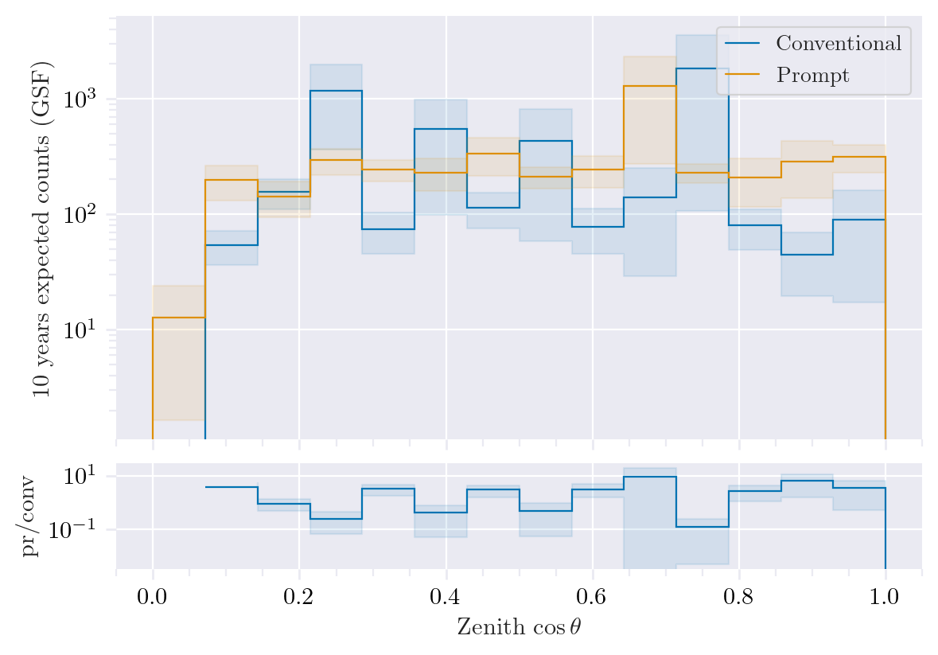
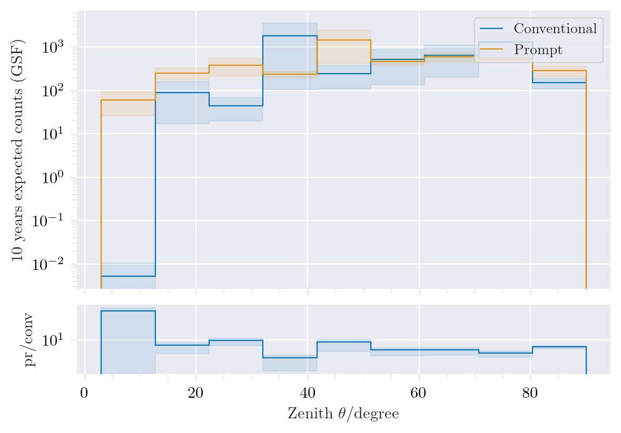
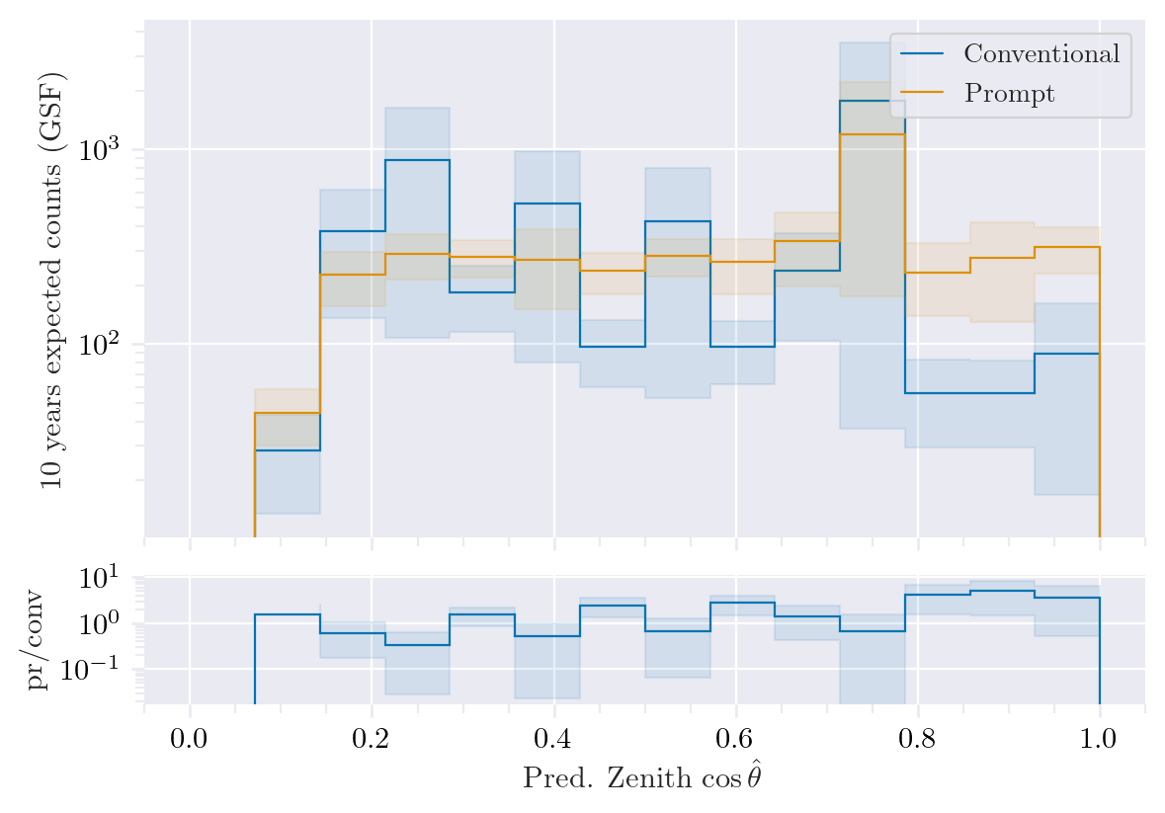
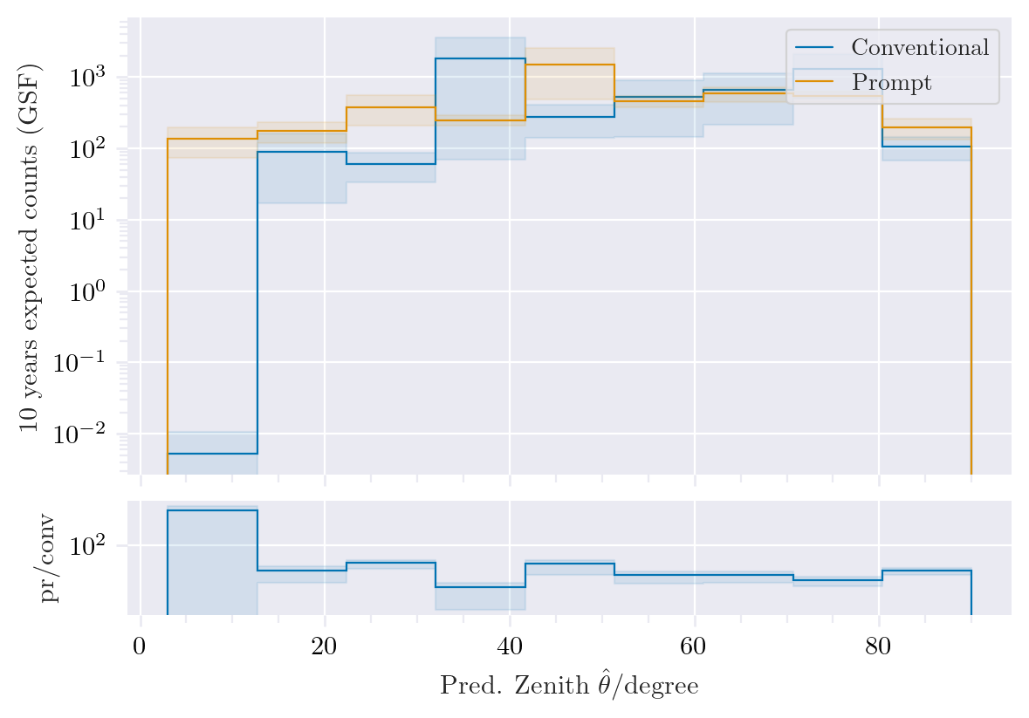
Zenith Cut: MostEnergeticMuonInside_energy > 1 PeV
Prompt dominates at low zenith angles
Same plots?
MostEnergeticMuonInside_zenith
DeepLearningReco_direction_even_bigger_PrimaryZenith

Slide 18
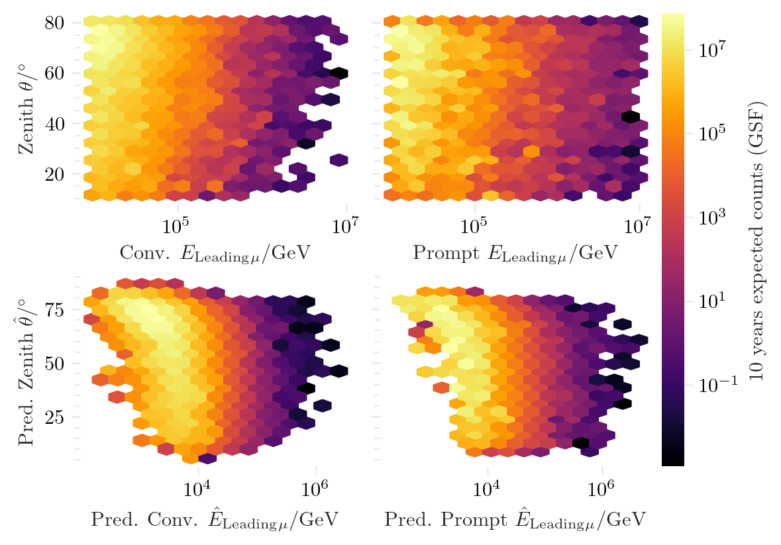
Zenith in dependence of leading muon energy
Cuts: 1e4 < MostEnergeticMuonInside_energy < 1e7
11° < MostEnergeticMuonInside_zenith < 80°

Slide 19
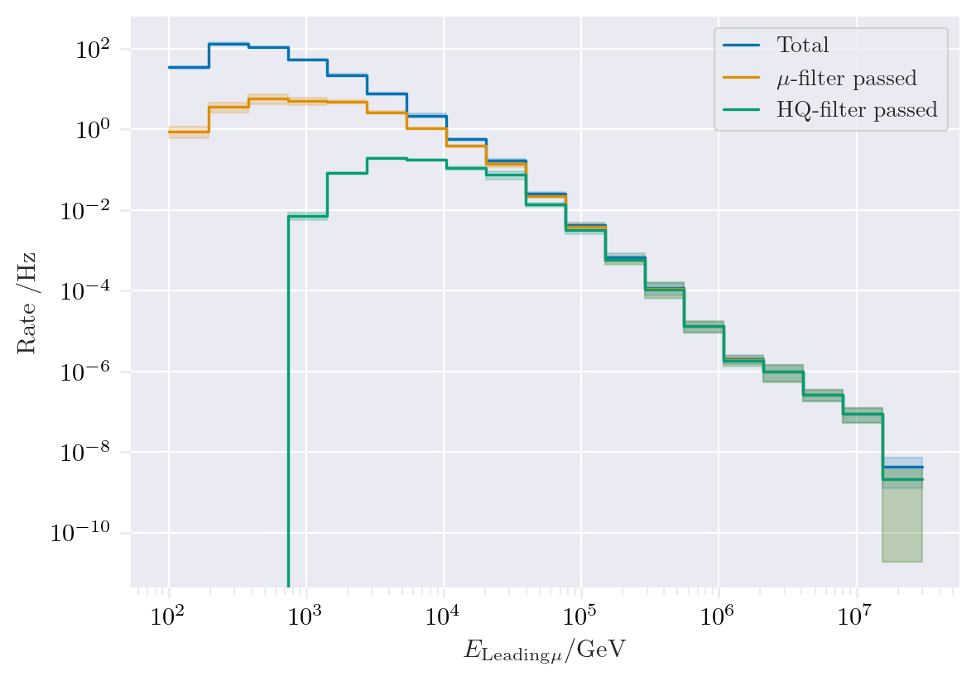
Filter – total flux
MCLabelsLeadingMuons_entry_energy

