Slide 1
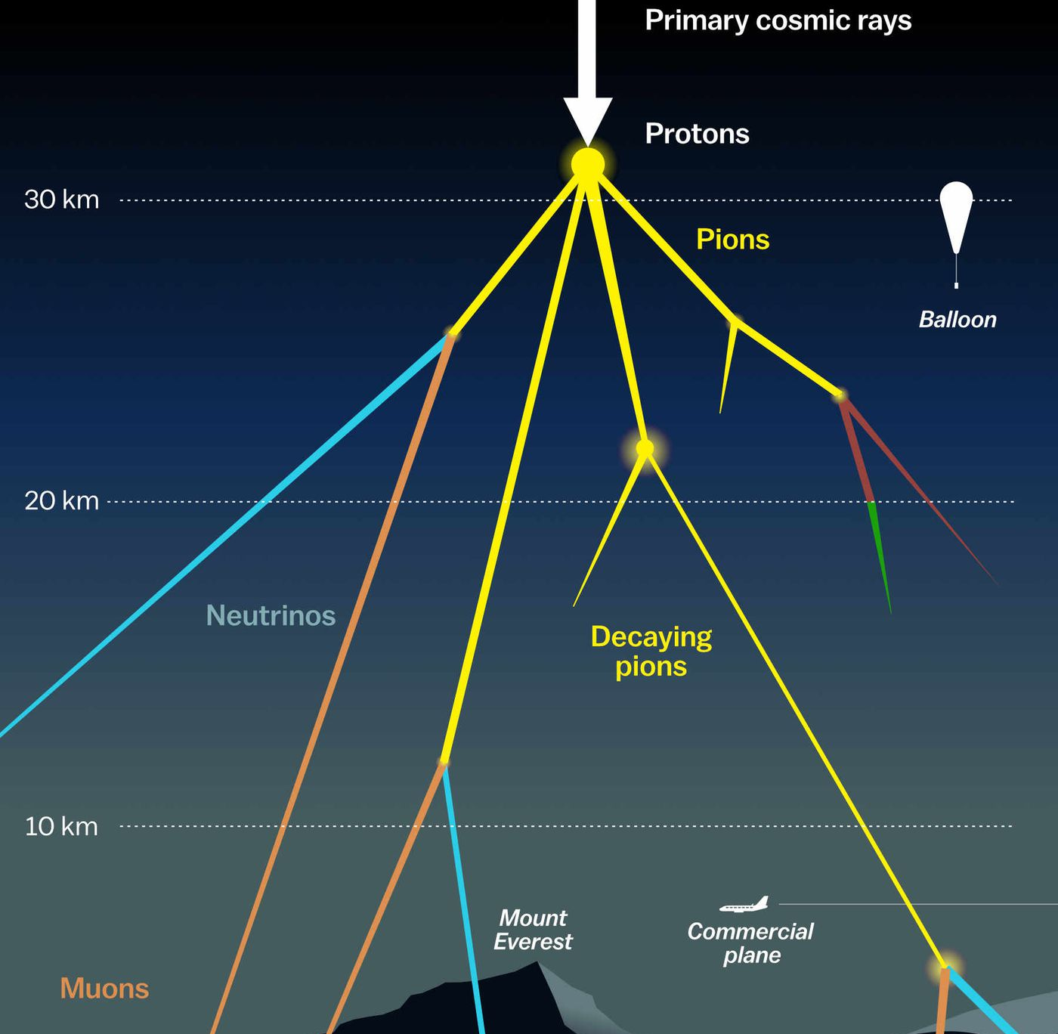

Unfolding the Atmospheric Muon Flux with IceCube: Investigating Stopping Muons and High-Energy Prompt Contributions Pascal Gutjahr ICRC 2025 Plot Approval May 30, 2025
WG reviewer: Dennis Soldin
Coll. reviewer: Anatoli Fedynitch
Technical reviewer: Karolin Hymon
Wiki: prompt wiki
Last update: Uppsala May 14
Plot approval: wiki
Source: NASA

Slide 2

Abstract
Atmospheric muons produced in cosmic-ray air showers are classified as conventional muons from pion and kaon decays and prompt muons from heavy hadron decays. Conventional muons dominate at lower energies, and the prompt component becomes more significant at PeV energies and above. Precisely measuring the atmospheric muon flux from a few GeV to several PeV is valuable for advancing our understanding of cosmic-ray interactions and testing hadronic interaction models. Low-energy muons that stop within the IceCube in-ice array provide valuable information about the energy spectrum of muons from a few 100 GeV up to 10 TeV.
Machine learning techniques are employed to enhance event reconstruction and selection to provide insights into the conventional and prompt components. This contribution presents the unfolding of the energy spectrum of stopping muons in IceCube as well as the unfolding of high-energy muons to probe the prompt component.
Presenter: Pascal Gutjahr
Authors: Lucas Witthaus and Pascal Gutjahr

Slide 3
Outline
Introduction / Motivation
Hadronic Interaction Models / Muon Puzzle
Prompt / Conventional
Event Selection
Stopping Muons
High Energy Muons
Event Reconstruction (DNN based)
Unfolding
Method + Regularization
Acceptance Correction
Systematics
Results
Proxy Variable Correlations (Depth + Energy + Zenith)
Data-MC (Depth + Energy + Zenith)
Unfolded Propagation Length (MC + Burnsample)
Unfolded Muon Flux at Surface (MC + Burnsample) – Stopping and High Energy
Robustness Tests (vary spectral index)
Conclusion & Outlook

Slide 4
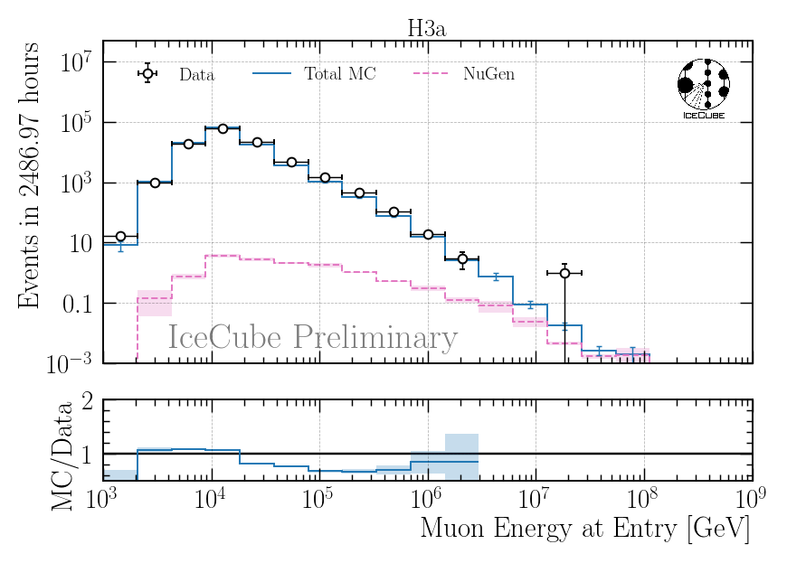
Data-MC: High Energy Muons
proxy variable for unfolding

Slide 5
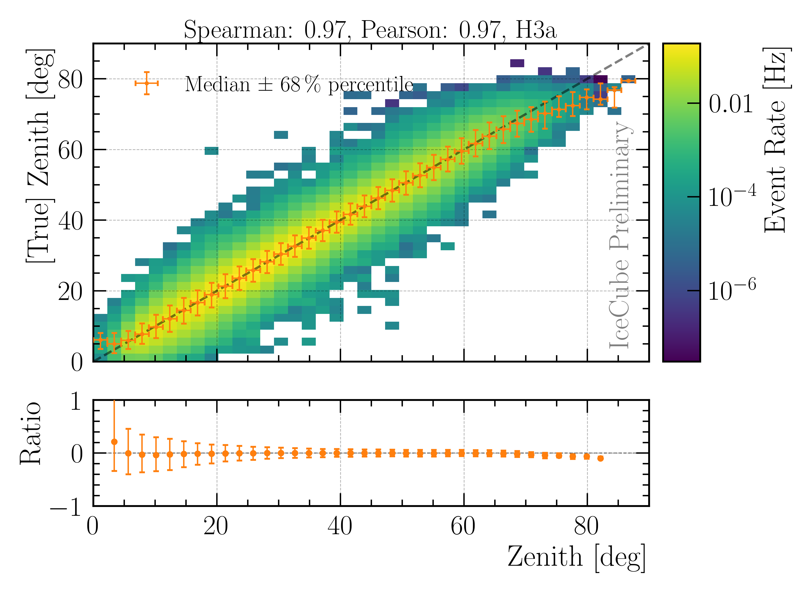
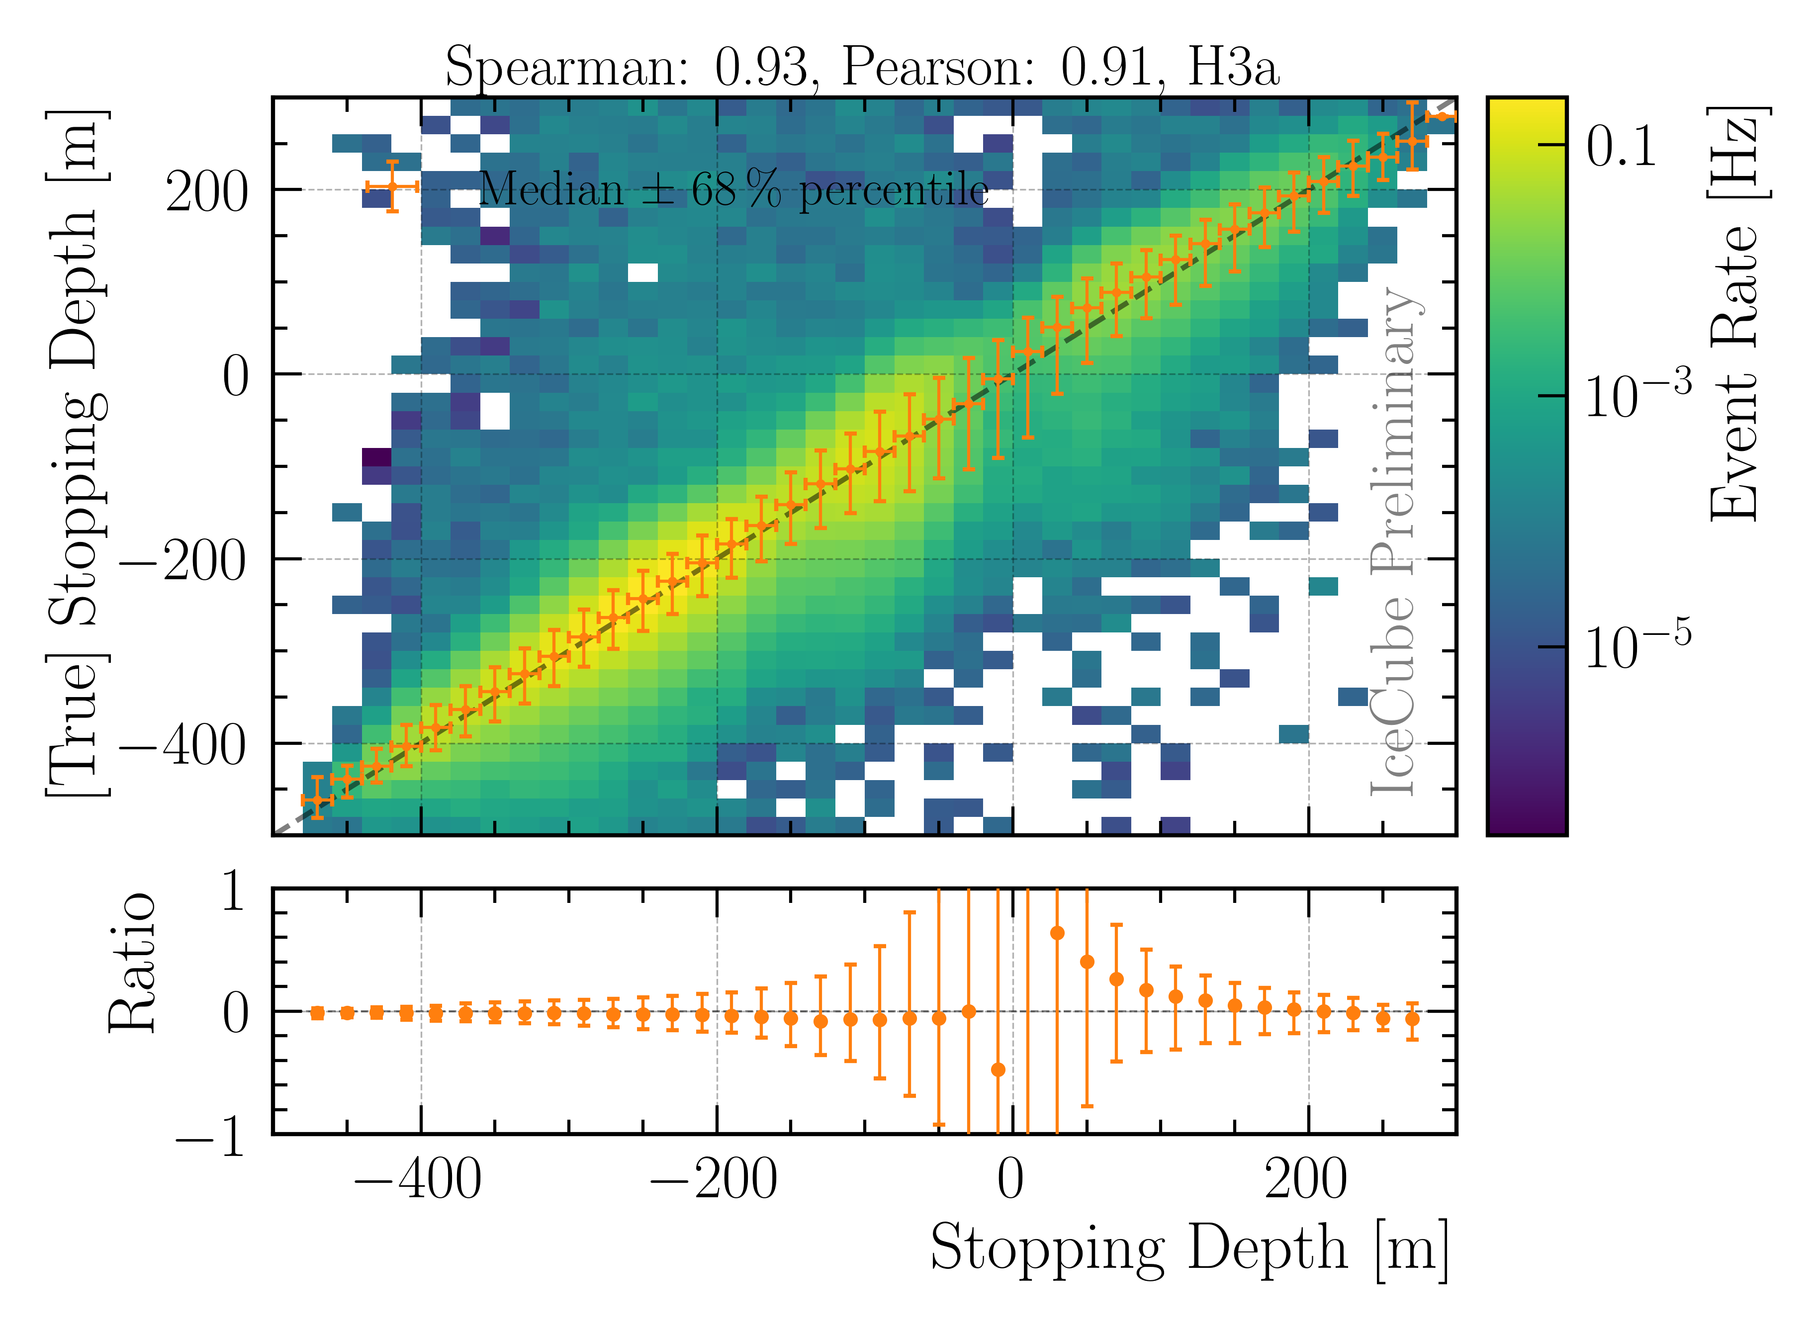
Reconstructions: Stopping Muons
DNN reconstruction of zenith angle and stopping depth
Used to calculate the propagation length → proxy variable in unfolding

Slide 6
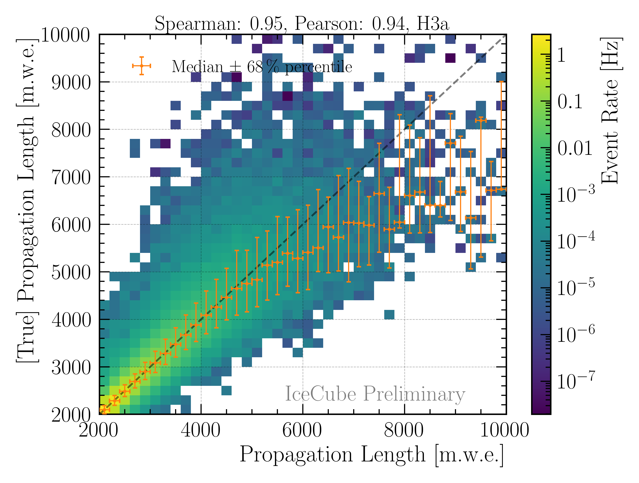
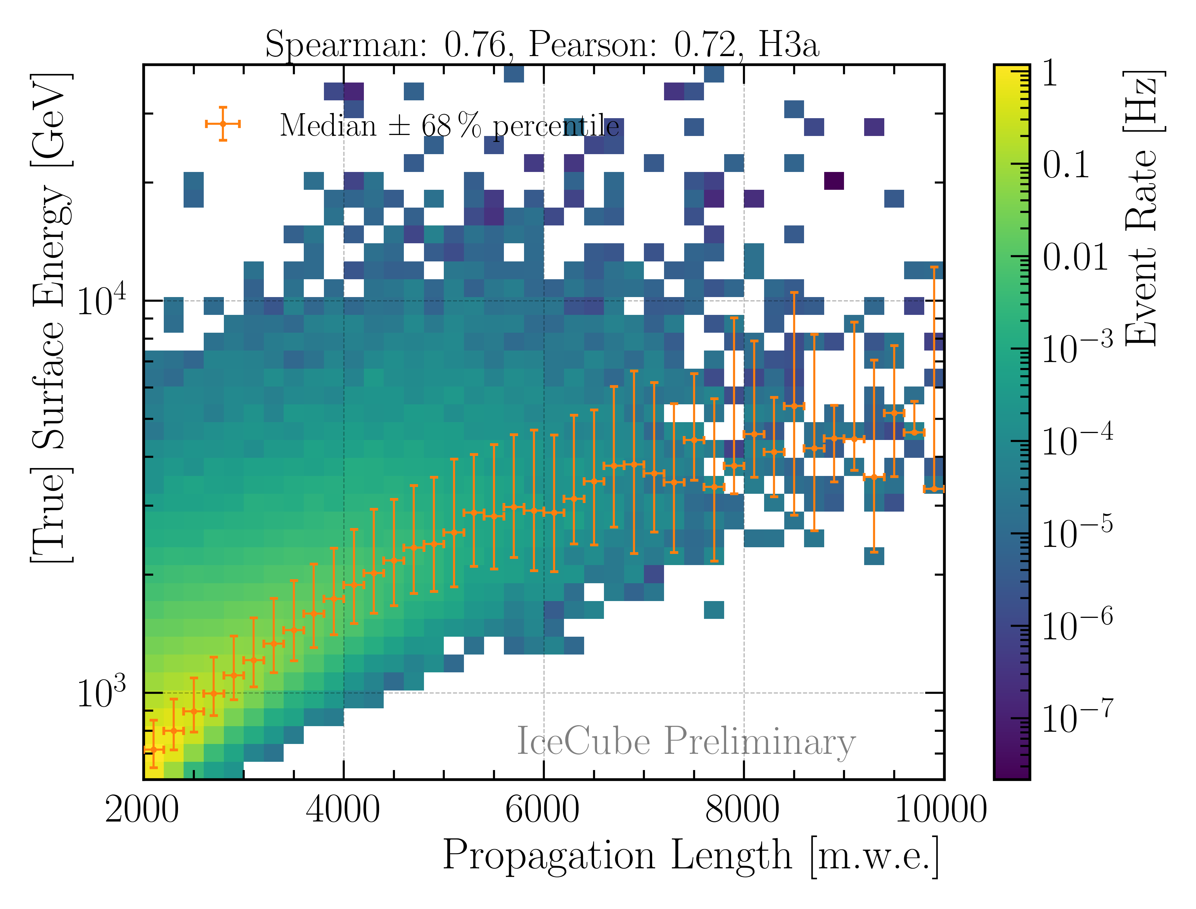
Proxy Variable: Stopping Muons
Propagation length
Muon energy at surface
Correlation between proxy and target variable in unfolding

Slide 7
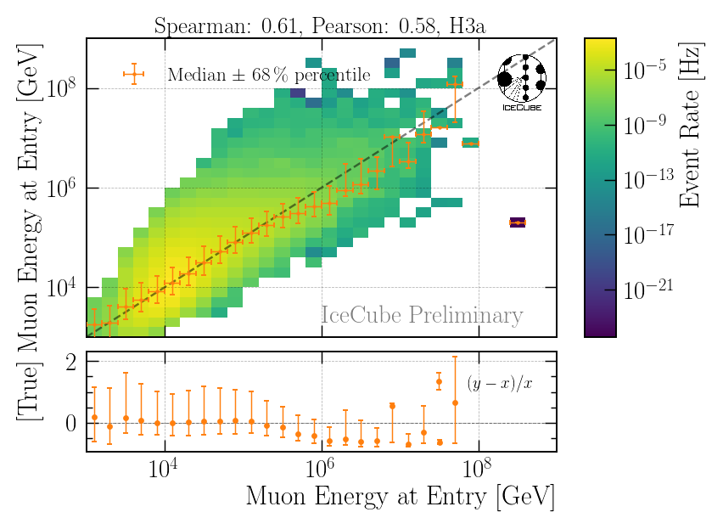
Reconstruction: High Energy Muons
DNN reconstruction of leading muon energy at detector entry
proxy variable in unfolding

Slide 8
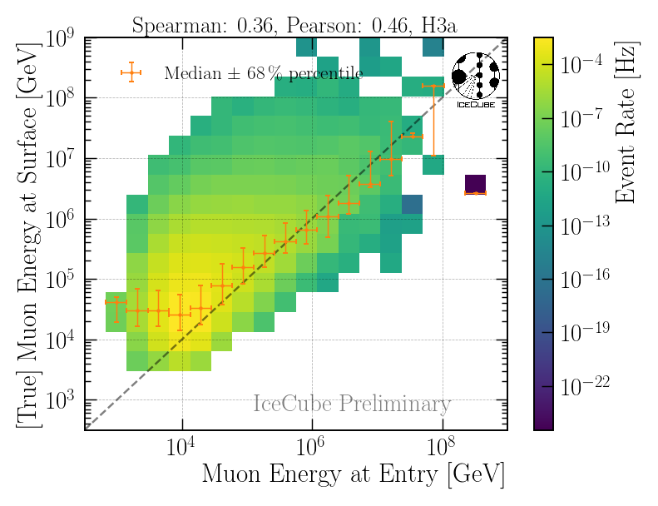
Proxy Variable: High Energy Muons
Correlation between proxy and target variable in unfolding

Slide 9
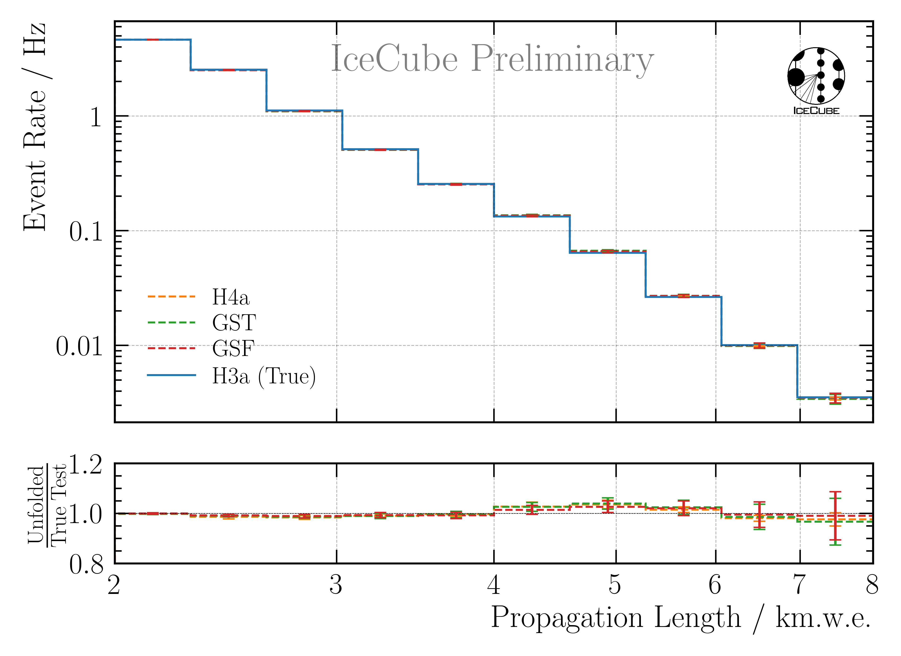
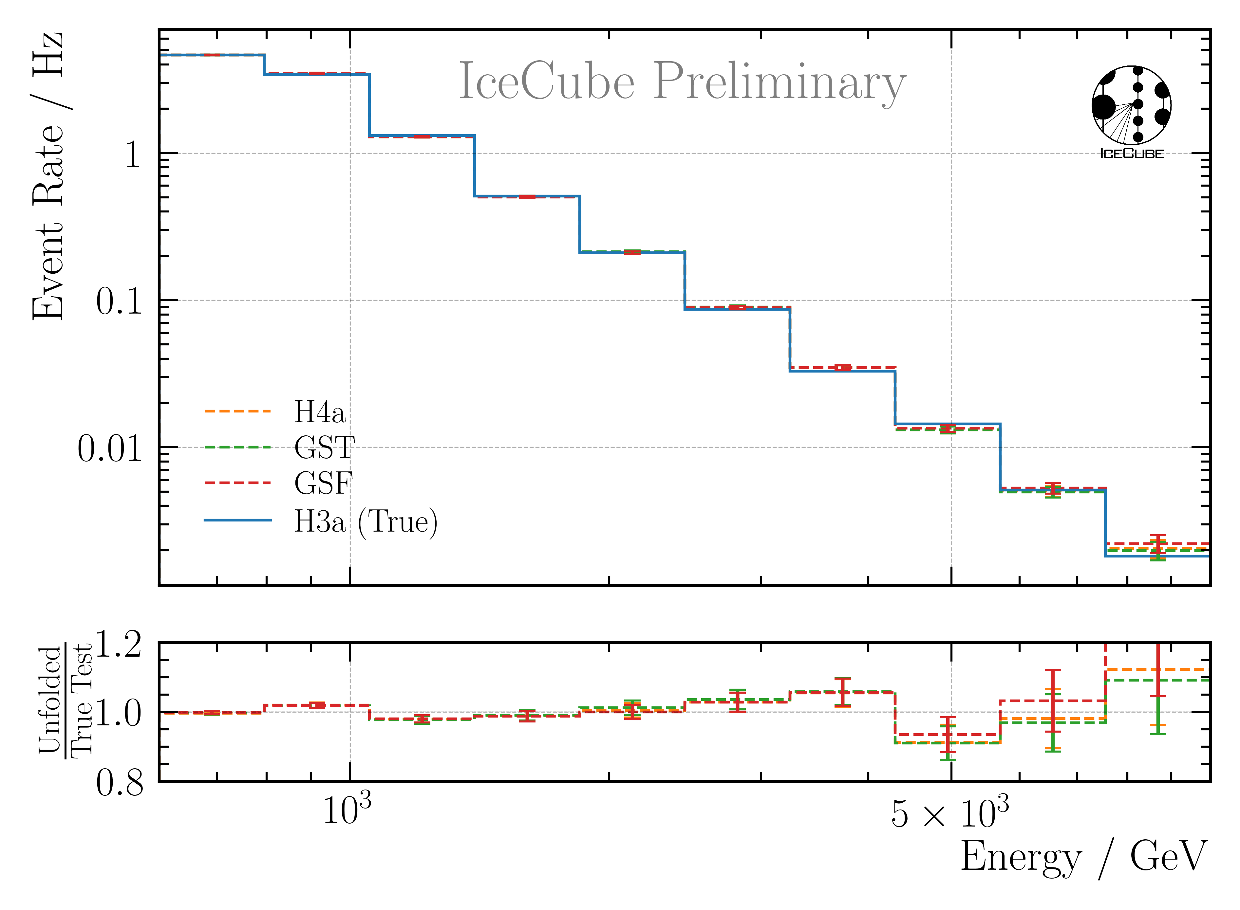
Robustness Stopping Muons

Slide 10
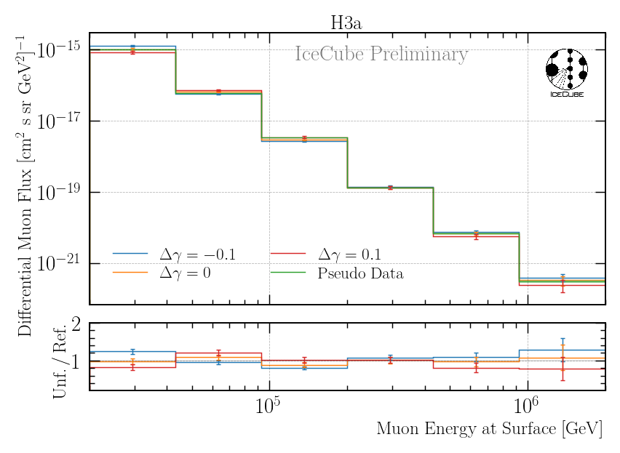
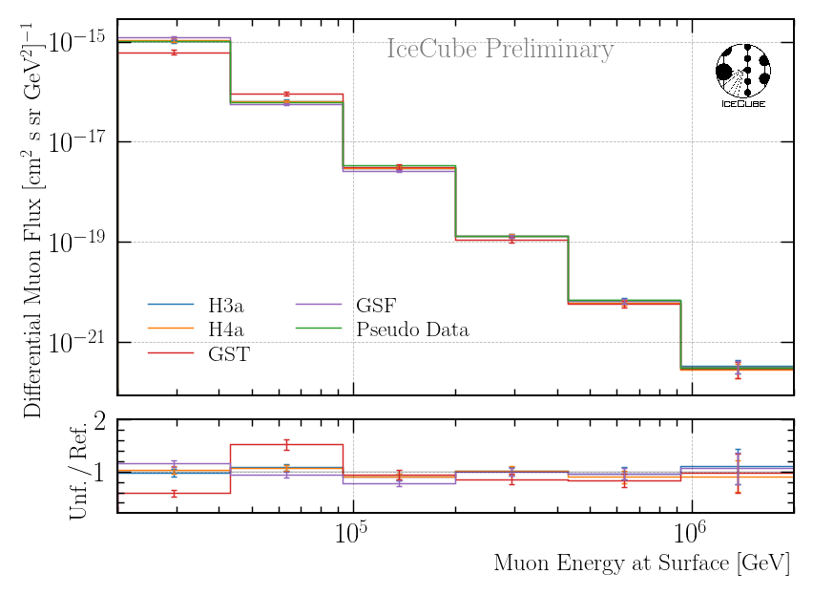
Robustness High Energy Muons – Starting at 20 TeV

Slide 11
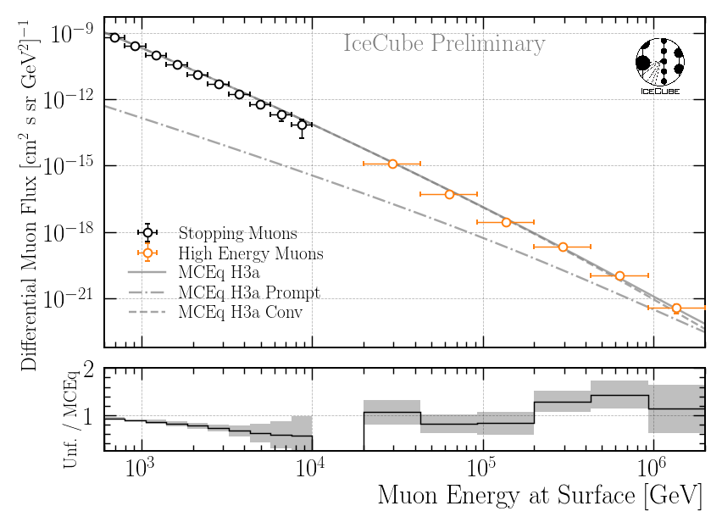
Unfolding Muon Flux
Both stopping muons and high energy muons show burnsample unfolding

Slide 12
Thank you for your comments

Slide 13
Data-MC: Stopping Muons
Style will be updated to the one
on the next slide by Monday
build proxy variable for unfolding: propagation length

Slide 14
Unfolding Propagation Length
Preliminary style will
be updated by Monday
Unfolding on burnsample

Slide 15
Backup

